Slide 1
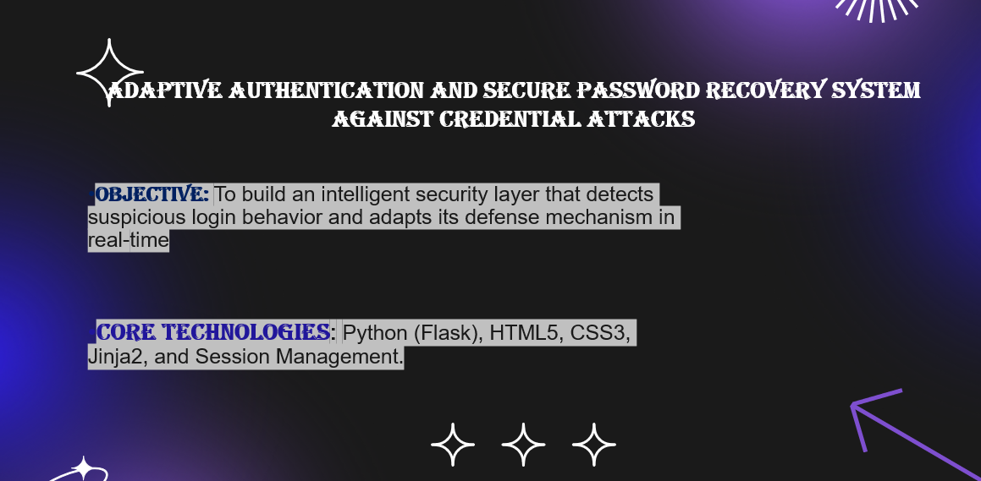
Objective: To build an intelligent security layer that detects suspicious login behavior and adapts its defense mechanism in real-time.
Core Technologies: Python (Flask), HTML5, CSS3, Jinja2, and Session Management.

Slide 2
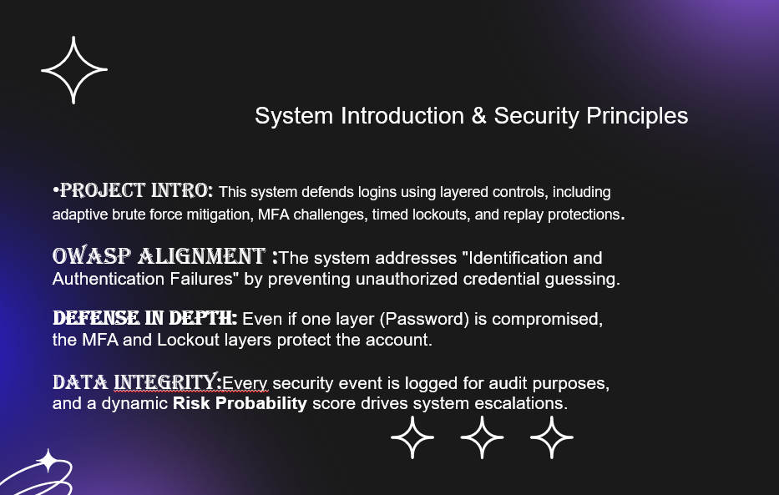

Slide 3
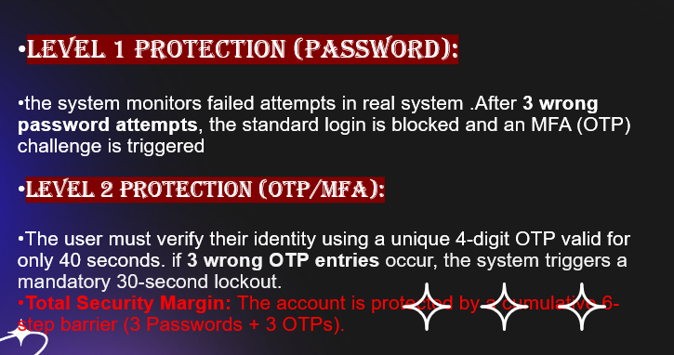
Adaptive Brute Force Defense

Slide 4
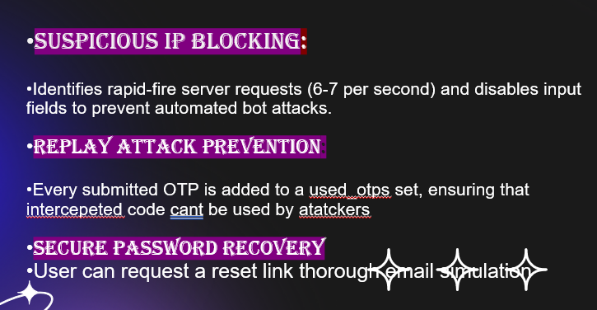
Advanced Security Measures

Slide 5
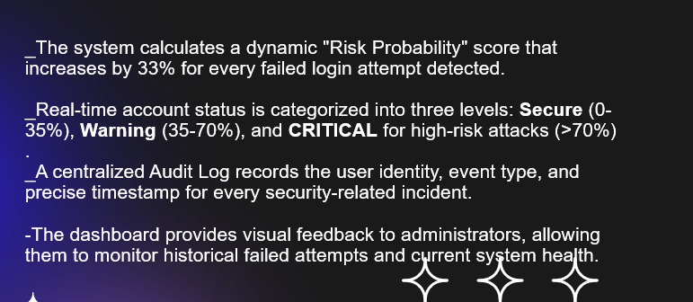
Risk Monitoring & Analytics

Slide 6
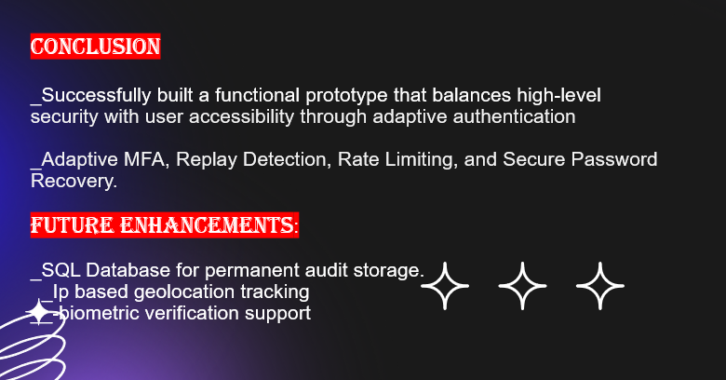
Conclusion and future scope

