Slide 1
Expense Approval Workflow
Durable Functions vs. Logic Apps + Service Bus
Faiza Boudehane
CST8917 — Serverless Applications_Final Project
2026/08/14

Slide 2
The Workflow & Business Rules
One expense request, evaluated the same way in both implementations
1
2
3
4
5
Submit
→
Validate
→
< $100 ?
→
≥ $100 ?
→
Notify
Employee sends: name, email, amount, category, description, manager email
Reject if a required field is missing or the category is invalid
Auto-approved instantly, no manager needed
Waits for manager approval, with a timeout
Employee gets the outcome: approved, rejected, or escalated
Valid categories: travel · meals · supplies · equipment · software · other
Same rules, two engines
Version A implements this with Azure Durable Functions — code-first orchestration.
Version B implements the identical rules with Azure Logic Apps + Service Bus — visual, declarative orchestration.
2

Slide 3
Version A — Durable Functions Architecture
Activity
validate_expense
HTTP Client
(submit_expense)
Orchestrator
(expense_orchestrator)
HTTP Client
(manager_decision)
→
→
raises event →
Activity
notify_employee
The Human Interaction Pattern
context.task_any([wait_for_external_event("ManagerDecision"), create_timer(deadline)])
The orchestrator suspends — at zero cost — until either the manager responds or the durable timer fires.
3 function types: HTTP client, orchestrator, activities
Activity chaining: validate → branch → notify
Deployed as a single Python v2 Function App
3

Slide 4
Version A — Key Design Decisions
Timeout window
Validation short-circuits early
Set to 2 minutes for demo/testing; production would use something like 48 hours. Configurable in one constant.
An invalid expense never reaches the approval branch — it notifies and returns immediately from the orchestrator.
Notification kept simple
Deterministic orchestrator
Outcome is logged rather than emailed, to keep the local demo self-contained — SendGrid/ACS Email is a drop-in swap.
All I/O lives in activities; the orchestrator itself only sequences calls, satisfying the Durable Task Framework's replay rules.
4

Slide 5
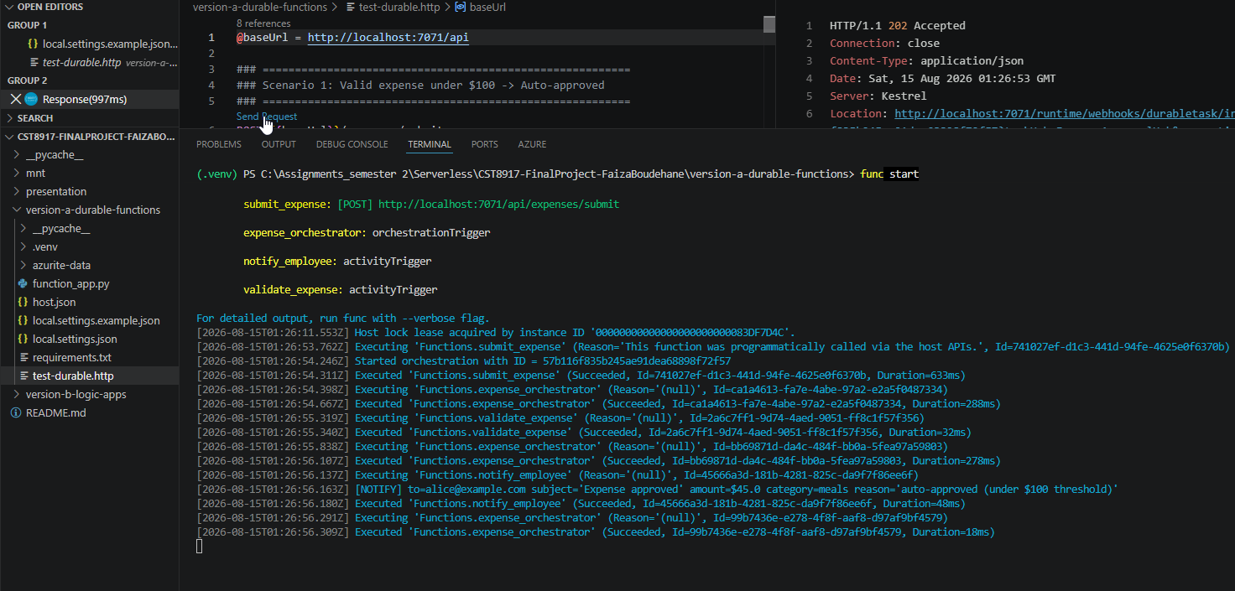
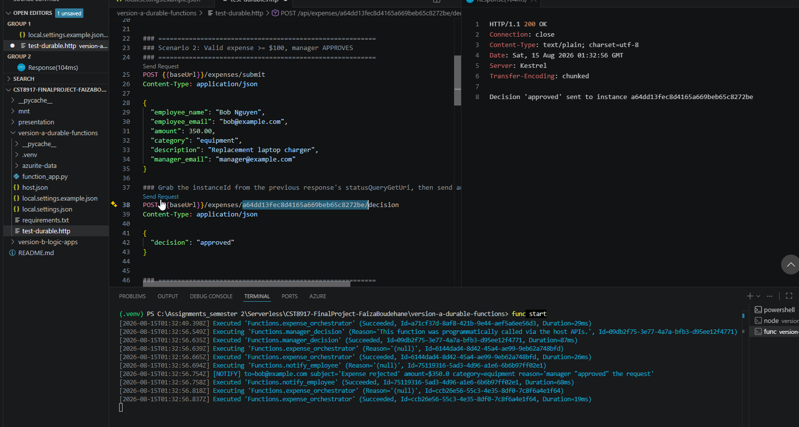
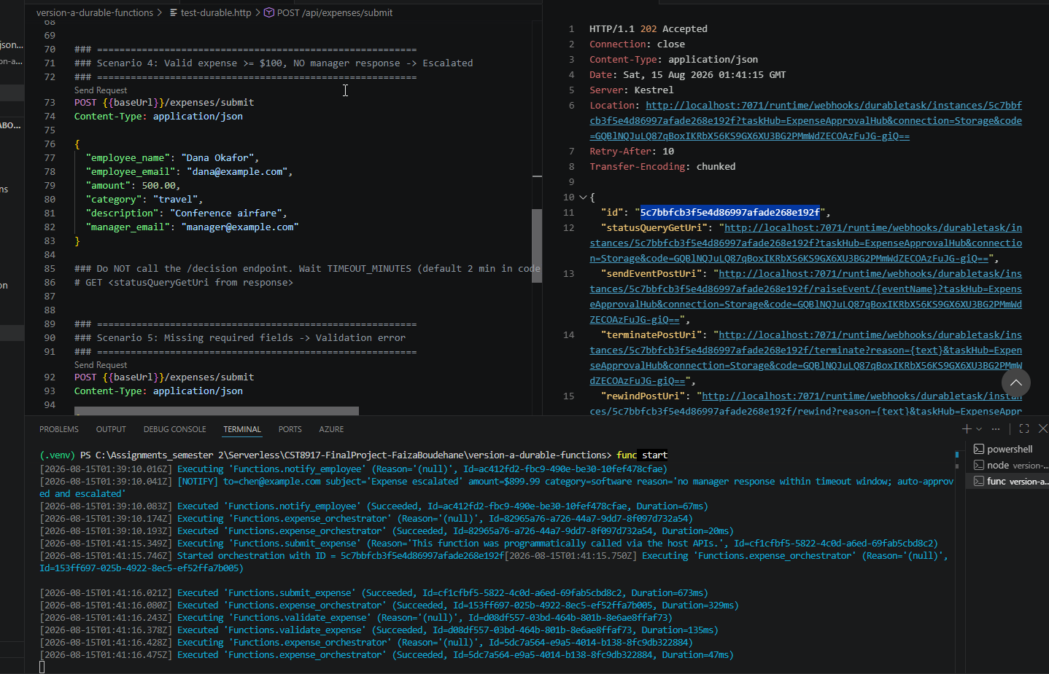
Version A — Live Demo
Local test run: auto-approve, manager approve/reject, and escalation — all confirmed against real Function executions
Scenario 1 — under $100, auto-approved
Scenario 2 — manager approves within the window
Scenario 4 — no response → escalated after timeout
5

Slide 6
Version B — Logic Apps + Service Bus Architecture
Service Bus
Queue
expense-requests
Logic App
(trigger + orchestration)
Azure Function
/api/validate
Topic: expense-outcomes
4 filtered subscriptions
→
→
→
publishes
manager-
decisions
approved-
sub
rejected-
sub
escalated-
sub
Manager approval, without a native “wait” primitive
Logic Apps publishes a “pending” message, then loops: wait ~20s → peek the manager-decisions subscription → repeat, up to a bounded iteration count that stands in for the timeout.
An Azure Function is called synchronously for validation — the one piece of custom code in an otherwise declarative flow.
6

Slide 7
Version B — The Polling Approach (and its Trade-off)
The honest limitation
Logic Apps has no equivalent to Durable Functions' task_any([wait_for_external_event, create_timer]). There is no native “suspend until X or timeout” primitive — so this workflow substitutes a bounded polling loop instead of an instant, event-driven wait.
What polling costs
What it gains
Decision latency bounded by poll interval (~20s), not instant
Each poll is a billable action execution, even when nothing changed
Iteration count/timeout must be hand-tuned to approximate the real window
No custom code needed — built from standard connector actions
Fully visible in the visual designer, easy to explain to a non-developer
Same Service Bus topic doubles as the eventual outcome-notification channel
7

Slide 8
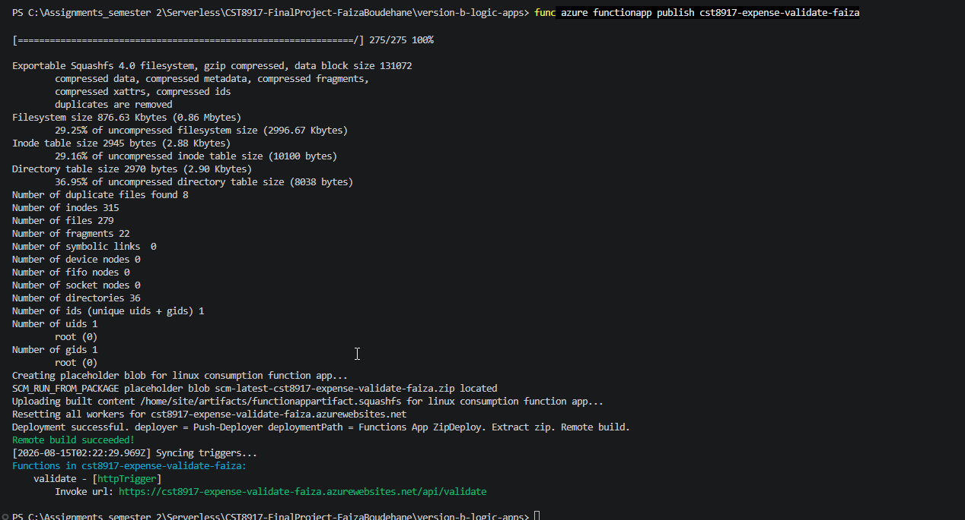
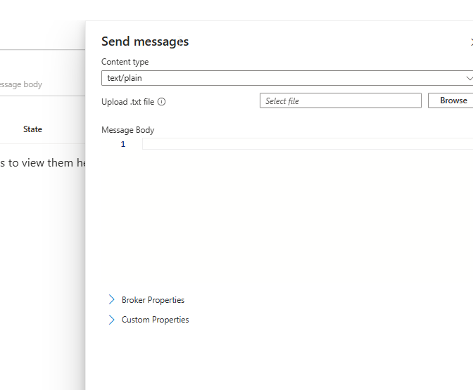
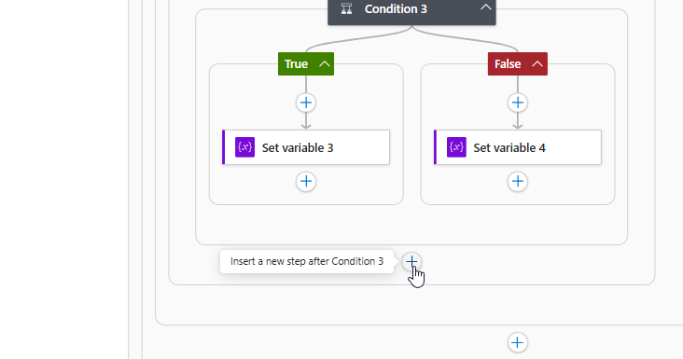
Version B — Live Demo
Validation Function deployed and confirmed, workflow built and published end-to-end in the designer
Validation Function deployed — returns valid/reason/requiresApproval
Sending a test expense into the expense-requests queue
Full workflow: validate → auto-approve / poll → publish outcome → email
8

Slide 9
Comparison — Development Experience & Testability
Durable Functions
Logic Apps + Service Bus
Dev loop
Dev loop
Plain Python + one constraint: deterministic orchestrator. func start gives a tight edit-test cycle.
Logic split across queue, Function, and visual workflow — individually simple, slower to wire and iterate on.
Testing
Testing
test-durable.http drives all 6 scenarios locally via Azurite — zero cloud dependency to validate logic.
Validation Function unit-tests like any Python code; the orchestration itself only runs by actually deploying.
9

Slide 10
Comparison — Error Handling, Human Interaction, Observability
Dimension
Durable Functions
Logic Apps + Service Bus
Error handling
RetryOptions on activities; exceptions are catchable in the orchestrator for explicit branching.
Per-action retry policy (count/interval/type) + “Run after” branches on Failed/TimedOut/Skipped.
Human interaction
task_any([event, timer]) — instant, native, zero cost while suspended.
Polling loop against a Service Bus subscription — coarser, and each poll costs an action execution.
Observability
statusQueryGetUri + Application Insights; instance replay history shows exact execution order.
Portal Run History shows every action's inputs/outputs inline — approachable for a non-developer audience.
10

Slide 11
Comparison — Estimated Cost
Both are consumption-priced — cost scales with volume, not idle capacity. Figures from the Azure Pricing Calculator; [insert your actual numbers].
Assumptions to state explicitly
% of expenses that actually require manager approval (≥ $100)
Average wait time for a manager decision — drives timer duration (A) and poll count (B)
Service Bus tier: Standard vs. Premium
Polling interval chosen for Version B — directly multiplies action-execution cost
Key insight
The polling loop is the line item to watch for Version B — every expense awaiting approval multiplies action-executions by however many poll cycles it takes to get a decision.
11

Slide 12
Recommendation & Lessons Learned
Verdict: Durable Functions for this workflow
The “wait for a human, with a timeout” requirement is central here — and it's a first-class Durable Task Framework pattern, not a workaround. That means better local testability, tighter retry/error control, and lower cost at scale since idle waiting is free.
Choose Logic Apps instead when: the maintainers are non-developers who need a visual, no-deploy way to adjust conditions — or the workflow leans on Logic Apps' 400+ prebuilt connectors more than on precise timing.
Lessons learned
The polling substitute for wait_for_external_event was the single biggest architectural surprise — it reshapes cost, latency, and design all at once.
[Add your own: what would you do differently next time?]
[Add your own: what took longer than expected — and why?]
12

