Slide 1
TOPIC:
OOP (Object Oriented Programming)
Presented by: Shakeela

Slide 2
Table of contents
Introduction
Classes and object
Inheritance
Type of inheritance

Slide 3
OOP in Python
In programming languages, mainly there are two approaches that are used to write program or code.
1). Procedural Programming
2). Object-Oriented Programming
To map with real world scenarios, we started using objects in code.
This is called object oriented programming.

Slide 4
Class & Object in Python
Almost everything in Python is an object, with its properties and methods.
Class is a blueprint for creating objects.
#creating class
class Student:
name = “karamat”
#creating object (instance) s1 = Student( )
print( s1.name )

Slide 5
Class & Instance Attributes
Class.attr obj.attr

Slide 6
_ _init_ _ Function
Constructor All classes have a function called __init__(), which is always executed when the object is being initiated.
#creating class class Student:
#creating object
s1 = Student( “karan” )
def __init__( self, fullname ):
self.name = fullname
print( s1.name )
*The self parameter is a reference to the current instance of the class, and is used to access variables that belongs to the class.

Slide 7
Methods
Methods are functions that belong to objects.
#creating class class Student:
#creating object
s1 = Student( “karan” )
s1.hello( )
def __init__( self, fullname ):
self.name = fullname
def hello( self ):
print( “hello”, self.name)

Slide 8
Static Methods
Methods that don’t use the self parameter (work at class level)
class Student:
@staticmethod
def college( ):
print( “ABC College” )

Slide 9
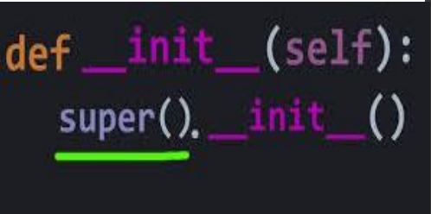
The super() Function
• The super() function is used in a child class to call methods from its parent class.

Slide 10
Inheritance
Inheritance in Python allows a class (child class) to inherit properties and methods from another class (parent class). This helps in reusing code and building hierarchical relationships between classes.
Types of Inheritance:
Single Inheritance
Multiple Inheritance
Multilevel Inheritance:
Hierarchical Inheritance
Hybrid Inheritance

Slide 11
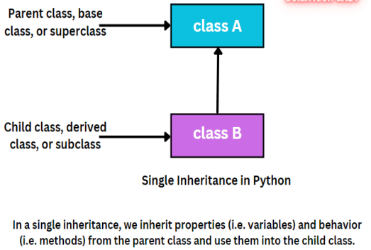
Single Inheritance
A child class inherits from a single parent class.
# Parent class
class Animal:
def speak(self):
print("Animal speaks")
# Child class
class Dog(Animal):
def bark(self):
print("Dog barks")
# Create an object of Dog
dog = Dog()
dog.speak() # Inherited method from Animal
dog.bark() # Method of Dog

Slide 12
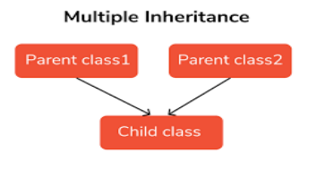
Multiple Inheritance
A child class inherits from multiple parent classes.
# Parent classes
class Father:
def skills(self):
print("Father has driving skills")
class Mother:
def hobbies(self):
print("Mother loves painting")
# Child class
class Child(Father, Mother):
def play(self):
print("Child loves to play")
# Create an object of Child
child = Child()
child.skills() # Inherited from Father
child.hobbies() # Inherited from Mother
child.play() # Method of Child

Slide 13
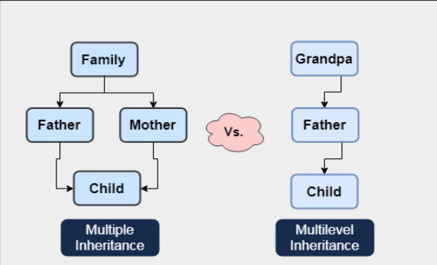
Multilevel Inheritance
Multilevel inheritance occurs when a child class inherits from another child class, creating a chain of inheritance.
# Grandparent class
class Vehicle:
def has_wheels(self):
print("Vehicles have wheels")
# Parent class
class Car(Vehicle):
def fuel_type(self):
print("Cars run on petrol or diesel")
# Child class
class ElectricCar(Car):
def battery_capacity(self):
print("Electric cars have batteries")
# Create an object of ElectricCar
tesla = ElectricCar()
tesla.has_wheels() # From Vehicle
tesla.fuel_type() # From Car
tesla.battery_capacity() # From ElectricCar

Slide 14
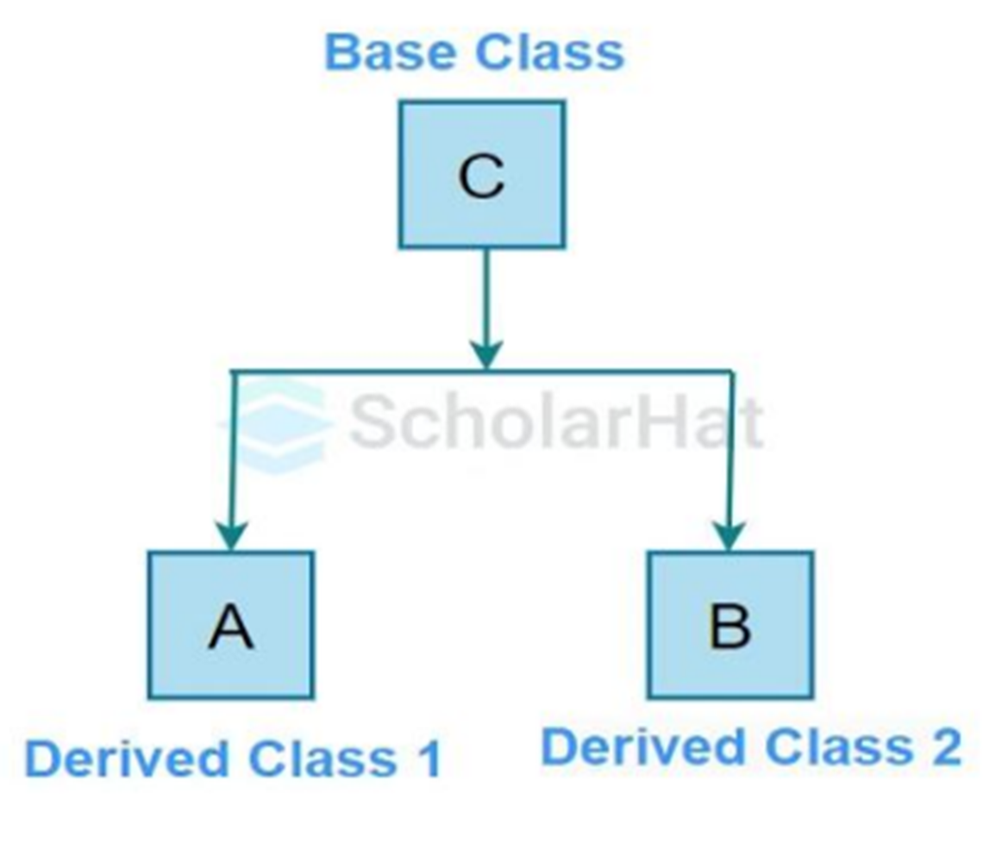
Hierarchical Inheritance
Multiple child classes inherit from a single parent class.
class Animal: # Parent class
def speak(self):
print("Animal makes a sound")
class Dog(Animal): # Child class 1
def bark(self):
print("Dog barks")
class Cat(Animal): # Child class 2
def meow(self):
print("Cat meows")
# Creating objects of child classes
dog = Dog()
cat = Cat()
# Accessing methods
dog.speak() # Inherited from Animal
dog.bark() # Method of Dog
cat.speak() # Inherited from Animal
cat.meow() # Method of Cat

Slide 15
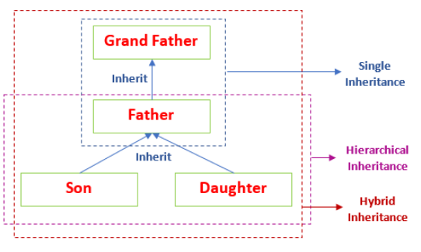
Hybrid Inheritance
Hybrid inheritance is a combination of two or more types of inheritance, such as single, multiple, multilevel, or hierarchical inheritance
Class Animal:
def make_sound(self):
return "Some sound"
class Dog(Animal):
def bark(self):
return "Woof!“
class HelperAnimal:
def assist(self):
return "Assisting human"
class GuideDog(Dog, HelperAnimal):
def guide(self):
return "Guiding the visually impaired”

Slide 16
THANK YOU…

