Slide 1
Formulas of arithmetic progressions
By: krish

Slide 2
What’s an ap ?
An arithmetic progressions (AP) is a list of numbers in which a term is obtained by adding a fixed number d to the preceding term, except the first term. The fixed term is called the common difference. (NCERT definition), in short An arithmetic progression is a sequence where the differences between every two consecutive terms are the same
For example: 2,4,6,8,10,12,14,16, ………

Slide 3
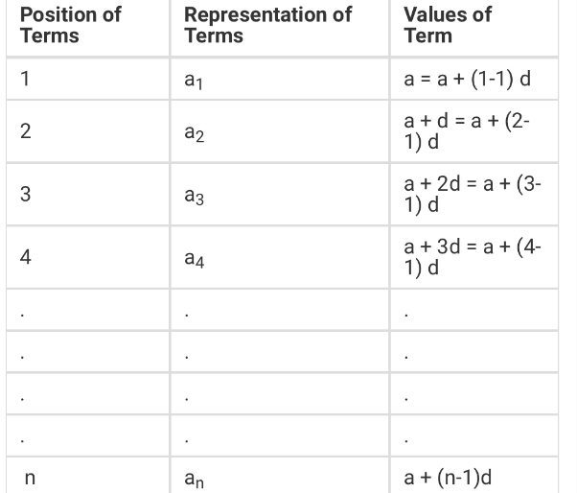
General form of an ap
The most commonly used general form of an AP is a, a+d, a+2d, a+3d

Slide 4
Nth term of an ap
The formula of the nth term of an AP is a_{n} = a + (n − 1) × d Where
a = First term
d = Common difference
n = number of terms
a_{n} = nth term

Slide 5
Example of an nth term of an ap
Example: Find the nth term of AP: 1, 2, 3, 4, 5…., a_{n}, if the number of terms are 15.
Solution: Given, AP: 1, 2, 3, 4, 5…., a_{n}
n=15
By the formula we know, a_{n} = a+(n-1)d
First-term, a =1
Common difference, d=2-1 =1

Slide 6
Note
Note: The finite portion of an AP is known as finite AP and therefore the sum of finite AP is known as arithmetic series. The behaviour of the sequence depends on the value of a common difference.
If the value of “d” is positive, then the member terms will grow towards positive infinity
If the value of “d” is negative, then the member terms grow towards negative infinity

Slide 7
Sum of n terms of ap
For any progression, the sum of n terms can be easily calculated. For an AP, the sum of the first n terms can be calculated if the first term and the total terms are known. The formula for the arithmetic progression sum is explained below:
Consider an AP consisting “n” terms.
S = n/2[2a + (n − 1) × d] (This is the AP sum formula to find the sum of n terms in series.)

Slide 8
Proof
Consider an AP consisting “n” terms having the sequence a, a + d, a + 2d, ………….,a + (n – 1) × d
Sum of first n terms = a + (a + d) + (a + 2d) + ………. + [a + (n – 1) × d] ——————-(i)
Writing the terms in reverse order,we have:
S = [a + (n – 1) × d] + [a + (n – 2) × d] + [a + (n – 3) × d] + ……. (a) ———–(ii)
Adding both the equations term wise, we have:
2S = [2a + (n – 1) × d] + [2a + (n – 1) × d] + [2a + (n – 1) × d] + …………. + [2a + (n – 1) ×d] (n-terms)
2S = n × [2a + (n – 1) × d]
S = n/2[2a + (n − 1) × d]

Slide 9
Example
Let us take the example of adding natural numbers up to 15 numbers.
AP = 1,2,3,4,5,6,7,8,9,10,11,12,13,14,15
Given, a = 1, d = 2-1 = 1 and an = 15
Now, by the formula we know;
S = n/2[2a + (n − 1) × d] = 15/2[2.1+(15-1).1]
S = 15/2[2+14] = 15/2 [16] = 15 x 8
S = 120
Hence, the sum of the first 15 natural numbers is 120.

Slide 10
Sum of an ap when the last term is given
Formula to find the sum of AP when first and last terms are given as follows:
S = n/2 (first term + last term)

Slide 11
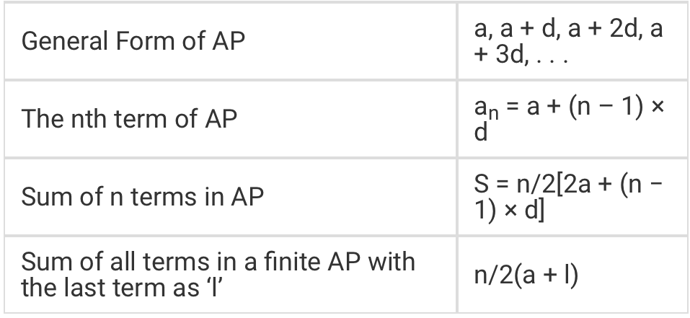
Formula lists

