Slide 1



IMPULSE FORGE

Slide 2
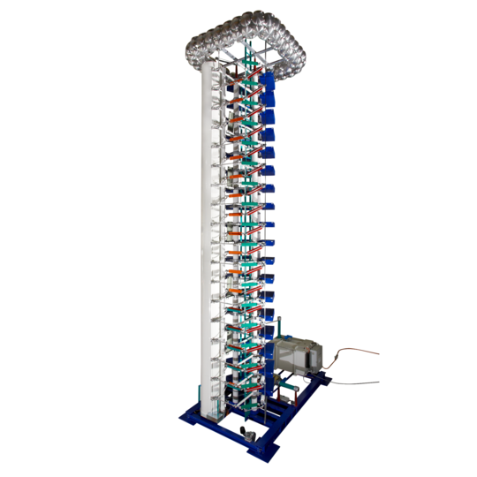
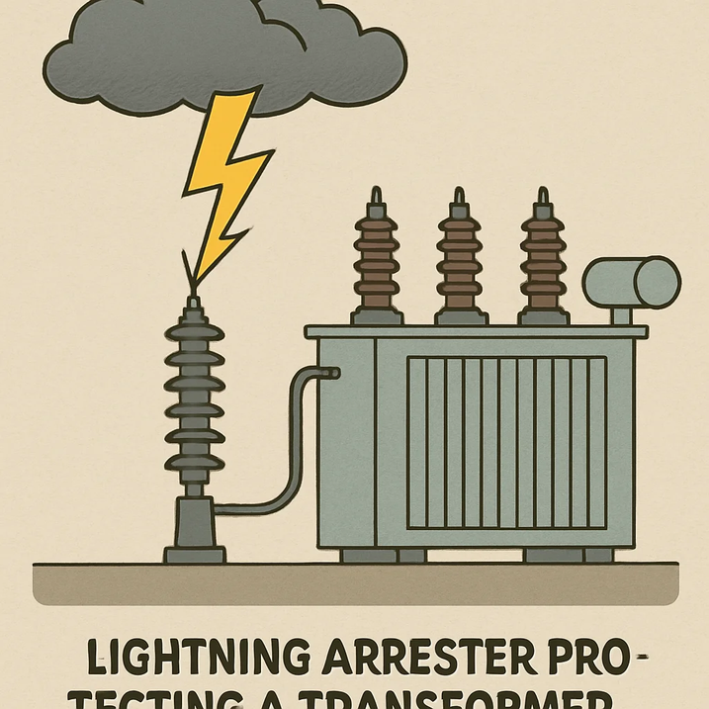
Introduction
High-voltage electrical equipment such as switchgear, cables, and transformers represent critical capital assets in any power network.
Operating in exposed environments, these components are routinely subjected to severe transient overvoltages from lightning strikes and grid switching operations. Before any new high-voltage equipment design is cleared for commercial deployment, it must undergo statutory type testing using impulse generators at accredited high-voltage laboratories. The objective of this high-voltage impulse testing is to verify that the equipment's insulation systems can safely withstand high-energy, microsecond-duration transient surges without experiencing dielectric breakdown. Let’s take an example of a transformer
Lightning
Switching
Direct lightning strikes to transmission conductors or back-flashovers across tower footings inject tens of kiloamperes. Extremely steep wavefront (∼1.2 μs). Voltage drops across initial turns of the transformer winding, creating extreme turn-to-turn paper insulation stress.
Operation of EHV circuit breakers, clearing line faults, dropping unloaded transformer banks, or energizing long 400 kV/765 kV open-ended lines. Trapped LC energy oscillates.Longer duration (∼250 μs front, 2500 μs tail). Stresses phase-to-ground clearances, major oil ducts, and drives the transformer core into severe magnetic saturation.

Slide 3
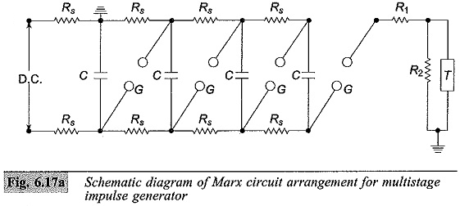
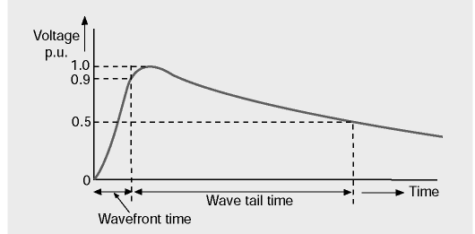
How it works
We can’t summon lightning on demand, so we recreate the high voltage conditions using a marx circuit
Marx generator circuit
Impulse V-t graph
  Energy stored in capacitors, C are charged in parallel to U_ch (volts).
  When capacitors start discharging, spark gaps fire up, creating a series discharge arrangement.
  If one stage capacitor discharges x volts, the final peak voltage on target would be x*n ideally, where n is number of stages.
Rf: front resistance - Lower the Rf, steeper the rising edge
Rt: tail resistance - Higher Rt, makes impulse decay slowly

Slide 4

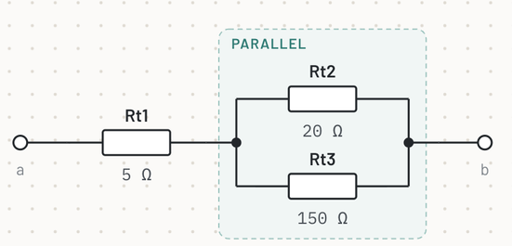
Problems
There are 2 problems engineers face:
PROBLEM 1
PROBLEM 2
Finding the right circuit configuration:
Physics calculations don’t account the effect of real life conditions.
Your physics model may give you the configuration to achieve 1400kV, but in real life, 1450kV might be generated.

Slide 5
Prerequisites
  Complete oil filling, impregnation and the prescribed settling period.
  Test oil BDV and moisture; collect a baseline DGA sample.
  Measure HV–LV, HV–earth and LV–earth insulation resistance/PI.
  Measure winding and bushing capacitance/tan δ at approved test voltages.
  Verify winding resistance, turns ratio, vector group and selected tap.
  Record SFRA, excitation current and magnetic balance where required.
  Connect the tested terminal, neutral and untested windings as specified.
  Verify calibration of the voltage divider, current sensor and recorder.

Slide 6
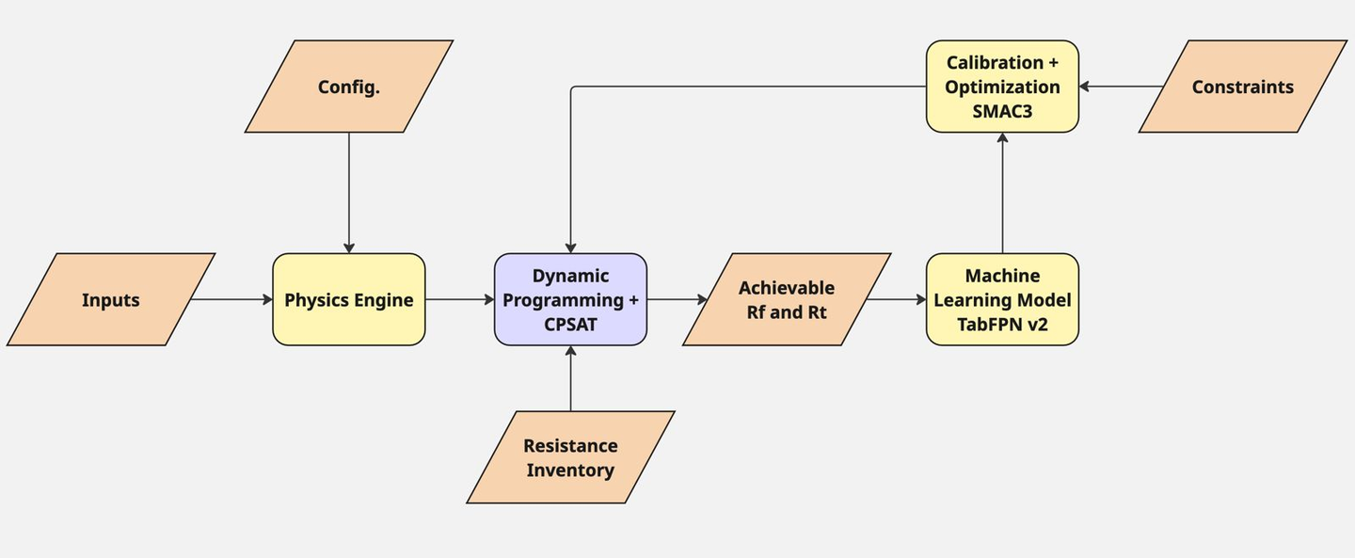
Architecture
3 engines, 1 DP solver
  Physics Engine: proposes the stage count and front/tail resistance per stage; predicts the waveform for buildable settings
  Inventory Solver (DP + CP-SAT): builds exact series–parallel resistor assemblies from stock; picks compatible front/tail pairs
  Residual ML Engine (TabPFN v2): corrects the physics prediction of front/peak time, tail time and crest voltage
  Optimisation Engine (SMAC3): refines the settings, scores the corrected predictions and stops at a set limit

Slide 7
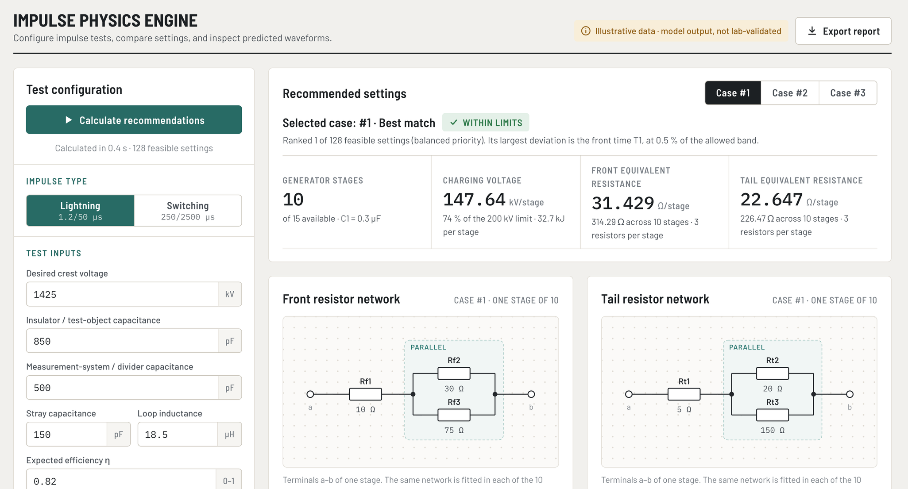
Demo

Slide 8
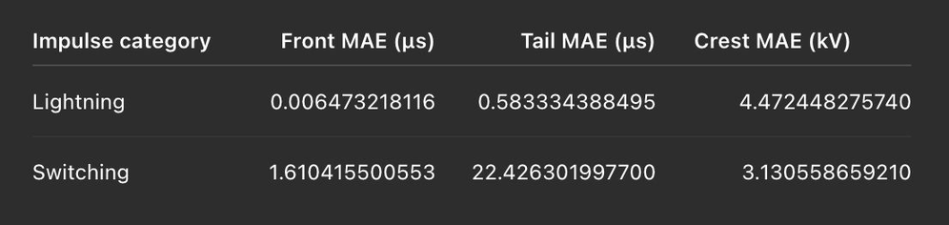
DP solver
Calibration & Optimisation engine
Builds the exact combination of series and parallel resistors to get the closest Req.
We use Dynamic programming and CP-SAT.
Limits: stock limits have been set to max 4 of one kind of resistor per stage
The optimisation engine uses SMAC3 to search for generator settings that the ML model predicts will hit the target waveform.
  Propose. SMAC3 suggests a new stage count N, a required front resistance Rf_req and a required tail resistance Rt_req.
  Build. The proposal goes to the DP solver, not straight to ML. DP turns the requested resistances into real assemblies from the inventory. The engine therefore scores what can actually be built, not ideal values.
  Keep the best three. The engine stores every attempt and keeps the three best distinct buildable setups. Different requests that produce the same physical assembly count as one setup.
  Repeat or stop. It stops when three setups meet all targets, or when it hits a repeated setup, stagnation, or the budget (24 attempts or 600 s).
ML Model metrics
TabPFN v2, a pretrained tabular model that fits in context: no training epochs, no gradient updates.

Slide 9
Limitations
01
02
Dataset skewed toward insulator test profiles, limiting generalization .
Absence of real-time ambient temperature, humidity, and barometric pressure metrics.
03
The computation restricts us to a search space of the best possible combination of 4 resistors in a single stage.

Slide 10
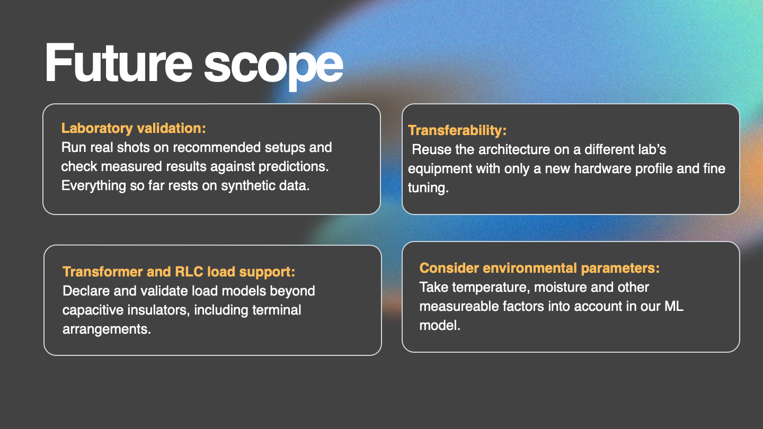

Slide 11








Meet Our Team
DIYA N REDDY
AMAN GIRI
JASMINE TANVIR ALAM
FAIZAAN NASIR
VIHAN GAUR

Slide 12
Thank You
for your time and attention

