Slide 1








ASIA Research Partners
Accurate Solutions & Insightful Analysis
Consumer Research
Healthcare Research
IT Research
Automotive Research
Key Opinion Leaders Research
Banking & Retail Research

Slide 2
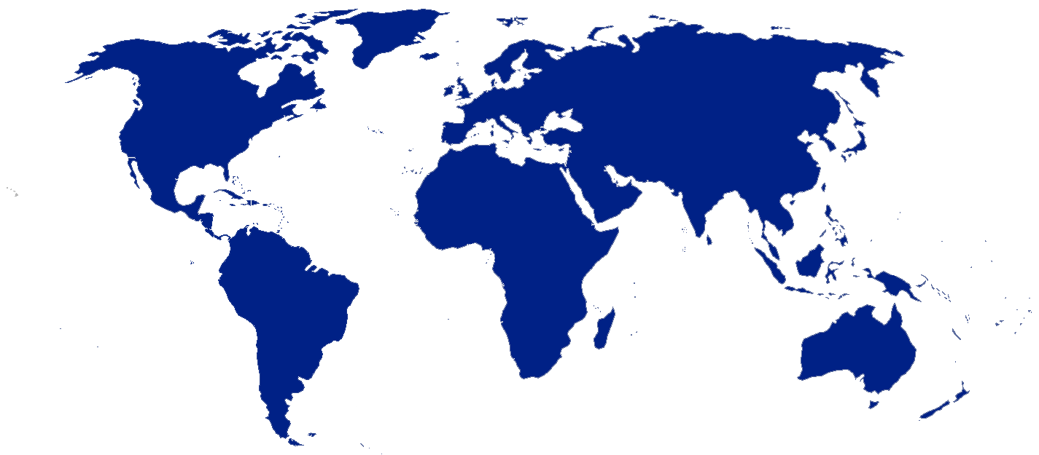
Overview
Asia Research Partners provides a full range of market research solutions to global clients. We're your single-stop resource for marketing research, nationally and internationally
Our custom-tailored approach is hands-on, cost-efficient, and results-focused
Accurate Solutions & Insightful Analysis makes us the most Preferred, Reliable & Competitive partner for Market Research Activities
Quick Facts
Full Service Research in Asia Market
India Research Experts
Online Panels in India
100,000 + CATI Interviews executed
1500 + MR Projects in Asia Market
Qualitative Research Experts
24/7 Coverage
We're wizards at managing multi-phased, multi-location, large-scale research projects
Expertise in Healthcare, Information Technology, Automotive, Consumer, -Senior level Opinion leaders and C-Level respondents.

Slide 3
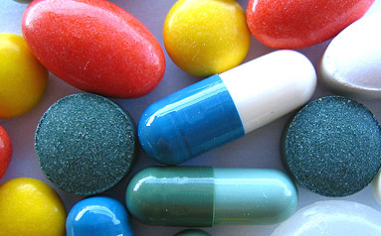


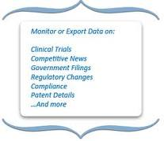
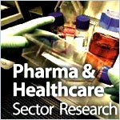
Healthcare Research

Slide 4
Healthcare Research Solutions
Familiarity Awareness / of brand across various market segments
Brand perception vis-à-vis competitor brands
Performance on what parameters, drives your brand’s perceptions?
Current positioning of your brand in the target segment’s mind
Brand Management
Prioritize areas of product/service improvement
Segment customers on basis of their satisfaction and loyalty
Incorporate customer satisfaction results into marketing/communications strategy
Influence customer behavior in-line with your strategic objectives
Customer Satisfaction
Determine the perceived attractiveness of the product for the target segment
Determine the ideal price and optimal design for the product/service
Predict off-take rates of alternative price-feature configurations
Identify possible matches/mismatches between unmet needs and new features
New Product/ Concept Testing
Are users aware of the full-functionality of your product?
What is the usage pattern of different features of your product?
Which product features are the most difficult to use?
Are customers using your product over multiple locations?
Usage & Attitude Measurement

Slide 5
Healthcare Research Solutions
Evaluate overall effectiveness of your ad campaigns
Measure positive influences of the campaign on awareness, perception, intention to use
Evaluate effectiveness of your ad campaign in communicating intended message
Identify the best medium for advertising
Advertising Effectiveness
Measure satisfaction and derive action-points to improve employee retention
Identify factors that employees consider when evaluating their experience with your firm
Determine satisfaction on each of these factors
Segment your employees to deliver focused training and implement retention programs
Employee Motivation
Measure impact of event association on the customers’ image of your brand
Assess impact of your association on industry analysts and competitors
Evaluate the success of the event in communicating your intended message
Measure impact on likelihood of purchase or recommendation
Event Effectiveness
The aggregate of individual attitudes or beliefs held by the adult population
An opinion poll is a survey of public opinion from a particular sample
Opinion polls are usually designed to represent the opinions of a population by conducting a series of questions and then extrapolating generalities in ratio or within confidence intervals
Public Opinion Poll

Slide 6
Investigated Populations
Our intervention bears the whole scope of Medical and HealthCare actors
  General Practitioners
  Private Practice Specialists
  Nurses
  Dieticians
  Dentists
  Pharmacists
  Hospital based practitioners
  Hospital Pharmacists
  Surgeons
  Radiologists
  Cardiologists
  Oncologists
  Ophthalmologists
  Gastroenterologists
  Nuclear Medicine Doctors
  Interventional Radiologists / Cardiologists
  C-Level Executive (CEO, CMO, Director etc)
  Industry Experts
  Consumers (patients, shoppers, students, alumni, subscribers)
  Associations members and many other specialities

Slide 7
Universes of therapeutics
The universes of therapeutics in which we are intervening the most frequently are :
  Antibiotherapy
  Anti-inflammatory, pain killers
  Anti-hyper cholesterolemia
  Radiology
  Gynecology
  Dermatology
  Oncology
  Immunology
  Ophthalmology
  Asthma
  Neurology: Multiple Sclerosis, Alzheimer
  Diabetes
  Many others

Slide 8
Type of studies executed
Launching and products repositioning studies
  Studies of prescription and qualifications of prescription makers
  Research and products concepts and communications Testing
  Advertising Pre and Post Testing
  Argumentary Testing
  Many others
  Studies among patients
    Perception of drugs
    Doctor-to-patient feedback studies
    Ethnographic studies in situ at the patient’s
    Expectations of new products, services, galenic forms
    Research and Packaging and Visual Identity Testing
    Studies on the image of laboratories

Slide 9
Global Research Expertise
Eastern European Countries
Poland
Romania
Western European Countries
Belgium
France
Germany
Netherlands
Northern European Countries
UK
Ireland
Sweden
Norway
Southern European Countries
Italy
Spain
Portugal
North and South America
USA
Canada
Mexico
Brazil
Asia Pacific Countries
China
Singapore
Australia
Hong Kong
Japan
Korea
India
Middle East Countries
Iraq
Kuwait
Turkey
UAE

Slide 10










Clients Snapshot- Healthcare

Slide 11











Clients Snapshot- Healthcare

Slide 12





Affiliations
In-house Focus Vision Facility
Expertise with different Healthcare physicians types, Senior level Opinion leaders and C-Level respondents.

Slide 13
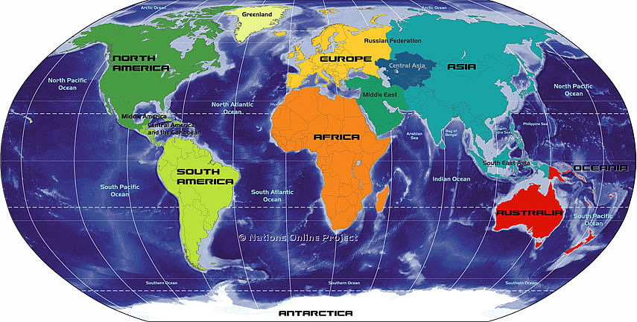
Contact Us
Asia Research Partners
Accurate Solutions & Insightful Analysis
Contact :
B-1/ E-9, Ground Floor,
Mohan Cooperative Industrial Estate
Mathura Road, Delhi – 110044
Tel: +91-74288-92926 Fax: +91-011-46161365
Email: salest2@asiaresearchpartners.com
Website: www.asiaresearchpartners.com

