Slide 1
TypeScript
Subham Salaria,Gowtham Talluri & Faizal

Slide 2

What is Typescript
Typescript is a typed superset of JavaScript that compiles to plain JavaScript.
Typescript is pure object oriented with classes, interfaces and statically typed like C# or Java.

Slide 3


Tools Needed for Typescript
test your scripts online by using The Typescript at www.typescriptlang.org/Playground
It is open source ,open host ,any OS
Typescript is a compiled or transpiled language. So you'll need at least two tools to work with Typescript, a text editor and a Typescript compiler.

Slide 4
Tools Needed For Typescript
For most of the popular text editors, such as Sublime Text, TextMate, Atom, Notepad++, it's as simple as searching in their library of extensions and installing the Typescript feature.
Some of the ID’s like visual studio , webstorm its inbuilt.

Slide 5
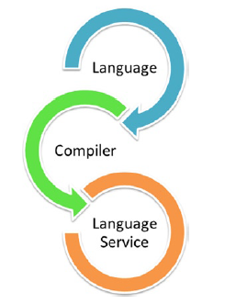
Components of Typescript
Language − It comprises of the syntax, keywords, and type annotations.
The Typescript Compiler − The Typescript compiler (tsc) converts the instructions written in Typescript to its JavaScript equivalent.
The Typescript Language Service − The language service supports the common set of a typical editor operations like statement completions, signature help, code formatting and outlining, colorization, etc.

Slide 6
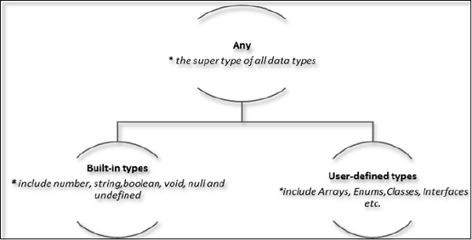
TypeScript Types
TypeScript provides data types as a part of its optional Type System. The data type classification is as given below −

Slide 7
Typescript Compiler Installation
Install as Visual Studio Extension
Install by Command-Line-Interface or via node package manager

Slide 8
Typescript - Variables
Typescript variables must follow the JavaScript naming rules −
Variable names can contain alphabets and numeric digits.
They cannot contain spaces and special characters, except the underscore (_) and the dollar ($) sign.
Variable names cannot begin with a digit.

Slide 9
Variable Declaration in TypeScript
Type Assertion in TypeScript
Inferred Typing in TypeScript
TypeScript Variable Scope
Global Scope
Class Scope
Local Scope

Slide 10
Typescript - Operators
An operator defines some function that will be performed on the data. The data on which operators work are called operands.
The major operators in Typescript can be classified as −
Arithmetic operators
Logical operators
Relational operators
Bitwise operators
Assignment operators
Ternary/conditional operator
String operator
Type Operator

Slide 11
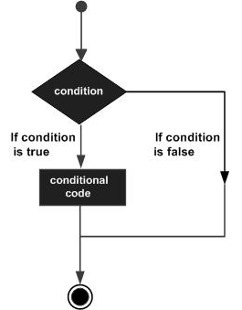
TypeScript - Decision Making
Decision-making structures require that the programmer specifies one or more conditions to be evaluated or tested by the program

Slide 12
TypeScript - Decision Making
Decision-making constructs in TypeScript are classified as follows −
S.No. | Statement & Description
1. | if statement An ‘if’ statement consists of a Boolean expression followed by one or more statements
2. | if...else statement An ‘if’ statement can be followed by an optional ‘else’ statement, which executes when the Boolean expression is false.
3. | else…if and nested if statements You can use one ‘if’ or ‘else if’ statement inside another ‘if’ or ‘else if’ statement(s).
4. | switch statement A ‘switch’ statement allows a variable to be tested for equality against a list of values.

Slide 13
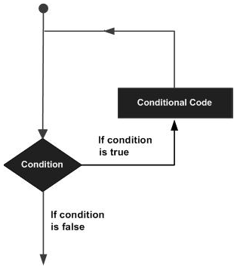
TypeScript - Loops
A loop statement allows us to execute a statement or group of statements multiple times.

Slide 14
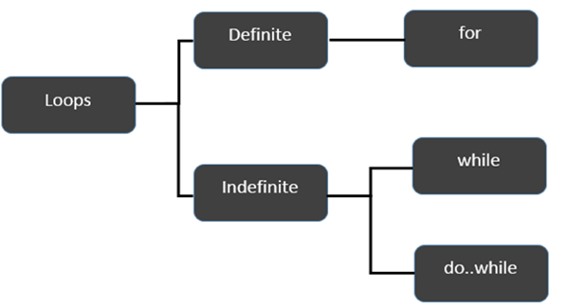
TypeScript – Loops Classification
TypeScript provides different types of loops to handle looping requirements. The following figure illustrates the classification of loops −

Slide 15
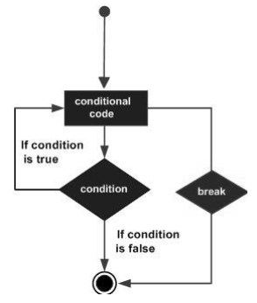
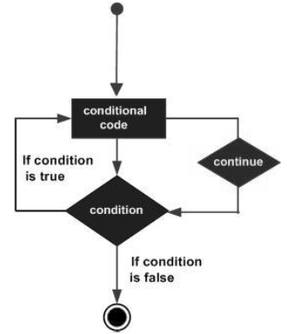
The break Statement & The continue Statement
The break statement is used to take the control out of a construct. Using break in a loop causes the program to exit the loop. Its syntax is as follows − | The continue statement skips the subsequent statements in the current iteration and takes the control back to the beginning of the loop.

Slide 16
TypeScript - Functions
A function is a set of statements to perform a specific task. Functions organize the program into logical blocks of code. Once defined, functions may be called to access code.
Sr.No | Funtions & Description
1. | Defining a Function A function definition specifies what and how a specific task would be done.
2. | Calling a Function A function must be called so as to execute it.
3. | Returning Functions Functions may also return value along with control, back to the caller.
4. | Parameterized Function Parameters are a mechanism to pass values to functions.

Slide 17
TypeScript - Numbers
TypeScript like JavaScript supports numeric values as Number objects. A number object converts numeric literal to an instance of the number class.
Property & Description
MAX_VALUE - The largest possible value a number in JavaScript can have 1.7976931348623157E+308.
MIN_VALUE -The smallest possible value a number in JavaScript can have 5E-324
NaN - Equal to a value that is not a number
NEGATIVE_INFINITY - A value that is less than MIN_VALUE.
NEGATIVE_INFINITY - A value that is less than MIN_VALUE.
Prototype - A static property of the Number object. Use the prototype property to assign new properties and methods to the Number object in the current document.
Constructor - Returns the function that created this object's instance. By default, this is the Number object.

Slide 18
TypeScript - Number Methods
Methods & Description
toExponential() Forces a number to display in exponential notation, even if the number is in the range in which JavaScript normally uses standard notation.
toFixed() Formats a number with a specific number of digits to the right of the decimal.
toLocaleString() Returns a string value version of the current number in a format that may vary according to a browser's local settings.
toPrecision() Defines how many total digits (including digits to the left and right of the decimal) to display of a number. A negative precision will throw an error.
toString() Returns the string representation of the number's value. The function is passed the radix, an integer between 2 and 36 specifying the base to use for representing numeric values.
valueOf() Returns the number's primitive value.

Slide 19
TypeScript – Strings Objects
Constructor Returns a reference to the String function that created the object.
Length Returns the length of the string.
Prototype The prototype property allows you to add properties and methods to an object.

Slide 20
String Methods
charAt() Returns the character at the specified index.
charCodeAt() Returns a number indicating the Unicode value of the character at the given index.
concat() Combines the text of two strings and returns a new string.
indexOf() Returns the index within the calling String object of the first occurrence of the specified value, or -1 if not found.
lastIndexOf() Returns the index within the calling String object of the last occurrence of the specified value, or -1 if not found.
localeCompare() Returns a number indicating whether a reference string comes before or after or is the same as the given string in sort order.
match() Used to match a regular expression against a string.
replace() Used to find a match between a regular expression and a string, and to replace the matched substring with a new substring.

Slide 21
String Methods
search() Executes the search for a match between a regular expression and a specified string.
slice() Extracts a section of a string and returns a new string.
split() Splits a String object into an array of strings by separating the string into substrings.
substr() Returns the characters in a string beginning at the specified location through the specified number of characters.
substring() Returns the characters in a string between two indexes into the string.
toLocaleLowerCase() The characters within a string are converted to lower case while respecting the current locale.
toLocaleUpperCase() The characters within a string are converted to upper case while respecting the current locale.
toLowerCase() Returns the calling string value converted to lower case.
toString() Returns a string representing the specified object.
toUpperCase() Returns the calling string value converted to uppercase.
valueOf() Returns the primitive value of the specified object.

Slide 22
TypeScript – Arrays Methods
Syntax :
var array_name[:datatype]; //declaration
array_name = [val1,val2,valn..] //initialization
concat() Returns a new array comprised of this array joined with other array(s) and/or value(s).
every() true if every element in this array satisfies the provided testing function.
filter() Creates a new array with all of the elements of this array for which the provided filtering function returns true.
forEach() Calls a function for each element in the array.

Slide 23
TypeScript – Array Method
indexOf() Returns the first (least) index of an element within the array equal to the specified value, or -1 if none is found.
join() Joins all elements of an array into a string.
lastIndexOf() Returns the last (greatest) index of an element within the array equal to the specified value, or -1 if none is found.
map() Creates a new array with the results of calling a provided function on every element in this array.
pop() Removes the last element from an array and returns that element.
push() Adds one or more elements to the end of an array and returns the new length of the array.
reduce() Apply a function simultaneously against two values of the array (from left-to-right) as to reduce it to a single value.
reduceRight() Apply a function simultaneously against two values of the array (from right-to-left) as to reduce it to a single value.

Slide 24
TypeScript - Tuples
Tuple types allow you to express an array where the type of a fixed number of elements is known, but need not be the same.
SYNTEX
var tuple_name = [value1,value2,value3,…value n]

Slide 25
TypeScript - Classes
ypeScript supports object-oriented programming features like classes, interfaces, etc. A class in terms of OOP is a blueprint for creating objects. A class encapsulates data for the object.
SYNTAX
class class_name {
//class scope
}

Slide 26
Class Example
class Car {
//field
engine:string;
//constructor
constructor(engine:string) {
this.engine = engine
}
//function
disp():void {
console.log("Engine is : "+this.engine)
}
}

Slide 27
TypeScript - Interfaces
An interface is a syntactical contract that an entity should conform to. In other words, an interface defines the syntax that any entity must adhere to
Syntax
interface interface_name {
}

Slide 28
Interfaces-Example
interface IPerson {
firstName:string,
lastName:string,
sayHi: ()=>string
}

Slide 29
Why use TypeScript?
Open Source, under the Apache 2.0 license, and available to download on codeplex.
Tooling support, for type safety, inference and refactoring.
Static types and compilation helps catch mistakes & bugs earlier.
Simplicity of design, self hosting (less than 25k LoC).
Works well with existing projects.

Slide 30
Resources
typescriptlang.org
https://www.udemy.com/typescript/
http://tutorialzine.com/2016/07/learn-typescript-in-30-minutes/
https://www.youtube.com/watch?v=hADI92zCIvE&list=PLYxzS__5yYQkX-95LHG5EDxPj3tVvVmRd

