Slide 1
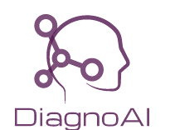
ChadGPT
Introducing DiagnoAI
Predictive Diagnosis just a Line Away
HackNITR 4.0
Krish Sharma
2nd year, NIT Silchar
Niyar R Barman
2nd year, NIT Silchar
Md Faizal Karim
2nd year, IIIT Hyderabad
Hirakjyoti Roy
3rd year, MIT Manipal

Slide 2
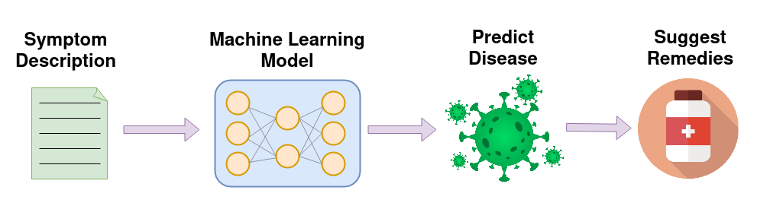
What is DiagnoAI ?
DiagnoAI is a tool, where user can provide text description of their problems and the tool will detect and predict the probability of disease.
Users can describe their symptoms in natural language.
Upon detection of the disease, remedies and information about the disease is provided.

Slide 3
Why DiagnoAI ?
This product solves the problem of accurately predicting diseases and their probabilities from a text description of symptoms
Using natural language processing techniques, the model is able to understand and interpret the meaning of the text input, allowing it to make informed predictions.
It can assist in the development of personalized treatment plans for patients, as the product can provide information about the likelihood of different diseases and their potential impacts on a patient's health.
It can be used by people in rural areas, students living in hostels etc where immediate access to a doctor is not possible.

Slide 4
Motivation
In Today's World, people are afraid to consult to doctor about their health until it is highly severe. DiagnoAI aims to reduce the gap between patient and doctor by reducing the amount of time spent talking to each other.
Because of transportation or Covid19 restrictions, some people may face barriers in visiting a doctor. A tool that can detect diseases based on a description of symptoms could be a valuable resource in such a scenario.
Such a tool can reduce the number of in-person appointments needed, freeing up resources and easing the burden on healthcare systems.

Slide 5
Novelty
DiagnoAI is different from other online tools because the user can express themself in natural language, thus enabling the user to describe the symptoms in detail.
Most of the existing tools either rely on reserved keywords for the symptoms. There can be scenarios where a user might want to describe a symptom in a particular way which might not be present in the list of reserved keywords.
Using a language model solves this problem as the model can be trained to understand the relationship between words, understand the context and finally, make the predictions.

Slide 6
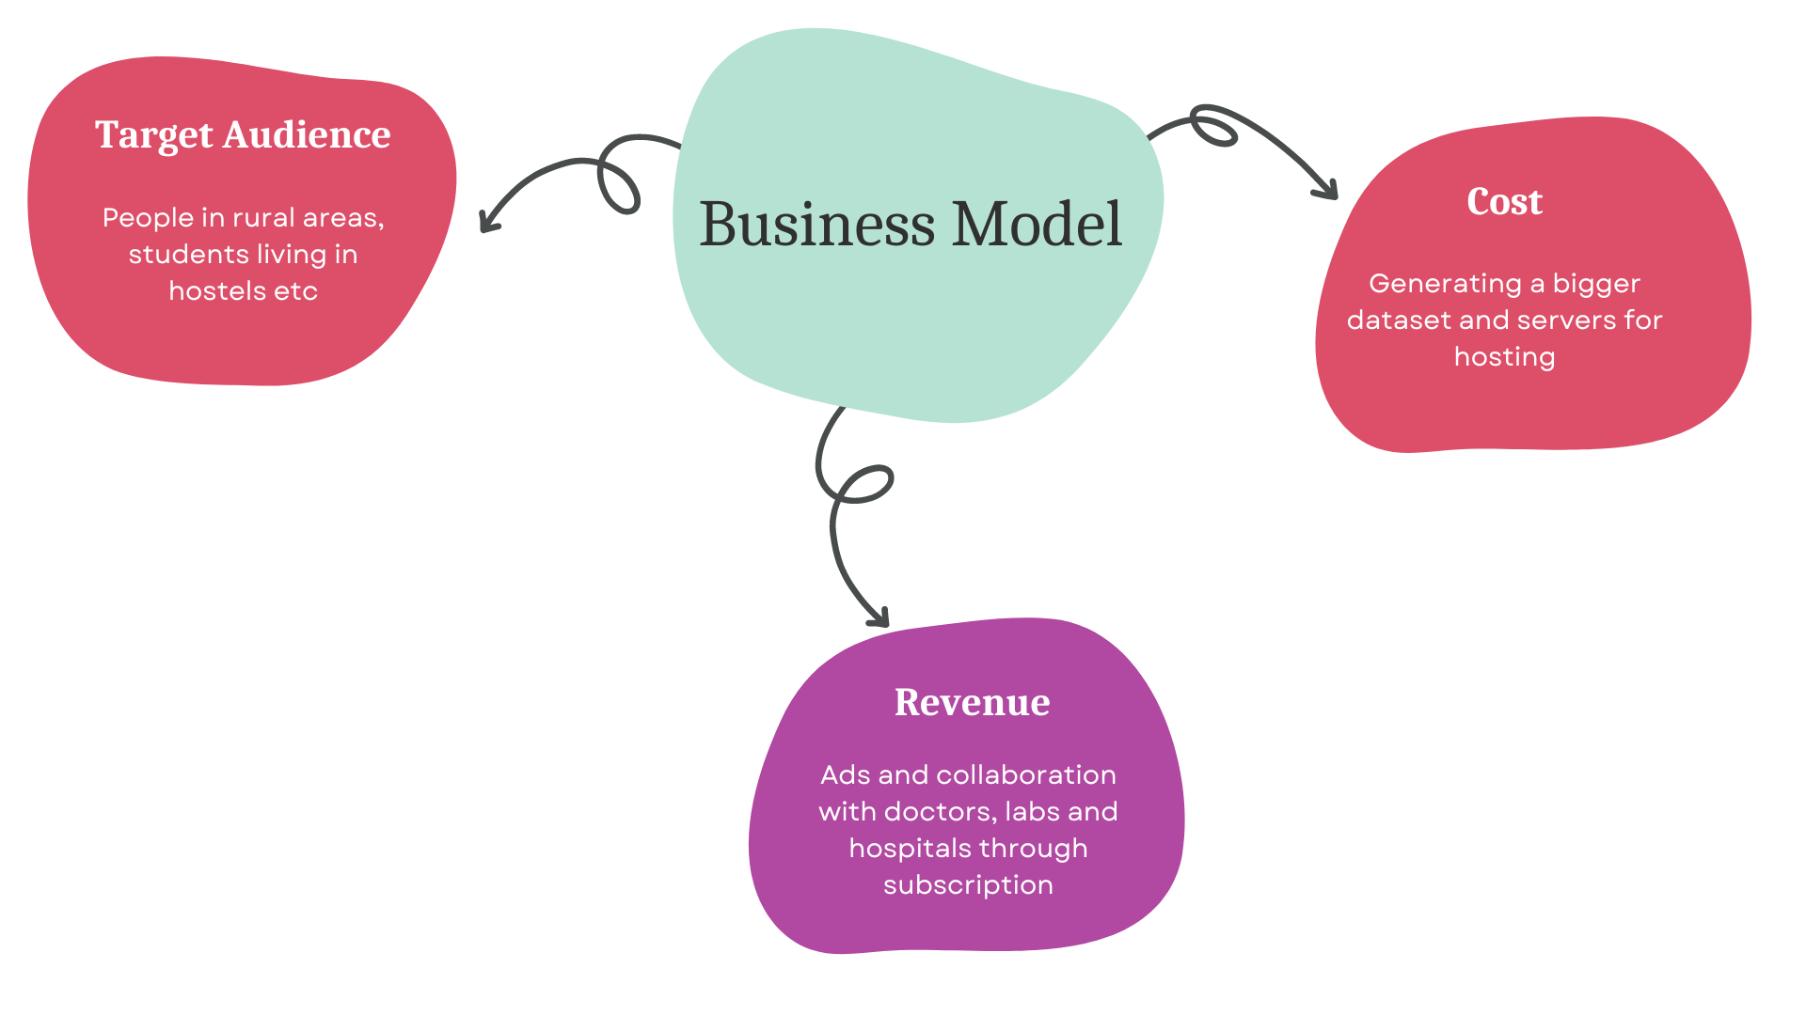
Business Model

Slide 7
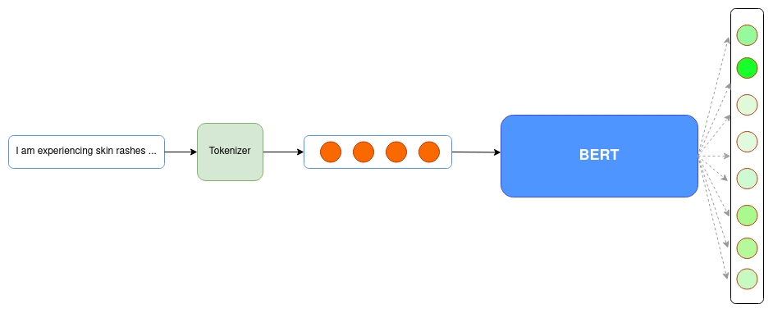
Methodology
Dataset Creation
We created a dataset containing 24 disease and 50 manually written descriptions of the symptoms (in english) for each disease.
Hence, a total 1200 descriptions were created, out of which 80% was used for model training and remaining 20% for validation and testing purposes.
Model Architecture
We used a pretrained BERT model and fine tuned it on our dataset.
We achieved a training accuracy of 100% and validation of 98.33%.

Slide 8
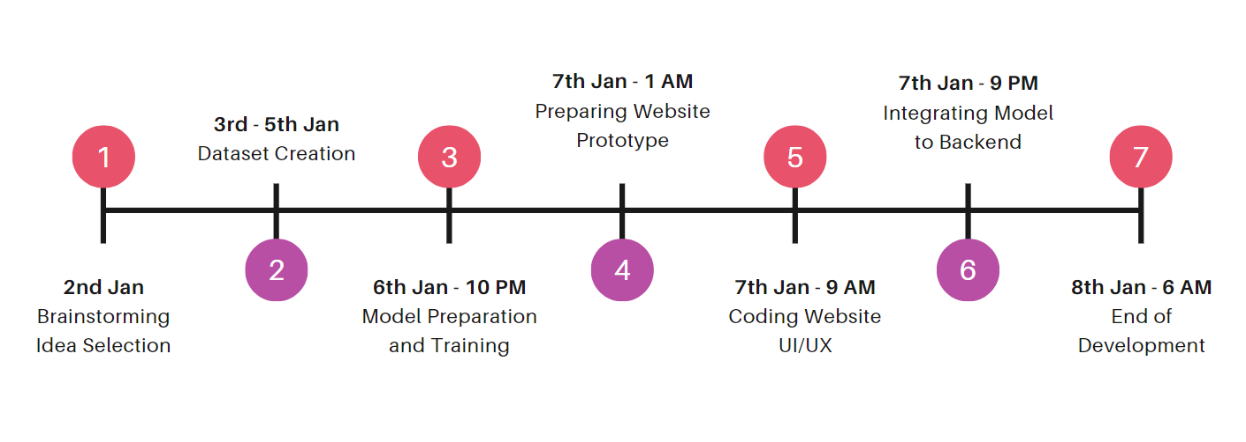
Timeline
*
* We began creating the dataset on January 2nd because we needed to build it from scratch using custom data.

Slide 9

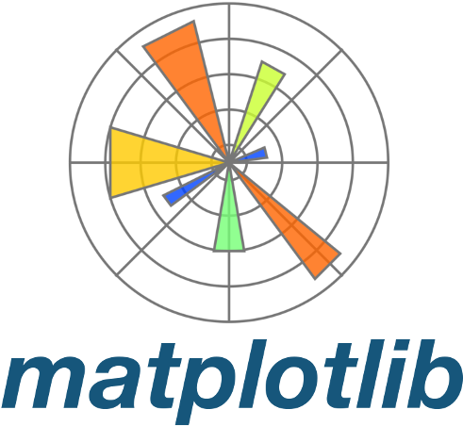








Tech Stack

Slide 10
Future Works
Include more diseases and remedies in the dataset.
Adding speech recognition input support.
Expand the model to support input in multiple Indian languages. This will enable more users to use the tool.
Visualizing where the disease is localized and its point of origin for better user experience.
Visualizing the words on which the model gave the most attention while giving the prediction. This might help the user to get more context.

