Slide 1


Discover the Best Eats with Food Finder
Food Finder, your ultimate tool for meal planning! Discover a wide array of delicious recipes tailored to your tastes and dietary needs. Our integrated calorie calculator helps you manage your nutritional intake with ease. Whether you're looking to maintain, lose, or gain weight, Food Finder has you covered every step of the way.
By Mohammad Faizal Shaikh

Slide 2
Key Features of Food Finder
Comprehensive Database
Personalized Recommendations
Seamless Ordering
Our extensive database covers thousands of restaurants, cafes, and food trucks, providing detailed information about menus, hours, and customer reviews.
With the integrated online ordering system, you can place your order directly through the website and have your meal delivered straight to your door.
Food Finder's intelligent algorithm analyzes your preferences and dietary needs to suggest the best dining options tailored just for you.

Slide 3

How Food Finder Works
Search
Order
Enter your location and cuisine preferences to browse the extensive directory of dining options.
With a few clicks, place your order and have your meal delivered or ready for pickup.
1
2
3
Discover
Explore detailed restaurant profiles, including menus, photos, and customer reviews to find the perfect match.

Slide 4

Benefits of Using Food Finder
1
Save Time
2
Discover New Flavors
No more endless scrolling through restaurant listings - Food Finder streamlines your search for the ideal dining experience.
Explore a diverse range of cuisines and eateries, expanding your culinary horizons with each visit.
3
Enjoy Convenience
4
Make Informed Choices
Order your meals with a few taps and have them delivered right to your doorstep.
Rely on customer reviews and ratings to make the best dining decisions for your needs and preferences.

Slide 5

Target Audience for Food Finder
Busy Professionals
Food Enthusiasts
Food Finder caters to those with hectic schedules, providing a quick and convenient way to discover and order delicious meals.
For those who love exploring new dining options, Food Finder offers a platform to discover unique and highly-rated eateries.
Health-conscious Individuals
Families and Groups
The app's filtering options and nutritional information help users make informed choices that align with their dietary needs.
Food Finder simplifies the process of finding and ordering meals that cater to diverse tastes and preferences.

Slide 6

Integrated Calorie Calculator
Our advanced calorie calculator is designed to help you effortlessly monitor your daily caloric intake.
By entering the food items you consume throughout the day, our tool provides precise calorie
counts and nutritional information. Whether you're aiming to lose weight, maintain your
current weight, or simply make healthier food choices, our calorie calculator offers personalized
insights to support your dietary goals. The intuitive interface makes it easy to track and adjust your
intake, ensuring you stay on track with your nutritional needs.
.
.

Slide 7


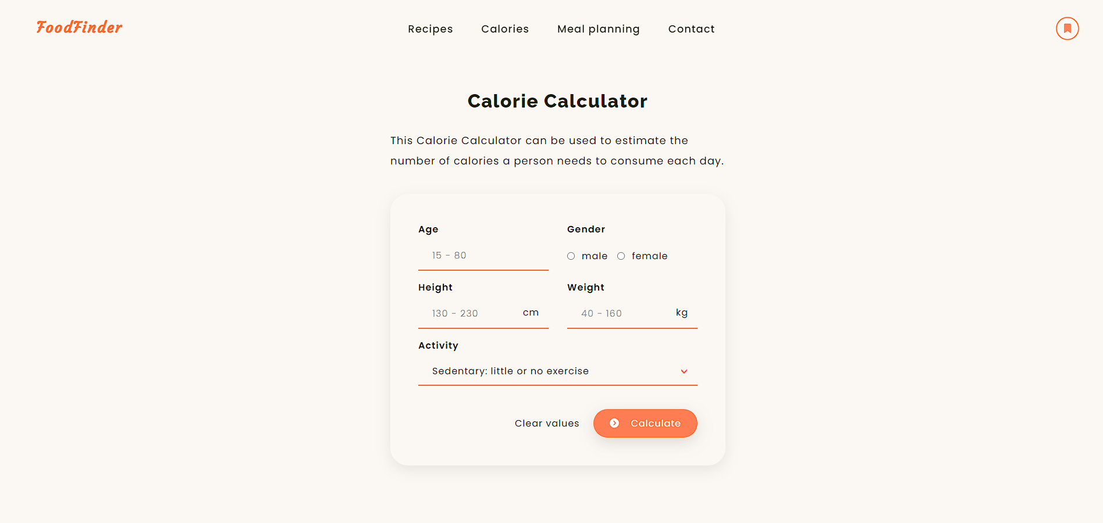


The Future of Food Finder
Expanded Partnerships
Collaborating with more restaurants and food providers to offer an even wider selection.
Integrated Loyalty Program
Rewarding frequent users with exclusive discounts and special offers.
Advanced AI Technology
Leveraging machine learning to provide even more personalized recommendations.

Slide 8

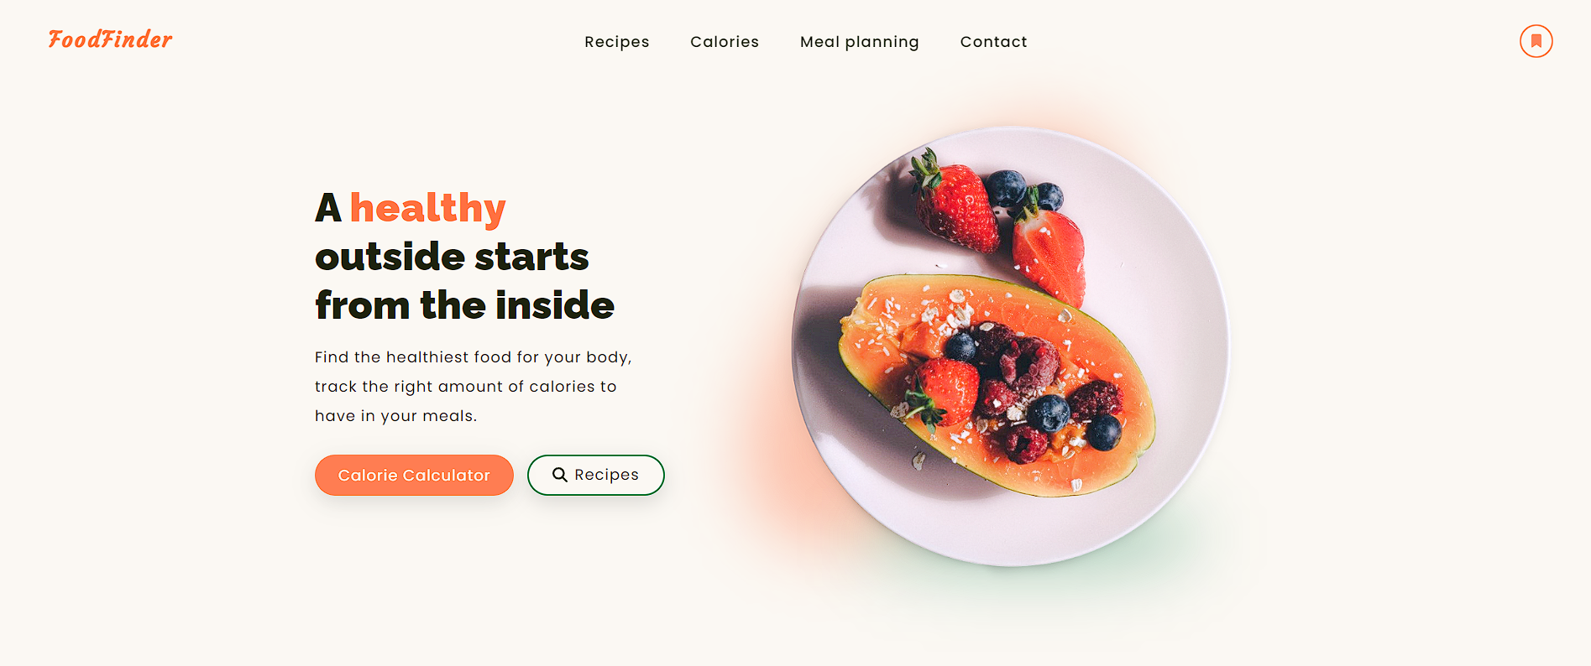
Discover the Best Eats with Food Finder
Whether you're craving a quick bite or planning a leisurely dining experience, Food Finder is your ultimate guide to the most delicious culinary adventures in your area. Start your search today and unlock a world of delectable possibilities!

