Slide 1
Graph-based Dependency Parsing with Graph Neural Networks.
Presented by:
Faizan E Mustafa

Slide 2
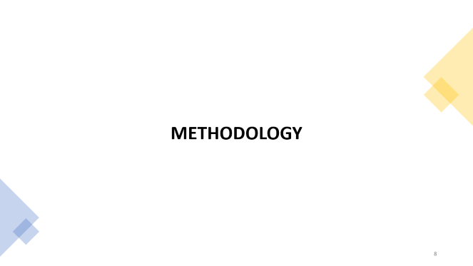

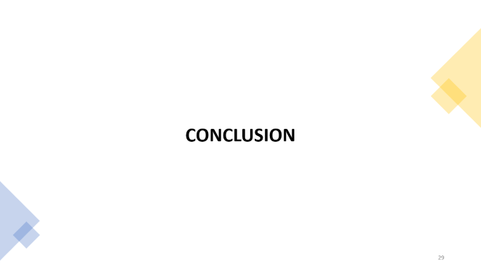

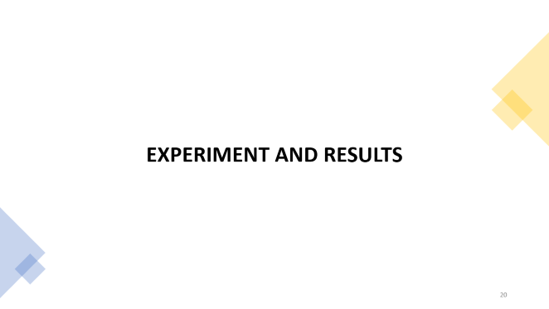

Slide 3
INTRODUCTION

Slide 4
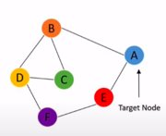
Node Representation
Effective encoding for dependency tree nodes.
Better node representation -> better edge scores -> better parser

Slide 5
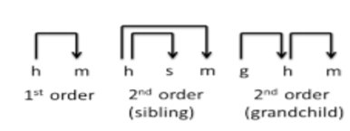
Effective Node Representation
Incorporating high-order features.
Adding siblings, grandchild, grandparent relation yield better result.
Figure: High order features ¹

Slide 6
Previous Work
Recurrent neural networks (RNNs)
Good for sentence level information
No dependency structure information
Biaffine mappings
Dependency structure information
Head and dependent representations of nodes
Only parent-child relation
No high-order relations
Baseline for this work.

Slide 7

Adding High-order features
Previous work(Zheng et. al.(2017)):
Incremental manner: New representation based on previous output.
Only one intermediated tree.
This work:
Incremental manner
Use all intermediate trees.
Figure: Usage to intermediate tree for high order features ¹

Slide 8
METHODOLOGY

Slide 9

Standard Parser
Sentence -> graph
Word(node): A vector representation from NN.
Scores: Inner product of node vectors.

Slide 10
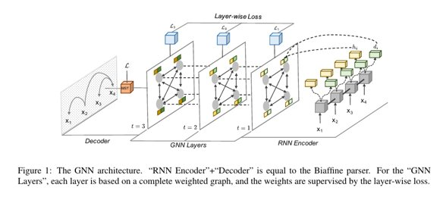
Overview

Slide 11
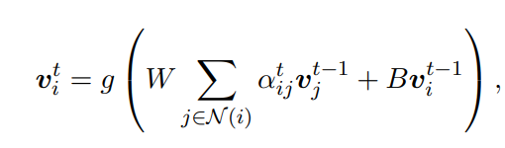
Graph Attention Network
Graph Attention Network used for high order features.
Parallelizable.
All neighboring node are not created equal.
Generalize to unseen graphs.
Aggregation strategy
Figure: Undirected Graph¹

Slide 12
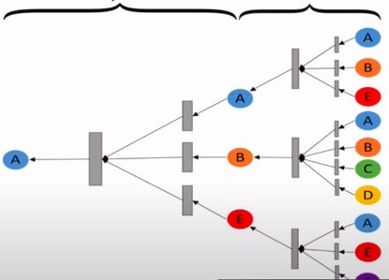
Graph Attention Network
Naturally encodes some high order features.
Figure: Description of a node calculation by layers ¹

Slide 13

Basic Node Representation
Bi-directional LSTM used
Good for encoding surface level information.
xi = (random embedding + glove embedding) ⊕ trainable POS embedding
Concat hidden states to make a word embedding
Obtain score for edges.

Slide 14


Basic Node Representation
Word plays different role when it is head or dependent.
Two embeddings for each node.
Use Multi-layer perctron to encode two roles.
Edge score changes to

Slide 15
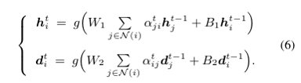
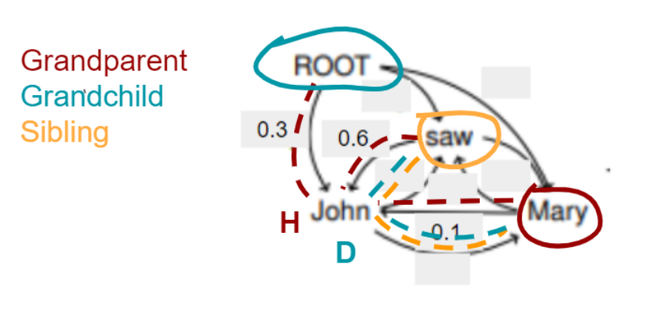
High Order Features
Grandparent and grandchild features
Grandparent: Mary gets its grandparent feature from head representation John(obtained using the aggregation step during node update)
Grandchild: Root gets its grandchild features from dependent representation of John as it already incorporate candidate children node representations.

Slide 16
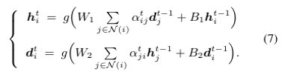
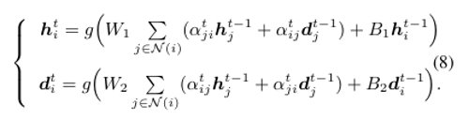
High Order Features
Siblings: Saw gets its sibling features from head representation of John( obtained using the aggregation step during update)
Combined:

Slide 17
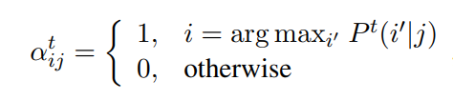

Graph Weights
A node only looks at the head node with the highest probability.
Consider top-k head nodes
Include more neighbourhood information.

Slide 18



Loss
Relation and score loss
Layer Loss
Total loss

Slide 19
Overview

Slide 20
EXPERIMENT AND RESULTS

Slide 21
Experiment Setup
Data:
English Penn Treebank (PTB 3.0)
five punctuation symbols (“ ” : , .) are excluded
12 languages from Universal Dependencies (UD 2.2)
Metrics: Unlabeled (UAS) and labeled attachment scores (LAS)

Slide 22
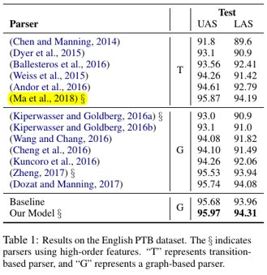





Results
Our Model:
GAN , High order features added
Baseline(Biaffine):
UAS ↑ 0.29 , LAS ↑ 0.35
Ma et al. 2018:
UAS ↑ 0.1 , LAS ↑ 0.12
Zheng et. al.(2017)
UAS ↑ 0.44 , LAS ↑ 0.37

Slide 23
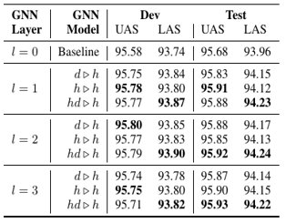
Results
d ▷h : sibling
h ▷h : grandparent, grandchild
hd ▷h : sibling, grandparent, grandchild
hd ▷h has better LAS.
UAS is not sensitive to aggregation.

Slide 24
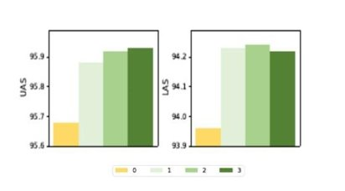
Results
Performance increases until second layer.
Layer-wise loss: L3 < L2 < L1
Adding one layer reduces the prediction time by 2.1%

Slide 25
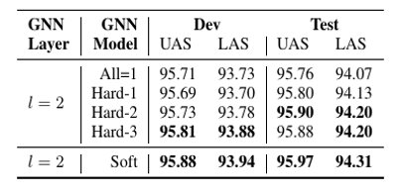
Results
All = 1: Unweighted. Similar to sentence embedding.
Hard-K: Consider top-k weights of node
K = 1: Greedy
K = sentence length: soft
Score improve as k increases.

Slide 26
ERROR ANALYSIS

Slide 27
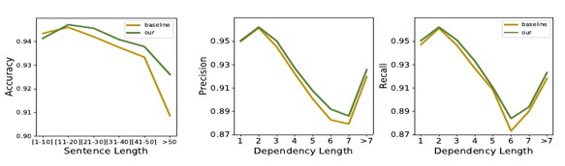
Error Analysis
Gains come from the difficult cases.
Sentence Length: Better performance for large sentences.
Dependency length: Better precison and recall.
Notes:
Precision is equal to the percentage of dependency arcs in the predicted graph that are at a distance of d and are correct.
Recall is the percentage of dependency arcs in the gold standard graph that are at a distance of d and were predicted.
https://www.aclweb.org/anthology/J11-1007.pdf

Slide 28
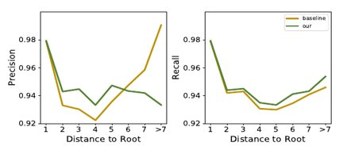
Error Analysis
Root distance:
Better recall, precision decreases as distance increases
Notes:
Overpredicting more arcs may lead to high recall but low precision.

Slide 29
CONCLUSION

Slide 30
Better Node Representation leads to better results.
Graph Attention Network
Naturally incorporate some high order features
Performance increases until second layer.
High order features improve results by adding more structural information.
Improvement in difficult cases.

Slide 31
Thanks for listening.

Slide 32
References
Ji et al. (2019) Graph-based Dependency Parsing with Graph Neural Networks
Veličković et al. (2018) Graph Attention Networks.

