Slide 1

Digital Image Processing
Dr. Mubashir Ahmad (Ph.D.)

Slide 2

The review of vectors and matrices
To provide background material in support of topics in Digital Image Processing that are based on matrices and/or vectors.

Slide 3
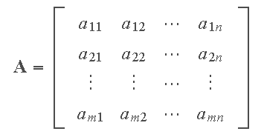
The review of vectors and matrices
An m×n (read "m by n") matrix, denoted by A, is a rectangular array of entries or elements (numbers, or symbols representing numbers) enclosed typically by square brackets, where m is the number of rows and n the number of columns.

Slide 4
The review of vectors and matrices
A is square if m= n.
A is diagonal if all off-diagonal elements are 0, and not all diagonal elements are 0.
A is the identity matrix ( I ) if it is diagonal and all diagonal elements are 1.
A is the zero or null matrix ( 0 ) if all its elements are 0.
The trace of A equals the sum of the elements along its main diagonal.
Two matrices A and B are equal iff the have the same number of rows and columns, and a_{ij} = b_{ij} .

Slide 5
The review of vectors and matrices
The transpose A^{T} of an m×n matrix A is an n×m matrix obtained by interchanging the rows and columns of A.
A square matrix for which A^{T}=A is said to be symmetric.
Any matrix X for which XA=I and AX=I is called the inverse of A.
Let c be a real or complex number (called a scalar). The scalar multiple of c and matrix A, denoted cA, is obtained by multiplying every elements of A by c. If c = −1, the scalar multiple is called the negative of A.

Slide 6


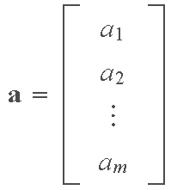
The review of vectors and matrices
A column vector is an m × 1 matrix:
A row vector is a 1 × n matrix:
A column vector can be expressed as a row vector by using
the transpose:

Slide 7

The review of vectors and matrices
The sum of two matrices A and B (of equal dimension), denoted A + B, is the matrix with elements a_{ij} + b_{ij}.
The difference of two matrices, A− B, has elements a_{ij} − b_{ij}.
The product, AB, of m×n matrix A and p×q matrix B, is an m×q matrix C whose (i,j)-th element is formed by multiplying the entries across the ith row of A times the entries down the jth column of B; that is,

Slide 8
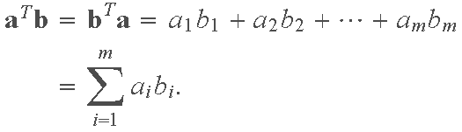
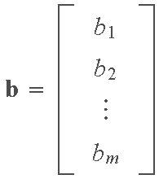
The review of vectors and matrices
The inner product (also called dot product) of two vectors
is defined as
Note that the inner product is a scalar

Slide 9
The review of vectors and matrices
A vector space is defined as a nonempty set V of entities called vectors and associated scalars that satisfy the conditions outlined in A through C below. A vector space is real if the scalars are real numbers; it is complex if the scalars are complex numbers.
Condition A: There is in V an operation called vector addition, denoted x + y, that satisfies:
1. x + y = y + x for all vectors x and y in the space.
2. x + (y + z) = (x + y) + z for all x, y, and z.
3. There exists in V a unique vector, called the zero vector, and denoted 0, such that x + 0 = x and 0 + x = x for all vectors x.
4. For each vector x in V, there is a unique vector in V, called the negation of x, and denoted −x, such that x + (− x) = 0 and (− x) + x = 0.

Slide 10
The review of vectors and matrices
Condition B: There is in V an operation called multiplication by a scalar that associates with each scalar c and each vector x in V a unique vector called the product of c and x, denoted by cx and xc, and which satisfies:
1. c(dx) = (cd)x for all scalars c and d, and all vectors x.
2. (c + d)x = cx + dx for all scalars c and d, and all vectors x.
3. c(x + y) = cx + cy for all scalars c and all vectors x and y.
Condition C: 1x = x for all vectors x.

Slide 11
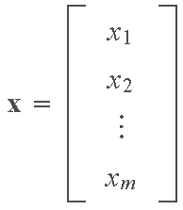
The review of vectors and matrices
We are interested particularly in real vector spaces of real m×1 column matrices. We denote such spaces by ℜ^{m} , with vector addition and multiplication by scalars being as defined earlier for matrices. Vectors (column matrices) in ℜ^{m} are written as

Slide 12
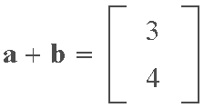
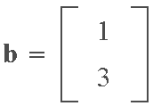
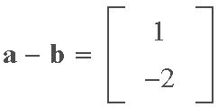
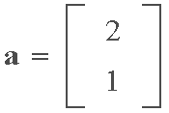
The review of vectors and matrices
Example
The vector space with which we are most familiar is the two-dimensional real vector space ℜ² , in which we make frequent use of graphical representations for operations such as vector addition, subtraction, and multiplication by a scalar. For instance, consider the two vectors
Using the rules of matrix addition and subtraction we have

Slide 13
The review of vectors and matrices
Consider two real vector spaces V₀ and V such that:
Each element of V₀ is also an element of V (i.e., V₀ is a subset of V).
Operations on elements of V₀ are the same as on elements of V. Under these conditions, V₀ is said to be a subspace of V.
A linear combination of v₁,v₂,…,v_{n} is an expression of the form
where the α’s are scalars

Slide 14
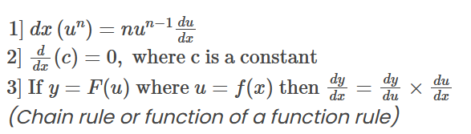
The review of derivatives

Slide 15
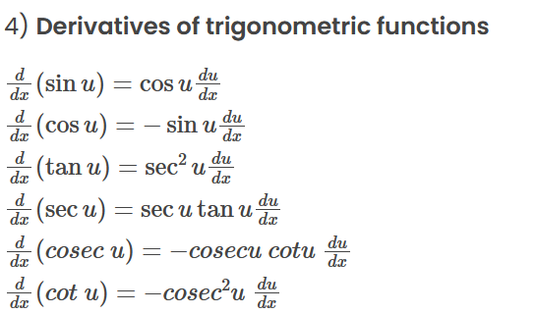
The review of derivatives

Slide 16
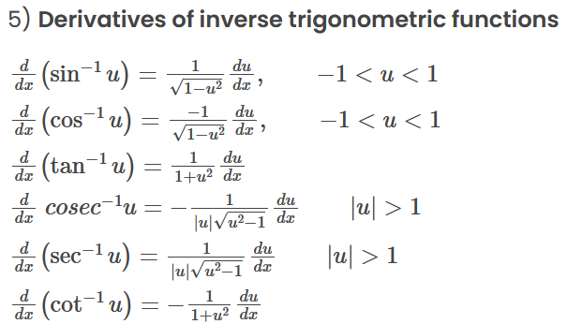
The review of derivatives

Slide 17
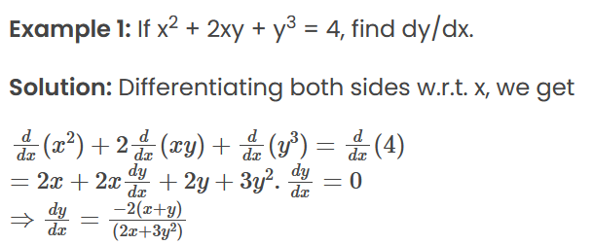
The review of derivatives

Slide 18
The review of derivatives

Slide 19
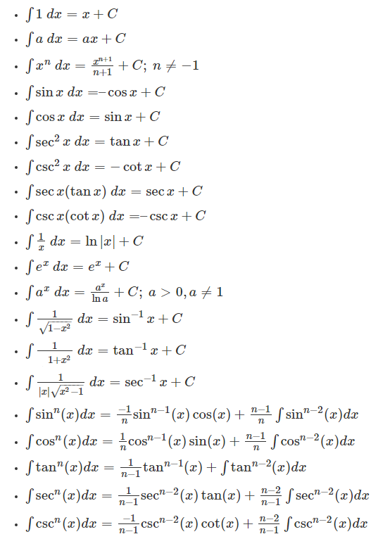
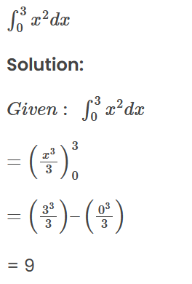

The review of integrals

Slide 20
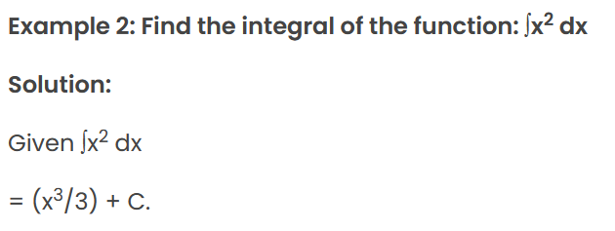
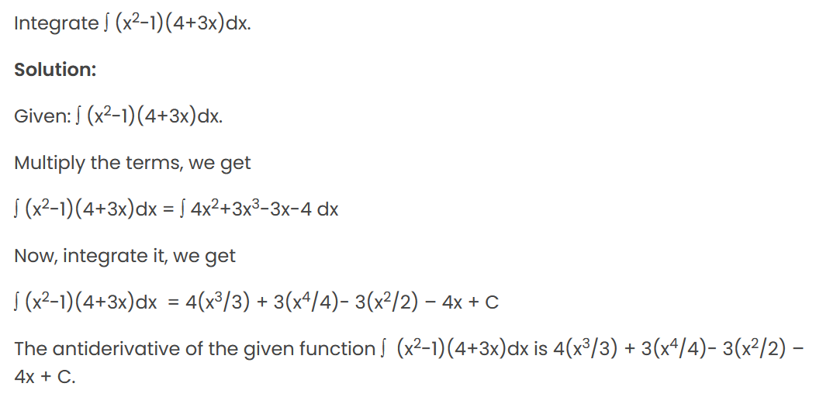
The review of integrals

