Slide 1

Digital Image Processing
Dr. Mubashir Ahmad (Ph.D.)

Slide 2
Contents
In this lecture we will look at image enhancement in the frequency domain
Jean Baptiste Joseph Fourier
The Fourier series & the Fourier transform
Image Processing in the frequency domain
Image smoothing
Image sharpening
Fast Fourier Transform

Slide 3
Image enhancement using frequency domain
Spatial and frequency-domain linear filters are classified into four broad categories: lowpass and high pass filters, and bandpass and band reject filters, which we introduce in this section.

Slide 4
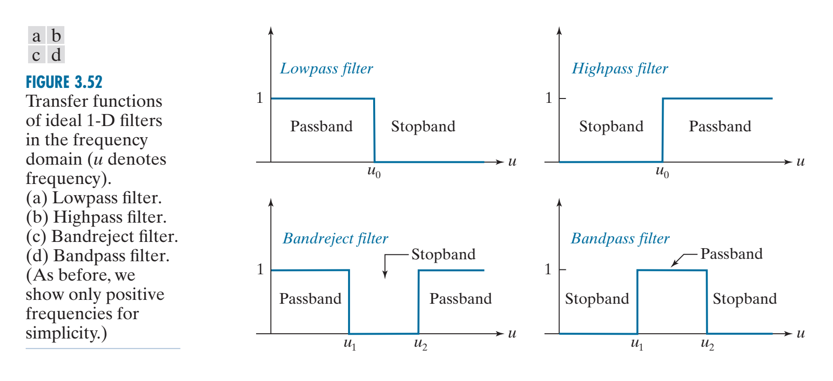
Image enhancement using frequency domain

Slide 5
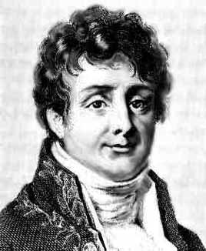
Jean Baptiste Joseph Fourier
Fourier was born in Auxerre,
France in 1768
Most famous for his work “La Théorie Analitique de la Chaleur” published in 1822
Translated into English in 1878: “The Analytic Theory of Heat”
Nobody paid much attention when the work was first published
One of the most important mathematical theories in modern engineering

Slide 6
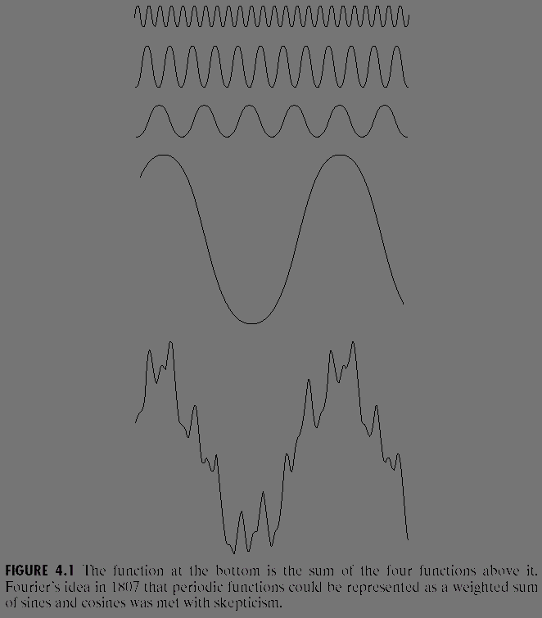
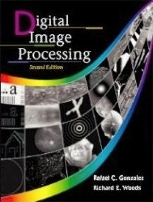
The Big Idea
=
Images taken from Gonzalez & Woods, Digital Image Processing (2002)
Any function that periodically repeats itself can be expressed as a sum of sines and cosines of different frequencies each multiplied by a different coefficient – a Fourier series

Slide 7
The Big Idea (cont…)
Taken from www.tfh-berlin.de/~schwenk/hobby/fourier/Welcome.html
Notice how we get closer and closer to the original function as we add more and more frequencies

Slide 8
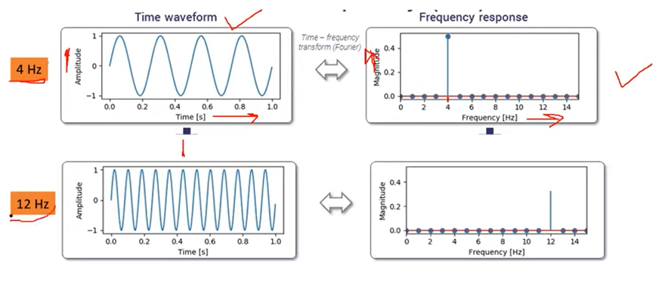

Slide 9
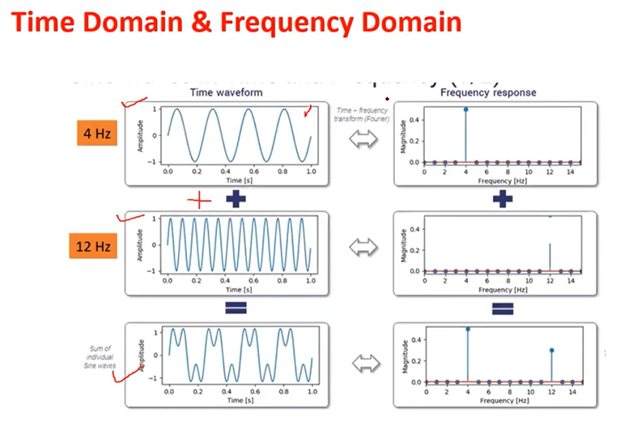

Slide 10
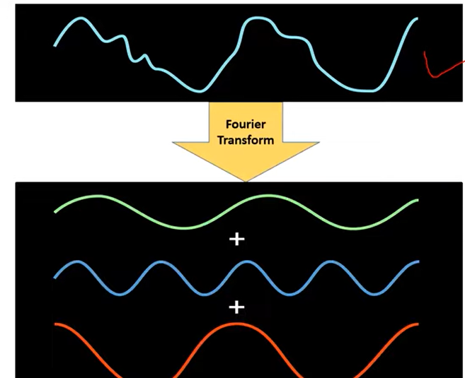
If we don’t know which combination of frequencies.

Slide 11
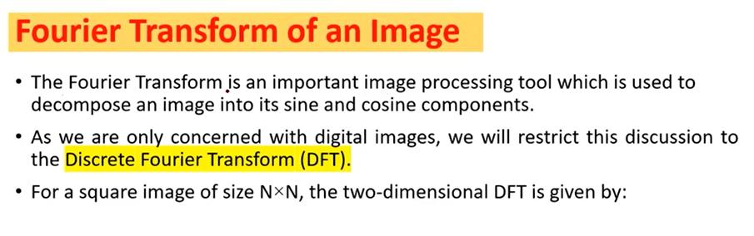

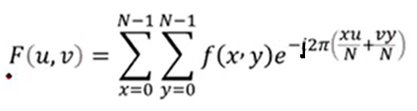


Slide 12
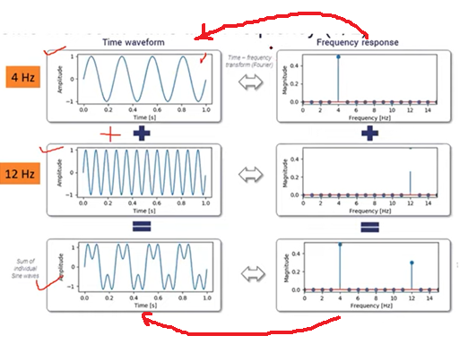


Inverse Fourier transform to get original image or signal

Slide 13
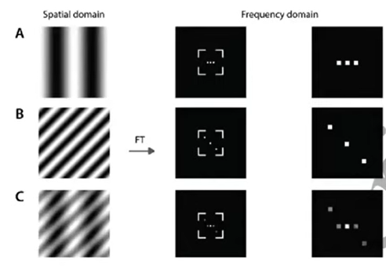
The Discrete Fourier Transform (DFT)
Shows variations in X and Y axis

Slide 14
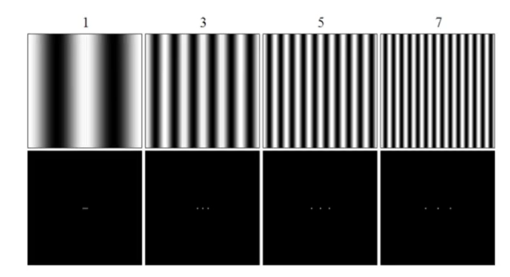
The Discrete Fourier Transform (DFT)

Slide 15
Compute 2D DFT Problem?
F(x, y) is the original image.
F(u, v) is the Fourier transform.
F(u, v) = [kernel] * [f(x, y)] * Transpose([kernel])
The above formula will calculate the 2D Fourier transform of an image.
We will use the following formula to calculate the kernel.
If we need 4*4 kernel then.
Wn = e^{-j2π/n}
^{So Wn = Cos(θ) – j*Sin(θ)}

Slide 16
Question?
Calculate the DFT of the following 1D matrix
X(n) = 1
0
0
1

Slide 17
4*4 kernel sketch
Wn = e^{-j2π/n}
^{So} W4 = e^{-j2π/4}
 | 0 | 1 | 2 | 3
0 | W₄⁰ | W₄⁰ | W₄⁰ | W₄⁰
1 | W₄⁰ | W₄¹ | W₄² | W₄³
2 | W₄⁰ | W₄² | W₄⁴ | W₄⁶
3 | W₄⁰ | W₄³ | W₄⁶ | W₄⁹

Slide 18
Calculate the elements by formula
W₄⁰ | e^{-j2π/4 *0} | 1 | 1
W₄¹ | e^{-j2π/4 *1} | ^{(Cos(2π/4) – j*Sin(2π/4)*1 )} | -j
W₄² | e^{-j2π/4 *2} | ^{(Cos(π) – j*Sin(π) )} | -1
W₄³ | e^{-j2π/4 *3} | ^{(Cos(3π/2) – j*Sin(3π/2) )} | +j
W₄⁴ | e^{-j2π/4 *4} | ^{(Cos(2π) – j*Sin(2π) )} | 1
W₄⁶ | e^{-j2π/4 *6} | ^{(Cos(3π) – j*Sin(3π) )} | -1
W₄⁹ | e^{-j2π/4 *9} | ^{(Cos(9π/2) – j*Sin(9π/2) )} | -j

Slide 19
Substituting the values
 | 0 | 1 | 2 | 3
0 | 1 | 1 | 1 | 1
1 | 1 | -j | -1 | j
2 | 1 | -1 | 1 | -1
3 | 1 | j | -1 | -j

Slide 20
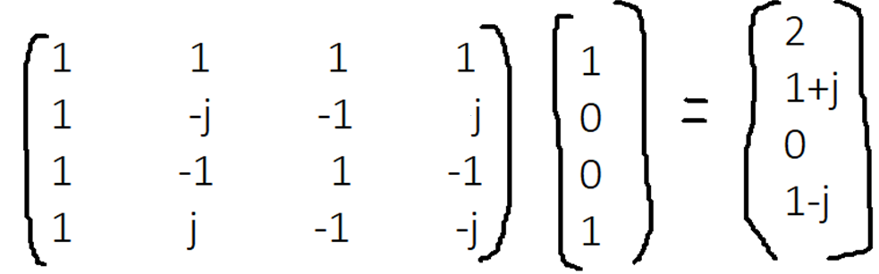
Final f(x, y) is converted to DFT

Slide 21
Inverse Fourier Transform
It is really important to note that the Fourier transform is completely reversible. The inverse DFT is given by:
Wn* = e^{j2π/n}
^{Wn* = Cos(θ) + j*Sin(θ)}

Slide 22
4*4 kernel sketch
Wn = e^{j2π/n}
^{So} W4 = e^{j2π/4}
 | 0 | 1 | 2 | 3
0 | W*₄⁰ | W*₄⁰ | W*₄⁰ | W*₄⁰
1 | W*₄⁰ | W*₄¹ | W*₄² | W*₄³
2 | W*₄⁰ | W*₄² | W*₄⁴ | W*₄⁶
3 | W*₄⁰ | W*₄³ | W*₄⁶ | W*₄⁹

Slide 23
Calculate the elements by formula
W*₄⁰ | e^{j2π/4 *0} | 1 | 1
W*₄¹ | e^{j2π/4 *1} | ^{(Cos(2π/4) + j*Sin(2π/4)*1 )} | j
W*₄² | e^{j2π/4 *2} | ^{(Cos(π) + j*Sin(π) )} | -1
W*₄³ | e^{j2π/4 *3} | ^{(Cos(3π/2) + j*Sin(3π/2) )} | -j
W*₄⁴ | e^{j2π/4 *4} | ^{(Cos(2π) + j*Sin(2π) )} | 1
W*₄⁶ | e^{j2π/4 *6} | ^{(Cos(3π) + j*Sin(3π) )} | -1
W*₄⁹ | e^{j2π/4 *9} | ^{(Cos(9π/2) + j*Sin(9π/2) )} | j

Slide 24
Substituting the values
 | 0 | 1 | 2 | 3
0 | 1 | 1 | 1 | 1
1 | 1 | j | -1 | -j
2 | 1 | -1 | 1 | -1
3 | 1 | -j | -1 | j

Slide 25
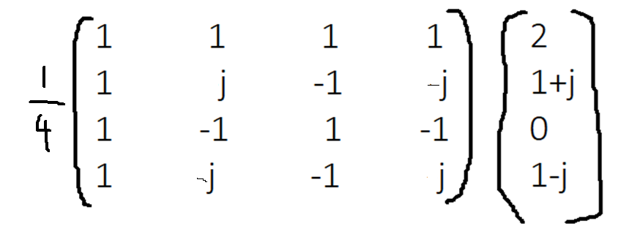
Inverse Fourier Transform
Apply inverse Fourier transform on [2, 1+j, 0, 1-j]
Xn = 1/n × Wn* × Xn, where n = 4, Wn = 4 ×4 matrix, Xn = 4 ×1 matrix.

Slide 26
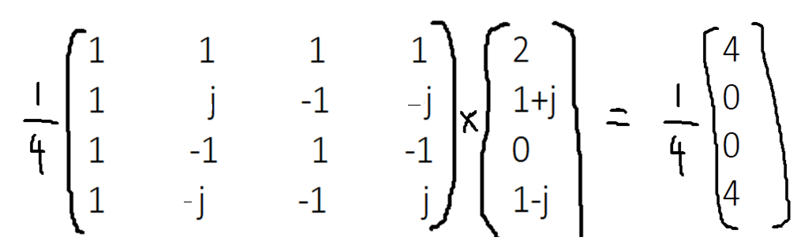
Inverse Fourier Transform

Slide 27
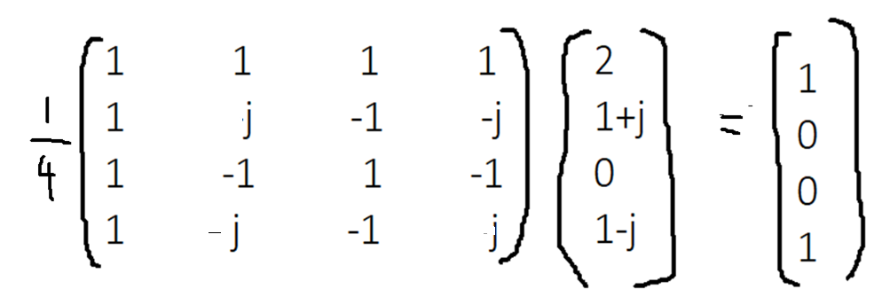
Inverse Fourier Transform
So we can say that Inverse Fourier transform = f(x, y)

