Slide 1

Digital Image Processing
Dr. Mubashir Ahmad (Ph.D.)

Slide 2
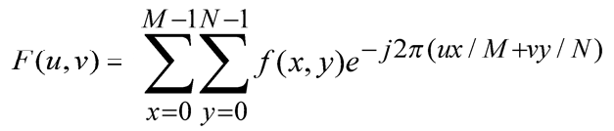
The Discrete Fourier Transform (DFT)
The Discrete Fourier Transform of f(x, y), for x = 0, 1, 2…M-1 and y = 0,1,2…N-1, denoted by F(u, v), is given by the equation:
f(x,y)(-1)^^{x+y} (to centre the transform)
for u = 0, 1, 2…M-1 and v = 0, 1, 2…N-1.

Slide 3
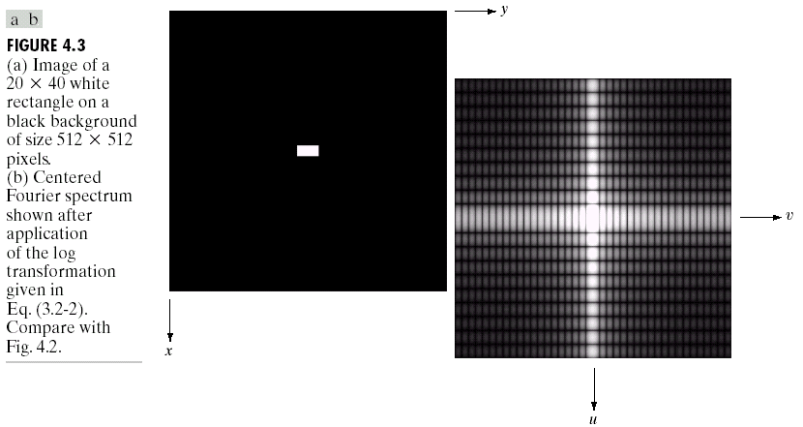
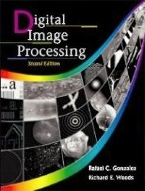
DFT & Images
The DFT of a two dimensional image can be visualised by showing the spectrum of the images component frequencies
DFT
Images taken from Gonzalez & Woods, Digital Image Processing (2002)

Slide 4
DFT & Images
Images taken from Gonzalez & Woods, Digital Image Processing (2002)

Slide 5
DFT & Images
Images taken from Gonzalez & Woods, Digital Image Processing (2002)

Slide 6
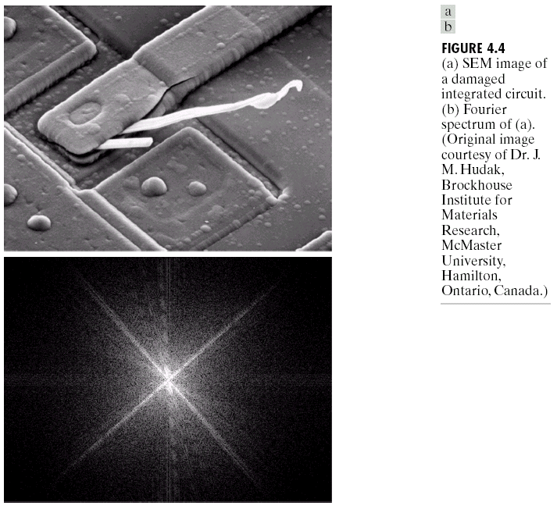
DFT & Images (cont…)
DFT
Images taken from Gonzalez & Woods, Digital Image Processing (2002)
Scanning electron microscope image of an integrated circuit magnified
Fourier spectrum of the image

Slide 7
DFT & Images (cont…)
Images taken from Gonzalez & Woods, Digital Image Processing (2002)

Slide 8
DFT & Images (cont…)
Images taken from Gonzalez & Woods, Digital Image Processing (2002)

Slide 9
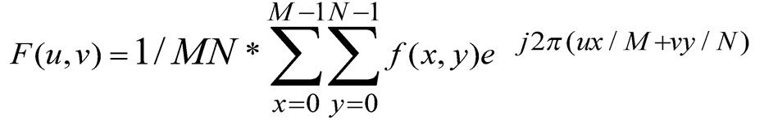
The Inverse DFT
It is really important to note that the Fourier transform is completely reversible
The inverse DFT is given by:
for x = 0, 1, 2…M-1 and y = 0, 1, 2…N-1

Slide 10
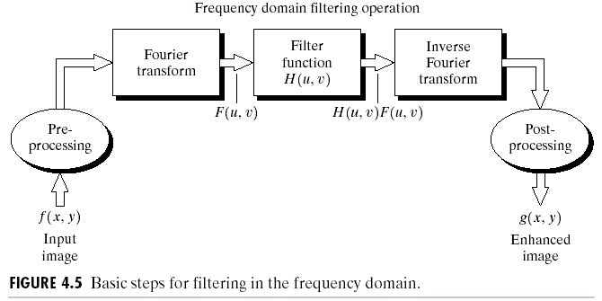
The DFT and Image Processing
To filter an image in the frequency domain:
Compute F(u,v) the DFT of the image
Multiply F(u,v) by a filter function H(u,v)
Compute the inverse DFT of the result
Images taken from Gonzalez & Woods, Digital Image Processing (2002)

Slide 11
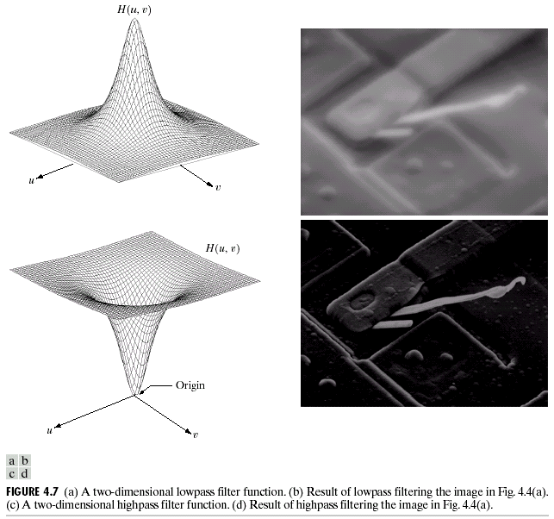
Some Basic Frequency Domain Filters
Low Pass Filter
Images taken from Gonzalez & Woods, Digital Image Processing (2002)
High Pass Filter

Slide 12
Some Basic Frequency Domain Filters (Response of Low Pass filtering of an image)
Images taken from Gonzalez & Woods, Digital Image Processing (2002)

Slide 13
Some Basic Frequency Domain Filters (Response of High Pass filtering of an image)
Images taken from Gonzalez & Woods, Digital Image Processing (2002)

Slide 14
Smoothing Frequency Domain Filters
Smoothing is achieved in the frequency domain by dropping out the high frequency components
The basic model for filtering is:
G(u,v) = H(u,v)F(u,v)
where F(u,v) is the Fourier transform of the image being filtered and H(u,v) is the filter transfer function
Low pass filters – only pass the low frequencies, drop the high frequencies which result in noise reduction due to blurring/smoothing of the image

Slide 15
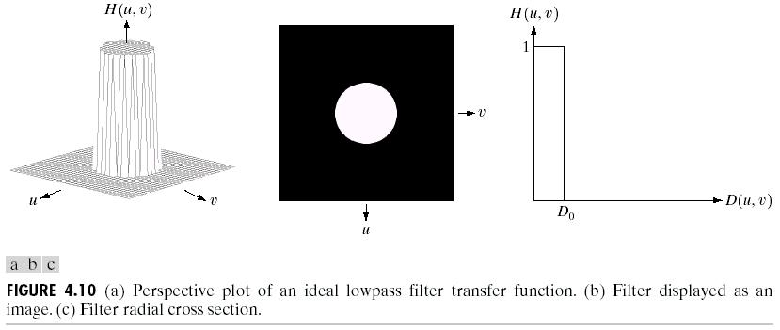
Ideal Low Pass Filter
Simply cut off all high frequency components that are at specified distance D₀ from the origin of the transform.
changing the distance changes the behaviour of the filter
Images taken from Gonzalez & Woods, Digital Image Processing (2002)

Slide 16
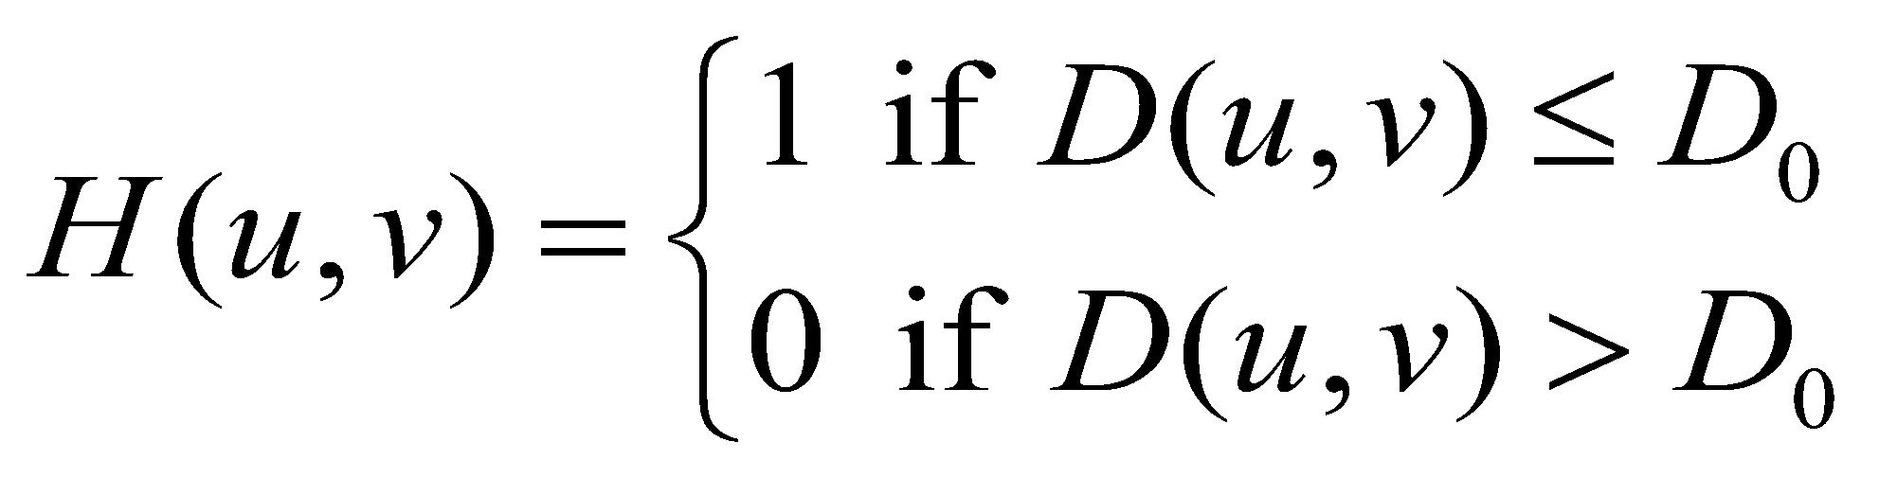
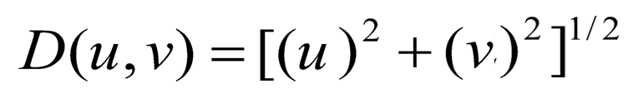

Ideal Low Pass Filter (cont…)
The transfer function for the ideal low pass filter can be given as:
where D(u , v) is given as:

Slide 17
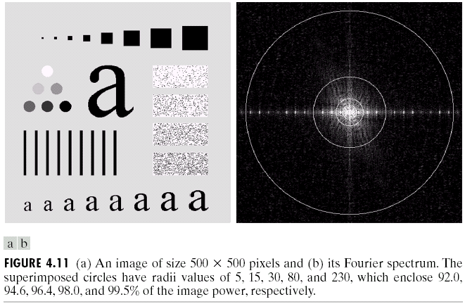
Ideal Low Pass Filter (cont…)
Images taken from Gonzalez & Woods, Digital Image Processing (2002)
Above we show an image, it’s Fourier spectrum and a series of ideal low pass filters of radius 5, 15, 30, 80 and 230 superimposed on top of it

Slide 18
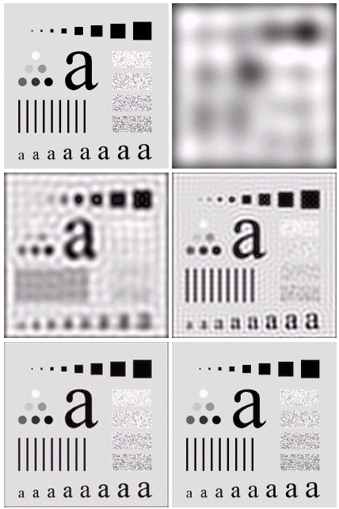
Ideal Low Pass Filter (cont…)
Result of filtering with ideal low pass filter of radius 5
Original image
Result of filtering with ideal low pass filter of radius 15
Result of filtering with ideal low pass filter of radius 30
Images taken from Gonzalez & Woods, Digital Image Processing (2002)
Result of filtering with ideal low pass filter of radius 80
Result of filtering with ideal low pass filter of radius 230

Slide 19
Ideal Low Pass Filter (cont…)
Result of filtering with ideal low pass filter of radius 5
Images taken from Gonzalez & Woods, Digital Image Processing (2002)

Slide 20
Ideal Low Pass Filter (cont…)
Result of filtering with ideal low pass filter of radius 15
Images taken from Gonzalez & Woods, Digital Image Processing (2002)

Slide 21
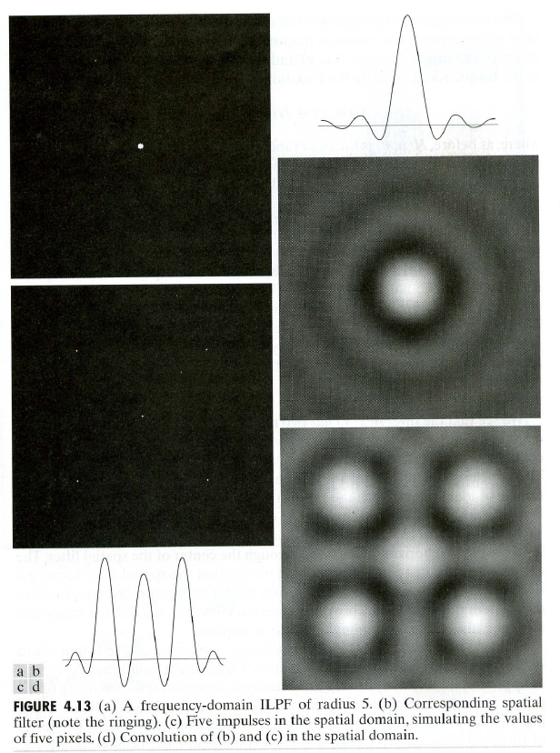

Slide 22
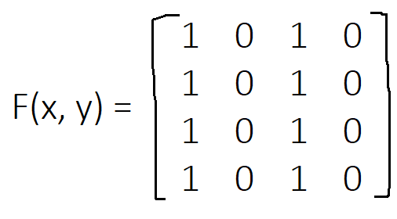
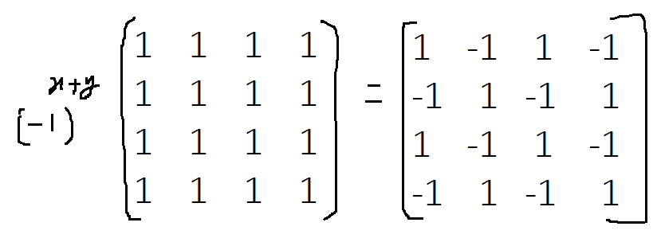
Calculate the spatial domain to the frequency domain to perform Ideal Low pass filter, Where cutoff frequency = 0.5
Input image f(x, y) in a spatial domain.
Multiply the input image with (-1)^x+y to move the transform in the center.

Slide 23
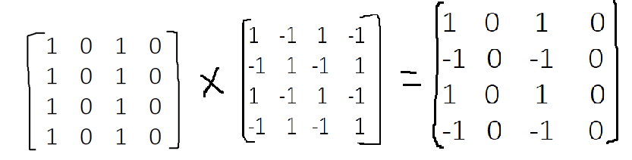
Ideal Low pass filter
After the transform center arrangement we got the results as follows.

Slide 24
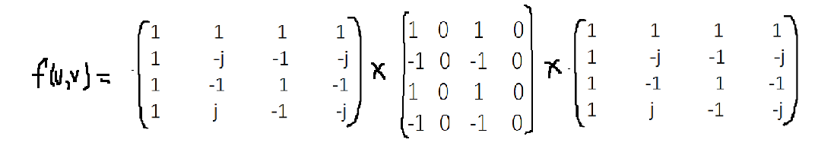
Ideal Low pass filter: Compute the DFT of the image
Compute the DFT of the image.
F(u, v) = kernel * f(x, y) * kernel ^Transpose

Slide 25
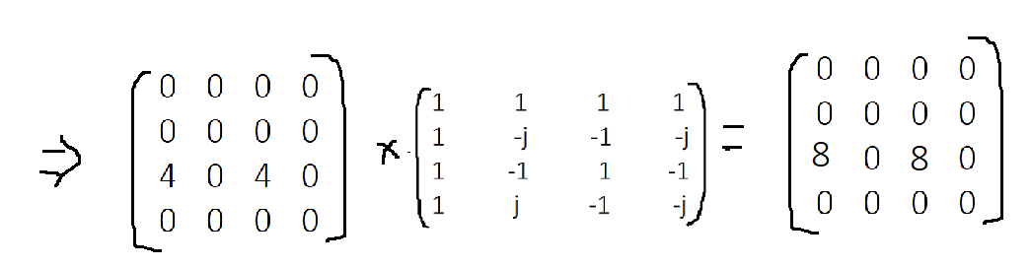
Ideal Low pass filter: Compute the DFT of the image

Slide 26
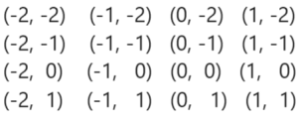



Distance measure
-2 -1 0 1
-2 -1 0 1
-2 -1 0 1
-2 -1 0 1
-2 -2 -2 -2
-1 -1 -1 -1
0 0 0 0
1 1 1 1

Slide 27
Ideal Low pass filter:
Now compute the distances
D(u, v) = sqrt(u.^2 + v.^2)
D(-2, -2) = (– 2)^2 + (– 2)^2 = (8) ^1/2 = 2.82
D(-2, -2) = (-1)^2 + (–2)^2 = (5) ^1/2 = 2.23
D(0, 2) = (0)^2 + (– 2)^2 = (4) ^1/2 = 2
D(1, -2) = (1)^2 + (– 2)^2 = 2.23
D(-2, -1) = (– 2)^2 + (– 1)^2 = 1.14
D(-1, -1) = (-1)^2 + (-1)^2 = 2.23

Slide 28
Ideal Low pass filter: Distance measure
D(0, -1) = (0)^2 + (-1)^2 = 1
D(1, -1) = (1)^2 + (-1)^2 = 1.41
D(-2, 0) = (– 2)^2 + (0)^2 = 2
D(-1, 0) = (-1)^2 + (0)^2 = 1
D(0, 0) = (0)^2 + (0)^2 = 0
D(1, 0) = (1)^2 + (0)^2 = 1
D(-2, 1) = (– 2)^2 + (1)^2 = 2.23
D(-1, 1) = (-1)^2 + (1)^2 = 1.41
D(0, 1) = (0)^2 + (1)^2 = 1
D(1, 1) = (1)^2 + (1)^2 = 1.41

Slide 29
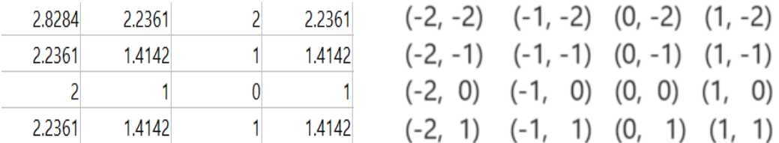


Ideal Low pass filter: Distance measure

Slide 30
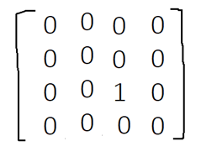
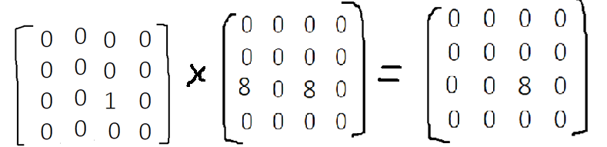
Cut off frequency D0 = 0.5
Distance matrix will be

Slide 31
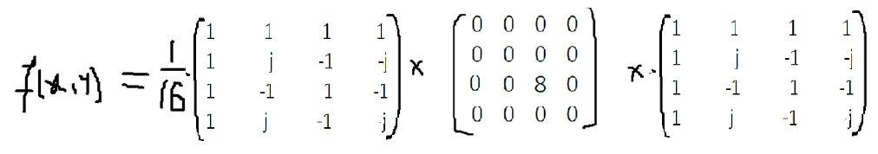
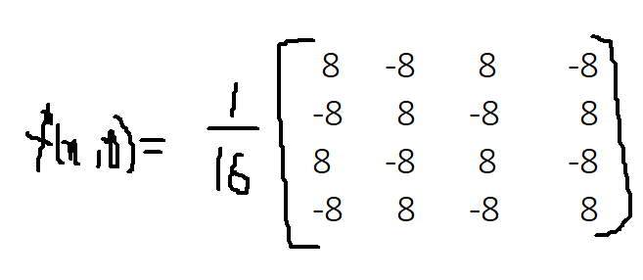
Inverse Fourier transform

