Slide 1
PAWS:
Veterinary
Management
System
Simplifying operations for better pet care

Slide 2
Table of Contents
Introduction
System Overview
01
02
The purpose, objective and problem statement
The scope, features and target audience
Major Usecase
Conclusions
03
04
The flow of events and benefits
A brief summary of the future scope

Slide 3
Objective
To provide an integrated system that simplifies and streamlines the operations of veterinary hospitals.

Slide 4
Why Develop PAWS
Develop a centralized platform for managing hospital operations.
Improve animal care efficiency through better data handling and Ensure data security.
Reduce operational costs and enhance administrative workflows.

Slide 5
Problem Statement
Challenges in Current Veterinary Clinics
Delays in Registration and Appointments: Leading to inefficiencies and frustration for pet owners.
Outdated Systems: Manual workloads result in suboptimal patient care.
Lack of Seamless Integration: Communication gaps between departments affect operations.
Solution: PAWS
A unified platform addressing these issues through automation, secure data management, and enhanced resource utilization.
Focused on improving patient care while reducing manual dependencies.

Slide 6
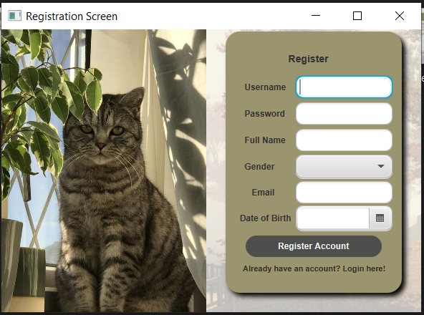
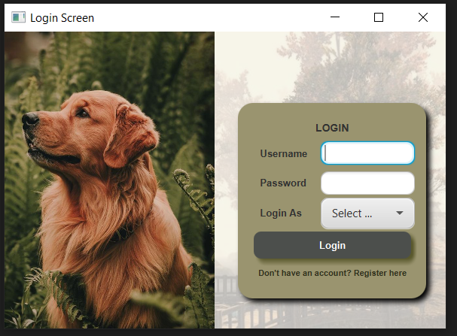
System Overview:
Key Featured Highlights

Slide 7
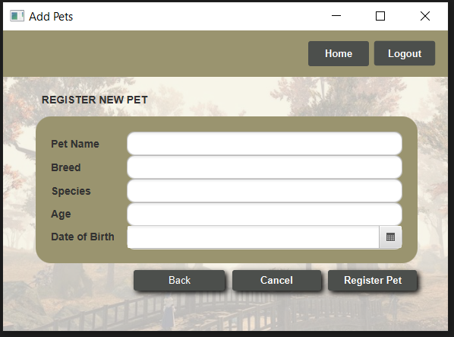
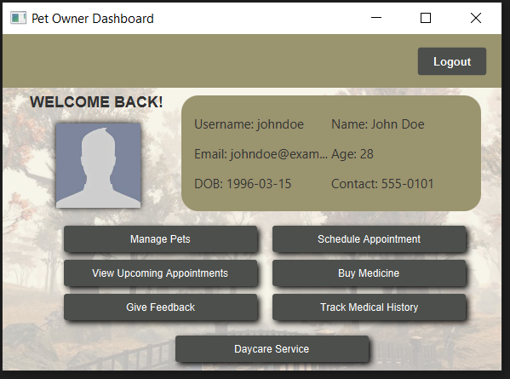
Interface Preview: Pet Owner

Slide 8
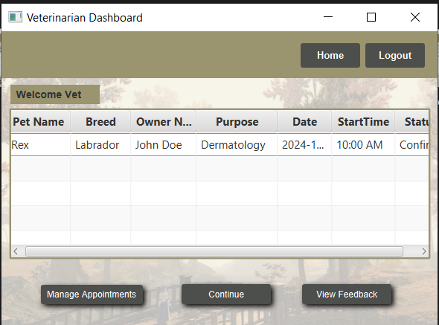
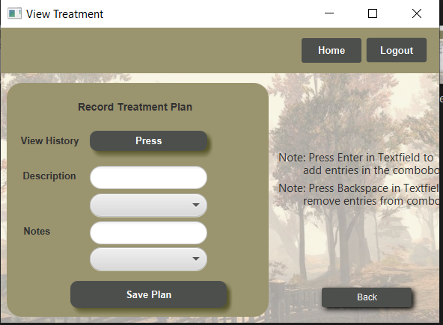
Interface Preview: Veterinarian

Slide 9
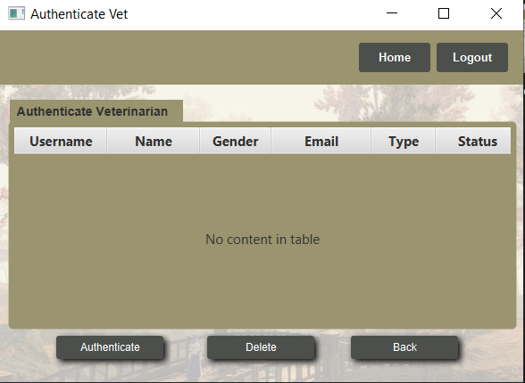
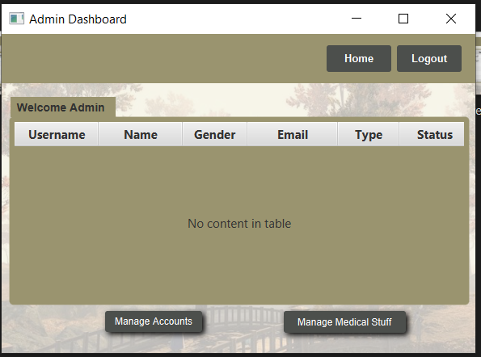
Interface Preview: Admin

Slide 10
Major
Use Case:
Manage Pet
This use case allows the Pet Owner and Veterinarian to manage the pet's information, including registration, medical records, and treatment history.

Slide 11
Actors Involved
Pet Owner: Initiates pet registration and manages pet details.
Veterinarian: Updates and views medical records and treatments.
Admin: Oversees all pet records and manages access.

Slide 12
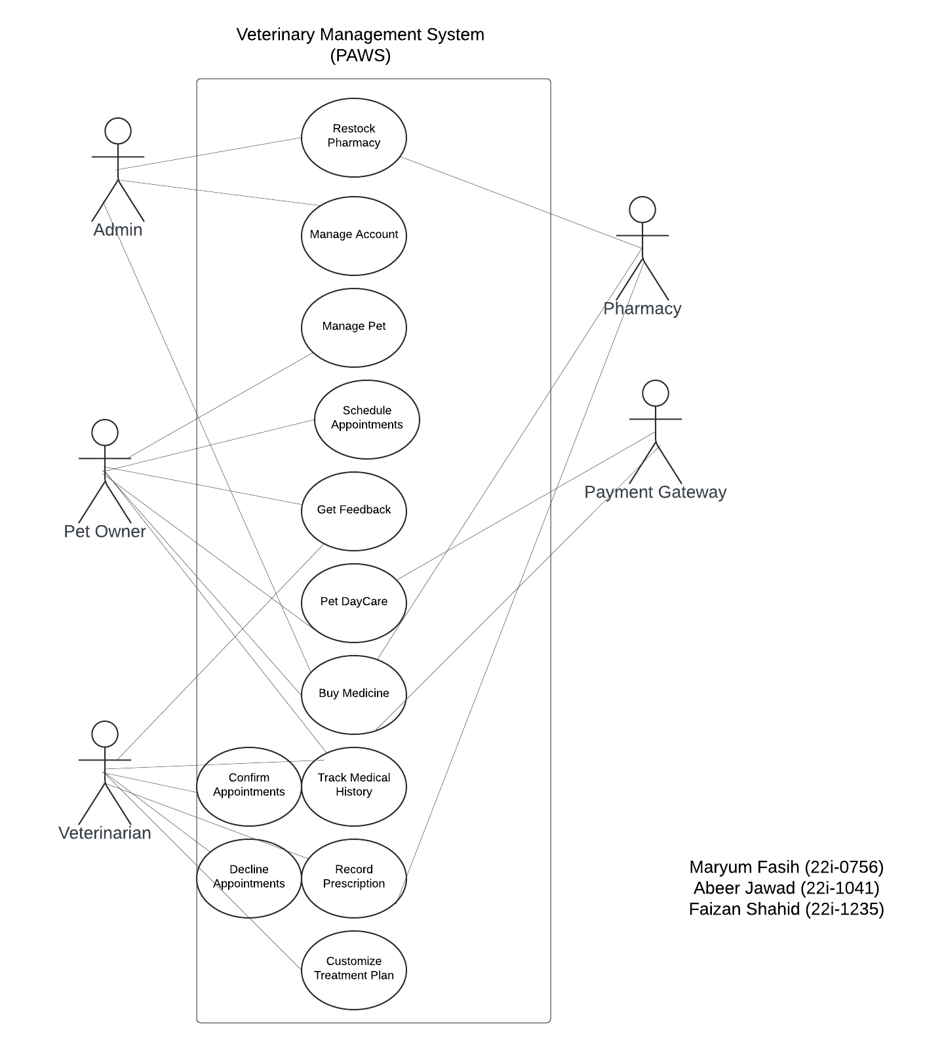
Use Case Diagram

Slide 13
Main Flow
Step 1: Pet Owner registers a new pet with details (name, breed, age, etc.)
Step 2: Veterinarian updates medical history and treatment details
Step 3: Pet Owner views and updates the pet’s profile if needed
Step 4: Veterinarian and Admin monitor pet health records, treatment plans, and appointment schedules

Slide 14
Alternative Flow
Step 1: If the pet owner tries to register an existing pet, the system alerts them.
Step 2: If the veterinarian tries to update an invalid treatment, the system prompts a correction.
PostConditions
-The pet's data (medical and personal) is updated in the system.
-New treatment history and appointments are saved.

Slide 15
Benefits
Streamlines pet management
Centralized data for improved healthcare tracking
Easy access for both owners and medical staff

Slide 16
Conclusion
The PAWS Veterinary Hospital Management System streamlines hospital operations by automating key processes like pet registration, appointments, and treatment history. It improves efficiency, reduces errors, and enhances service delivery, benefiting both staff and pet owners. The system's flexibility allows for future growth and feature additions, ensuring it can adapt to the hospital's evolving needs while providing high-quality care.
Thank you for your attention!

