Slide 1
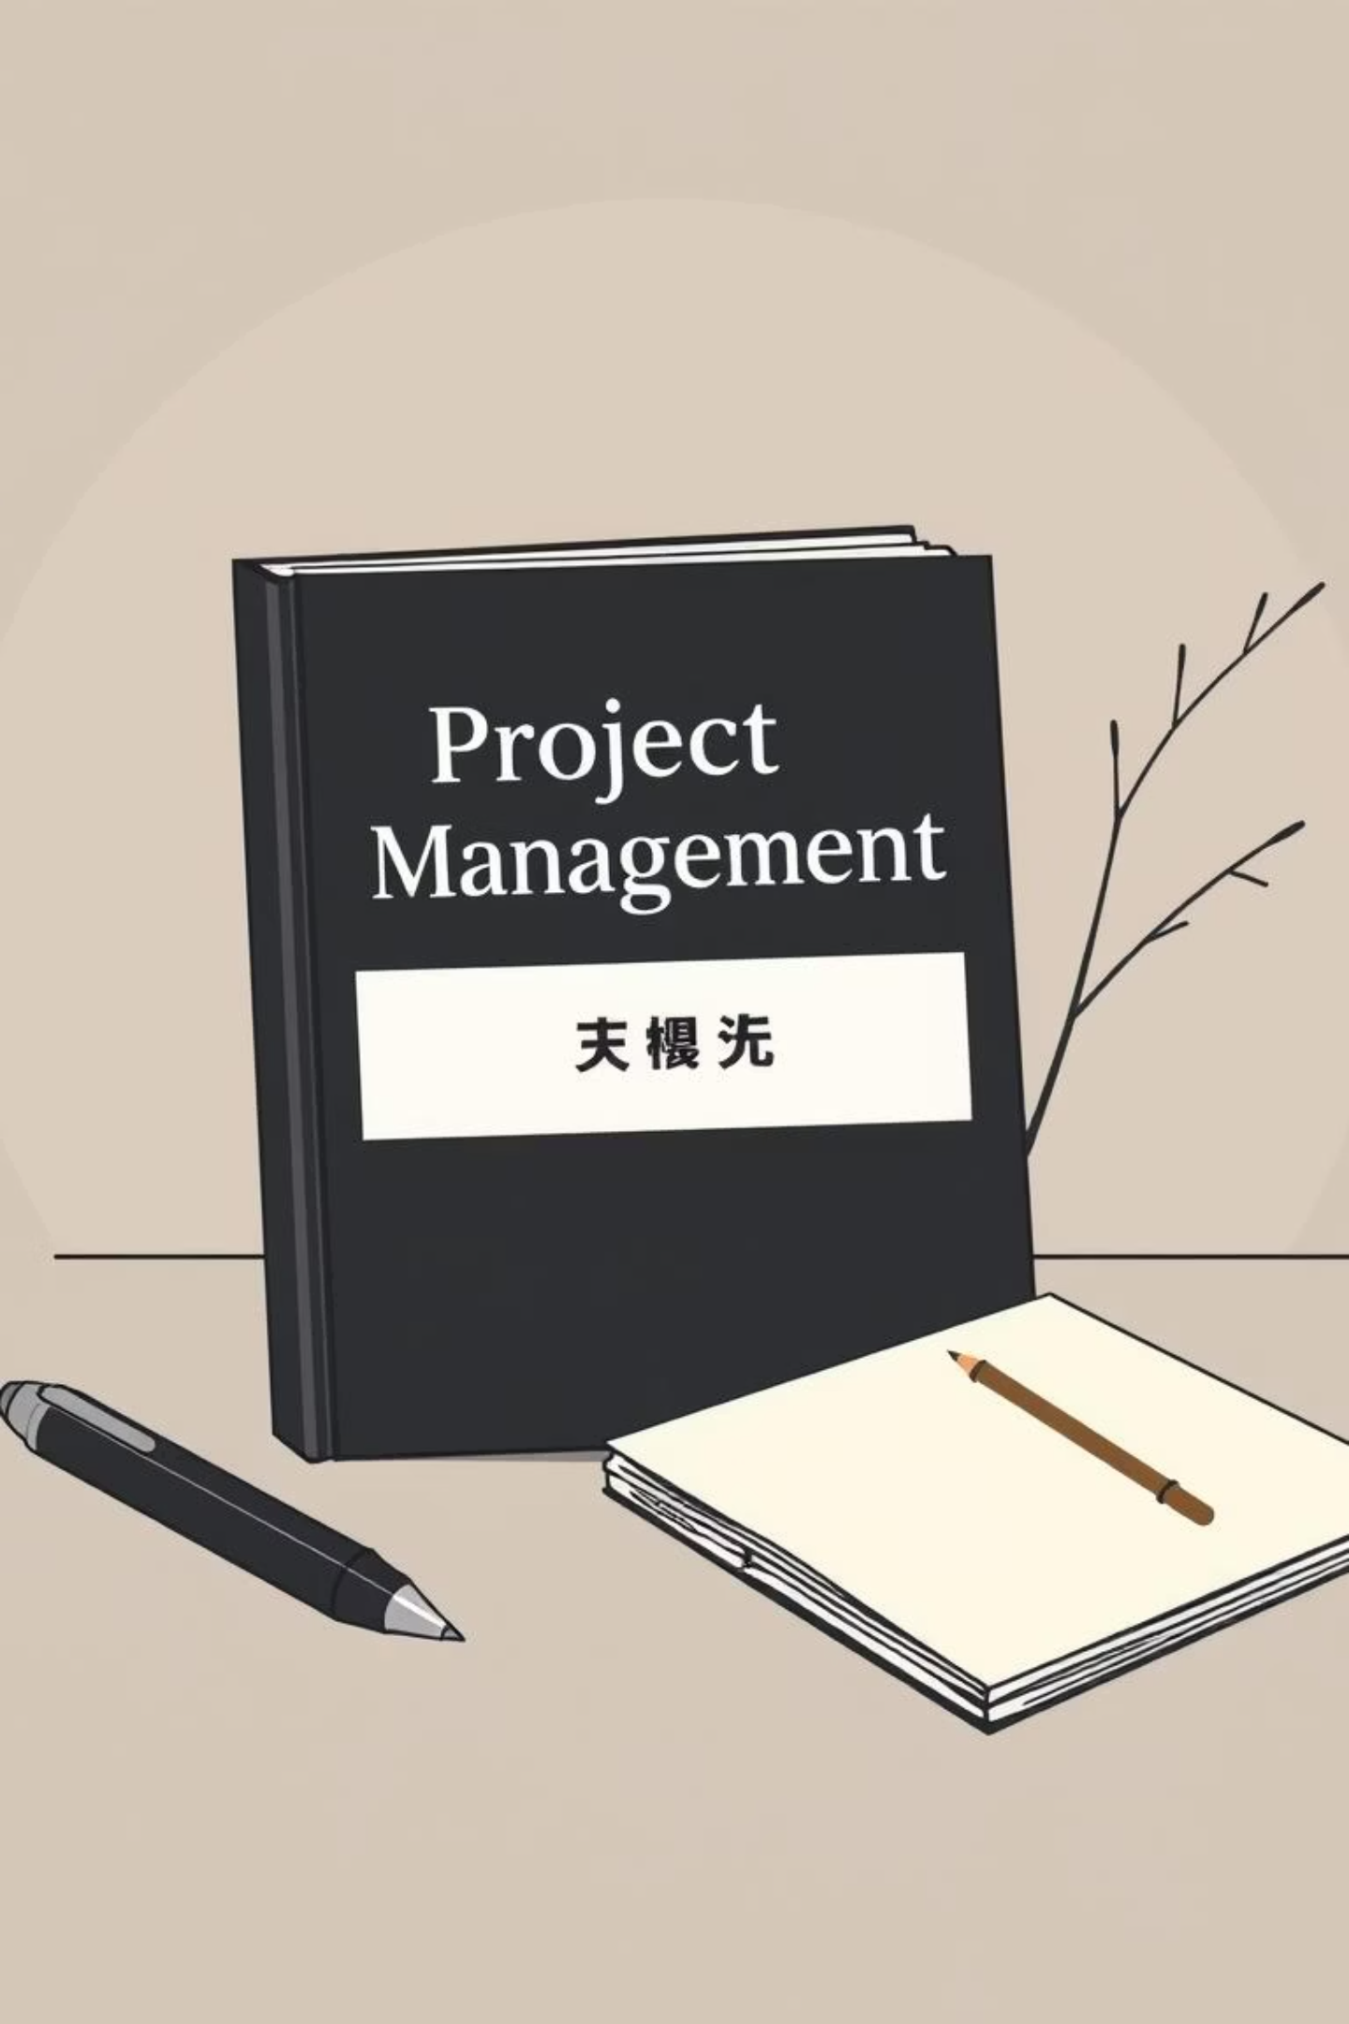
Chapter 5, Section 5.2: Estimating Guidelines for Times, Costs, and Resources
A Framework for Actionable Project Estimation
Based on 'Project Management: The Managerial Process' (8th Ed) by Erik W. Larson. This guide provides essential, practical rules for project managers seeking to improve the accuracy and reliability of their time and cost estimates.

Slide 2

Why Accurate Estimates Matter
Foundation for Control
Risk of Failure
Poor, rushed, or biased estimates are one of the leading causes of project failure, scope creep, and budget overruns.
Accurate estimates are critical for effective planning, scheduling, resource allocation, and project control. Without them, project baselines are meaningless.
Art Meets Science
Estimating combines art and science—balancing empirical data, established methodologies, professional experience, and inherent uncertainty.
Example: NASA’s complex Mars projects rely heavily on historical data (analogous estimating) and expert judgment to develop comprehensive estimates and avoid catastrophic cost overruns.

Slide 3




Guideline 1
Responsibility & Ownership
Estimator Expertise
Field-Level Input
Accountability
Estimates should always be made by the person(s) most familiar with the technical details of the task or work package.
These are typically the first-line supervisors, team leads, or technicians who will execute the work, not high-level managers.
This approach promotes immediate accountability and ownership over the resulting time or cost figures.
Example: A construction site foreman is better equipped to estimate concrete curing time than a general project manager who lacks daily field experience.

Slide 4




Guideline 2
Use of Several People
Diverse Perspectives
Involving multiple subject matter experts (SMEs) leads to more well-rounded and realistic estimates by mitigating individual biases.
Reduce Error
Combining estimates from several sources reduces the chances of extreme errors or wildly inaccurate projections.
Consensus Building
The process of group discussion naturally encourages consensus and ensures all major assumptions are surfaced and validated (the 'wisdom of the crowd').

Slide 5

Guideline 3
Normal Conditions Assumption
Base all estimates on normal, standard working conditions and typical resource availability.
Assume resources will work at a steady, efficient pace, not a rushed or peak performance level.
Do not incorporate cushion or padding into the base estimate; save contingency for later.
Avoid overly optimistic or worst-case scenarios unless explicitly using a three-point (PERT) method.
Example: Estimate software development time assuming a standard team workload and no major unplanned system outages, rather than planning for a holiday rush or a server migration.

Slide 6

Guideline 4
Clear Time Units
Standardize Units
1
Define clear, consistent time units for all tasks (e.g., hours, days, weeks). This eliminates ambiguity across the project.
Work Time
2
Clarify if units refer to actual work time (e.g., 8-hour workdays) or calendar time (including weekends and holidays).
Avoid Confusion
3
A "2-week task" must be clearly defined as either 10 dedicated workdays or 14 calendar days to ensure scheduling accuracy.

Slide 7

Guideline 5
Task Independence
Estimate Individually
Each task or work package should be estimated in isolation, without consideration for other tasks' durations.
Avoid Aggregation Bias
Do not allow task times to be aggregated or adjusted prematurely to fit pre-determined project deadlines.
Preserve Realism
This approach prevents optimistic bias and ensures the resulting project schedule remains as realistic as possible.
The goal is to determine the true effort required for each component before compiling the entire project network.

Slide 8

Guideline 6
No Individual Contingency
Pure Effort
Estimates for specific tasks must reflect only the direct effort required to complete the work, excluding any buffer or "padding."
Centralized Buffer
Management should set aside separate, centralized contingency funds or time buffers to cover expected but unknown risks.
Separating the base estimate from the contingency allows for greater transparency and better control over risk reserves.
Example: Unforeseen server downtime in an IT project is covered by central risk reserves, not by individual engineers adding extra hours to their code review estimates.

Slide 9





Guideline 7
Incorporate Risk Assessment
Estimation is inherently linked to risk. Acknowledging uncertainty through structured assessment techniques is crucial for reliable forecasting.
Pessimistic Estimate
Worst-case duration
Most Likely Estimate
Expected typical duration
Optimistic Estimate
Best-case duration
Identify Risks
List uncertainties and factors
For tasks involving significant uncertainty, the Program Evaluation and Review Technique (PERT) requires three scenarios:
Optimistic (a): Best-case scenario.
Pessimistic (b): Worst-case scenario.
Most Likely (m): Normal conditions.

Slide 10

Foundation for Accuracy: Summary
Key Takeaway 1: Accountability
Key Takeaway 2: Realism
Estimation accuracy depends on who estimates (SMEs) and the assumptions they make (Normal Conditions, Clear Units).
Guidelines prevent underestimation, overconfidence, and unwarranted padding within task durations.
Key Takeaway 3: Control
Following these rules promotes realism, transparency, and establishes a solid foundation for accurate project control, budgeting, and scheduling.

