Slide 1

Methods for Estimating Project Times and Costs
Balancing Speed and Accuracy in Project Management
MARYAM ASIF FA22-BCE-014
OMAMA MUKHTAR FA22-BCE-051
JUNAID ZAHEER FA22-BCE-045
ALIYAN AHMED FA22-BCE-028

Slide 2


Two Foundational Estimation Approaches
Choosing the right estimation approach is critical and depends on the level of detail available at the project stage.
Top-Down Approach
Bottom-Up Approach
Used early in the project life cycle when details are vague (Conceptual Stage). Relies on high-level expertise and historical data.
Used later when the project scope and deliverables are clearly defined. Requires detailed work package breakdown and task-level effort analysis.
The Hybrid Approach (Phase Estimating) combines both, often used for projects with high initial uncertainty.

Slide 3
Top-Down Methods: Quick and High-Level
These methods are ideal for initial feasibility assessments and budgetary estimates in the conceptual stage when scope is still evolving.
Consensus Method
1
Leveraging pooled experience and expert judgment (e.g., the Delphi Method).
Ratio Method
2
Using historical ratios or surrogates (e.g., cost per square foot or line of code).
Apportion Method
3
Allocating total project cost to WBS deliverables based on past project percentages.
Function Point (Software)
4
Estimating effort based on software functionality units (inputs, outputs, interfaces, files).
Learning Curves
5
Applicable to repetitive, labor-intensive tasks where time decreases with repeated execution.

Slide 4
Deep Dive: Consensus and Ratio Methods
1. Consensus Method (Delphi)
2. Ratio Method
This technique involves senior and middle managers to quickly generate an estimate.
Estimates are made using surrogates or standardized unit costs from similar prior work.
Delphi Technique: Experts submit anonymous estimates over several rounds, guided by facilitated feedback, to converge on a collective, unbiased estimate.
Example: If building a similar facility cost $160 per square foot previously, a 10,000 sq ft project is estimated at $1.6M.
Advantage: Fast and utilizes vast collective wisdom.
Use Case: Highly useful in the earliest concept phase when only scope size is known.
Disadvantage: Estimates can be imprecise and potentially influenced by high-level managerial goals rather than task reality.
Notes:
• The Delphi technique is a consensus-based method where experts submit anonymous estimates over several rounds, with facilitated feedback to help converge on a collective, unbiased estimate. • This approach allows us to quickly generate an estimate by tapping into the vast collective wisdom of senior and middle managers. • The main advantage is speed and the ability to leverage our team's experience. However, the estimates can be imprecise and potentially influenced by high-level goals rather than the task reality. • The ratio method uses surrogates or standardized unit costs from similar prior work to estimate the current project. For example, if a similar facility cost $160 per square foot previously, we can estimate a 10,000 sq ft project at $1.6M. • This method is highly useful in the earliest concept phase when we only know the scope size, as it allows us to quickly generate a rough estimate.

Slide 5
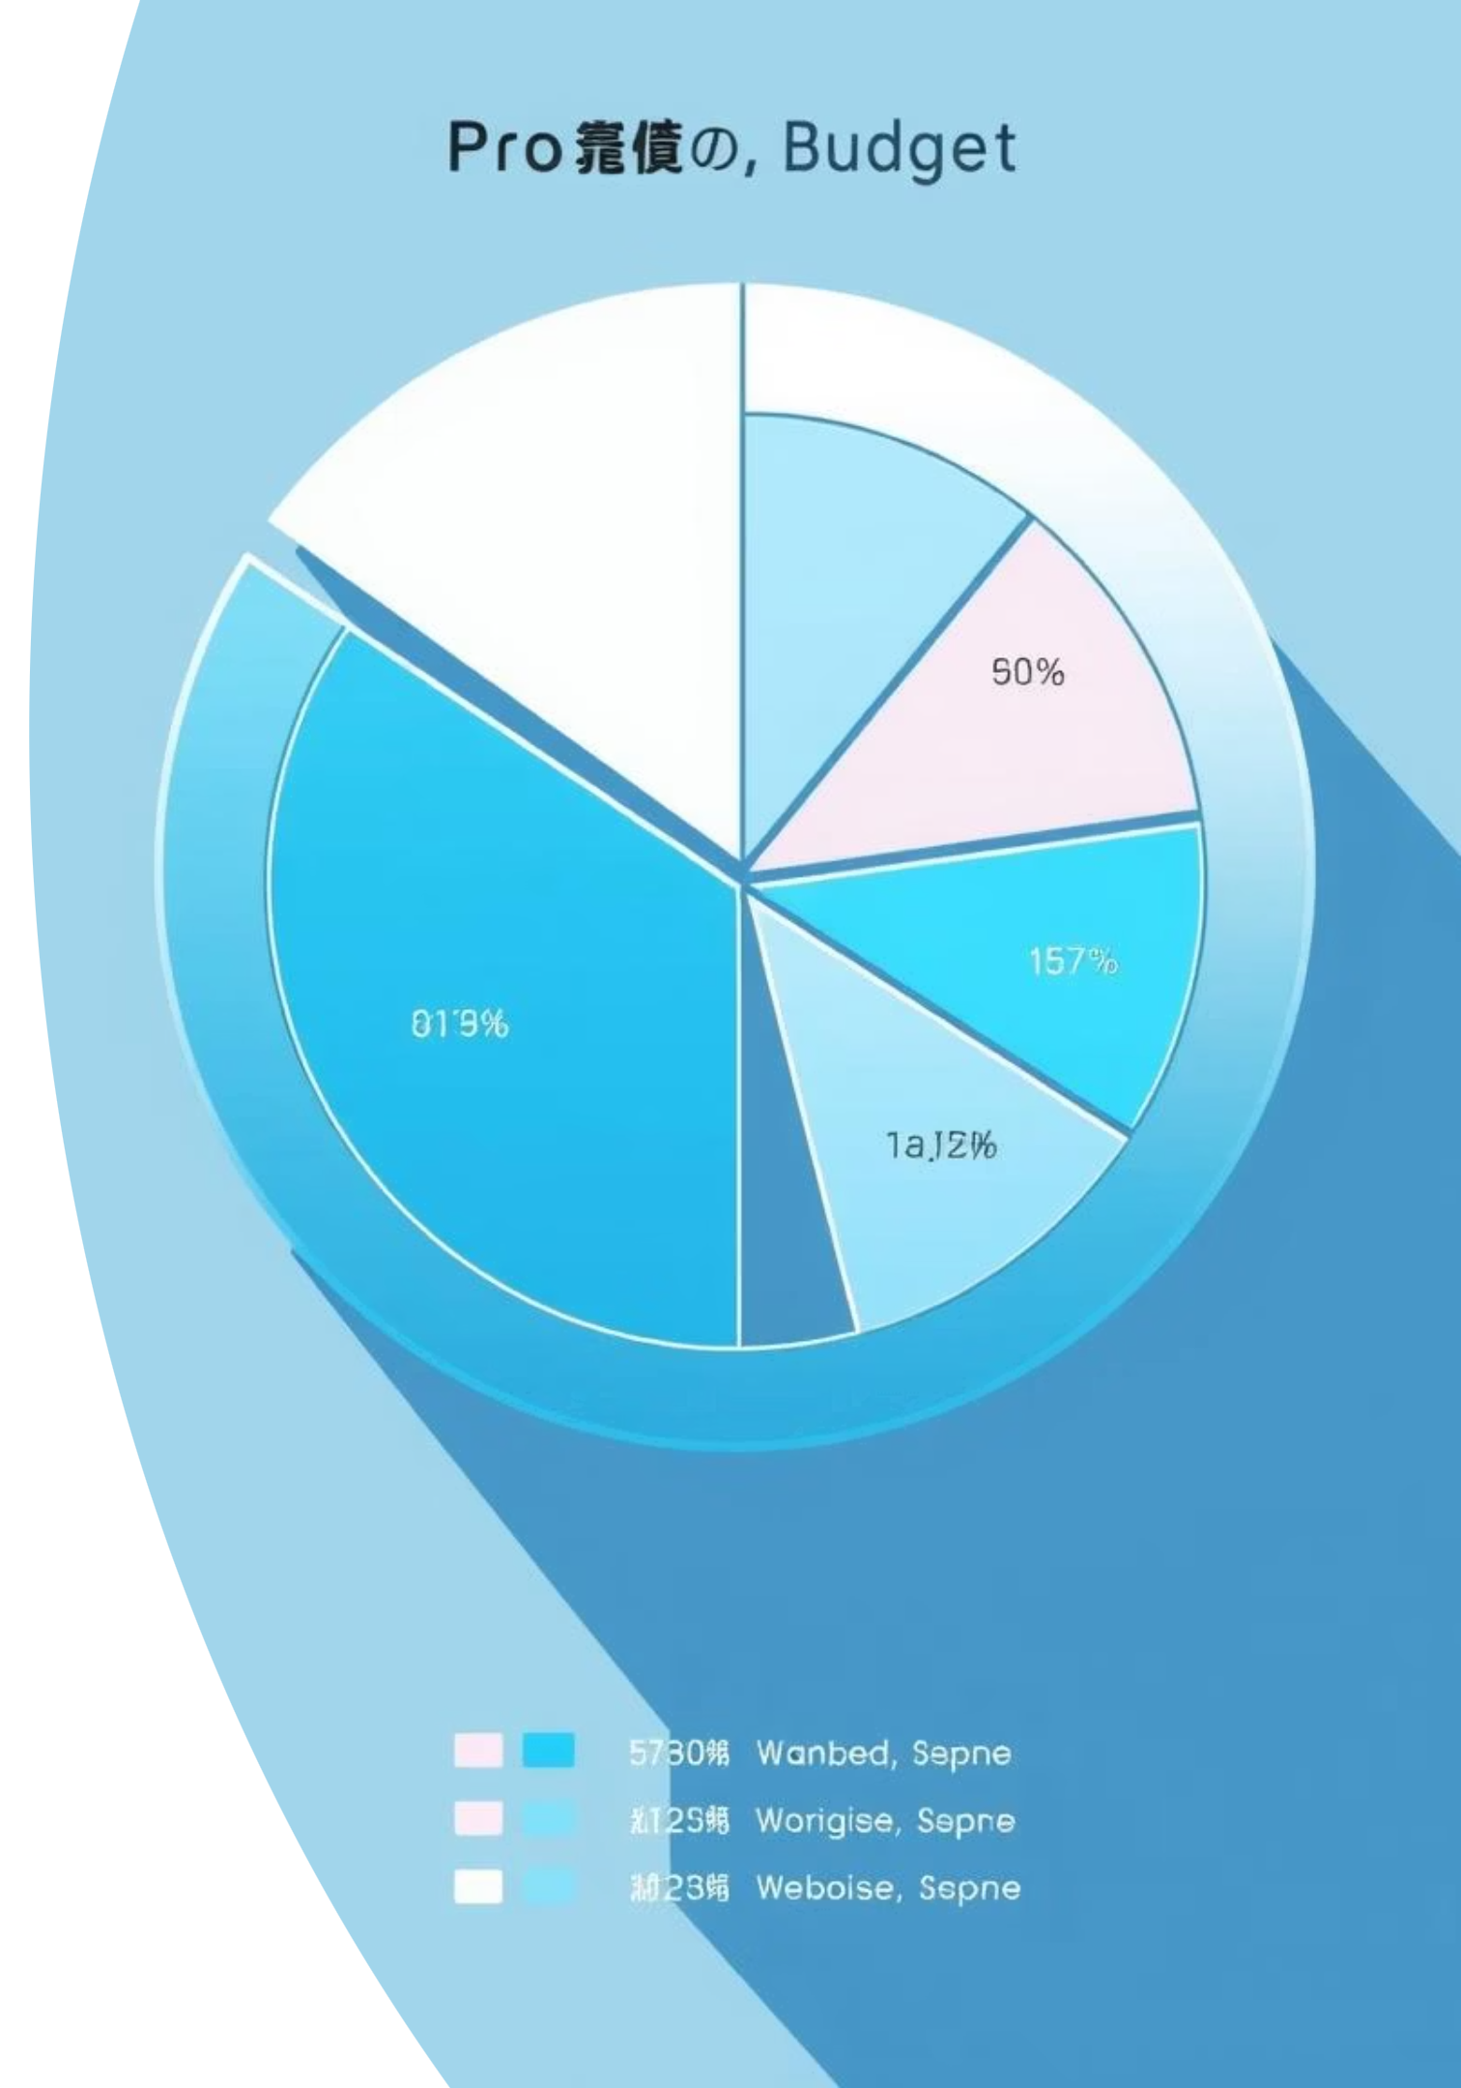
Apportioning Cost and Effort
The Apportion Method is a powerful extension of the Ratio Method, relying on the structural similarity to previous, completed projects.
How it Works
The total cost of a new project is estimated (usually using the Ratio or Consensus method), and then this total is distributed among the Work Breakdown Structure (WBS) deliverables based on historical percentage allocations.
Example Allocation
If historical data shows that 'Design' typically accounts for 30% of the total cost, and 'Testing' for 15%, these percentages are applied to the new project's overall estimated budget.

Slide 6



Bottom-Up Methods: Detail and Accuracy
These methods produce highly accurate estimates, but only after significant effort has been invested in defining the scope and tasks in detail.
Range Estimating
Parametric Procedures (Specific Tasks)
Template Method
Using three estimates (Optimistic, Pessimistic, Most Likely) to define a confidence interval for high-uncertainty tasks, aiding contingency planning.
Uses previous, similar project plans as templates, adjusting for differences in the new context. Faster than starting from scratch.
Applying ratios (e.g., productivity rates) to specific, detailed work packages rather than the entire project.

Slide 7

The Bottom-Up Advantage and Top-Down Risk
While the bottom-up approach is time-consuming, it provides clarity and buy-in by detailing specific resources and task durations.
Why Top-Down Falls Short
Parametric Procedures in Practice
❌ Ignores specific, granular tasks required for completion.
These use established productivity metrics applied to defined scope quantities:
If 3 technicians can convert 36 workstations at a rate of 3 per day, the task takes 4 days.
❌ Prone to errors of omission, missing critical elements.
If installing wallpaper costs $7 per square yard ($5 material + $2 labor), a 50 sq yd room costs $350 total.
❌ Can be significantly inaccurate, especially on novel projects.
❌ Accuracy is generally lower compared to detailed, WBS-driven methods.

Slide 8
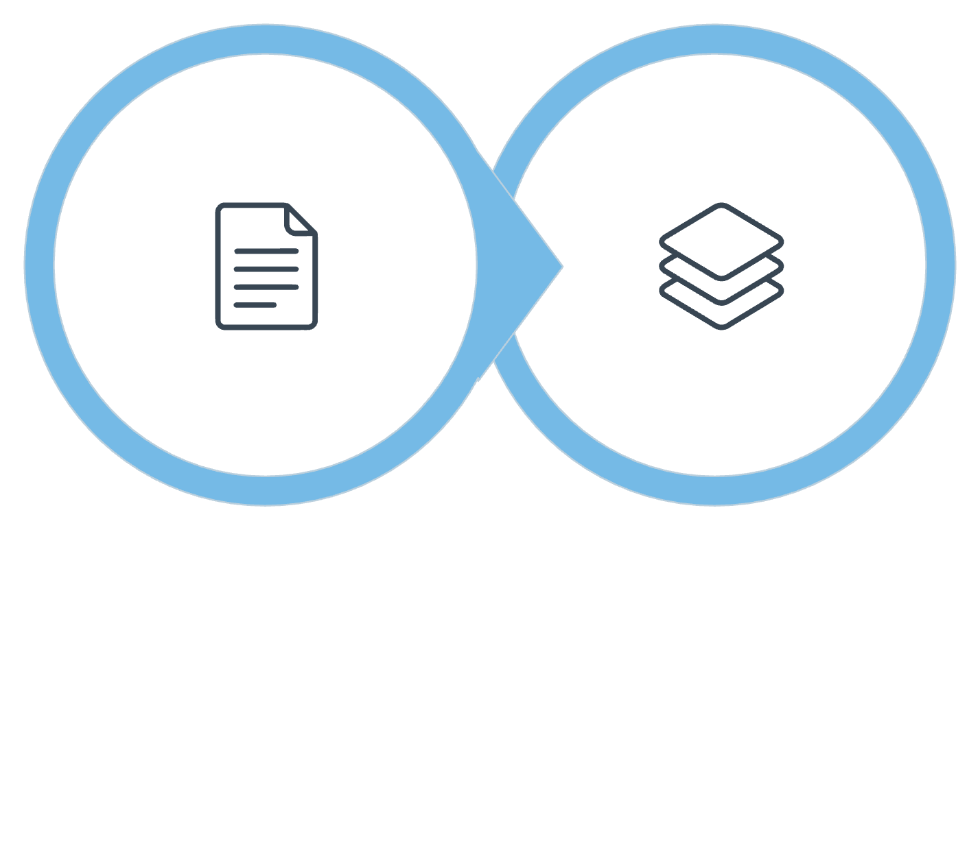



Hybrid Approach: Phase Estimating
Phase Estimating balances the need for early budget projections with the reality of high uncertainty, often seen in R&D or large IT projects.
Detailed Phase 1
Macro Phases
Immediate Phase
Remaining Phases
Requires a detailed, bottom-up estimate for the tasks immediately ahead (e.g., the planning or discovery phase).
Only a high-level, macro estimate is provided for the rest of the project, acknowledging the lack of current definition.
This method provides flexibility but requires careful management of customer expectations who may view the approach as providing a "blank check."

Slide 9
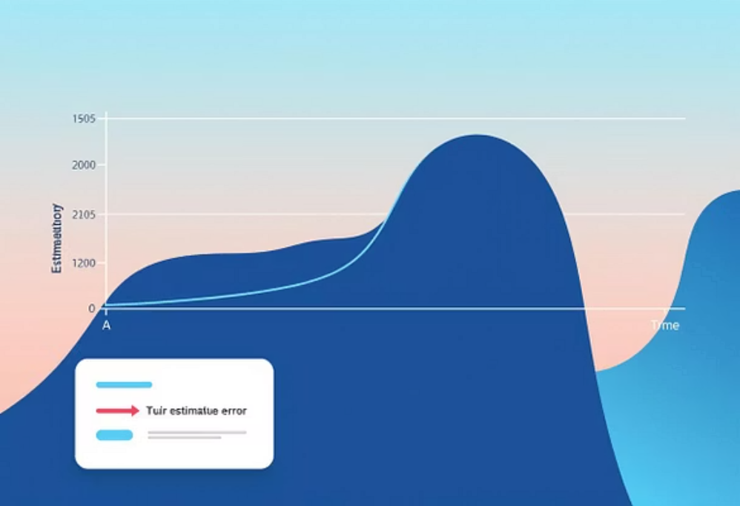

Estimate Accuracy Improves With Definition
The potential variance (overrun or underrun) in estimates narrows significantly as the project moves from concept to defined work packages.
Bricks & Mortar
+60% to -30%
+30% to -15%
+15% to -5%
IT Projects
+200% to -30%
+100% to -15%
+50% to -5%
These ranges illustrate why early estimates (Conceptual Stage) must be treated as ballpark figures, especially for high-uncertainty IT projects.

Slide 10



Key Takeaway: Selecting the Right Method
There is no universal "best" method. The ideal choice is a function of project context and information availability.
Project Uncertainty
Available Information
Required Accuracy
High uncertainty demands Hybrid (Phase) estimating; low uncertainty allows for detailed Bottom-Up planning.
Limited early data necessitates Top-Down; clear, complete WBS enables Bottom-Up accuracy.
If a tight budget is required, invest the time for detailed Bottom-Up estimation and range analysis.
Accurate, transparent estimates are the foundation of effective project governance and stakeholder trust.

Slide 11
THE END ANY QUESTIONS?

