Slide 1
Problem Statement Worksheet
Maintaining Profitability of Big Mountain Resort at 9.2% at the end of the year keeping in
Mind the increased operational cost of newly installed Chair at the resort
H
1
Context
4
Constraints within solution space
Big Mountain Resort has recently installed an additional chair lift to help increase the distribution of visitors across the mountain. This additional chair increases their operating costs by $1,540,000 this season. Every year about 350,000 people ski or snowboard at Big Mountain. This business profit margin is 9.2% and the investors would like to keep it there. The business is eager to get your recommendations on recouping the increased operating costs from the new chair this season.
Location of the park also the mountain elevation summit and amount of snowfall ,
2
Criteria for success
5
Stakeholders to provide key insight
Keeping the Profit Margin at 9.2% By accommodating the operational cost for the new chair installed.
Director of Operations- Jimmy Blackburn, and Database Manager - Alesha Eisen,
3
Scope of solution space
6
Key data sources
Increasing the ticket prices for the weekdays and weekend for the visitors marginally also explore the possibility of opening the park for more days than the normal. Nightskeeing facilities
.Csv File obtained from the database manager containing details of resort ticket prices etc
H
D
E
I
P
Notes:
Hypothesis: Create a Hypothesis with an emphasis on SMART principles. (S – Specific, M – Measurable, A – Achievable, R – Realistic, T – Timebound). If you cannot do this, you do not have a good grasp on the business problem.
Context: With context, we have clearly identified the problem at hand and have elucidated on how our initiative may solve this problem, alongside the commercial implications this will have on the business.
Criteria for Success: Clearly defining the criteria for success ensures that the scope of your work is clearly defined and understood. Otherwise, if this isn’t defined – your work will never end which will result in mismatched expectations.
Scope of Solution Space: Scoping out the solution space ensures that the business initiative is SPECIFIC for a certain segment or area. This prevents solutions that have been developed being scaled and applied for all other business units that the solution may not be responsible or scalable for.
Constraints within Solution Space: Looking forward, what are the foreseeable problems we are likely to encounter? Could this be stakeholder resistance? Could this be we don’t have access to the right data?
Stakeholders to provide key insight: Who are the people I need to speak to, to get the answers I need for my data analysis?
What key data sources are required?
Based off my discussions with the key stakeholders – can we clearly list out all the data sources we need so we can make a highly targeted request as opposed to a scatter-gun approach where we ask for a bit of everything?

Slide 2
Modeling Results and Analysis
Model Summary:
Key Variables Involved In the above case study:
Region/State where resort is located
AdultWeekday Ticket Prices.
AdultWeekend Ticket Prices.
No of Days when resort is open and predicted days.
Model | Y Variable | Predicted Value | Actual Value | Mean error | Variance | Features Drop
1 | AdultWeekend | 88 | 81 | 5.51 | 0.91 | 'state','summit_elev','base_elev', Adultweekend,vertical Drop
2 | AdultWeekday | 74 | 81 | 5.83 | 0.92 | state','summit_elev','base_elev', Adultweekday,vertical Drop
3 | Days open | 129 | 123 | 13.66 | 0.36 | state','summit_elev','base_elev', daysopen,vertical Drop
4 | Projected Days open | 130 | 123 | 13.31 | 0.011 | state','summit_elev','base_elev', projecteddays,vertical Drop

Slide 3
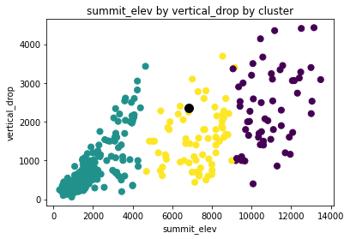
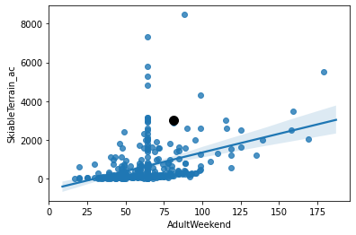
Results Visualization
Clusterization of summit elevation and vertical drop of resorts mountain with the use of Kmeans Clustering into three clusters ,
In the image it can be seen that the black dot represents the Big mountain resort located in montessa state
Plot between adultweekend ticket prices with respect to skiable terrain,
In the image it can be inferred that for majority of resort ticket prices hover around 50-75 range and most people preferring terrain range of
0-2000 mtrs.

Slide 4
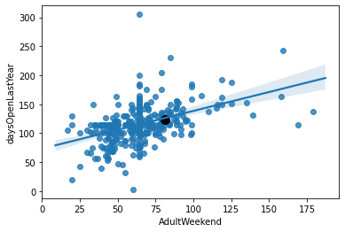
Results Visualization
Plot between adultweekend ticket prices with respect to days open of the resort.
In the image it can be inferred that for majority of resort ticket prices hover around 50-75 range and on average most resorts are open for 100-150 days in a year.
Conclusions:
As seen in model results more emphasis should be laid on increasing the prices of tickets for the Big Mountain Resort on weekends also prices can be increased on weekdays too.
Furthermore by opening the resorts on more days will result in more profitability.

