Slide 1
Real-Time NYC 311 Complaint Analytics Dashboard
Data-Driven Public Service Monitoring Using Power BI
Faizan Shaikh
20/08/2025

Slide 2
Project Objective
• Build a real-time analytics dashboard for NYC 311 complaints.
• Enable data-driven decision-making through complaint visualization.
• Identify and respond to public issues faster using live data insights.

Slide 3
Key Challenges
• Real-time data access and transformation from public APIs.
• Handling data variety and volume.
• Accurate resolution time calculation.
• Smooth dashboard performance with live connections.

Slide 4
Data Source
• Source: NYC Open Data 311 API
• Format: JSON (accessed via Web URL)
• Fields Used: Complaint Type, Borough, Created Date, Closed Date, Status, Location
• Method: Web Connector in Power BI

Slide 5
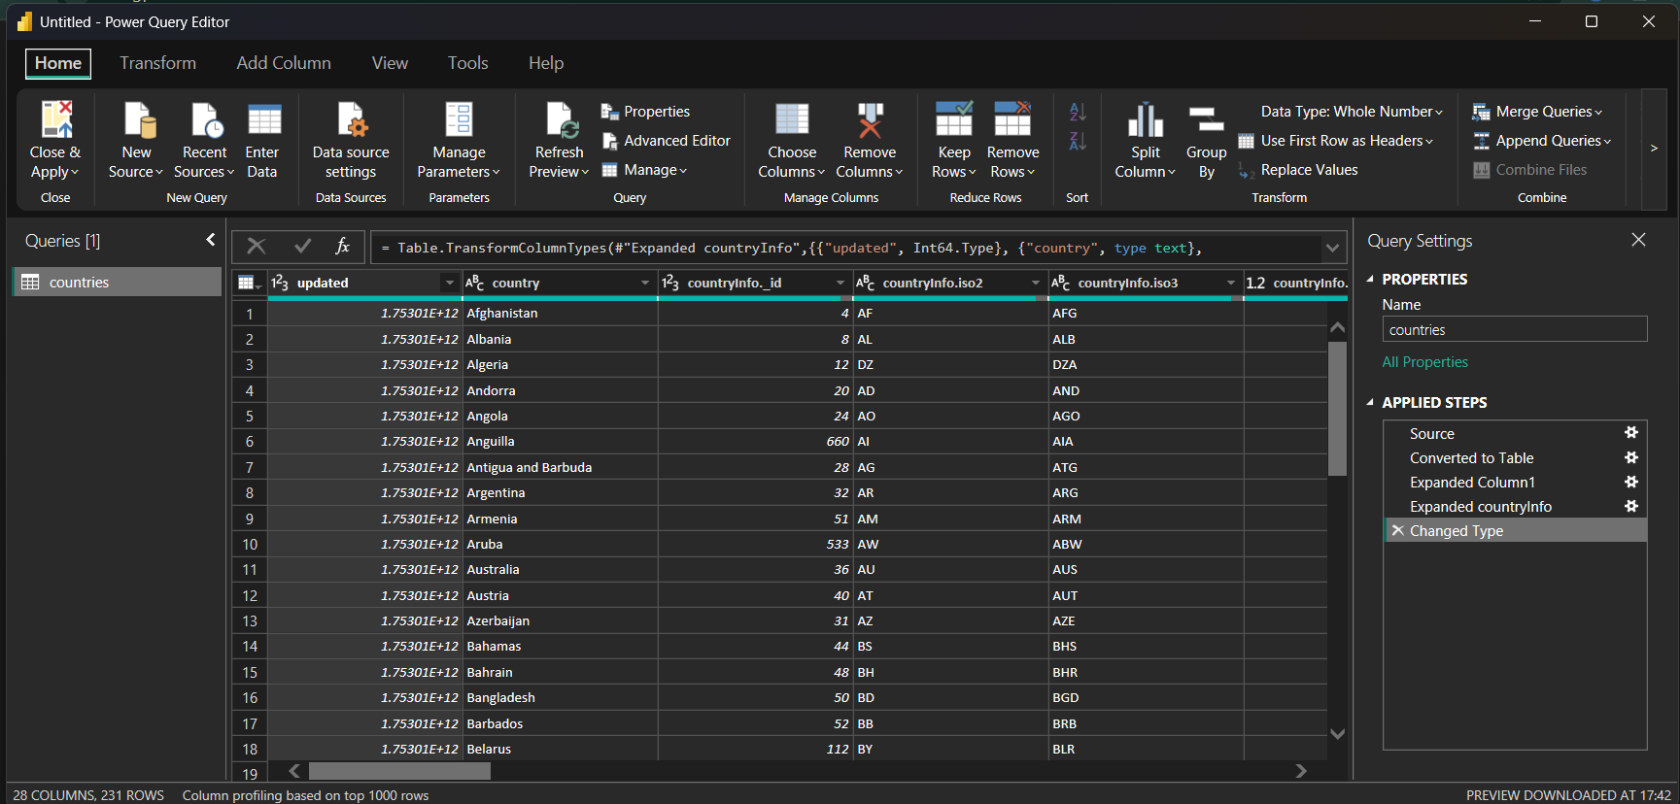
Data modeling

Slide 6
Proposed Solution
• Connect Power BI to NYC 311 API
• Transform and clean data in Power Query
• Calculate resolution time in hours
• Create interactive visuals with filters and KPIs

Slide 7
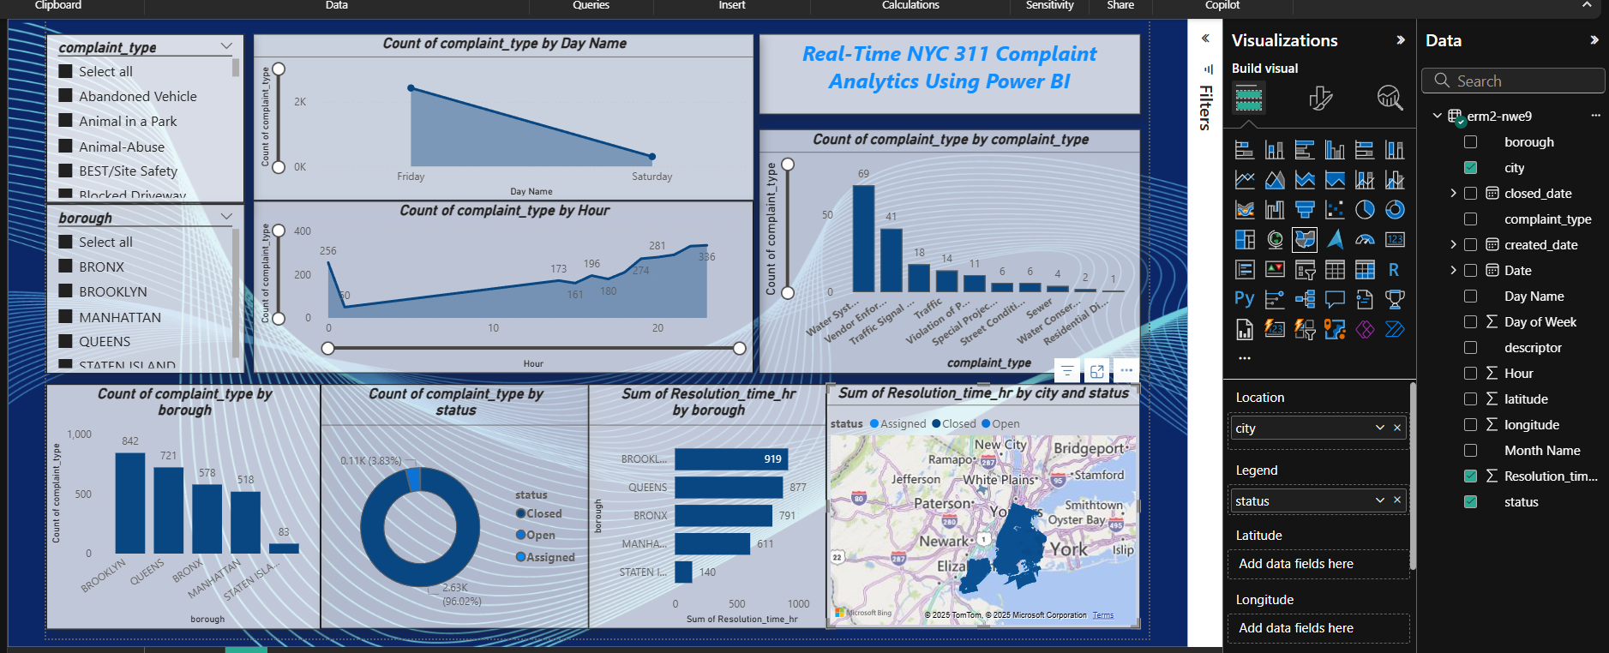
Proposed Solution

Slide 8
Dashboard Highlights
• Complaint count by borough and type
• Hourly complaint patterns
• Resolution time visualized
• Dynamic filtering using slicers
• Real-time refresh with live connection

Slide 9
Key Performance Indicators (KPIs)
• Total complaints
• Average resolution time (in hours)
• Resolved vs Open Complaints
• Top complaint types
• Complaint distribution by borough

Slide 10
Stakeholders
• NYC 311 Administration
• City Service Departments
• Residents and Local Communities
• Urban Planners
• Data Analysts & Researchers

Slide 11
Impact and Benefits
• Real-time complaint monitoring
• Hotspot detection for service improvements
• Greater transparency
• Improved response prioritization

Slide 12
Future Enhancements
• Add map visuals for location analysis
• Predictive analytics on complaint volume
• Mobile & embedded dashboard versions
• Automated alert notifications

Slide 13
Technology Stack
• Power BI
• NYC 311 API (JSON)
• Power Query (M)
• DAX (KPIs, Time Calculations)

Slide 14
Conclusion
• Live dashboard showcases real-time 311 complaint data
• Supports fast, informed decision-making
• Empowers citizens and improves city services

