Slide 1
Team Osama Bin Codin

Slide 2
CampusConnect
University Talent Finder Platform
A role-based networking and opportunity discovery system for students.
Ensures verified users, moderated content, and structured collaboration.

Slide 3
Tech Stack Overview
Frontend: React + Tailwind CSS + Vite
Backend: Node.js + Express.js
Media: cloudinary
Database: MongoDB (Mongoose)
Auth: JWT + Google OAuth + Nodemailer (OTP)
Real-time: Socket.IO
Hosting: Vercel (Frontend) + Render (Backend)

Slide 4
System Design Goals
• Authenticity: Verified university members only
• Safety: Admin-moderated content approval
• Scalability: Multi-university modular hierarchy
• Transparency: Clear approval statuses and visibility rules

Slide 5
User Roles Overview
Master Admin: Platform owner, manages universities and admins
University Admin: Approves students and posts, moderates content
Student: Can join, create posts, connect, and apply to opportunities

Slide 6
Role Hierarchy
Master Admin > University Admin > Student
All Powers → University Scope → User Features
⚠️ Admins manage their own university only.
🚫 No cross-university access.

Slide 7
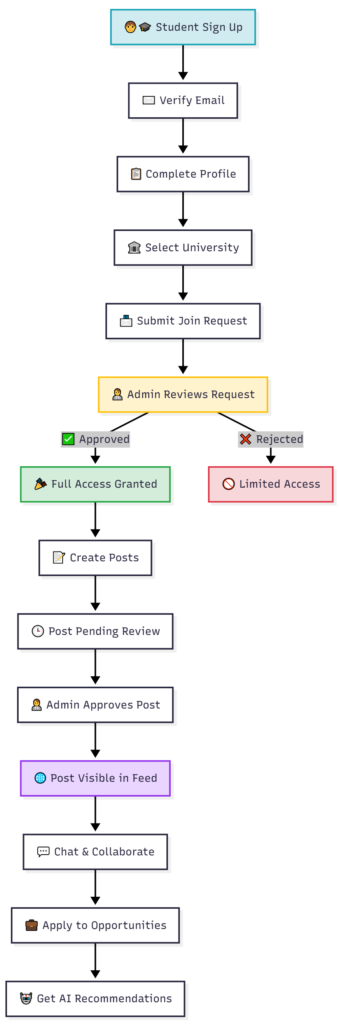
Student Registration Flow

Slide 8
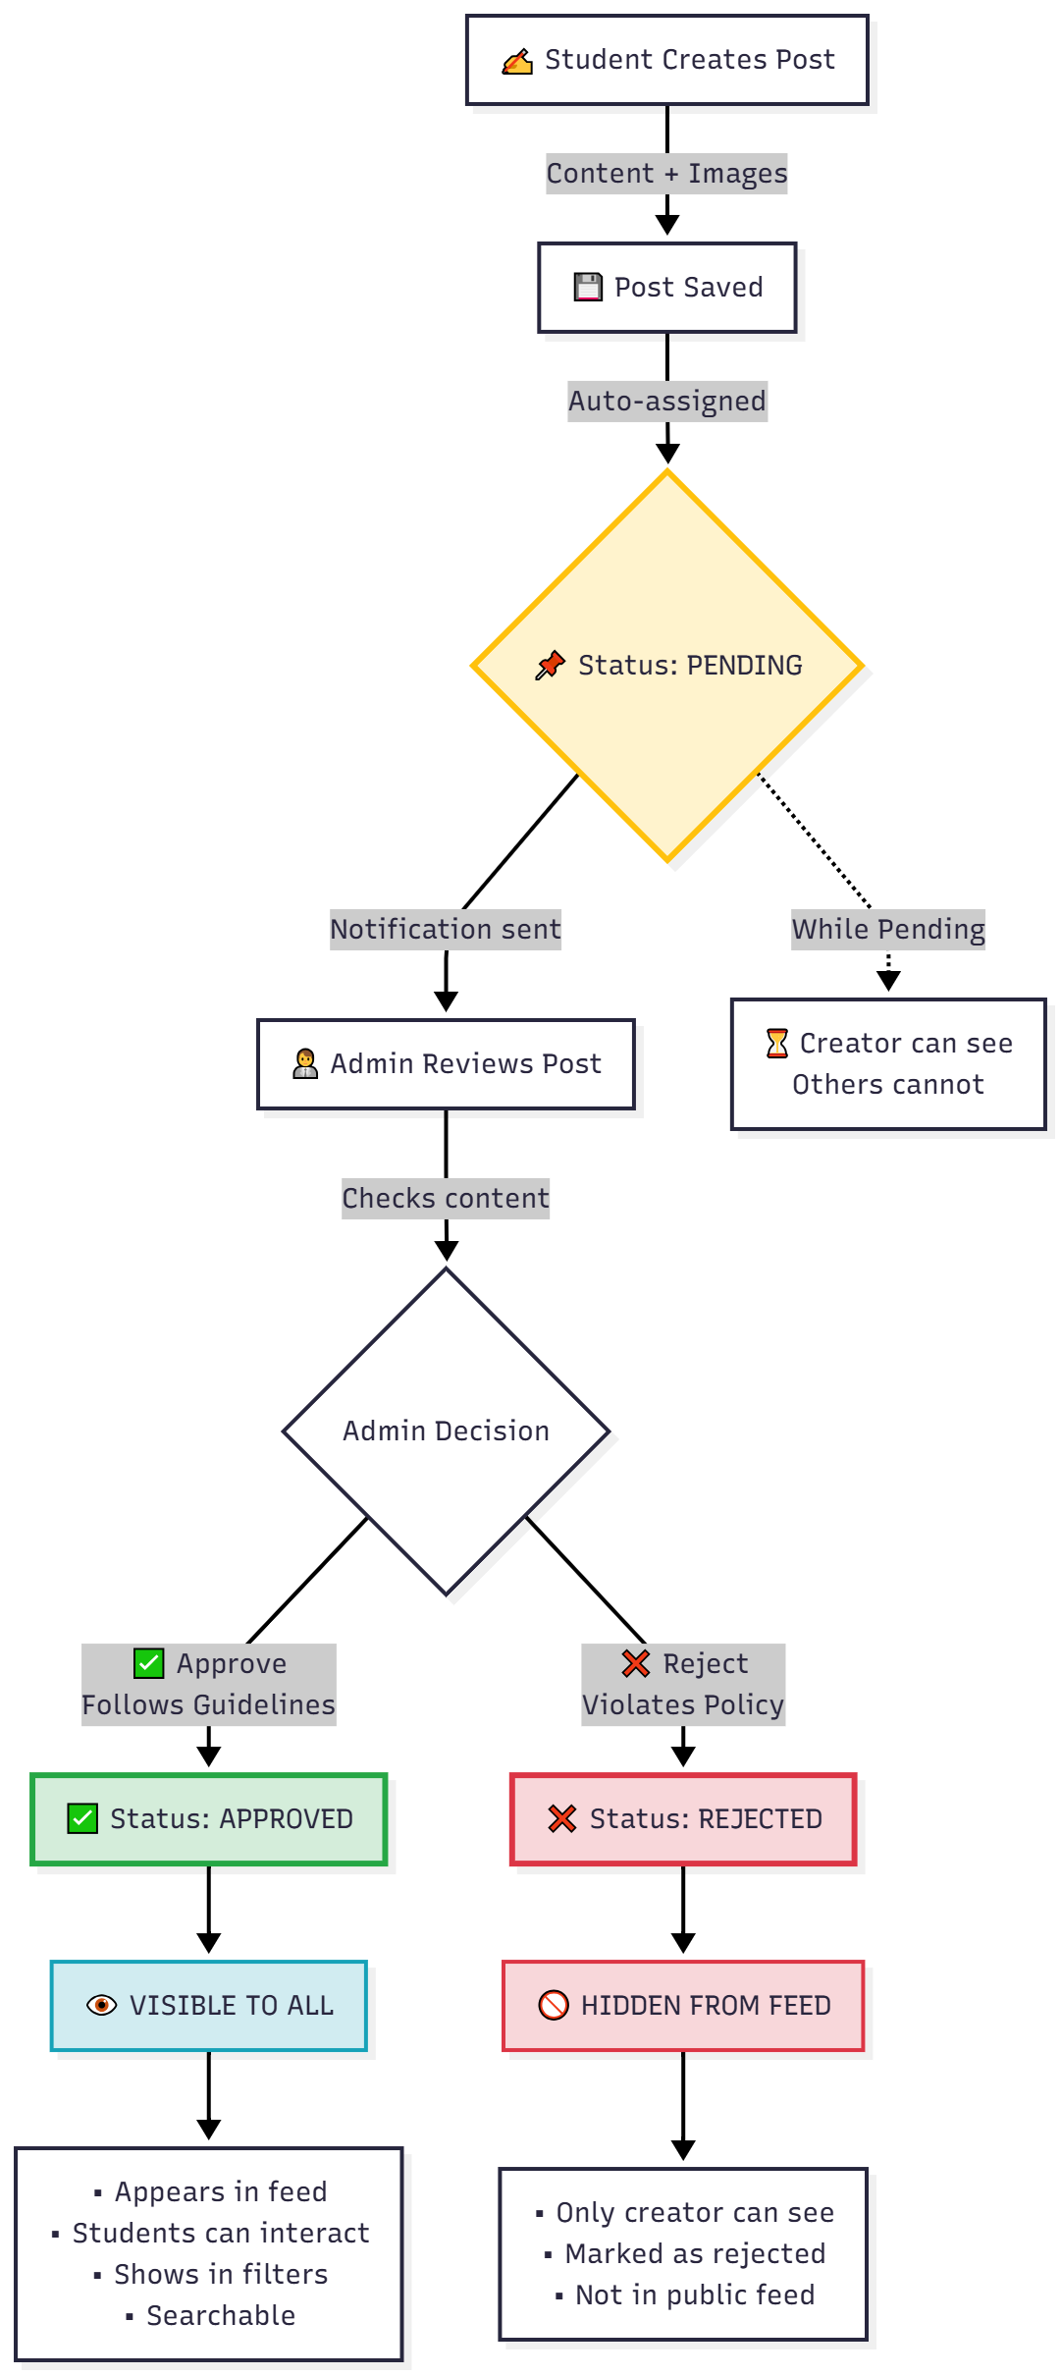
Post Creation & Approval Flow

Slide 9
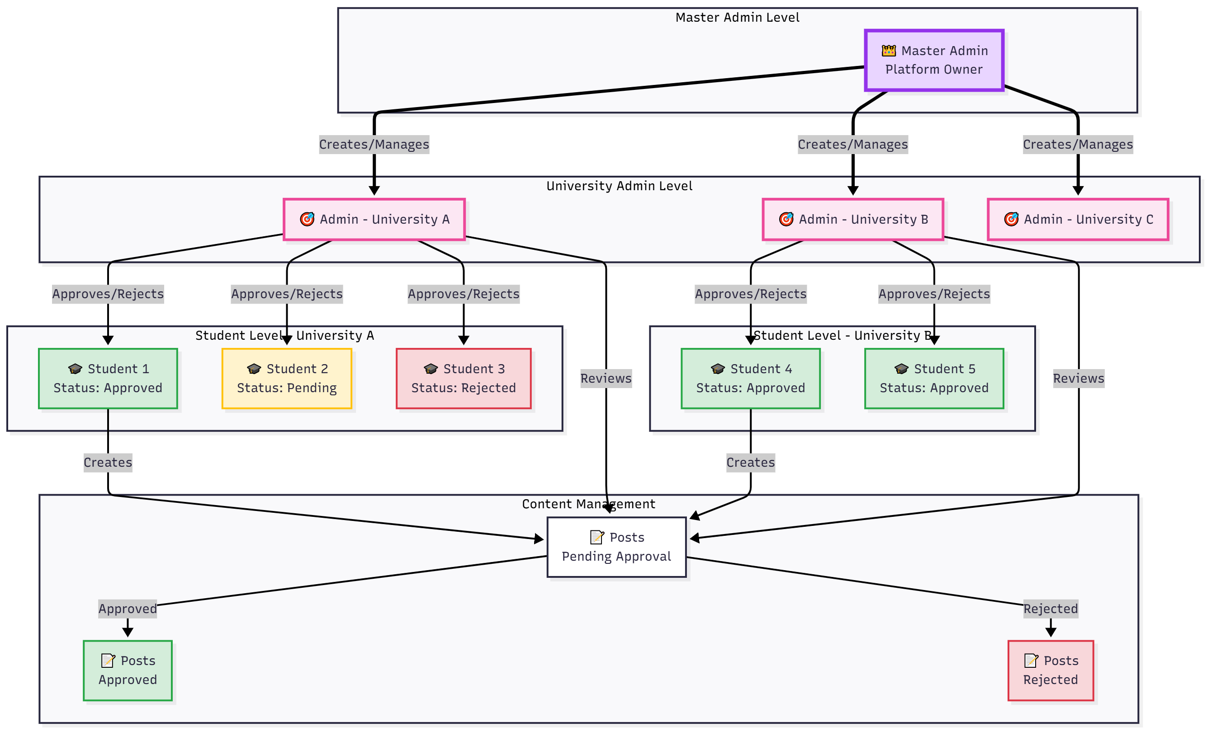
System Architecture

Slide 10
Security & Data Integrity
Email OTP verification for users
Role-based access control (RBAC)
University data isolation
Soft deletion for recoverability
Timestamps and traceability for all database actions

Slide 11
Why This Matters
• Verified, safe, and authentic collaboration
• Vetted opportunities and trusted connections
• Scalable for multiple universities
• Encourages innovation within campus ecosystems

