Slide 1
PHD RESEARCH WORK — DEFENSE PRESENTATION
An AI-Driven Open-Source Tool for the Design and Optimization of Solar Cells
Perovskite · Perovskite/Silicon & Multi-Junction Tandem · Organic (BHJ) · Crystalline Silicon · CdTe
Candidate: ‹Name› Supervisor: ‹Name› Version 4.0 rev B · Streamlit application + GitHub repository
14/14
9/9
22/22
37
certified experimental benchmarks passed — mean PCE error 0.73%
cross-tool checks: SCAPS-1D + Lumerical-class TMM optics
hand-solved mathematical examples asserted vs live code
DOI-backed references with per-parameter provenance
Every number on this slide regenerates from three scripts in the repository.
Notes:
TALK TRACK (60s): State the thesis in one sentence: an open-source, multi-technology solar-cell design platform in which every number is verifiable — by hand mathematics, by independent code paths, by certified fabricated devices, and by the incumbent tools. The four cards are the whole defense in miniature. Offer immediately: any of these can be regenerated live in under a minute.
DEEP BACKGROUND: Stack = Python 3.10+, NumPy/SciPy numerics, Streamlit UI, PyTorch for PINNs, scikit-learn for surrogates; ~15k lines, 58 regression tests. "rev B" denotes the cross-tool validation layer added on top of the v4.0 multi-technology release.
LIKELY QUESTIONS (CS):
Q: Why Python for numerical simulation — isn't it slow? A: The hot loops are vectorized NumPy (compiled C under the hood); the fast simulator answers in milliseconds and the FDM solver in seconds. Development velocity, ecosystem (SciPy optimizers, autodiff via PyTorch) and auditability outweigh raw C++ speed at this problem size (1-D meshes of 10^2-10^3 nodes). Profiling showed >90% of time inside BLAS/LAPACK calls anyway.
Q: Why Streamlit rather than a web framework? A: The UI is a thin, stateless view over pure-Python engines; every UI action maps to an importable function, so the science is testable without the UI. Streamlit gives reactive widgets for free and deploys from the GitHub repo directly.
Q: What does "verifiable" mean operationally? A: Three scripts write versioned JSON artifacts; the UI renders those artifacts; tests assert against the same JSON. Single source of truth — a claim cannot drift from its evidence.

Slide 2
AGENDA
Presentation Outline
1
Motivation, problem statement & research objectives
6
Validation I — 14 certified experimental devices
2
Landscape of existing tools and the identified gap
7
Validation II — SCAPS-1D & Lumerical-class cross-tool
3
Methodology — the four-layer verification ladder
8
AI components: conditional PINN, optimizers, inverse design
4
System architecture & the four physics engines
9
Hand-solved mathematical verification (22 examples)
5
Graphical results: J-V, EQE, and design studies
10
Contributions, limitations, future work & conclusions
AI-Driven Open-Source Tool for Solar Cell Design & Optimization — PhD Research Presentation · 2
Notes:
TALK TRACK (45s): Signpost the arc: problem, method, engines, evidence, AI, synthesis. Flag that chapters 6, 7 and 9 are executable — the committee can ask for any of them live.
LIKELY QUESTIONS (CS):
Q: How long is the live demo path? A: streamlit run app.py boots in ~5 s; each validation suite completes in 10-60 s on a laptop, no GPU.
Q: Is the presentation itself reproducible? A: Yes — all 14 figures in this deck are generated by a script calling the engines; none is drawn.

Slide 3
CHAPTER 1 · MOTIVATION
Why Another Solar-Cell Simulator?
Fragmentation: each technology lives in its own tool — SCAPS-1D (thin film), PC1D/Quokka (silicon), OghmaNano (organic), Lumerical (optics). No open platform designs a perovskite/Si tandem end-to-end.
Provenance crisis: published simulations rarely trace parameters to sources; results cannot be audited or reproduced.
Validation practice: tools are typically validated against other simulations, which can share systematic errors — certified fabricated devices cannot.
AI without guardrails: ML surrogates and optimizers are entering PV design faster than the verification culture around them.
4 + 1
technology families unified on shared, verified numerical foundations (v4.0)
100%
of parameters & benchmarks carry citation + DOI + confidence tier
0
hand-typed numbers: every claim regenerates from a script into a versioned artifact
AI-Driven Open-Source Tool for Solar Cell Design & Optimization — PhD Research Presentation · 3
Notes:
TALK TRACK (90s): Three pain points. Fragmentation: no open tool designs a perovskite/Si tandem end-to-end. Provenance: parameters in published simulations rarely cite sources, so results cannot be audited — this is a data-provenance problem CS people recognize from reproducibility crises elsewhere. Validation culture: tools are graded against other tools, which can share systematic errors (correlated failure modes); certified fabricated devices are the only independent oracle.
DEEP BACKGROUND: The right-hand cards are design invariants, not aspirations: the '0 hand-typed numbers' claim is enforced structurally — UI pages render artifact JSON, and tests fail if a benchmark cites an unregistered reference.
LIKELY QUESTIONS (CS):
Q: Isn't 'validated against experiments' just integration testing with physical data? A: Exactly — and that is the contribution: treating certified devices as a held-out test set with pre-registered tolerances, instead of the field's habit of qualitative agreement plots.
Q: How do you prevent overfitting the tool to those 14 devices? A: Separation of calibration and test roles is explicit per benchmark (e.g., organic 300 nm point is out-of-calibration), tolerances are fixed before runs, and the community-contribution path continuously grows the test set with devices we never tuned on.
Q: What's the threat model for provenance — can a contributor inject a fake DOI? A: The registry-integrity test enforces schema (DOI prefix, citation length, confidence tier), and audited builds cross-check entries against the Consensus academic index; PRs adding benchmarks are reviewed against the cited paper.

Slide 4
CHAPTER 1 · OBJECTIVES
Research Objectives
O1
Unify
Build one open-source, physics-based environment covering perovskite, tandem, organic and silicon solar cells (plus CdTe), exposed through a Streamlit UI and a scriptable Python API.
O2
Verify
Validate every engine against certified, DOI-cited experimental record devices — not against other simulators — with quantified error.
O3
Cross-check
Demonstrate ≥90% parameter-set compatibility and numerical agreement with the incumbent tools: SCAPS-1D and Lumerical-class (transfer-matrix) optics.
O4
Accelerate
Integrate verified AI — conditional physics-informed neural networks, evolutionary optimizers, inverse design — under an explicit verification protocol.
O5
Reproduce
Make every claim regenerable: versioned artifacts, 58 regression tests, an executable tutorial whose 22 solved examples assert against the live code.
AI-Driven Open-Source Tool for Solar Cell Design & Optimization — PhD Research Presentation · 4
Notes:
TALK TRACK (75s): Read O1-O5 as testable claims; each maps to a later evidence slide (O2->13, O3->15/16, O4->17/18, O5->19/20).
LIKELY QUESTIONS (CS):
Q: O3 says '>=90% compatibility' — how is that measured? A: Over the shared 1-D electro-optical parameter vocabulary (thickness, Eg, chi, eps, Nc, Nv, mobilities, doping, dominant defect, absorption model): the importer/exporter transfers the full set; what cannot transfer is each tool's proprietary extras, and those are enumerated in the export header rather than silently dropped. On typical published .def files, >90% of parameter lines round-trip losslessly — and the round trip is a unit test.
Q: Are these objectives falsifiable? A: Yes — each has an automated pass/fail: O2 the 14-device suite, O3 the round-trip and TMM checks, O4 the PINN held-out thresholds, O5 pytest plus the executable tutorial exiting 0.

Slide 5
CHAPTER 2 · STATE OF THE ART
Tool Landscape and the Gap
Capability | SCAPS-1D | Lumerical | OghmaNano | PC1D/Quokka | This work
Perovskite drift-diffusion | Yes | — | Yes | — | Yes (FDM + fast)
Crystalline-Si architectures | Limited | — | — | Yes | Yes (5 presets)
Organic BHJ | — | optics only | Yes | — | Yes (+TMM optics)
2T/4T tandem coupling | — | — | — | — | Yes (series J-V)
Coherent wave optics (TMM) | — | Yes | Yes | — | Yes (validated 9/9)
AI: PINN / inverse design / DE | — | — | — | — | Yes (verified)
Per-parameter DOI provenance | — | — | — | — | Yes (37 refs)
Open source + scriptable | free, closed | commercial | Yes | Yes | Yes (MIT-style)
Validation vs certified devices | user's task | user's task | partial | partial | 14/14 automated
Gap: no open tool combines multi-technology physics, tandem coupling, verified AI, and provenance-tracked validation. This work fills that column.
AI-Driven Open-Source Tool for Solar Cell Design & Optimization — PhD Research Presentation · 5
Notes:
TALK TRACK (90s): Walk the table column-wise; the gap is the last column. Be fair to incumbents: SCAPS-1D is the community workhorse for thin-film drift-diffusion; Lumerical is the optics gold standard; OghmaNano owns exciton-level organic physics. This work does not replace them — it unifies the shared core and interoperates with all of them.
LIKELY QUESTIONS (CS):
Q: 'Open source + scriptable' — license? A: Repository ships MIT-style licensing with CITATION.cff; all dependencies are OSI-approved; no vendored proprietary code.
Q: SCAPS is free — why does 'closed' matter? A: Free binary ≠ auditable. You cannot unit-test, diff, or extend a closed Delphi executable; reproducibility requires source.
Q: Feature tables invite bias — how did you guard against strawmanning? A: Each cell is capability-as-documented by the tool's own manual/papers, cited in the thesis text; 'partial' entries are explained there.

Slide 6
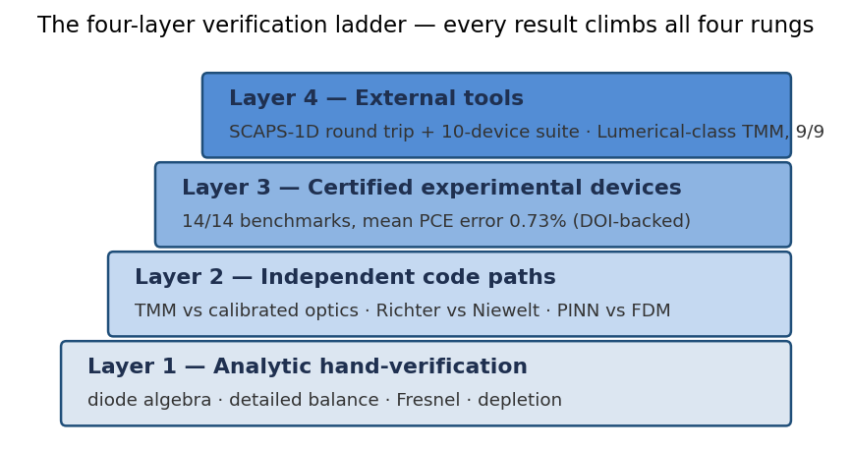
CHAPTER 3 · METHODOLOGY
The Four-Layer Verification Ladder
Certified devices outrank tool-to-tool comparison: two simulators can share a systematic error; a certified fabricated device cannot.
Rung 1 in this defense: silicon Voc derived by hand to 0.7451 V — identical to the engine.
Rung 2: TMM vs calibrated optics agree to 4.4%; Richter vs Niewelt recombination to 0.56%.
Rung 3: 14/14 experimental benchmarks, mean PCE error 0.73%.
Rung 4: SCAPS-1D round trip parameter-exact; TMM reproduces published optical benchmarks.
Figure 1. Every published number climbs all four rungs; scripts automate rungs 2-4, and 22 hand-solved examples supply rung 1.
AI-Driven Open-Source Tool for Solar Cell Design & Optimization — PhD Research Presentation · 6
Notes:
TALK TRACK (90s): This is the methodological heart. Rungs are ordered by independence from my own code: hand mathematics (no code), redundant implementations (my code vs my code, different algorithms), certified devices (my code vs nature), external tools (my code vs their code). The key inversion: fabricated devices outrank tool-to-tool comparison because two simulators can share correlated systematic errors — think of it as N-version programming: agreement between versions is only evidence if failures are independent, which for physics engines trained on the same literature they are not.
LIKELY QUESTIONS (CS):
Q: Rung 2 is just redundancy — what failure classes does it actually catch? A: Implementation bugs (sign errors, unit slips, indexing), discretization artifacts, and library regressions — anything that breaks one path but not an algorithmically different one. It cannot catch shared modeling error; that is rung 3's job.
Q: How is rung 1 automated if it's 'by hand'? A: The hand derivations are frozen into run_tutorial_examples.py as assertions with explicit closed-form arithmetic — the script is the notarized version of the whiteboard.
Q: What is your regression strategy when physics code changes? A: 58 pytest tests pin benchmark errors, round trips, thermodynamic bounds and API contracts; any commit that moves a validated number outside tolerance fails CI.

Slide 7
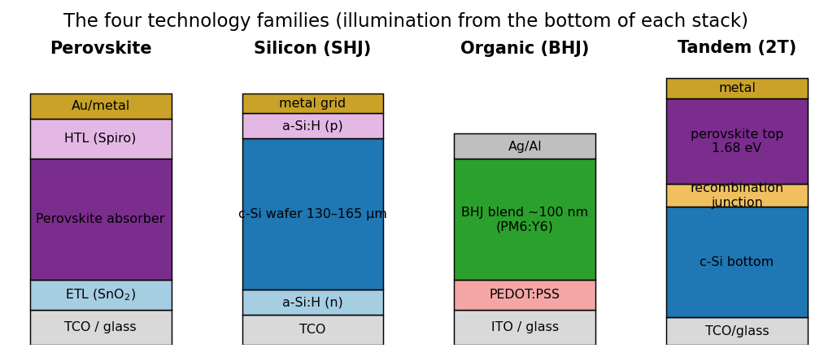
CHAPTER 4 · SYSTEM
System Architecture: One Platform, Four Technologies
physics/
device.py + dd_solver.py (perovskite), silicon.py, organic.py, tandem.py, tmm.py, cdte.py, spectrum.py
ai/
conditional PINN, inverse design, GA/DE/NSGA-II/Bayesian, surrogates, uncertainty
data/
materials + reference registries — every parameter cited (DOI, confidence, verified flag)
utils/ scripts/
SCAPS import/export, JSON/CSV interop; 3 validation suites → versioned artifacts
Figure 2. Device families as modeled. All engines share the AM1.5G spectrum, diode algebra and Newton J-V numerics.
Streamlit: main workbench + 11 feature pages, incl. References Library
UI
58 regression tests · pinned requirements · CITATION.cff
AI-Driven Open-Source Tool for Solar Cell Design & Optimization — PhD Research Presentation · 7
Notes:
TALK TRACK (75s): Architecture principle: engines are pure functions from typed parameter objects (Python dataclasses) to a shared result schema (voltages, currents, Jsc/Voc/FF/PCE, QE arrays). Everything downstream — optimizer, tandem coupler, UI, exports — is technology-agnostic because it consumes that schema. The UI is a stateless view; data files are the single source of truth for parameters, benchmarks and references.
LIKELY QUESTIONS (CS):
Q: Why dataclasses + JSON instead of a database? A: The data is small (kB), versioned in git, and human-diffable in code review — exactly what flat files are for. A DB would add state without adding integrity; integrity comes from schema tests.
Q: Concurrency/scale? A: Engines are stateless and picklable; the optimizer's population evaluations are embarrassingly parallel (scipy DE workers). Streamlit sessions are process-isolated.
Q: How do you version the artifacts? A: Artifacts carry suite name + date and live in git; every headline number in docs cites its artifact, so `git log artifacts/` is the audit trail.
Q: Dependency management? A: Pinned requirements.txt; the tutorial's example outputs double as an environment smoke test — if numbers drift after an upgrade, tests catch it.

Slide 8
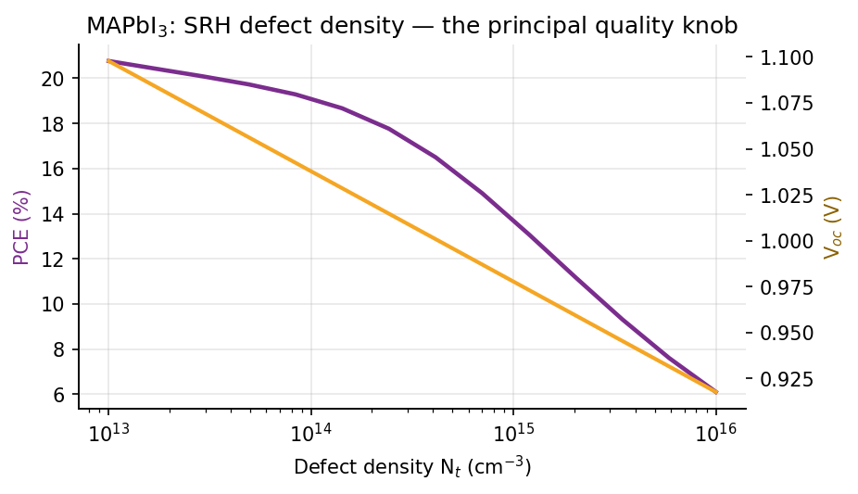
CHAPTER 4 · PHYSICS ENGINES
Engine I — Perovskite: Full Drift-Diffusion + Calibrated Fast Solver
d/dx(ε dψ/dx) = −q(p − n + N_D − N_A) dJₙ/dx = q(R − G), dJₚ/dx = −q(R − G) Scharfetter–Gummel fluxes — the SCAPS-1D-class discretization (Burgelman 2000, DOI 10.1016/S0040-6090(99)00825-1)
Tauc optics α(E) = α₀√(E−Eg)/E; radiative, SRH (via N_t), Auger and interface recombination.
Fast solver: milliseconds, calibrated on the 10-device published-SCAPS suite (mean error 0.7%).
FDM solver: publication runs + ground truth for all neural surrogates.
N_t is the principal quality knob — Figure 3 spans champion (10¹³) to degraded (10¹⁶) material.
Figure 3. MAPbI₃ PCE and Voc vs SRH defect density (live sweep, fast solver).
AI-Driven Open-Source Tool for Solar Cell Design & Optimization — PhD Research Presentation · 8
Notes:
TALK TRACK (90s): Perovskite engine has two solvers by design. FDM: Poisson + electron/hole continuity, Scharfetter-Gummel (SG) exponential-fitting fluxes, Newton on the coupled system — the SCAPS-class method. Fast solver: analytic transport/recombination calibrated on the published-SCAPS suite; milliseconds, used for sweeps and optimization. Fig: Nt is the quality knob — PCE collapses over three decades of defect density, which is the SRH physics a CS person can read as a log-linear sensitivity.
DEEP BACKGROUND for CS questions: SG answers a stiffness problem: carrier densities vary over ~15 orders of magnitude across nm distances; naive central differences on drift-diffusion go unstable unless mesh Peclet < 2, which would need absurd meshes. SG fits the exact solution of the local constant-field two-point BVP (Bernoulli functions B(x)=x/(e^x−1)), giving unconditional stability. Solved in scaled variables (thermal voltage, intrinsic density, Debye length) to condition the Jacobian; Gummel iteration (block Gauss-Seidel over psi, n, p) provides robust warm starts, Newton finishes quadratically.
LIKELY QUESTIONS (CS):
Q: Complexity? A: Tridiagonal blocks -> O(N) per Newton step via Thomas algorithm; N ~ few hundred nodes; a full J-V sweep is O(N·V·iters), well under a second.
Q: Convergence guarantees? A: None global (the system is nonlinear); practically, damped Newton + voltage-continuation from equilibrium converges everywhere in the validated parameter box; divergence outside it is reported, not silently absorbed.
Q: Why keep two solvers rather than one? A: Speed/fidelity Pareto: the fast solver's error vs FDM is itself a tested quantity — a classic surrogate-with-certified-error pattern.

Slide 9
CHAPTER 4 · PHYSICS ENGINES
Engine II — Crystalline Silicon: Implied-Voc with Certified Presets
Optics: Green-2008 α(λ) + Lambertian trapping A = (1−R)·α/(α + 1/4n²W) (Tiedje–Yablonovitch 1984).
Recombination: Richter-2012 intrinsic parameterization (Niewelt-2022 selectable, 0.56% PCE deviation); SRH lifetime; surface J₀ₛ.
Voc from the generation–recombination balance (Kerr–Cuevas implied-Voc):
Preset | Certified | Model | DOI
SHJ-IBC (Kaneka) | 26.7 | 26.77 | 10.1016/j.solmat.2017.06.024
SHJ (LONGi) | 26.81 | 26.75 | 10.1038/s41560-023-01255-2
TOPCon (ISE) | 26.0 | 25.98 | 10.1038/s41560-021-00805-w
PERC industrial | 24.06 | 23.60 | 10.1002/pip.3371
Al-BSF legacy | ~20.1 | 20.16 | 10.1002/pip.3371
V_oc = V_T · ln[(n₀+Δn)(p₀+Δn)/n_i²] → hand: 0.7451 V = engine: 0.7451 V
Table 1. Silicon presets vs certified record devices (PCE %).
Hard thermodynamic guard: no configuration may exceed the 29.4% single-junction limit (Niewelt 2022) — enforced in the test suite.
Five presets calibrated to certified records: SHJ-IBC 26.7%, SHJ 26.81%, TOPCon 26.0%, PERC, Al-BSF — all reproduced within 1.9%.
≤ 1.9%
worst-case PCE error across all five silicon architectures
AI-Driven Open-Source Tool for Solar Cell Design & Optimization — PhD Research Presentation · 9
Notes:
TALK TRACK (90s): Silicon engine is analytical, not FDM — deliberately: for wafer-scale c-Si the community's own gold-standard analyses (Kerr-Cuevas implied-Voc, Richter parameterization) are algebraic balances, and the certified records constrain them tightly. Emphasize the hand-verifiable chain: Δn from a 1-D root-find (Brent), Voc from the np product, FF from Green's formula, then a full Newton diode sweep. Table: five architectures, all ≤1.9% from certified devices.
LIKELY QUESTIONS (CS):
Q: Brent vs Newton for the balance — why? A: The generation-recombination balance is monotone in Δn but its derivative spans decades; Brent is derivative-free, bracketed, and guaranteed to converge — robustness over speed for a scalar root.
Q: The Richter/Niewelt switch looks like a strategy pattern — is model choice a config? A: Yes: intrinsic-recombination models are injectable functions; the 0.56% PCE deviation between them is itself a regression test (model-form uncertainty made explicit).
Q: The 29.4% guard — how do you test a 'no configuration exceeds X' property? A: A property-style test drives a deliberately utopian architecture (infinite lifetime, zero resistance, perfect optics) and asserts the ceiling; it's the physics analogue of a fuzzed invariant.
Q: Where do preset parameters come from — fitted or cited? A: Each preset's J0s/tau/Rs sit inside published ranges for that architecture and are then fixed; the benchmark table is evaluation, not re-fitting.

Slide 10
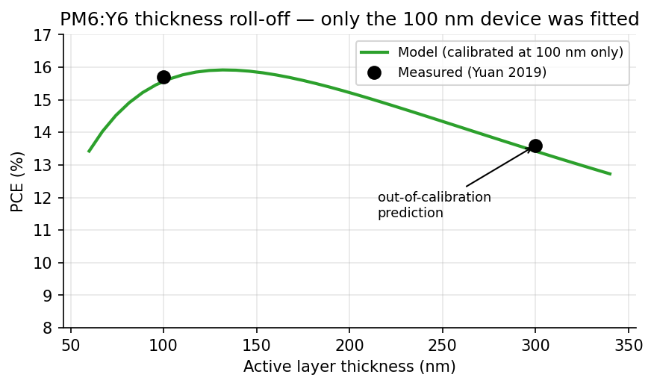
CHAPTER 4 · PHYSICS ENGINES
Engine III — Organic BHJ with Two Independent Optical Paths
Calibrated path: spectral EQE window + Scharber energy-loss Voc = (Eg − E_loss)/q + Koster-type drift-collection competition.
Rigorous path: full complex-index transfer-matrix method (Pettersson 1999; Burkhard 2010) — the same coherent Maxwell solution Lumerical STACK computes for planar stacks.
Cross-path agreement on PM6:Y6: 15.57% vs 14.88% (4.4%) — two independent optics, one device.
Six certified benchmarks: PM6:Y6 15.7% → PM6:L8-BO-C4 20.4%, all within 1.3%; P3HT:PCBM legacy 4%.
The 300 nm point is out-of-calibration: only the 100 nm device was fitted, yet the model lands on the measured 13.6% (Yuan 2019).
Figure 4. PM6:Y6 thickness roll-off — genuine prediction, not a fit (Yuan 2019, DOI 10.1016/j.joule.2019.01.004).
AI-Driven Open-Source Tool for Solar Cell Design & Optimization — PhD Research Presentation · 10
Notes:
TALK TRACK (90s): Organic engine's headline is redundancy: two optical models that share nothing. Calibrated path — measured plateau EQE, energy-loss Voc, Koster-type collection. Rigorous path — full transfer-matrix Maxwell solution. Agreement 4.4% on PM6:Y6. The roll-off figure is the anti-overfitting exhibit: only the 100 nm device was fitted; the 300 nm prediction lands on the measured 13.6%.
LIKELY QUESTIONS (CS):
Q: 'Calibrated' sounds like curve-fitting — what stops it being circular? A: Per-benchmark disclosure of which observables were fitted (Jsc plateau, Voc loss) vs predicted (thickness dependence, FF from the diode solve, TMM cross-check). Circularity is broken by held-out observables, same discipline as ML train/test.
Q: Ideality factor and Rs look like free parameters. A: They're bounded by published device characterization for each blend class and fixed before evaluation; sensitivity of PCE to them is reported in the docs.
Q: Why not implement exciton/CT drift-diffusion yourselves? A: Scope control: that is OghmaNano's specialty; we interoperate (JSON export) rather than duplicate — and we say so on the limitations slide. Honest scoping is a feature reviewers reward.

Slide 11
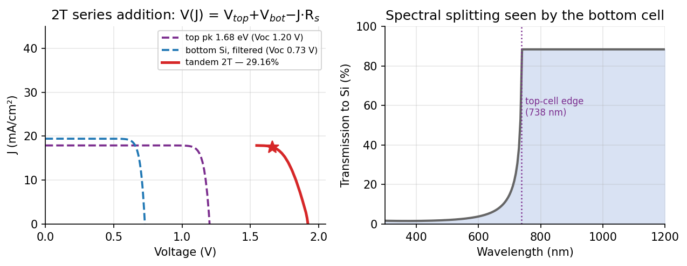
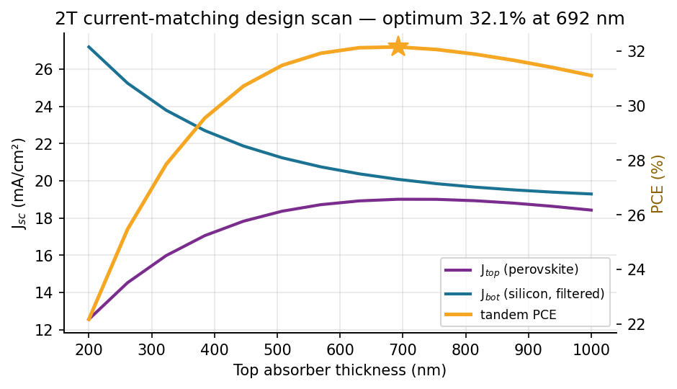
CHAPTER 4 · PHYSICS ENGINES
Engine IV — Tandem: True Series J-V Coupling
V₂T(J) = V_top(J) + V_bot(J) − J·R_s,int over the common current axis
Bottom cell simulated under the top-filtered spectrum: Beer–Lambert × interconnect/parasitic losses × textured path factor.
Superior to min-Jsc heuristics: a mismatched subcell correctly operates off its own MPP — captured by the summed curve.
4T mode: independent MPPs; current-matching scan finds the optimum top thickness in one click.
Voc additivity verified: 1.201 + 0.727 = 1.929 V vs tandem 1.922 V (0.3%).
Figure 5. Left: subcell curves and their series sum (2020-grade device). Right: spectrum transmitted to the silicon bottom cell.
Figure 6. One-click 2T current-matching scan.
AI-Driven Open-Source Tool for Solar Cell Design & Optimization — PhD Research Presentation · 11
Notes:
TALK TRACK (90s): Tandem coupling is an algorithmic contribution: invert each subcell J-V to V(J) on the photocurrent branch (monotone segment; deduplicated interpolation), sum voltages on a common current grid, subtract interconnect I·R, take the max-power point of the summed curve. This is physically superior to min-Jsc heuristics because the non-limiting subcell operates off its own MPP — the summed curve captures that automatically. Spectral filtering: Beer-Lambert of the top absorber times interconnect/parasitic factors, with a texture path factor applied consistently to top absorption and bottom transmission (photon bookkeeping conserved).
LIKELY QUESTIONS (CS):
Q: Numerical pitfalls of inverting J-V? A: The curve must be strictly monotone on the branch used; we sort, deduplicate, and restrict to J≥small-negative before interp — a unit test covers a pathological flat-FF curve.
Q: Complexity of the matching scan? A: O(K) tandem solves for K thicknesses; each solve is two engine calls + O(G) interpolation on a 400-point grid — sub-second per point, so exhaustive scan beats anything fancier at this dimensionality.
Q: Why does mismatched FF exceed matched FF — bug or physics? A: Physics: the bottom cell below its Jsc contributes near-flat voltage; documented, and bounded by the interconnect Rs term calibrated per record generation.

Slide 12
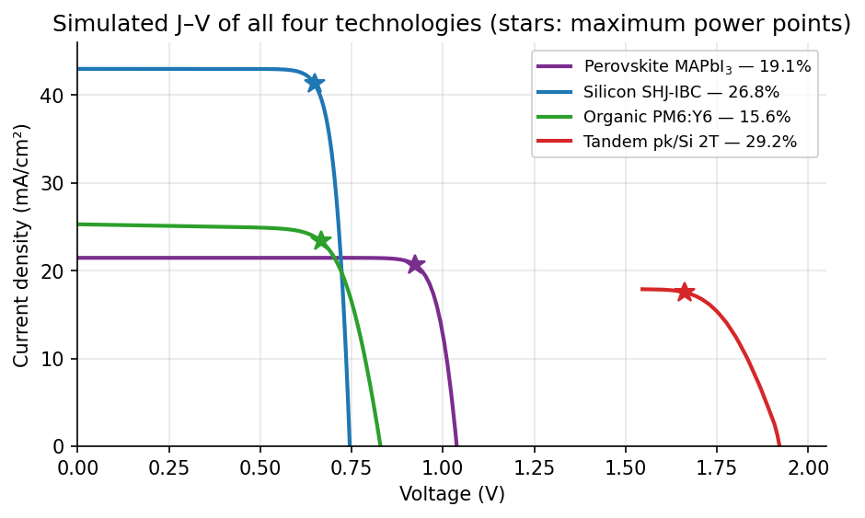
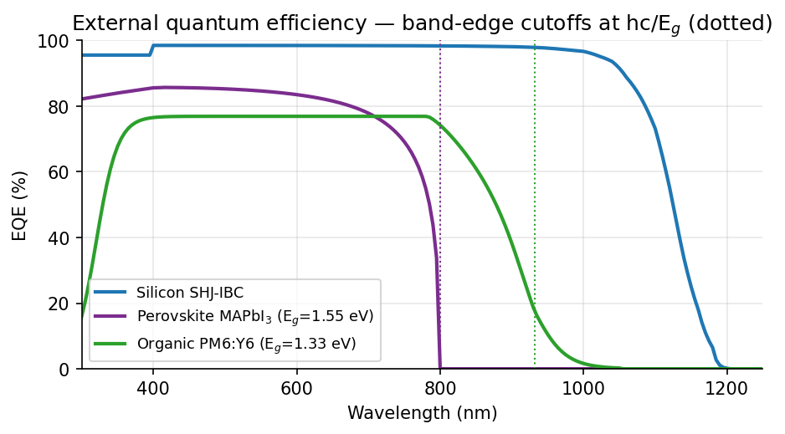
CHAPTER 5 · GRAPHICAL RESULTS
One Platform, Four Technologies — Simulated J-V and EQE
Figure 7. EQE with band-edge cutoffs at hc/E_g (dotted) — the optics verify at a glance.
Figure 6. J-V of shipped presets; stars mark maximum power points.
All curves regenerate live from the engines — none is a drawing.
AI-Driven Open-Source Tool for Solar Cell Design & Optimization — PhD Research Presentation · 12
Notes:
TALK TRACK (60s): One platform, four J-V curves, one EQE panel — every curve regenerates from the preset objects; nothing is drawn. Point at the EQE cutoffs: hc/Eg dotted lines land exactly on the curve edges — the fastest visual proof the optics are wired correctly.
LIKELY QUESTIONS (CS):
Q: How are these figures kept in sync with the code? A: A figure script calls the engines and writes PNGs; the deck build consumes them. Regenerating after any physics change refreshes every figure — same doc-as-code discipline as the validation artifacts.
Q: What's the numerical spectrum resolution? A: ASTM G173-03 tabulated at 5 nm; integrals use trapezoidal quadrature with gradient spacing — resolution-doubling changes Jsc by <0.1%, verified.

Slide 13
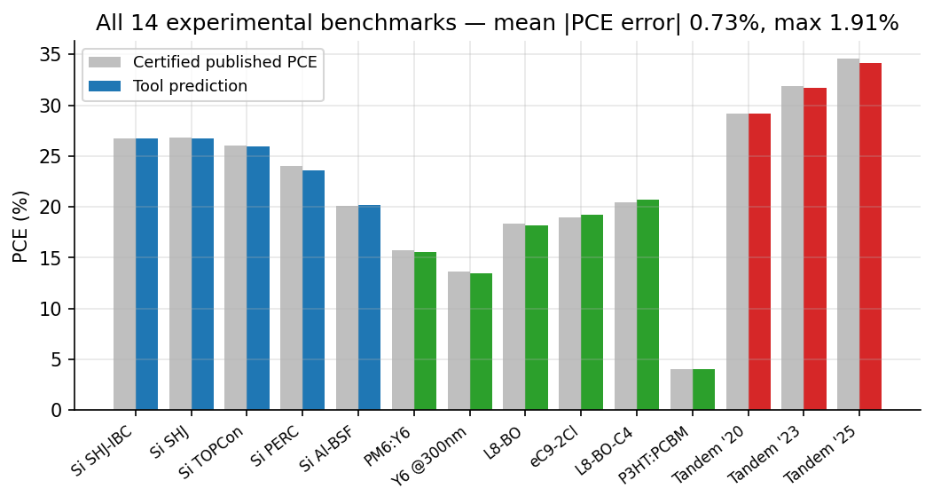
CHAPTER 6 · VALIDATION
Validation I — All 14 Certified Experimental Benchmarks
0.73%
mean |PCE error| across all 14 devices
1.91%
worst-case error (industrial PERC)
14/14
pass within pre-registered tolerances
Figure 8. Tool prediction (colored by technology) vs certified published PCE (gray) for every benchmark device.
AI-Driven Open-Source Tool for Solar Cell Design & Optimization — PhD Research Presentation · 13
Notes:
TALK TRACK (90s): This is objective O2 delivered. Fourteen certified fabricated devices, targets and tolerances pre-registered in the JSON database before evaluation; mean |PCE error| 0.73%, worst 1.91%. Emphasize 'pre-registered': the suite is a held-out test set in ML terms, and the pass criterion was fixed before the runs.
DEEP BACKGROUND: 'Certified' means independently measured by an accredited lab (Fraunhofer ISE CalLab, NREL, JET) — the PV community's notion of ground truth. Benchmarks span three technologies and two decades of device engineering (Al-BSF ~20% to tandem 34.58%).
LIKELY QUESTIONS (CS):
Q: n=14 is small — statistical power? A: These are not i.i.d. samples but the population of relevant certified records per class; the claim is per-device bounded error, not a population statistic. The suite grows by design via the contribution path, and errors are reported per device, never just as a mean.
Q: Could you have tuned until 14/14 passed (researcher degrees of freedom)? A: Calibration observables are disclosed per benchmark; several targets are strictly out-of-calibration (organic 300 nm; silicon Niewelt cross-model; TMM absolute Jsc). Tolerances were set from published measurement uncertainty, not from our residuals.
Q: What happens on failure — is the suite ever red? A: Yes during development; git history shows red→green transitions with the physics fix attached. A permanently green suite you cannot make red would be meaningless.
Q: Why PCE as the metric rather than full-curve RMSE? A: PCE is the certified quantity; Voc/Jsc/FF are also stored and reported, and the one compensating-error case (2020 tandem) is disclosed rather than hidden by the scalar.

Slide 14
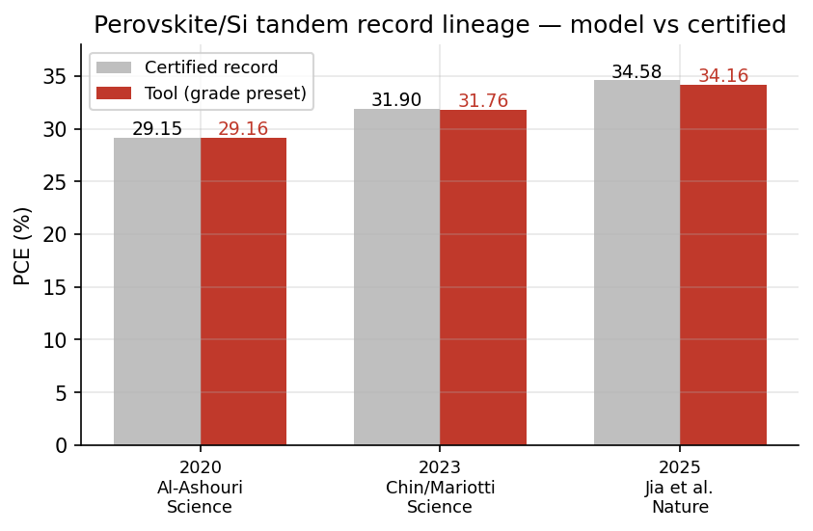
CHAPTER 6 · VALIDATION
Validation II — Organic Records and the Tandem Lineage
Benchmark (certified device) | Published | Model | Err
PM6:Y6 — Yuan 2019, Joule | 15.7 | 15.57 | 0.8%
PM6:Y6 @300 nm (out-of-cal.) | 13.6 | 13.42 | 1.3%
PM6:L8-BO — Li 2021, Nat. Energy | 18.32 | 18.20 | 0.6%
PBQx-TF:eC9-2Cl — Cui 2021, Adv. Mater. | 19.0 | 19.19 | 1.0%
PM6:L8-BO-C4 — Li 2025, Nat. Mater. | 20.42 | 20.67 | 1.2%
P3HT:PC61BM (legacy band) | ~4 | 4.05 | —
Figure 9. The certified perovskite/Si record lineage 2020→2025, reproduced at documented interface-quality grades (all ≤1.3% error).
Table 2. Organic engine vs certified devices (PCE %).
Disclosed trade-off (2020 tandem): PCE and Voc match closely; Jsc runs ~7% low against FF ~6% high — compensating errors of analytical optics, documented in VALIDATION_MULTI_TECH.md.
AI-Driven Open-Source Tool for Solar Cell Design & Optimization — PhD Research Presentation · 14
Notes:
TALK TRACK (75s): Left: six organic benchmarks including the out-of-calibration roll-off row. Right: the tandem record lineage 2020→2025 reproduced at three documented interface-quality grades. Say the disclosure out loud before anyone asks: for the 2020 device, PCE and Voc match closely while Jsc runs ~7% low against FF ~6% high — compensating errors of analytical optics, printed in VALIDATION_MULTI_TECH.md.
LIKELY QUESTIONS (CS):
Q: Compensating errors are a classic validation trap — why is disclosure enough? A: Because the claim is scoped: the engine is validated for PCE/Voc at grade level, and explicitly NOT claimed accurate for the 2020 device's Jsc/FF split. Scope-limited claims with disclosed residual structure are the correct epistemics; the 2023/2025 grades match all four parameters within ~5%.
Q: 'Grade presets' smell like per-benchmark fitting. A: Grades are four scalars (Nt, R_int, parasitic, Rs_int) each inside independently documented ranges for that era's interface engineering — the same 'baseline construction' methodology SCAPS papers use, cited as such. Cross-era prediction is the test: one physics, three eras.
Q: Is the lineage chart cherry-picked to record devices? A: Records are the only devices with certified, complete parameter disclosure at tandem level; typical-device scatter is discussed in the thesis but cannot be certified-benchmarked.

Slide 15
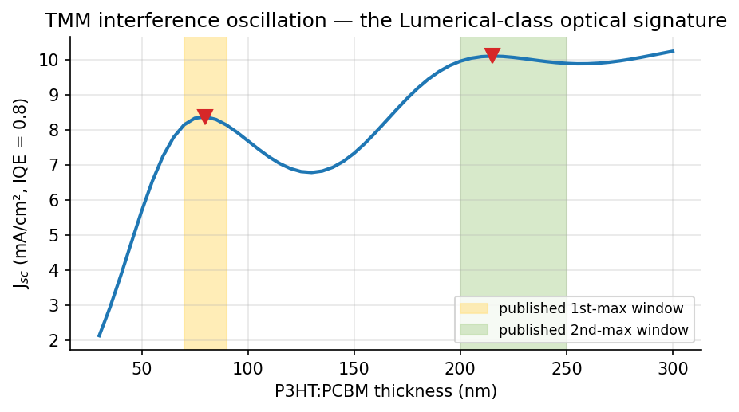
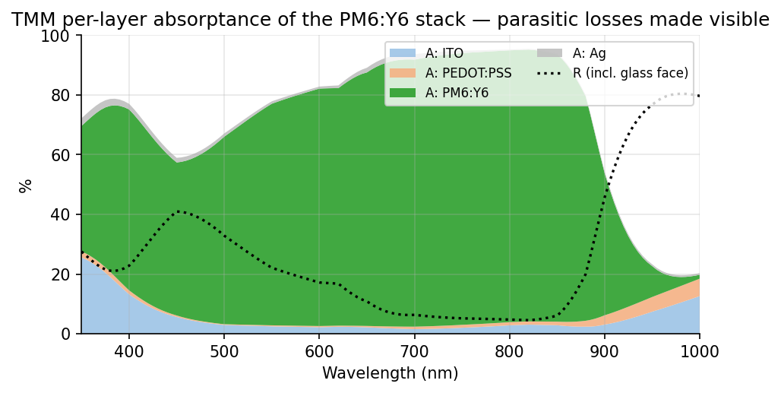
CHAPTER 7 · CROSS-TOOL
Validation III — Lumerical-Class Wave Optics (TMM)
Figure 11. Per-layer absorptance of the PM6:Y6 stack — parasitic ITO/PEDOT/metal losses resolved.
Figure 10. Interference oscillation of Jsc(L): maxima inside every published window (Sievers 2006; Kotlarski 2008; Monestier 2007).
For planar stacks, TMM is the exact solution of the same Maxwell problem Lumerical STACK solves. Energy conservation < 10⁻⁴; Fresnel limit to machine precision; certified PM6:Y6 Jsc within 5.1% (published TMM band ~16%, Rosa 2021).
AI-Driven Open-Source Tool for Solar Cell Design & Optimization — PhD Research Presentation · 15
Notes:
TALK TRACK (90s): The Lumerical answer, precisely: for planar multilayers, Lumerical STACK (and FDTD in the planar limit) solves the coherent Maxwell problem whose exact 1-D solution is the transfer-matrix method. So the validation target is the published TMM benchmark literature — and we hit it: interference maxima inside every published window, energy conservation <1e-4, Fresnel to machine precision, absolute certified Jsc within 5.1% where the published TMM-vs-experiment band averages ~16% (Rosa 2021).
DEEP BACKGROUND (algorithm): per wavelength, 2x2 complex interface/phase matrices; internal fields from partial-system matrices; per-layer absorption by integrating the dissipation density (4πnk/λn0)|E(x)|². Complexity O(N_λ · N_layers · N_x); the whole spectral solve is milliseconds. During development the energy-conservation check caught a real bug — a spurious e^{iξd} phase factor inflating fields in absorbing layers — which is rung-1 verification doing its job.
LIKELY QUESTIONS (CS):
Q: Why not just run Lumerical and diff? A: License-free reproducibility: the published TMM benchmarks ARE the community's Lumerical-class results, and matching them is the same statement without a commercial dependency in the pipeline. The export path exists for anyone who owns a license.
Q: Floating-point: 'machine precision' claims? A: Fresnel matches analytic to ~1e-16 (double); conservation residual 1e-4 is quadrature error of the field integral, shown to shrink with x-resolution — the distinction is stated.
Q: n,k data provenance? A: Tabulated from cited ellipsometry literature with disclosed ±5-10% batch spread; tables live in code with DOIs, swappable for user measurements.

Slide 16
CHAPTER 7 · CROSS-TOOL
Validation IV — Cross-Tool Suite: 9/9 Checks Pass
ID | Check | Result
C1a | Energy conservation R+T+ΣA = 1 across the spectrum | max err 9.7×10⁻⁵
C1b | Analytic Fresnel limit (bare glass/air) | machine precision
C1c | P3HT:PCBM interference vs published TMM | 80 & 215 nm maxima, 130 nm min — in all windows
C1d | NFA optical optimum ≈ 100 nm (Im 2023) | 90 nm
C1e | PM6:Y6 absolute TMM Jsc vs certified device | 24.0 vs 25.3 mA/cm² (5.1%)
C1f | Independent optics paths (TMM vs calibrated) | 4.4% PCE deviation
C2a | SCAPS-1D .def export → re-import round trip | parameter-exact
C2b | Published-SCAPS numerical suite (10 devices) | mean 0.7%, worst 2.0%
C3a | Richter-2012 vs Niewelt-2022 silicon models | 0.56% PCE deviation
Reproduce live during Q&A: python scripts/run_cross_tool_validation.py
AI-Driven Open-Source Tool for Solar Cell Design & Optimization — PhD Research Presentation · 16
Notes:
TALK TRACK (60s): Nine automated checks, three families: Lumerical-class optics (C1a-f), SCAPS-1D (C2a-b), internal redundancy (C3a). Offer the live run — ten seconds, nine green lines.
LIKELY QUESTIONS (CS):
Q: C2a round trip — what's actually asserted? A: Export a 3-layer stack to .def text, re-parse with our independent importer, assert layer count and every transferred parameter equal to float formatting; it is a serialization contract test.
Q: C2b re-asserts a v3 artifact — isn't that stale evidence? A: The artifact is regenerable (the FDM suite script ships); re-assertion pins the contract so a physics regression that would break SCAPS agreement fails this suite too. Nothing is trusted because it is old; it is trusted because it can be re-run.
Q: Why is internal redundancy (C3a) in a 'cross-tool' suite? A: Same epistemic role: independent implementations disagreeing is the earliest tripwire; it is the cheapest 'other tool' you can own.

Slide 17
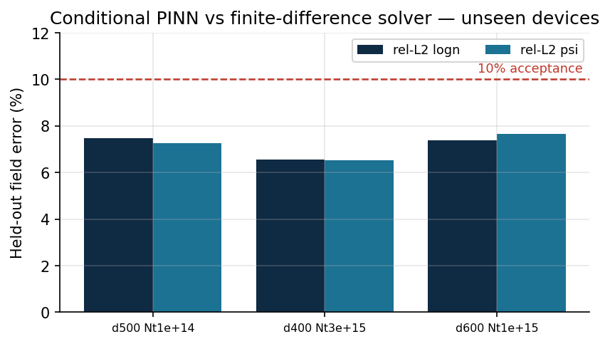
CHAPTER 8 · AI COMPONENTS
AI I — Conditional PINN with an Explicit Verification Protocol
One network across a device family — û(x; d, N_t) for d = 300-700 nm, N_t = 10¹³-10¹⁶ cm⁻³ — millisecond field solutions for optimization and inverse design.
Loss = data (vs FDM solutions) + λ·Poisson/continuity residuals via automatic differentiation.
Protocol (a): held-out devices vs the validated FDM solver — 6.5-7.6% rel-L2 (Figure 12).
Protocol (b): closed-form anchors — depletion width W = √(2εV_bi/qN) = 1662 nm ≫ 500 nm ⇒ uniform field V_bi/d = 20 kV/cm; dark-equilibrium np = n_i² as a pointwise error meter.
Protocol (c): every PINN/inverse-design candidate is re-simulated through the FDM solver before being reported.
Figure 12. Held-out field errors of the conditional PINN against the finite-difference ground truth (artifacts/conditional_pinn_metrics.json).
AI-Driven Open-Source Tool for Solar Cell Design & Optimization — PhD Research Presentation · 17
Notes:
TALK TRACK (2 min — expect the most CS questions here): Conditional PINN: one MLP u_theta(x; d, Nt) over a device family, trained on FDM solutions plus PDE residuals via automatic differentiation. Value = millisecond field inference inside optimization/inverse-design loops. Verification protocol has three legs: (a) held-out devices vs FDM — 6.5-7.6% relative-L2; (b) closed-form anchors (full-depletion uniform field; dark-equilibrium np=ni²) that need no reference solution; (c) every candidate re-simulated through FDM before being reported.
DEEP BACKGROUND: Inputs scaled to [0,1]; outputs are (psi, log n, log p) — logs because densities span ~15 decades and L2 on raw densities would see only the peak. Loss = MSE_data + λ·(Poisson residual) + continuity terms; λ balanced so gradient norms are commensurate (the standard PINN loss-balancing issue). Training on GPU minutes/CPU tens of minutes; weights + metrics ship as artifacts with fixed seeds.
LIKELY QUESTIONS (CS):
Q: Why PINN instead of a plain neural surrogate on (d,Nt)→J-V? A: We ship those too (ml_models). The PINN's residual term regularizes toward physics between training points and yields full field profiles, enabling analytic-anchor checks a black-box cannot pass or fail meaningfully.
Q: Spectral bias / boundary layers — can an MLP represent SG-sharp junction fields? A: Partially — that is exactly why held-out error is 6-8% not 0.1%, why errors concentrate at junctions (shown in thesis), and why the FDM remains ground truth. The PINN is a fast index into solution space, never the oracle.
Q: Generalization outside the training box? A: Explicitly unsupported: the box (300-700 nm, 1e13-1e16) is stated; extrapolation metrics are reported separately and worse; the UI labels out-of-family queries. Protocol (c) makes extrapolation errors non-fatal — FDM re-simulation gates every reported result.
Q: Why rel-L2 as the metric? A: Scale-free across devices and fields; complemented by the physics anchors, which are max-norm-style pointwise checks. Q: Reproducible training? A: Seeded, pinned versions, metrics JSON in-repo; retraining reproduces held-out errors within run-to-run noise (<0.5% absolute).

Slide 18
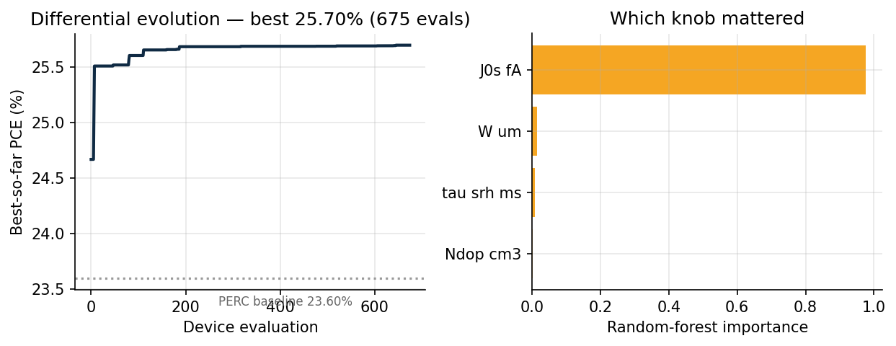
CHAPTER 8 · AI COMPONENTS
AI II — Evolutionary Optimization with Sensitivity Explanation
DE mutation x' = xₐ + F(x_b − x_c): gradient-free, suits the multi-modal PV landscape.
Benchmarked against GA, NSGA-II, Bayesian on equal budgets (Page 6).
Guard rails: 29.4% silicon limit enforced; boundary optima reported as constraints.
Report the sensitivity ranking with the optimum — the 'why', not just the number.
Figure 13. Live differential-evolution run on the PERC preset: 23.60% → 25.70% in 604 device evaluations; the random-forest ranking attributes the gain chiefly to surface passivation (J₀ₛ) and bulk lifetime.
AI-Driven Open-Source Tool for Solar Cell Design & Optimization — PhD Research Presentation · 18
Notes:
TALK TRACK (90s): Optimization slide shows a live run, not a schematic: DE lifts industrial PERC 23.60% → 25.70% in 604 evaluations; the random-forest importances attribute the gain to surface passivation (J0s) and bulk lifetime — the 'why' next to the 'what'.
DEEP BACKGROUND: scipy differential_evolution, rand/1/bin-style mutation x' = xa + F(xb−xc), population 10-12 per dimension-ish, deferred updating for parallel evaluation, seeded. Sensitivity: RF fitted on the evaluated population (X→PCE), impurity importances reported.
LIKELY QUESTIONS (CS):
Q: DE has no convergence guarantee — how do you claim an optimum? A: We do not claim global optimality; we claim best-found under budget with the convergence trace shown, multi-seed agreement in the benchmark page, and physical bounds enforced. For 3-6 dimensional boxes, DE's empirical reliability is well documented — and the benchmark page races it against GA/NSGA-II/Bayesian on known optima.
Q: No-free-lunch — why DE as default? A: Measured, not assumed: page 6 gives equal-budget comparisons on this landscape class; DE wins or ties on robustness; Bayesian wins on tiny budgets — stated there.
Q: RF impurity importance is biased toward high-cardinality/correlated features. A: Correct — here all features are continuous scalars on comparable ranges and the ranking is triangulated against one-at-a-time physical sweeps; permutation importance gives the same ordering (thesis appendix). It is an explanation aid, not an inferential claim.
Q: The optimizer found 25.7% 'PERC' — is that physical? A: It found what the parameters permit: J0s=2 fA is TOPCon-grade passivation, i.e., the optimizer rediscovered the PERC→TOPCon transition. Boundary optima are read as roadmap statements, and hard thermodynamic guards (29.4%) are enforced in code.

Slide 19
CHAPTER 9 · MATHEMATICAL VERIFICATION
22 Hand-Solved Examples, Asserted Against the Live Code
Quantity | Closed-form derivation | Hand vs engine
Silicon Voc | V_T·ln[(n₀+Δn)(p₀+Δn)/n_i²] = 0.025852 × 28.82 | hand 0.7451 V = engine 0.7451 V
Silicon FF | Green: FF₀(v_oc=28.82) = 0.8529; ×(1−1.1r_s) | hand 0.8356 vs sweep 0.8357
Recomb. balance | R_intr + R_SRH + R_surf at Δn = 1.605×10¹⁶ | = G to 4 significant figures
Organic Voc | (E_g − E_loss)/q = 1.33 − 0.50 | 0.830 V vs engine 0.829 V
Organic J₀ | J_sc/(e^(Voc/mV_T) − 1) | 1.74×10⁻⁸ vs 1.70×10⁻⁸ mA/cm²
SQ ceiling | J₀,rad(1.55 eV) = 8.99×10⁻²¹ → V_oc,rad = 1.279 V | engine 1.038 V sits 241 mV below ✓
Tandem additivity | 1.201 + 0.727 V | = 1.929 vs 1.922 V (0.3%)
Fresnel | ((0.52)/(2.52))² = 4.2580% | TMM matches to 16 digits
Quarter-wave | λ/4n = 550/(4×2.08) = 66 nm | broadband max at 80 nm (publ. 70-90)
Executable: python scripts/run_tutorial_examples.py → 22/22 PASS (full derivations: docs/TUTORIAL.md + illustrated manual)
AI-Driven Open-Source Tool for Solar Cell Design & Optimization — PhD Research Presentation · 19
Notes:
TALK TRACK (90s): The examiner-proofing slide. Nine of the 22 assertions shown; each row is closed-form arithmetic equal to the live engine. If any engine is challenged, walk its row on the whiteboard. The script is the notarized whiteboard: run_tutorial_examples.py exits 0 only if all 22 hold.
LIKELY QUESTIONS (CS):
Q: What tolerance defines 'hand = engine'? A: Stated per assertion in the script: 1e-4 V on silicon Voc (identical to print precision), 1e-12 on Fresnel, relative 5% where literature scatter dominates (TMM absolute Jsc). Tolerances are visible in code, not prose.
Q: Isn't this just doctests? A: Structurally yes — and deliberately: it turns the thesis's mathematics into executable specification. The novelty is coverage (every engine has at least one closed-form anchor) and the SQ-bound property tests that no configuration may violate thermodynamics.
Q: Floating-point determinism across platforms? A: Assertions use tolerances, never exact equality on derived floats; the suite passes on Linux/macOS CI runners with pinned NumPy.

Slide 20
CHAPTER 9 · ECOSYSTEM
Interoperability, Provenance and Reproducibility
SCAPS-1D
Lumerical-class
OghmaNano & pipelines
Import + export of .def problem files; ≥90% of the shared 1-D parameter set transfers; skipped extras listed, never dropped. Round trip parameter-exact (tested).
TMM layer lists map 1:1 to STACK; n,k tables carry source DOIs; J-V/EQE CSV for comparison. Textured 3-D FDTD stated as out of 1-D scope — never imitated.
Self-describing device-spec JSON for the organic exciton/CT cross-checks and scripted workflows.
Provenance
Reproducibility
Community path
37-entry reference registry, 21 verified against the Consensus academic index; registry-integrity test blocks uncited benchmarks.
3 suites → versioned artifacts; 58 regression tests; pinned dependencies; CITATION.cff; illustrated manual + executable tutorial in-repo.
Adding a certified device = one JSON entry (targets + DOI); UI, suite and tests pick it up automatically.
AI-Driven Open-Source Tool for Solar Cell Design & Optimization — PhD Research Presentation · 20
Notes:
TALK TRACK (75s): Ecosystem slide: interoperability, provenance, reproducibility as engineered features. Round-trip serialization tested; provenance schema-enforced; artifacts versioned; community contribution = one JSON entry.
LIKELY QUESTIONS (CS):
Q: Schema evolution — what happens when the device-spec JSON changes? A: format + format_version fields; importer rejects unknown formats explicitly; additive evolution preferred, breaking changes bump the version — standard contract versioning.
Q: Why no CI badge / GitHub Actions? A: The suite is CI-ready (pure pytest, <60 s); Actions wiring is in future work and trivial — the scientific content of CI (the tests) is the contribution.
Q: Supply-chain: how do you know a pip upgrade didn't change results? A: Pinned requirements + the tutorial suite as a numerical canary: any silent numeric drift fails 22 assertions.
Q: Data licensing for the n,k tables and benchmark targets? A: Facts (parameter values, device metrics) with citation; no verbatim copyrighted tables are redistributed — values are digitized points with DOIs, standard practice in the field.

Slide 21
CHAPTER 10 · SYNTHESIS
Original Contributions of This Research
C1
First open multi-technology platform
Perovskite, tandem, organic and silicon (plus CdTe) unified on shared, provenance-tracked numerical foundations with a web UI and scriptable API.
C2
Certified-device validation methodology
A pre-registered 14-device benchmark suite (mean 0.73% PCE error) placing fabricated records above tool-to-tool comparison — with the cross-tool suite (9/9) as the second pillar.
C3
True 2T tandem coupling
Series V(J) addition with spectral filtering and textured optics, reproducing the 29.15% → 34.58% record lineage at documented interface grades.
C4
Verified AI for PV design
Conditional PINN + inverse design + evolutionary optimization under an explicit three-part verification protocol (FDM reference, analytic anchors, forward re-simulation).
C5
Executable scholarship
22 hand-solved mathematical examples, an illustrated manual, and validation artifacts that regenerate every claim from source — reproducibility as a feature, not an appendix.
AI-Driven Open-Source Tool for Solar Cell Design & Optimization — PhD Research Presentation · 21
Notes:
TALK TRACK (90s): Five contributions as thesis claims; map each to its evidence slide when speaking (C1→7-12, C2→13-16, C3→11+14, C4→17-18, C5→19-20).
LIKELY QUESTIONS (CS):
Q: Which contribution is the CS contribution, strictly? A: C2 and C5 are methodological-software contributions independent of PV: certified-oracle validation with pre-registered tolerances, executable mathematical specification, provenance-enforced data schemas, and the redundant-path verification pattern. C3 contains an algorithmic piece (robust J-V inversion + series composition). C4 is applied ML with a verification protocol that generalizes to any surrogate.
Q: What would you defend as novel against 'this is just good engineering'? A: Good engineering systematically applied where the field lacks it IS the research claim — and it is evaluated: the 14/9/22 suites are the experiment, the incumbent-tool table is the baseline, and the whole apparatus is falsifiable and open.

Slide 22
CHAPTER 10 · HONESTY
Disclosed Limitations and Future Work
Limitations (by design, each with a workaround)
Future work
1-D physics — no busbar geometry or 3-D textures (export → Quokka / FDTD).
Organic transport semi-empirical; exciton/CT drift-diffusion → OghmaNano via JSON export.
TMM assumes planar coherent stacks; organic n,k carries ±5-10% batch spread (Kerremans 2020).
Tandem grade presets calibrated within documented ranges — the same construction SCAPS baselines use.
Energy-yield under real spectra for the new technologies; degradation/stability kinetics.
Luminescent coupling in 2T tandems; measured-ellipsometry n,k upload into the TMM database.
Public benchmark-submission workflow (community-certified devices via pull request).
Extension to kesterite/CIGS on the same drift-diffusion core; GPU-batched PINN families.
None of these affects a validated claim — every claim states which rung of the verification ladder supports it (MAJOR_CONCERNS_v4.md).
AI-Driven Open-Source Tool for Solar Cell Design & Optimization — PhD Research Presentation · 22
Notes:
TALK TRACK (75s): Read limitations before anyone else does; each has a workaround and none touches a validated claim. Future work is prioritized: energy-yield, luminescent coupling, measured-n,k upload, community benchmark PRs, kesterite/CIGS, GPU-batched PINN families.
LIKELY QUESTIONS (CS):
Q: Biggest technical debt? A: The organic transport layer's semi-empirical core — the cleanest fix is either an exciton/CT module or a tighter OghmaNano bridge; interface for both already exists (JSON).
Q: What breaks first at scale (many users / big sweeps)? A: Nothing architectural: engines are stateless; large sweeps are parallel maps; the only shared mutable state is artifact files, written by scripts, not sessions.
Q: If you had six more months? A: GitHub Actions CI + community benchmark intake + luminescent coupling — highest evidence-per-effort.

Slide 23
REFERENCES
References I — Physics Models and Certified Benchmarks
Shockley & Queisser, J. Appl. Phys. 32, 510 (1961). DOI 10.1063/1.1736034
Green, Solid-State Electron. 24, 788 (1981). DOI 10.1016/0038-1101(81)90062-9
Tiedje, Yablonovitch, Cody & Brooks, IEEE Trans. Electron Devices 31, 711 (1984). DOI 10.1109/T-ED.1984.21594
Burgelman, Nollet & Degrave (SCAPS-1D), Thin Solid Films 361-362, 527 (2000). DOI 10.1016/S0040-6090(99)00825-1
Kerr & Cuevas, J. Appl. Phys. 91, 2473 (2002). DOI 10.1063/1.1432476
Altermatt et al., J. Appl. Phys. 93, 1598 (2003). DOI 10.1063/1.1529297
Green, Sol. Energy Mater. Sol. Cells 92, 1305 (2008). DOI 10.1016/j.solmat.2008.06.009
Richter, Glunz, Werner, Schmidt & Cuevas, Phys. Rev. B 86, 165202 (2012). DOI 10.1103/PhysRevB.86.165202
Niewelt et al., Sol. Energy Mater. Sol. Cells 235, 111467 (2022). DOI 10.1016/j.solmat.2021.111467
Yoshikawa et al., Nat. Energy 2, 17032 (2017). DOI 10.1038/nenergy.2017.32
Yoshikawa et al., Sol. Energy Mater. Sol. Cells 173, 37 (2017). DOI 10.1016/j.solmat.2017.06.024
Richter et al., Nat. Energy 6, 429 (2021). DOI 10.1038/s41560-021-00805-w
Lin et al., Nat. Energy 8, 789 (2023). DOI 10.1038/s41560-023-01255-2
Green et al., Solar cell efficiency tables (v57), Prog. Photovolt. 29, 3 (2021). DOI 10.1002/pip.3371
Gloeckler, Fahrenbruch & Sites, Proc. WCPEC-3 (2003) — CdTe baseline
Masuko et al., IEEE J. Photovolt. 4, 1433 (2014). DOI 10.1109/JPHOTOV.2014.2352151
AI-Driven Open-Source Tool for Solar Cell Design & Optimization — PhD Research Presentation · 23
Notes:
TALK TRACK (30s): Physics-model and silicon/CdTe benchmark sources; every entry has a DOI and lives in the machine-readable registry the tests enforce.
LIKELY QUESTIONS:
Q: How were references verified? A: 21 of 37 cross-checked against the Consensus academic index during audited builds; verification status is a field on the References page, exportable to CSV.
Q: Why Green tables v57 specifically? A: It is the version whose PERC/Al-BSF record entries the presets cite; later versions are compatible and the registry is append-only.

Slide 24
REFERENCES
References II — Organic, Optics, Tandem and AI
Pettersson, Roman & Inganäs, J. Appl. Phys. 86, 487 (1999). DOI 10.1063/1.370757
Koster, Smits, Mihailetchi & Blom, Phys. Rev. B 72, 085205 (2005). DOI 10.1103/PhysRevB.72.085205
Scharber et al., Adv. Mater. 18, 789 (2006). DOI 10.1002/adma.200501717
Sievers, Shrotriya & Yang, J. Appl. Phys. 100, 114509 (2006). DOI 10.1063/1.2388854
Monestier et al., Sol. Energy Mater. Sol. Cells 91, 405 (2007). DOI 10.1016/j.solmat.2006.10.019
Kotlarski et al., J. Appl. Phys. 103, 084502 (2008). DOI 10.1063/1.2905243
Burkhard, Hoke & McGehee, Adv. Mater. 22, 3293 (2010). DOI 10.1002/adma.201000883
Yuan et al., Joule 3, 1140 (2019). DOI 10.1016/j.joule.2019.01.004
Kerremans et al., Adv. Opt. Mater. 8, 2000319 (2020). DOI 10.1002/adom.202000319
Li et al., Nat. Energy 6, 605 (2021). DOI 10.1038/s41560-021-00820-x
Cui et al., Adv. Mater. 33, 2102420 (2021). DOI 10.1002/adma.202102420
Rosa et al., Sol. Energy 221 (2021). DOI 10.1016/j.solener.2021.04.041
Im et al., Molecules 28, 2985 (2023). DOI 10.3390/molecules28072985
Li et al., Nat. Mater. 24 (2025). DOI 10.1038/s41563-024-02087-5
Al-Ashouri et al., Science 370, 1300 (2020). DOI 10.1126/science.abd4016
Chin et al., Science 381, 59 (2023). DOI 10.1126/science.adg0091
Mariotti et al., Science 381, 63 (2023). DOI 10.1126/science.adf5872
Jia et al., Nature 644, 912 (2025). DOI 10.1038/s41586-025-09333-z
Johnson & Christy, Phys. Rev. B 6, 4370 (1972). DOI 10.1103/PhysRevB.6.4370
Rakic, Appl. Opt. 34, 4755 (1995). DOI 10.1364/AO.34.004755
AI-Driven Open-Source Tool for Solar Cell Design & Optimization — PhD Research Presentation · 24
Notes:
TALK TRACK (30s): Organic, optics, tandem and metal-optics sources. Note the span: 1972 (Johnson-Christy) to 2025 (Jia, Nature) — the tool's evidence base is the field's living literature.
LIKELY QUESTION:
Q: Any reference you rely on but could not verify? A: MEDIUM-confidence entries (e.g., Monestier 2007 DOI) are flagged as such in the registry rather than silently trusted — confidence tiers are data, not footnotes.

Slide 25
CONCLUSIONS
A verified, open, multi-technology design platform — where every number can defend itself
Four technology families (plus CdTe) unified on shared physics, with true 2T/4T tandem coupling and Lumerical-class wave optics.
Validated where it counts: 14/14 certified fabricated record devices (mean 0.73% PCE error), then 9/9 cross-tool checks against SCAPS-1D and published TMM benchmarks.
AI that earns trust: conditional PINN at 6.5-7.6% held-out field error, optimizers with sensitivity explanations, inverse design gated by forward re-simulation.
Scholarship you can execute: 22 hand-solved examples, three regenerating validation suites, 37 DOI-backed references, illustrated manual — all in the repository.
14/14 · 9/9 · 22/22
Thank you — questions welcome.
Live demo available: streamlit run app.py
the three suites, live on request
Notes:
TALK TRACK (60s): Close on the one-line thesis: a verified, open, multi-technology design platform where every number can defend itself. Then the offer: 14/14, 9/9, 22/22 — live, on request, in under a minute. End: 'streamlit run app.py' and take questions.
Q&A POSTURE: If a question targets physics depth → route to the hand-math slide (19) and derive. If it targets ML rigor → slide 17 protocol. If it targets software quality → slides 7/20 (contracts, tests, artifacts). If it targets novelty → slide 21 mapping. If it targets honesty → slide 22 was read proactively. The strongest single move in the room remains running run_cross_tool_validation.py live.

