Slide 1
🛵
Bike Rental Demand Prediction
Machine Learning • Feature Engineering • Streamlit Dashboard
Project Goal
Technology Stack
Predict hourly bike rental demand from time, weather, seasonal and working-day conditions, then expose the model through an interactive local web app.
Python • Pandas • NumPy • Scikit-learn • Random Forest • Plotly • Streamlit • Joblib
Team
RAHUL SALVI
MANTHAN SAGANE
GANESH MUSTAPURE
DEVI KOSURU
FAIZANULLAH ANSARI
AMALNADH K

Slide 2
1. Introduction
From historical rental data to an actionable prediction dashboard
17,379
36
94.6%
41.37
records in Dataset.csv
final model features
R² of Random Forest
RMSE (bike count)
• The project analyzes hourly bike rental demand and identifies patterns across time, weather, seasons and working-day context.
• The target is the total rental count (cnt), modeled after log1p transformation to reduce skew and the effect of extreme values.
• A tuned Random Forest regression model is saved as model.pkl and used by the Streamlit application.
Project flow
Dataset → Cleaning → EDA → Feature Engineering → Encoding → Model Training → Tuning → Evaluation → Streamlit App

Slide 3
2. Dataset & Data Preprocessing
Cleaning the raw 17,379 × 17 dataset
17,379
17
0
505
rows
original columns
duplicates
cnt IQR outliers
Cleaning
Target Preparation
Leakage Control
• Replace '?' with NaN
• Convert date to datetime
• Convert numeric fields
• Median fill for numeric missing values
• Mode fill for categorical values
Target: cnt
Create cnt_log = log1p(cnt)
Skewness changed from 1.2774 to −0.8182 after transformation.
Remove cnt, cnt_log, casual and registered from predictors. Remove the identifier instant before modeling.
• Final modeling matrix: 17,379 rows × 36 features; no missing values remained.

Slide 4
3. Exploratory Data Analysis
Visual analysis used to understand demand drivers
Season
Month
Hour
Average rentals by season
Monthly rental trend
Hourly rental trend
Weather
Working Day
Weather Factors
Demand by weather
Working vs non-working
Temp / humidity / windspeed vs demand

Slide 5
4. Feature Engineering
Turning raw fields into model-friendly signals
Calendar
Demand timing
Time cycles
Season cycles
day, weekofyear, yr, mnth
Date context
hr, is_weekend, rush_hour
Usage peaks
hr_sin, hr_cos
23:00 close to 00:00
month_sin, month_cos
Yearly periodicity
Week cycles
Weather
Derived weather
Categoricals
weekday_sin, weekday_cos
Weekly periodicity
temp, atemp, hum, windspeed
Environmental effect
temp_difference, comfort_index
Comfort signal
season, holiday, workingday, weather, time_of_day
One-hot encoded

Slide 6
5. Proposed System Framework
End-to-end architecture from user input to prediction
User Inputs
Date • hour • weekday • season
holiday • working day • weather
normalized weather factors
Feature Builder
Calendar features
Cyclical encodings
Rush hour / weekend
Comfort index
Encoding
OneHotEncoder
Categorical → numeric
36 final features
ML Model
Tuned Random Forest
Regression on log1p(cnt)
Prediction
expm1(log prediction)
Non-negative rounded demand
Dashboard
Streamlit result
Feature importance
Condition charts
Optional Gemini insight
Inference rule
The deployed app recreates the same engineered feature order expected by model.pkl before calling model.predict().

Slide 7
6. Algorithms & Model Training
Three regression models were compared
Decision Tree Regressor
Random Forest Regressor
Gradient Boosting Regressor
Single tree model
• max_depth = 10 (baseline)
• Easy to interpret
• More variance than ensembles
Ensemble of decision trees
• captures non-linear interactions
• robust and high-performing
• selected as best model
Sequential boosting approach
• strong non-linear learner
• competitive with Random Forest
• Train/test split: 80/20 with random_state=42.
• Training set: 13,903 rows × 36 features.
• Testing set: 3,476 rows × 36 features.
• Models learn the log-transformed target; evaluation converts predictions back to bike counts.

Slide 8
7. Hyperparameter Tuning
GridSearchCV used to select stronger model settings
Model | Best parameters from tuning
Decision Tree | max_depth=15; min_samples_leaf=4; min_samples_split=10
Random Forest | n_estimators=100; max_depth=15; min_samples_split=2; min_samples_leaf=1
Gradient Boosting | n_estimators=100; learning_rate=0.1; max_depth=3
Cross-validation
Selected deployment model
GridSearchCV evaluates parameter combinations using cross-validation and negative MSE as the scoring objective.
Random Forest was retained and refit on the full feature matrix before saving model.pkl.

Slide 9
8. Model Evaluation & Comparison
Random Forest achieved the strongest overall test performance
Model | RMSE ↓ | MAE ↓ | R² ↑
Random Forest | 41.37 | 24.50 | 0.9459
Gradient Boosting | 41.91 | 25.51 | 0.9445
Decision Tree | 62.55 | 39.10 | 0.8765
41.37
24.50
lowest RMSE
lowest MAE
0.9459
≈94.6%
highest R²
variance explained
Decision Tree
0.8765
Interpretation
Gradient Boosting
0.9445
The Random Forest explains about 94.6% of the variance in held-out rental demand and outperforms the single Decision Tree.
Random Forest
0.9459
Bike Rental Demand Prediction • 10

Slide 10
9. Feature Importance
What the model relies on most
Hour (hr)
0.66
Key insight
Hour (cyclical)
0.10
Hour of day is the dominant signal in the model. The app also presents the top 10 feature importances interactively after prediction.
Temperature
0.04
Comfort Index
0.04
Year
0.03
Working Day
0.03
Weekend
0.02
Feels-like Temp
0.02
Non-Working Day
0.02
Other
0.05
Note
Feature importance is global across the model, not a causal explanation for an individual prediction.
Bike Rental Demand Prediction • 11

Slide 11
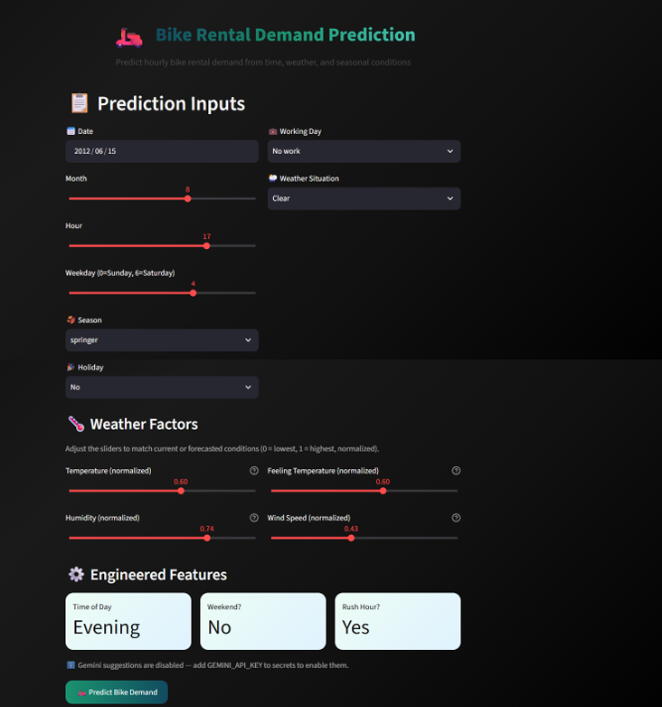
11. Streamlit Dashboard
Inputs
Date • month • hour • weekday • season • holiday • working day • weather • temperature • feels-like temperature • humidity • windspeed
Prediction
Loads model.pkl → builds 36 features → predicts log1p(cnt) → applies expm1 → displays predicted bike demand.
Analytics
Top influencing factors + current weather conditions + rush-hour/weekend/holiday/working-day context.
Optional AI
Gemini can generate a concise operational recommendation when GEMINI_API_KEY is configured.
Bike Rental Demand Prediction • 12

Slide 12
10. Conclusion & References
From data preparation to a usable ML application
Conclusion
Future Scope
• The project transforms 17,379 hourly records into a 36-feature modeling matrix.
• Feature engineering captures calendar, cyclic, weather and operational context.
• Random Forest achieved the best test performance with R² ≈ 0.946.
• The trained model is saved as model.pkl and integrated into a Streamlit dashboard.
• Add live weather/API inputs
• Add station-level predictions
• Add demand forecasting across multiple future hours
• Add model monitoring and retraining
• Add richer operational recommendations
Thank You

