Slide 1
Bank Personal Loan Modelling – Risk Analysis Report
Name: Faizan Ahmad Khan
Date: 07/08/25
Project: Bank Loan Modelling.
This report analyzes customer data to identify key factors affecting loan risk, high-risk customer segments, and actionable risk rules for better lending decisions.

Slide 2
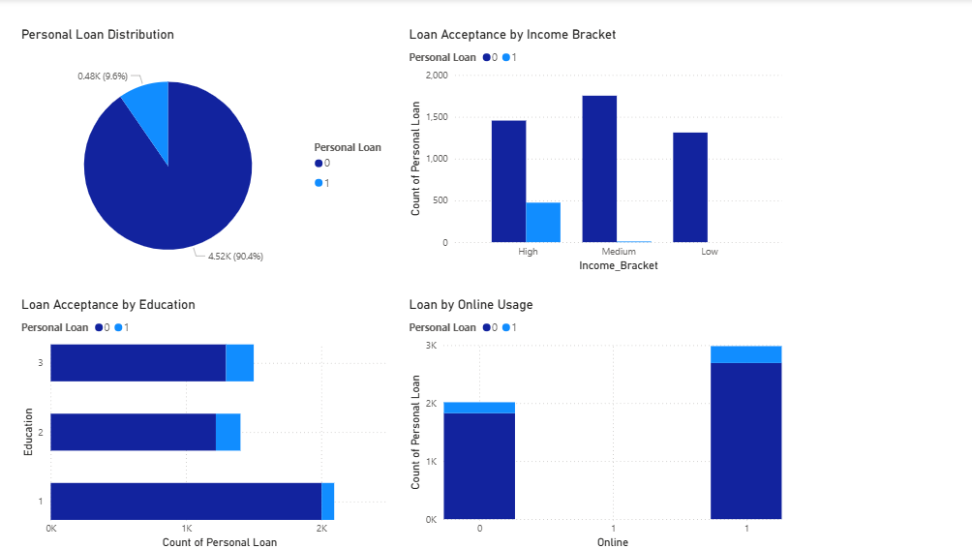

Slide 3
Slide Title: Key Insights from Loan Acceptance Analysis
1. Loan Distribution
Only 9.6% of customers have taken a personal loan.
High untapped potential if right customer segments are targeted.
2. Income Bracket Impact
Medium- and high-income groups show higher loan acceptance.
Low-income group shows minimal adoption, possibly due to eligibility/risk issues.
3. Education Influence
Higher education levels have significantly higher loan acceptance.
Lower-education customers form the largest base but lowest acceptance.

Slide 4
4. Online Banking Effect
Customers using online banking adopt loans more than offline users.
Digital platforms may increase awareness and accessibility of loan products.
5. Strategic Recommendations
Focus marketing on medium/high-income & highly educated customers.
Promote online banking to improve engagement.
Consider customized products/financial literacy for low-income, low-education segments.

Slide 5
Thank You

