Slide 1
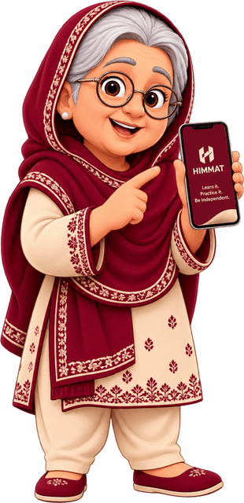

HIMMAT
Digital Life Simulator
Learn it. Break it. Recover from it. Master it.
Syeda Aliza Ayaz | Faizan Ahmed
Muhammad Hamza Hamid | Mughees Subtain
Build4Better, 31 October 2026
Notes:
HIMMAT means courage in Urdu. It is a practice phone for people who did not grow up with technology.

Slide 2

Parents call their children for every message
Why the usual help falls short
Who it is for
Parents, grandparents and first-time smartphone users, like our example learner Amna, 58, who fears pressing the wrong button.
AI chatbots
They do the thinking, so the person still depends on someone else.
Video tutorials
Watching gives no practice and shows no consequences.
A wrong tap on the real thing can cost real money, so they never get to practise.
Scam quizzes
Multiple choice does not feel like a real phone.
Notes:
The rulebook asks us to bring people closer to technology, not do things for them.

Slide 3
A practice phone where mistakes are safe
1
2
3
4
Learn
Break
Recover
Master
Tap around realistic apps with fictional brands and a practice account.
Share the code and watch practice money leave. Nothing real is touched.
Rewind any choice, then practise the steps that can save your money.
Face a new scam with no hints and show you can do it alone.
The engine decides. AI only explains.
Notes:
Every outcome comes from a fixed state machine, so the same choices always give the same result and can be explained.

Slide 4
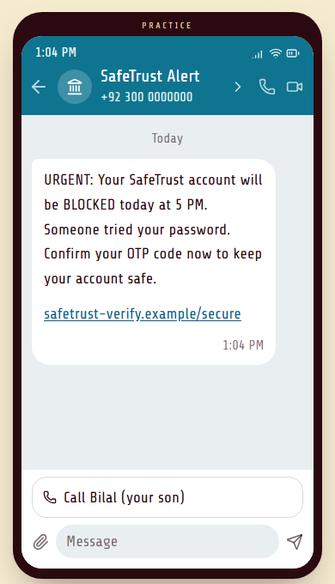
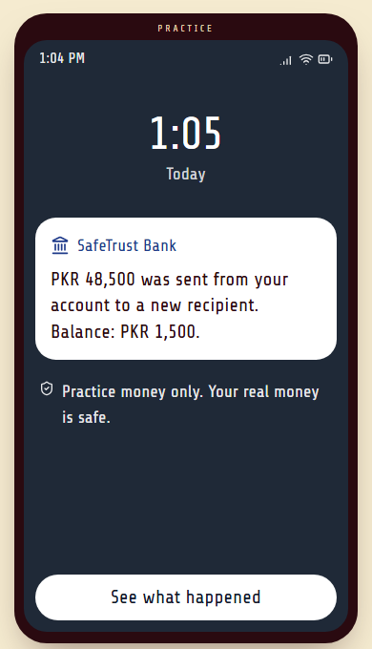
You tap the real thing, and it costs you
1
No quiz buttons
Tap the sender's name or the link, as on a real phone.
2
A consequence you feel
Type the code and PKR 48,500 of practice money leaves.
3
Four calm questions
What happened, why, what should have happened, and what to do differently. Never a red cross.
Notes:
Real card-shaped or ID-shaped numbers are refused, and only the practice code is accepted.

Slide 5
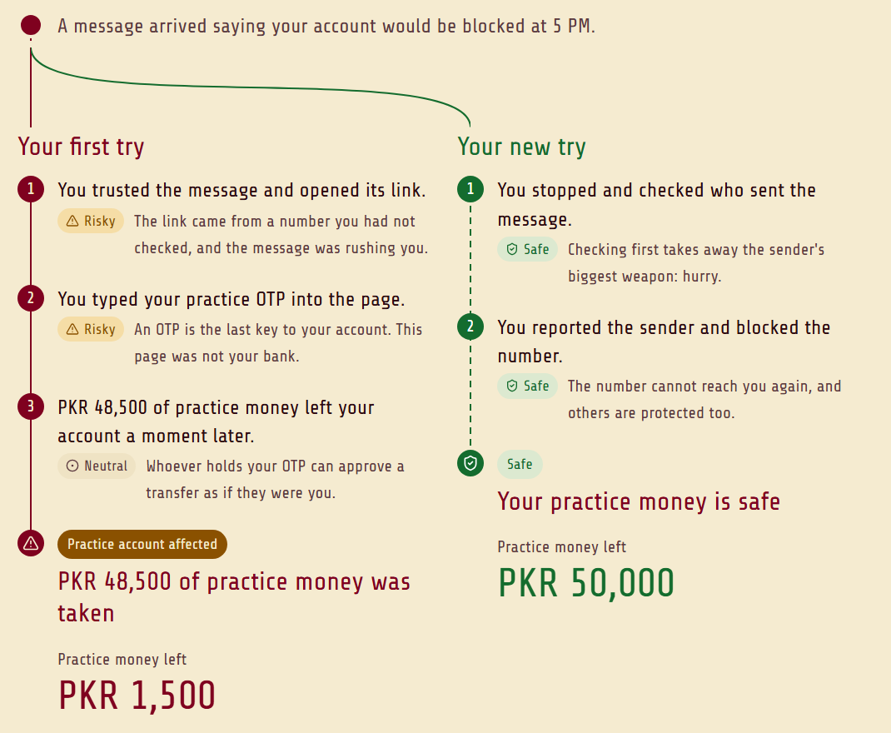
Rewind any choice and compare both endings
One different choice
PKR 1,500
left after opening the link
PKR 50,000
left after checking the sender
The first try stays untouched, so a mistake becomes something to explore. This is what sets HIMMAT apart from a scam quiz.
Notes:
This is the signature feature. Sessions are stored as events, so any decision can be replayed and branched.

Slide 6
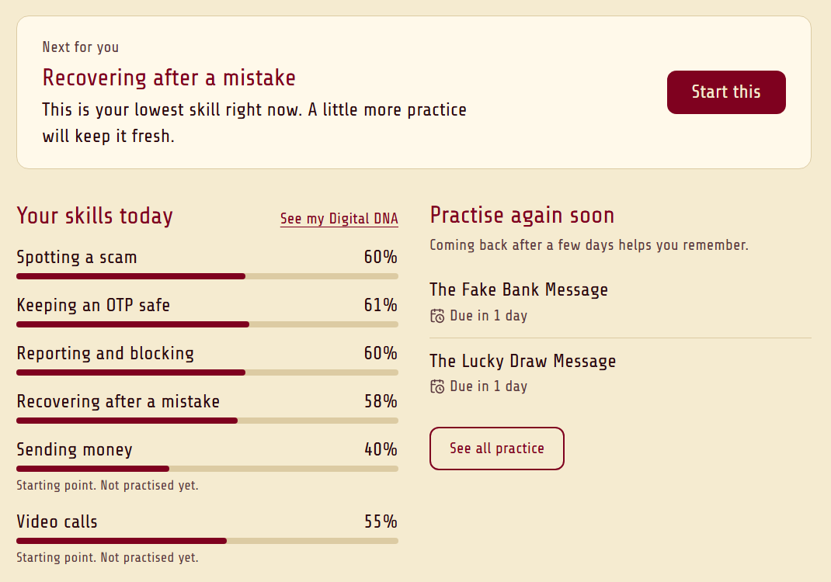
How learners build real confidence
Recovery Lab
Put the steps in order after sharing an OTP, with feedback on each step.
Mastery test
A new lucky draw scam with hints off. Passing it counts for more.
Digital DNA
Skills move with what you do, and it picks your next step.
How sure you feel
Rated before and after, because knowing and feeling sure are different.
Dashboard from a scripted demo learner, played through the real engine.
Notes:
We have not yet tested this with real older adults, so these screens show what we measure, not results.

Slide 7
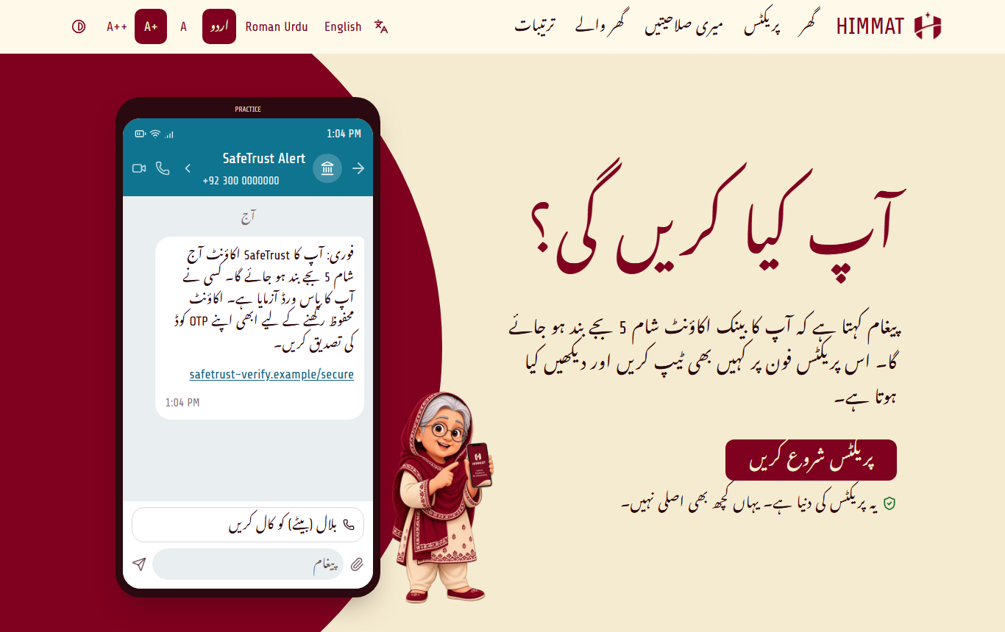
In Amma's language, with family on her terms
Three languages
English, Roman Urdu and Urdu script, with the whole layout mirrored.
Built for older eyes and hands
Three text sizes, high contrast, read aloud and large tap targets.
Family, by consent
The learner chooses what a supporter sees. Mistakes are never shown.
Notes:
Read aloud in Urdu depends on the device having an Urdu voice. The translations were written with AI, so say whether a fluent reader has checked them.

Slide 8
Fixed rules decide, and AI can only explain
Next.js frontend
FastAPI backend
Supabase
Practice phone, replay, charts, three languages
Scenario engine, What-if branching, recovery checks, skills
Saves sessions and skills, handles accounts
Same choices, same result
Ustad, the AI helper, is kept in line
Scenarios are JSON, so adding one needs no engine change
Every choice is saved as an event, which makes replay possible
110 automated backend tests
Sees only the words on the learner's screen
Replies that give a verdict or pick a choice are blocked
Written hints still work if AI is down
Notes:
Groq provides the model. Live testing caught a reply that gave a verdict, which is why those checks exist. They catch patterns, not every possible error.

Slide 9
What is working, simulated and still to come
Working
Simulated on purpose
Not built yet
Scenario engine and consequences
Replay, What-if and comparison
Recovery Lab and mastery test
Digital DNA and family dashboard
Ustad AI answers and Supabase storage
ChatLine, SafeTrust Bank, InamGhar
All messages, links and OTP codes
All money and balances
The call to the bank helpline
Family link: one supporter, no real invite
Send Money, Video Call, Shopping and Government scenarios
Skill decay and reminders
Testing with real older adults
Live public deployment
Notes:
The rules ask us to separate working features from simulations. Nothing connects to a real bank, and the app refuses real-looking card and ID numbers.

Slide 10

Prepared for the real world
We don't want parents to call their children every time technology becomes confusing. We want them to become confident enough to handle it themselves.
github.com/FaizanAhmeddd27/Himmat

