Slide 1



Programming in Android

Slide 2




Explain Android
Explain the history of Android
Describe the architectural framework of Android
Explain the downloading and installation process of Android SDK and IDEs

Slide 3
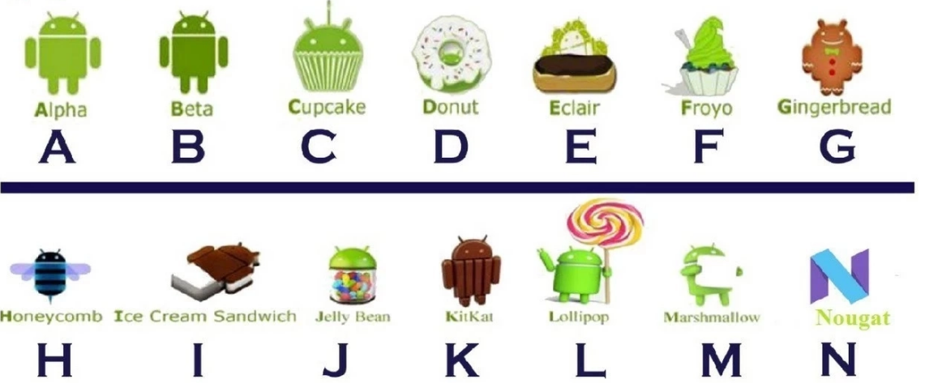




Android Version
Android
10
Android
11
Oreo
O
Pie
P

Slide 4
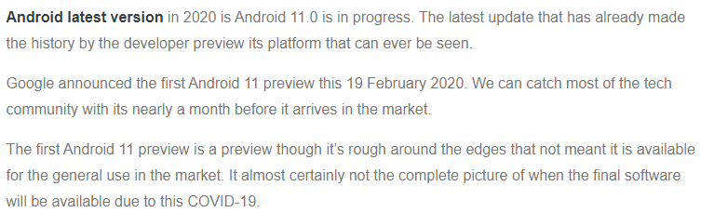

Slide 5







An Operating System is a software program that enables communication and utilization of the hardware resources by the software programs
Each OS can be broadly divided into:
 Application Layer
 Kernel Layer
 Hardware and device driver layers
Kernel translates requests from one layer to another
Android is a Mobile Operating System
Mobile market is dominated by Android and iOS
Applications are OS specific

Slide 6














What is Android?
 A Mobile OS running on the Linux Kernel
 Android applications are written in Java
 Applications run on a virtual machine
 Dalvik VM was used until Android Kitkat
 Lollipop introduces Android Run Time (ART)
History of Android
 Android 1.0 released in 2008
 Latest version is Android Lollipop released in November 20, 2014
 Several improvements made over years
 User base has grown exponentially

Slide 7







Features of Android
 Ease of Programming
 2D and 3D Graphics and Animation
 Multiple Languages
 Web Browsers
 Multi Touch
 Connectivity
 Media Processing
 Sensor Support
 Storage Capabilities
 Large Market Share
 Abstraction of Hardware Differences
 Open Source
 Free to Use
 Ease of Use
 Google Now

Slide 8



Device types running Android
 Smartphones
 Tablets
 Televisions
 Cars and In Vehicle Entertainment
 Android Wear Devices
 Google Glass

Slide 9


Challenges to Developing for Android
 Hardware Fragmentation
 Software Fragmentation
 Lack of Hardware Software Integration Standards
 Lack of Quality Control on Android devices
Android and Open Source platform
 Android is developed privately by Google
 Later, source code is made available to everyone
 Anyone can make changes
 Huge community of mod’ers and developers
 Custom ROMs available to most devices

Slide 10





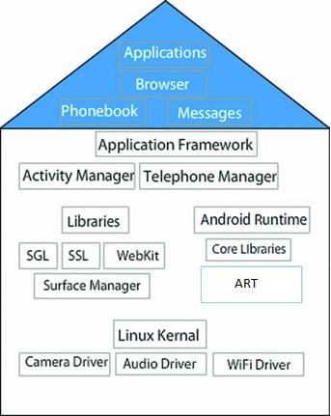
Linux Kernel
 Base layer
 Communicates with the hardware
 Responsible for managing the connected devices
 Interacts with Libraries layer
Libraries
 Consists of the libraries
 Surface Manager
 OpenGL
 Media Framework
 Webkit
 FreeType
 SSL
 SQLite

Slide 11

Android Runtime
 Part of library layer
 ART is similar to JVM
 ART replaces Dalvik VM
 ART replaces JIT with AoT
 Applications are run in Native code
 .odex files replaced with ELF files
Application Framework
 It manages the applications for the basic functioning of the device
 Consists of Activity Manager, Package
Manager, and so on
 This layer interacts with the Applications layer
Application Layer
 Consists of applications
 Includes default and user installed
applications
 The layer interacts with other layers
◆
◆
◆

Slide 12



Dalvik was the VM used earlier for running applications
ART replaces Dalvik in Android Lollipop
Dalvik VM
Just in time compilation
Serves as an alternative to JVM
Relatively high memory consumption
Applications run in Byte code
ART
Replaces Dalvik VM
Ahead of Time (AoT) compilation
Improved performance
Reduced memory usage
Improved garbage collection

Slide 13



It was originally called Android Market
Play Store is the official market place for Android Applications
It comes pre-installed in almost all Android Devices
Primary source for installing applications
Millions of customers
Available in 135 countries
Music, Videos, Movies, and Books are also purchasable

Slide 14



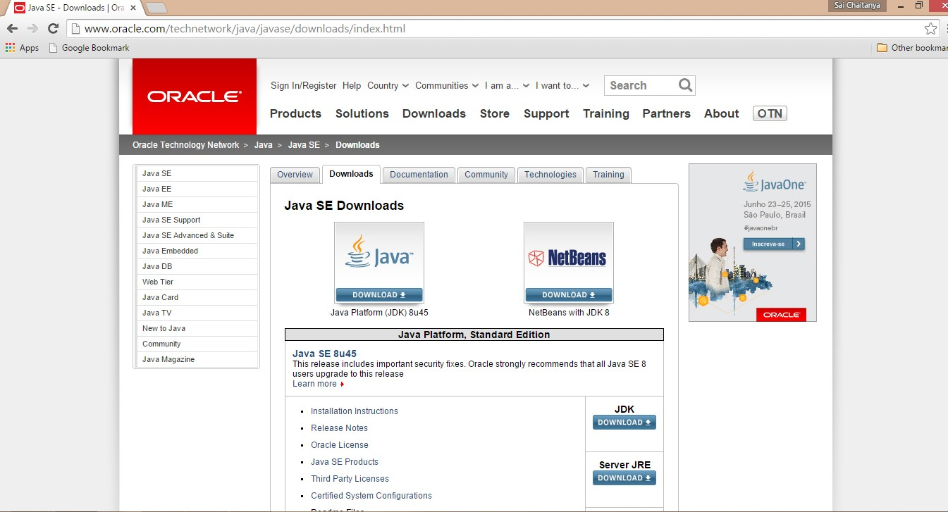
Check system requirements
Go to download link and download the installation file as shown in the following
figure:

Slide 15


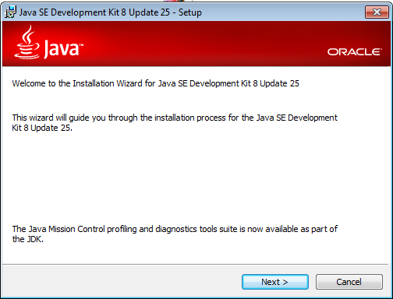
Start the installation running the downloaded setup file.
Click Next to proceed with the installation as shown in the following figure:

Slide 16


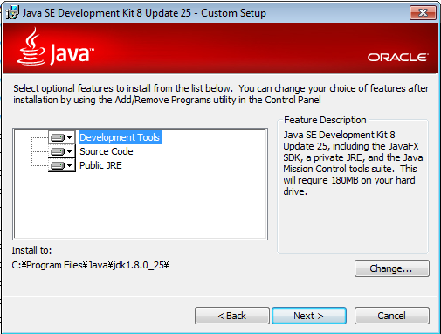
Select the components as shown in the following figure:

Slide 17


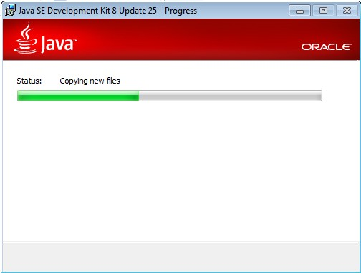
Click Next
The installation begins as shown in the following figure:

Slide 18


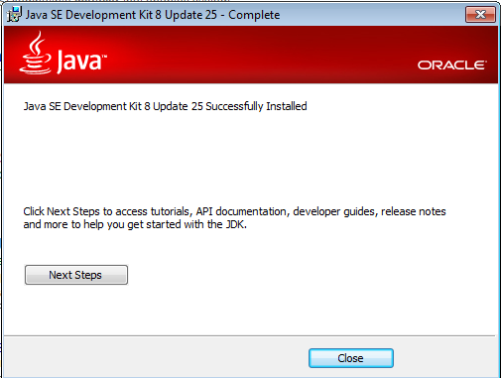
Click Close to complete the installation as shown in the following figure:

Slide 19



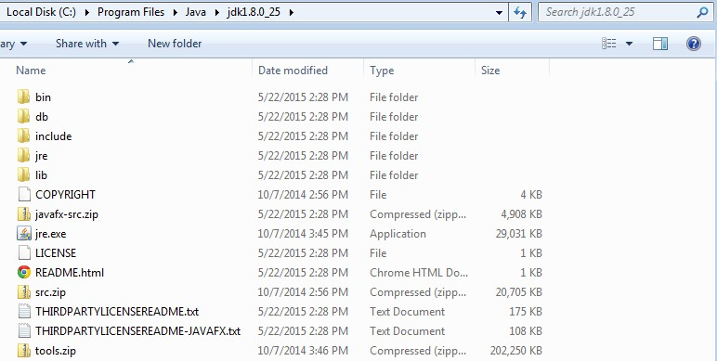
The installation folder can be opened to verify the installation as shown in the
following figure:

Slide 20

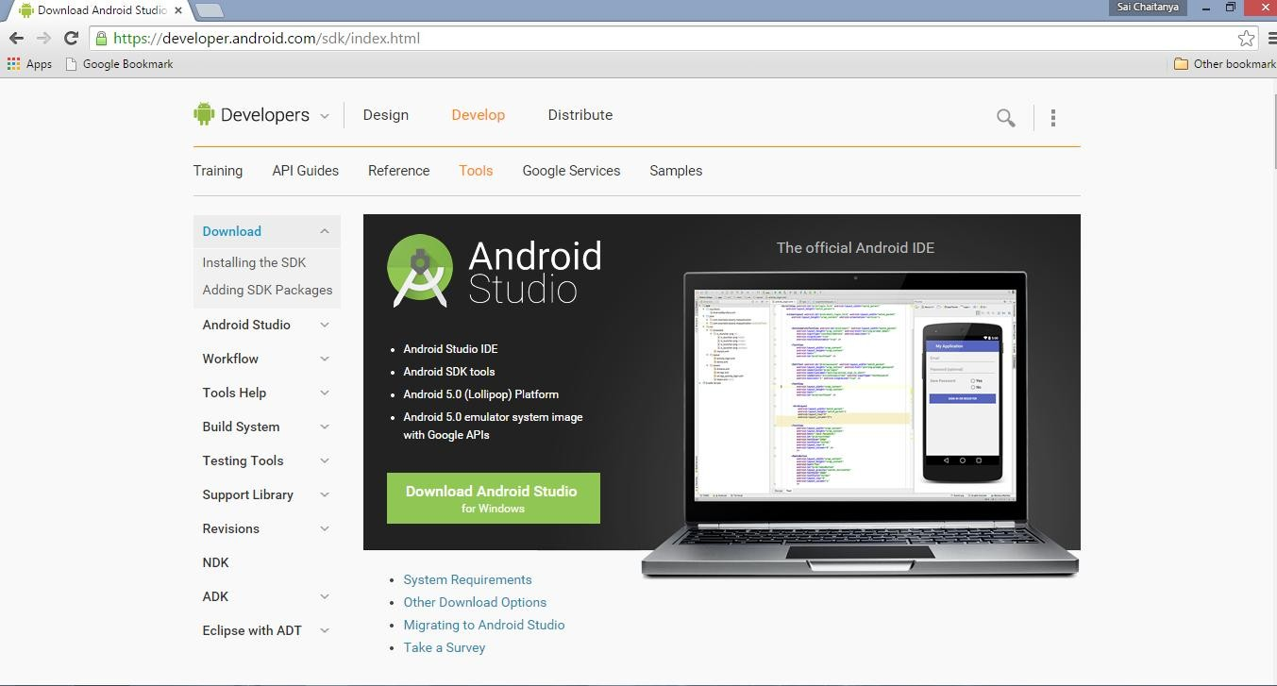
Go to download link and click download as shown in the following figure:

Slide 21




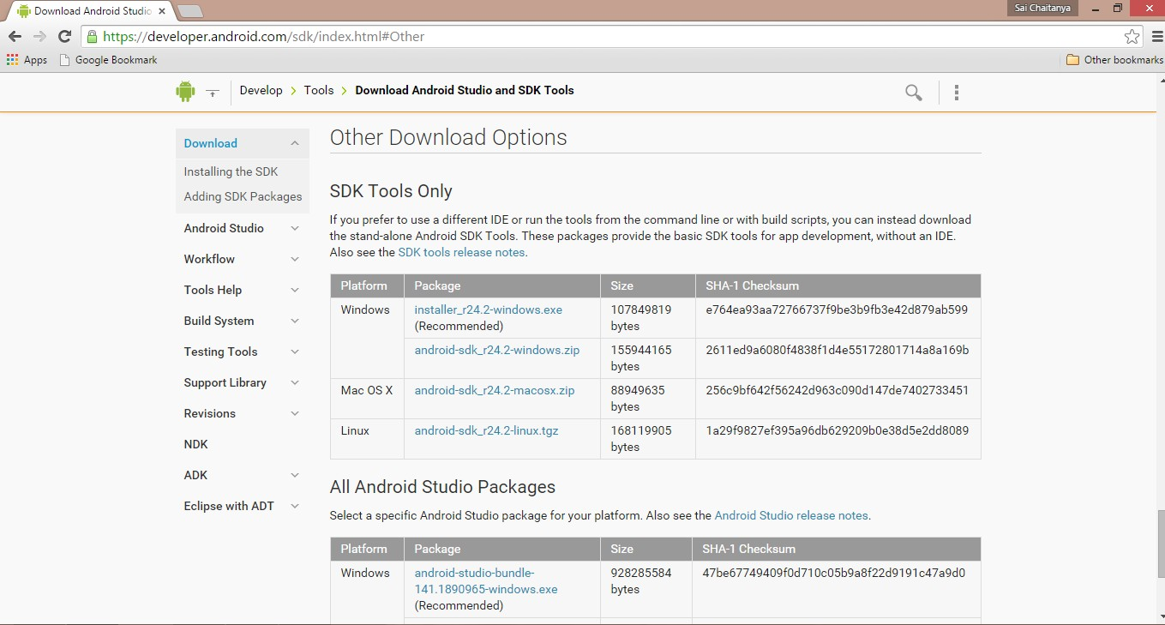
Scroll down to the Other Download Options section as shown in the following
figure:

Slide 22


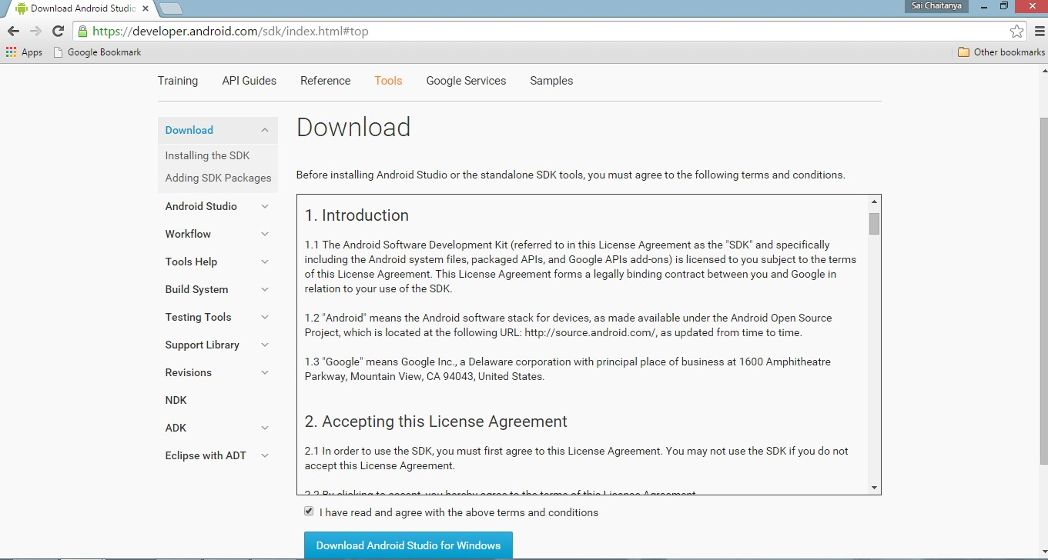
In the Terms and Conditions page, select the ’I have read and agree with the above
terms and conditions’ check box as shown in the following figure:

Slide 23


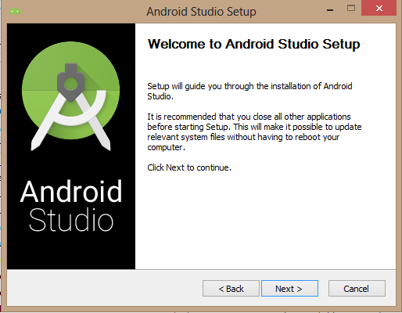
Go to the directory where the SDK has been downloaded
Double-click the Installer. The wizard appears as shown in the following figure:

Slide 24





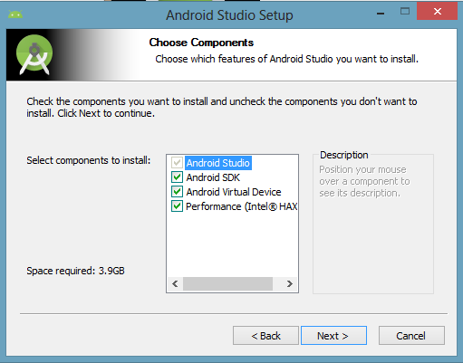
Select all the components in the components screen as shown in the following
figure and click Next.

Slide 25

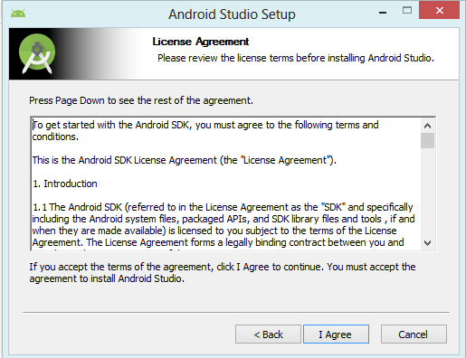
The SDK license agreement appears. Click the ‘I Agree’ button as shown in the
following figure:

Slide 26

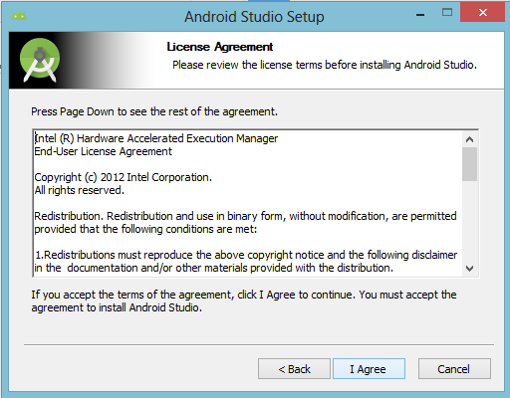
The Intel Hardware Accelerated Execution Manager License Agreement appears if the component was selected as shown in the following figure:

Slide 27

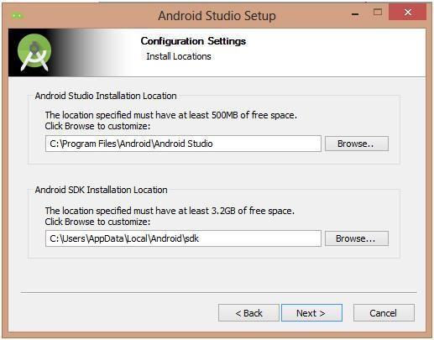
Select ‘I Agree’
The installation path as shown in the following figure:

Slide 28


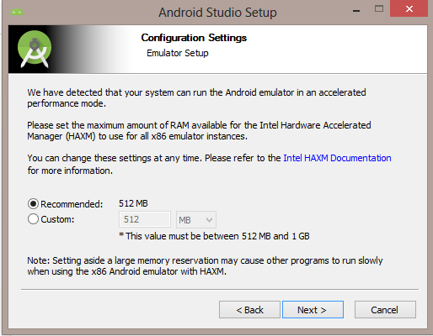
Select the path of installation and click Next. The AVD configuration page appears
as shown in the following figure:
Select the default RAM size for the device and click Next

Slide 29


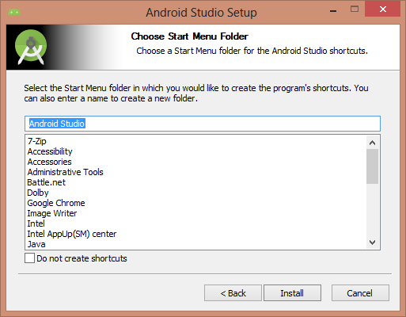
The start menu selection screen appears as shown in the following figure:
Click Install

Slide 30


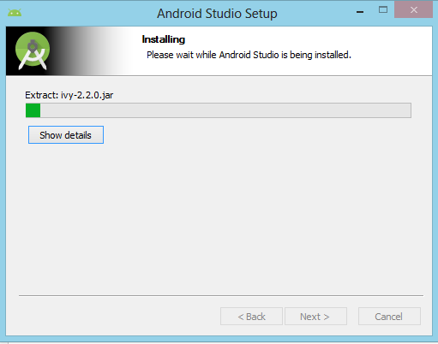
The installation begins as shown in the following figure:

Slide 31


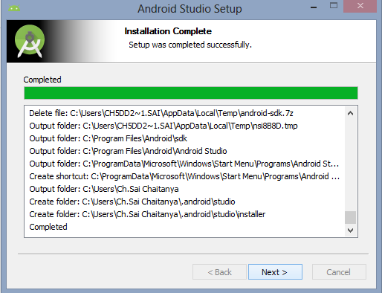
Click Next after the installation completes as shown in the following figure:

Slide 32

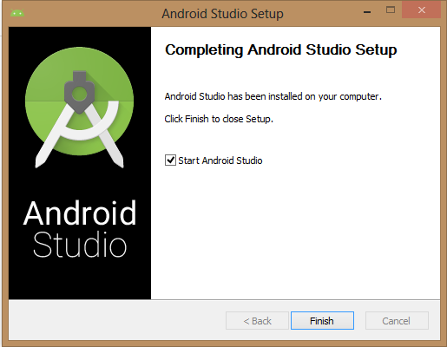
The successfully installed screen appears as shown in the following figure:
Click Finish

