Slide 1
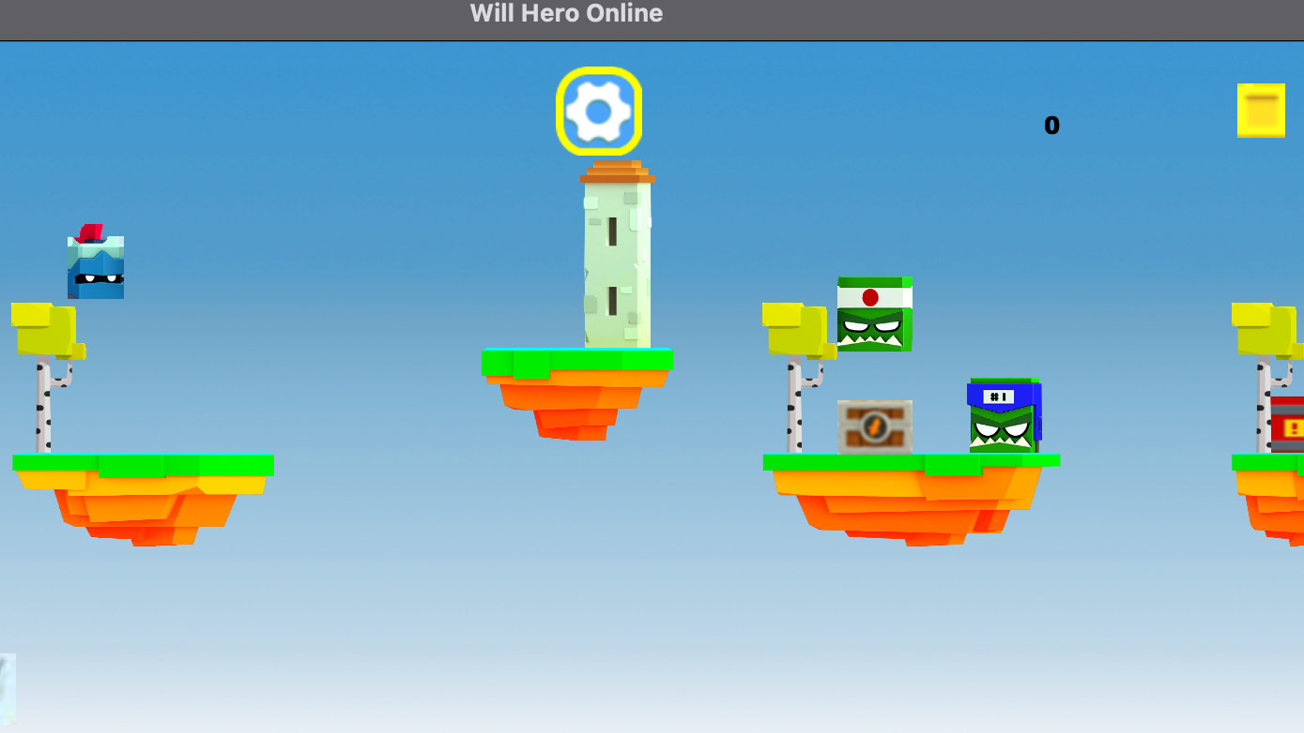
CSE - 201
Divyam Gupta and Mohammad Faizan Haider
Final Project - Will Hero Online, the game (refuelled)

Slide 2
Dynamic Components - Orcs, Platforms, Boss, TNT’s, Coins, Weapon Chests, Coin Chests, Decorations, Hero, Text, buttons
Static Components - Background, Menus and some buttons
Static components were generated using Scene Builder. All dynamic components were coded and added as and when needed. Almost all of the dynamic components are intended to be random. They are also facilitated using imageView objects and added to the main AnchorPane.

Slide 3
Divyam | Faizan
Oops | Collisions
Error Handling | Gravity
Serialize - Deserialize | Motion
Fxml | Weapons
Corner Cases | Boss
Debugging | Decoration
Jumping | Randomisation

Slide 4
Bonus Features
> Stats generation - All stats related to the game are recorded. This is not reset on closing the game and thus are a very practical feature.
> Music - Music and Audio effects are added in the game at different points to make the game a more immersive experience.
> Boss attack - The boss throws spears which are projectile attacks, thus increasing the game’s difficulty and fun.
>Technically extravagance - We built a collision and gravity system from the ground up, we used semaphores to control boss ai, and most of the functions have neglegible library usage.

