Slide 1
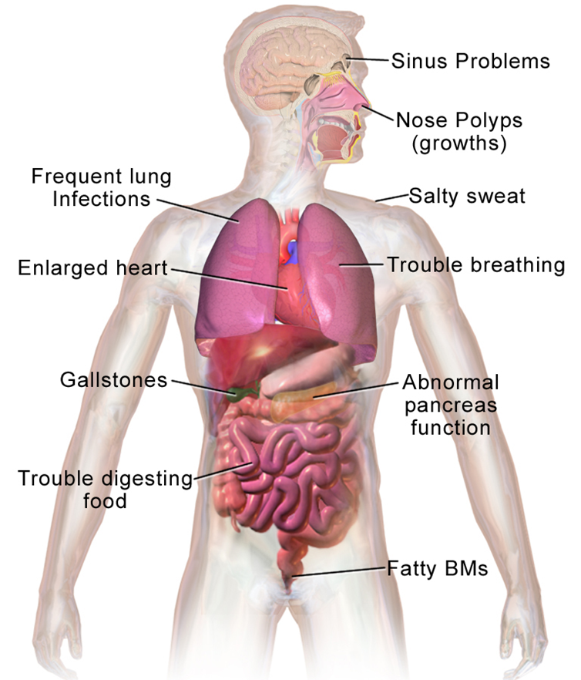
This Scientific Poster Template Is Provided By MakeSigns
Enter A Title And Add Logos To Your Poster
Add Author Names and Information
Include University or Department Names if Needed
ABSTRACT
2. METHODOLOGY
3. RESULTS
4. CONCLUSION
Add your information, graphs and images to this section.
Add your information, graphs and images to this section.
Add your information, graphs and images to this section.
Add your information, graphs and images to this section.
1. INTRODUCTION
1.1. CYSTIC FIBROSIS
Fig 1. Issues associated with CF
Add your information, graphs and images to this section.
Cystic fibrosis (CF) is the most common fatal genetic disease affecting Canadian children and young adults.
At present, there is no cure.
5. ACKNOWLEDGEMENTS
Add your information, graphs and images to this section.
1.2. MODIFIER GENES

