Slide 1
Phenome-wide Association Study of Cystic Fibrosis Modifier Genes
Supervisor: Dr. Lisa Strug
Faizan Khalid Mohsin

Slide 2
Overview
Practicum Site
Background: There is a disease called CF. Three modifier genes worsen the effects of disease. E.g. Disease that decreases lung function and heart problems, the presence of these 3 modifier genes decreases the immune system, or causes increased mucus which increase lung infection and decrease lung function. The modifier genes - mechanism does not affect the disease directly.
Research Question
Data: UK Biobank
What is the prevelance of the 3 SNP (gene modefiers) in the general population and what is it in our population (UK biobank).
What is a PheWAS
The Analysis Plan
References

Slide 3

The Hospital for Sick Children (SickKids)

Slide 4
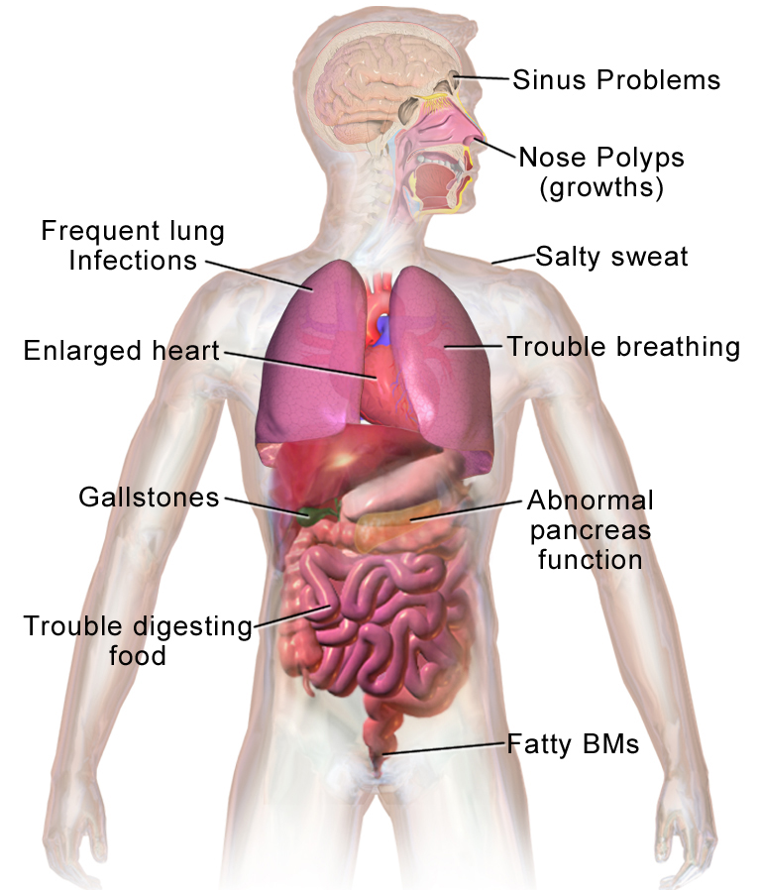
bACKGROUNd
Cystic fibrosis (CF) is the most common fatal genetic disease affecting Canadian children and young adults. At present, there is no cure.

Slide 5
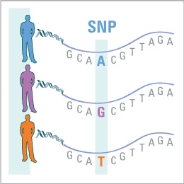
SNP and Modifier Genes
SNP:
A single-nucleotide polymorphism, often abbreviated to SNP (/snɪp/; plural /snɪps/), is a variation in a single nucleotide that occurs at a specific position in the genome, where each variation is present to some appreciable degree within a population (e.g. > 1%).[1]
For example, at a specific base position in the human genome, the C nucleotide may appear in most individuals, but in a minority of individuals, the position is occupied by an A. This means that there is a SNP at this specific position, and the two possible nucleotide variations – C or A – are said to be alleles for this position.
SNPs underlie differences in our susceptibility to a wide range of diseases (e.g. – sickle-cell anemia, β-thalassemia and cystic fibrosis result from SNPs).[2][3][4] The severity of illness and the way the body responds to treatments are also manifestations of genetic variations. For example, a single-base mutation in the APOE (apolipoprotein E) gene is associated with a lower risk for Alzheimer's disease.[5]

Slide 6
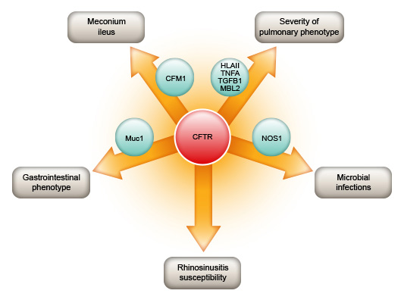
SNP and Modifier Genes
SNP:
A single-nucleotide polymorphism, often abbreviated to SNP (/snɪp/; plural /snɪps/), is a variation in a single nucleotide that occurs at a specific position in the genome, where each variation is present to some appreciable degree within a population (e.g. > 1%).[1]
Notes:
Reference image: http://www.cftr.info/about-cf/cftr-mutations/the-correlation-between-cftr-mutations-and-disease-severity/modifier-genes/

Slide 7
Which phynotypes are associated with the three modifier genes of interest in non-cystic fibrosis population?
Research Question
The 3 modifier genes of interest:
SLC26A9
SLC6A14
SLC9A3
Notes:
WHAT THEIR IMPACT is:
Identify the phenotypes that are associated with being a carrier of Cystic Fibrosis.
The 3 Modifier genes of interest: what phenotypes those modifier genes effect
E.g.
Variability in response to a CFTR-directed therapy attributed to SLC26A9 genotype was assessed in Canadian patients with gating mutations. A primary airway model system determined if SLC26A9 shows modification of Phe508del CFTR function upon treatment with a CFTR corrector.
In those with gating mutations that retain cell surface-localized CFTR we show that SLC26A9 modifies lung function while this is not the case in individuals homozygous for Phe508del where cell surface expression is lacking.
Reference: Cystic fibrosis gene modifier SLC26A9 modulates airway response to CFTR-directed therapeutics
https://academic.oup.com/hmg/article/25/20/4590/2525897

Slide 8
UK Biobank Cohort
Volunteer recruits: England, Scotland and Wales
500,000 people aged between 40-69 years in 2006-2010 from across the country (UK)
The volunteers were largely healthy, wealthy and white European (W)
Notes:
Though only people aged 40-69 years were recruited into the project, there is no upper age limit for participants.
(which measures are self report, which are clinically measured)
Reference:
(UK) https://www.ukbiobank.ac.uk/about-biobank-uk/
(W) https://en.wikipedia.org/wiki/UK_Biobank - (So the goal of my research is to make rich, white people live longer, lol)

Slide 9
Data Wrangling

Slide 10
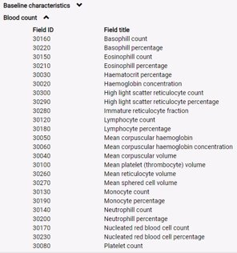
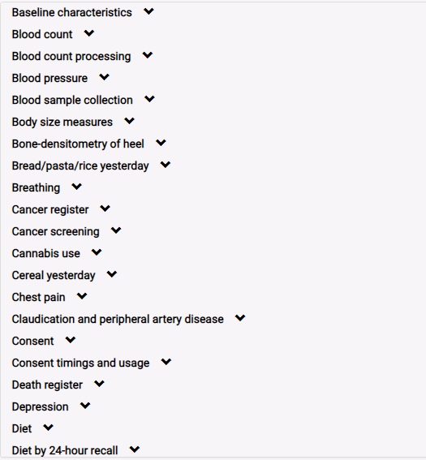
UK Biobank
3450 variables
About 2000 phynotypes
Notes:
Though only people aged 40-69 years were recruited into the project, there is no upper age limit for participants.
(which measures are self report, which are clinically measured)
Reference:
(UK) https://www.ukbiobank.ac.uk/about-biobank-uk/
(W) https://en.wikipedia.org/wiki/UK_Biobank - (So the goal of my research is to make rich, white people live longer, lol)

Slide 11
UK Biobank Phenotypes

Slide 12
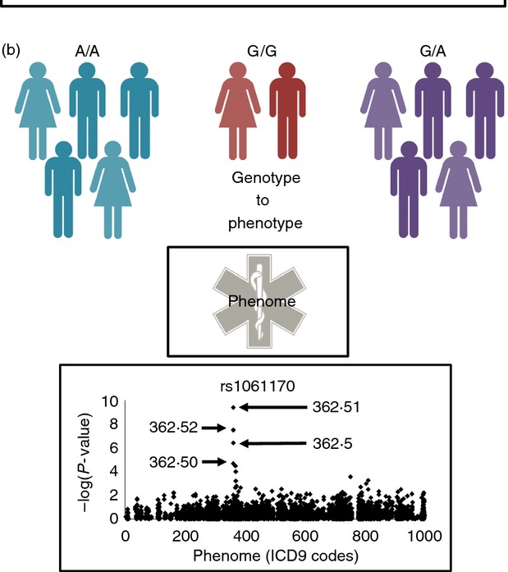
What is a PheWAS?
Notes:
Review paper: The challenges, advantages and future of phenome-wide association studies
https://www.ncbi.nlm.nih.gov/pmc/articles/PMC3904236/

Slide 13
Phenome-Wide Association Study (PheWAS)
PheWAS correlates the genetic variants of interest with every possible phenotype measured to characterize the clinical impact across the body system of these genes.
Statistical Methods to perform PheWAS
Linear or Logistic Regression
χ² and t-tests are available for fast unadjusted tests.
Mind full of multiple testing "uncorrected P-value, Bonferroni correction, etc.".
Results: PheWAS ‘Manhattan’ plots
Advanced Methods
PCA before classification
Notes:
Tree based Methods (Random Forest, etc.)? Perhaps?
R PheWAS: data analysis and plotting tools for phenome-wide association studies in the R environment
https://www.ncbi.nlm.nih.gov/pmc/articles/PMC4133579/

Slide 14
Statistical Methods to perform PheWAS
All data analyses in PheWAS are standard logistic or linear regression analysis, dependent on design or whether the phenotypes are continuous or binary. For variables with multiple categories, binning is used to create new variables of the form “A vs. not A.” An example would be a measurement of menarche, where study participants indicated where they fell within a series of age ranges (9–10, 11–12, 13–14, etc.). In PheWAS, these results would be broken into the age range of 9–10 vs. all other respondents, then a separate binary variable of the age range of 11–12 vs. all other respondents, etc. In addition all continuous phenotypes are natural log transformed after a constant of one is added to each quantitative trait measurement (as some traits have values of “0”). After this transformation, the associations between all SNPs and the transformed phenotypes are calculated. Data transformation will not be necessary for some phenotypes; however, to maintain a high-throughput workflow, we perform the same analyses on all continuous variables. Depending on the phenotype, results from linear regressions on untransformed or transformed data can be later selected for interpretation and further downstream analyses. Because each PAGE study site performs their own tests of association, a variety of statistical packages are used, such as SAS version 9.2 and R version 2.11.0 (The R Foundation for Statistical Computing). How big is the effect of scale of variables?
Notes:
Reference: The Use of Phenome-Wide Association Studies (PheWAS) for Exploration of Novel Genotype-Phenotype Relationships and Pleiotropy Discovery
https://www.ncbi.nlm.nih.gov/pmc/articles/PMC3116446/

Slide 15
Statistical Methods to perform PheWAS
For logistic regression and proportional hazards regression, odds ratios that are greater than 3 are flagged. While these results may be simply be very significant results, more likely, the phenotype may need more inspection or the result may reflect poor estimation because of small cell sizes. Results with an absolute value of beta divided by the standard deviation of the phenotype used in the regression greater than 2.5 (|beta|/SD>2.5) are also flagged. Much like the OR flag, these may be very significant results or perhaps some aspect of the association that should be investigated further. Finally, regression results where the Hardy-Weinberg Equilibrium (HWE) P-value of the SNP used in the regression is P<0.00001 are flagged.
Notes:
Reference: The Use of Phenome-Wide Association Studies (PheWAS) for Exploration of Novel Genotype-Phenotype Relationships and Pleiotropy Discovery
https://www.ncbi.nlm.nih.gov/pmc/articles/PMC3116446/

Slide 16
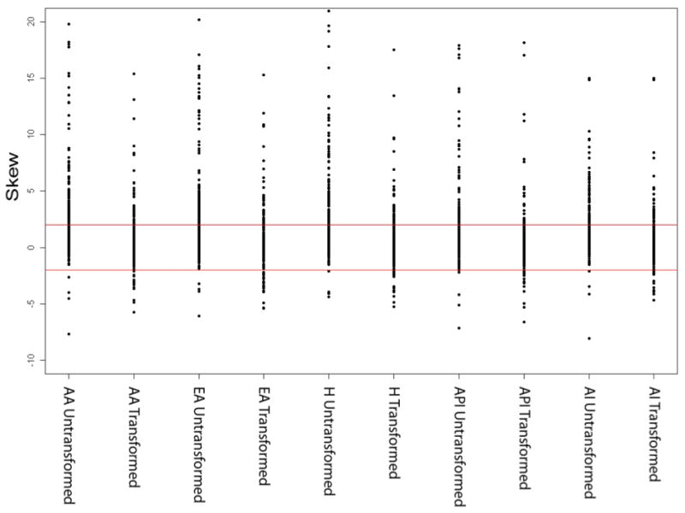
Statistical Methods to perform PheWAS
For continuous variables, skewness of the data is a potential issue; thus, degree of skewness is calculated for all continuous phenotypes. Skewness is also calculated for transformed phenotypes. For most continuous traits, the outliers should not impact the skewness of the data given the relatively large sample sizes for this study. Results are “flagged” where the phenotype for a given set of linear regression results have an absolute skewness value greater than 2 (|skewness| > 2) for the transformed and/or untransformed phenotypes.
Notes:
Reference: The Use of Phenome-Wide Association Studies (PheWAS) for Exploration of Novel Genotype-Phenotype Relationships and Pleiotropy Discovery
https://www.ncbi.nlm.nih.gov/pmc/articles/PMC3116446/

Slide 17
Preliminaries before performing a PheWAS.
We performed a large-scale single-cohort PheWAS, using electronic health record (EHR)-derived case-control status for 541 diagnoses using International Classification of Disease version 9 (ICD-9) codes and 25 median clinical laboratory measures

Slide 18
International Classification of Disease codes diagnostic code data
ICD-9 codes

Slide 19
PheWAS Analysis Plan
Software: R ("PheWAS/PheWAS" package from github), PERL and Linux for high performance computing.

Slide 20
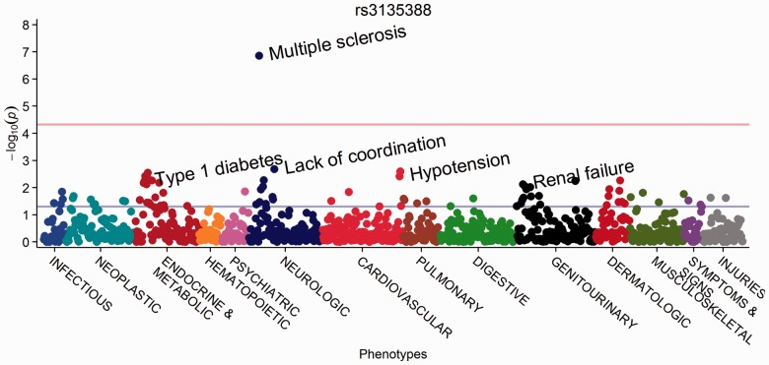
PheWAS
Fig. PheWAS Manhattan plot for rs3135388, with phenotypes ordered by PheWAS code
Notes:
References:
R PheWAS: data analysis and plotting tools for phenome-wide association studies in the R environment
https://www.ncbi.nlm.nih.gov/pmc/articles/PMC4133579/

Slide 21
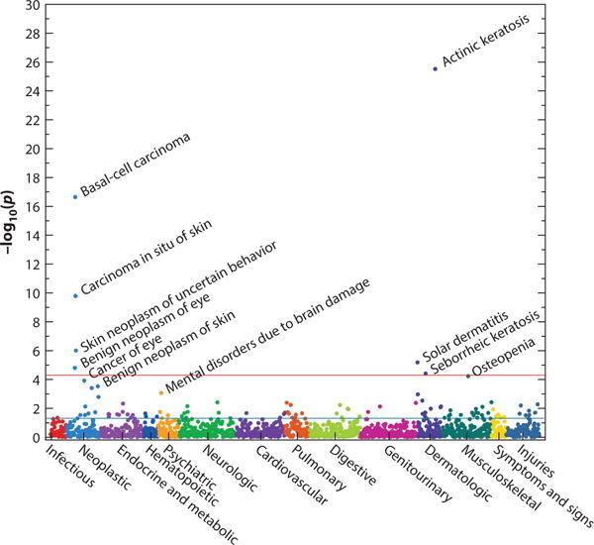
PheWAS
Figure 5
A phenotype-wide association study (PheWAS) plot of rs12203592 in IRF4. The horizontal red line indicates a Bonferroni correction for the number of phenotypes tested in this PheWAS (p = 0.05/1,358 = 3.7 × 10⁻⁵); the horizontal blue line indicates p = 0.05. The analysis shows that this single-nucleotide polymorphism is associated with several phenotypes related to sun exposure, such as actinic keratosis, basal cell carcinomas, osteopenia, and solar dermatitis (sunburns); these were new discoveries in this PheWAS. Figure drawn using data derived from Reference 16 with permission from Nature Biotechnology.
Notes:
References:
Phenome-Wide Association Studies as a Tool to Advance Precision Medicine
https://www.ncbi.nlm.nih.gov/pmc/articles/PMC5480096/

Slide 22
Challenges of a PheWAS Study

Slide 23
LIMITATIONS OF PHEWAS
Multiple comparison testing. For example, if 17 000 phenotypes are tested for association with one SNP, an association with a P < 2·9E-6 would be considered statistically significant if a Bonferroni correction and an experimental wide α of 0·05 is applied. This also assumes that only one SNP is analysed by PheWAS. Conversely, a Bonferroni correction may not be an appropriate multiple comparison adjustment because of the lack of independence across many phenotypes, especially in phenomes that use multiple levels of phenotypic resolution when defining individual case groups (e.g. ICD9 codes 714, 714.3, 714.33).

Slide 24
LIMITATIONS OF PHEWAS
Once a phenome is constructed, association testing is often simplified to basic statistical approaches uniformly applied across the phenome. Small numbers of cases for many phenotypes restrict analyses to contingency table tests of independence (e.g. Fisher’s exact test) precluding the use of covariates. But even if case groups are large enough for regression analysis, standard variables such as age and sex may be inappropriate to implement within a regression model. Age and sex may be covariates for some conditions and confounders for others.

Slide 25
LIMITATIONS OF PHEWAS
Differences across populations may affect the ability to validate findings. At the SNP level, it would not be unexpected to see very different GWAS results from a population with European ancestry compared with a population with African ancestry as a result of significant differences in the linkage disequilibrium structure and allele frequencies between the two populations.
There may be significant differences in clinical care, and the use of ICD9 codes, that is observed in different ethnicities, between different physicians, and across different healthcare providers. These differences may change over time with changes in standard medical practice.

Slide 26
Questions?

Slide 27
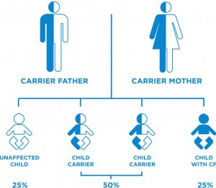
Cystic Fibrosis
Approximately, one in 25 Canadians carry one defective copy of the CF gene. Carriers do not have CF, nor do they exhibit any of the related symptoms.
If both parents are carriers, there is a 50 percent chance that the child will be a carrier.
Notes:
CF is a genetic disease that occurs when a child inherits two defective copies of the gene responsible for cystic fibrosis, one from each parent.
When two CF carriers have a child, there is a 25 percent chance that the child will be born with CF. There is also a 50 percent chance that the child will be a carrier, and a 25 percent chance that the child will not be a carrier, nor have CF.

Slide 28
pleiotropy (countable and uncountable, plural pleiotropies)
(genetics) The influence of a single gene on multiple phenotypic traits; pleiotropism.

Slide 29
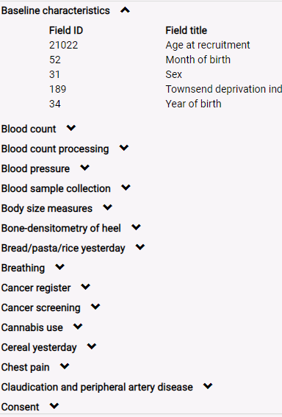
UK Biobank
Notes:
Though only people aged 40-69 years were recruited into the project, there is no upper age limit for participants.
(which measures are self report, which are clinically measured)
Reference:
(UK) https://www.ukbiobank.ac.uk/about-biobank-uk/
(W) https://en.wikipedia.org/wiki/UK_Biobank - (So the goal of my research is to make rich, white people live longer, lol)

Slide 30
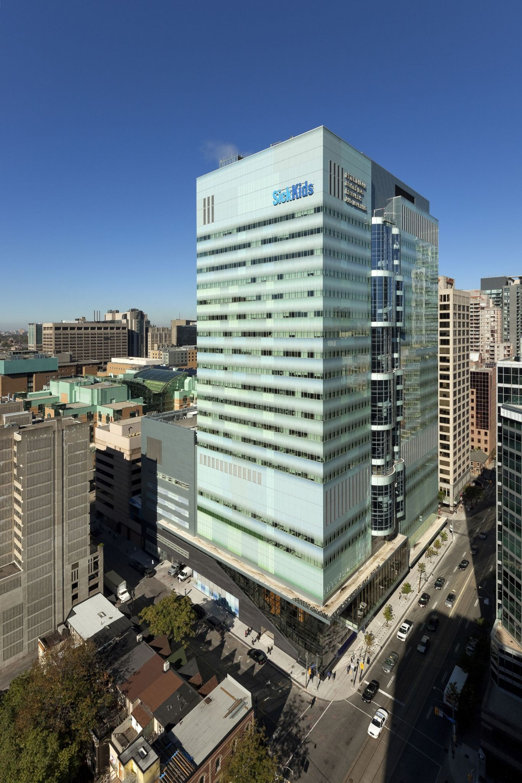
The Hospital for Sick Children

Slide 31
The Hospital for Sick Children (SickKids)

Slide 32
The Hospital for Sick Children (SickKids)

