Slide 1
Phenome-wide Association Study of Cystic Fibrosis Modifier Genes
Supervisor: Dr. Lisa Strug
Faizan Khalid Mohsin

Slide 2




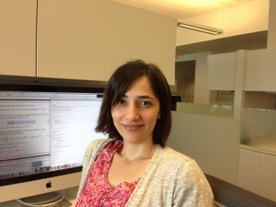
The Hospital for Sick Children
Strug Lab

Slide 3
Overview
Background: Cystic Fibrosis and Modifier Genes
Research Question
What is a PheWAS?
PheWAS Methods
Database: UK Biobank
Limitations and Challenges

Slide 4
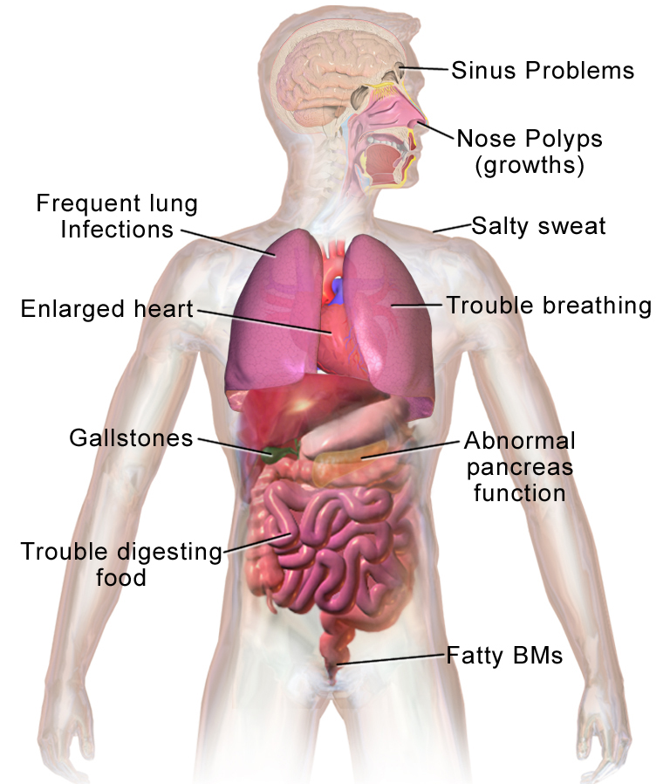
bACKGROUNd
Cystic Fibrosis
Cystic fibrosis (CF) is the most common fatal genetic disease affecting Canadian children and young adults. At present, there is no cure.
Commonly suffer from lung disease.
All physical and observable traits.
E.g. Height, hair color, white blood cell count, and diseases you may have (diabetes, cystic fibrosis, etc.).
Phenotype
Notes:
[1] Reference: Cystic Fibrosis Canada website
https://www.cysticfibrosis.ca/about-cf/what-is-cystic-fibrosis

Slide 5
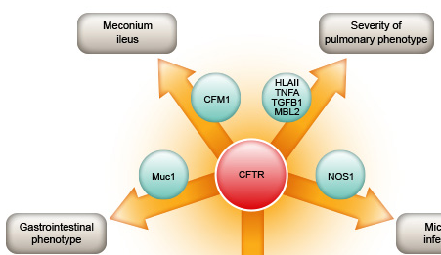
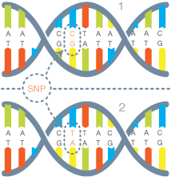
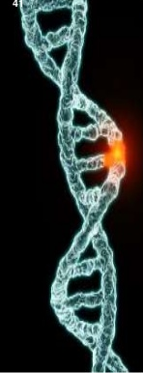
Modifier Genes
Modifier Gene
SLC26A9
RS4077468
Cystic Fibrosis (CF) Genetic modifiers are SNPs that affect the severity of the disease.
Modifier gene: SLC26A9
Affects lung function for people with CF.
SNP: RS4077468
SNP Variation:
AA
AT
TT
SLC26A9
SNP
A
A
SLC26A9 Gene
RS4077468
A
T
Notes:
Reference image: http://www.cftr.info/about-cf/cftr-mutations/the-correlation-between-cftr-mutations-and-disease-severity/modifier-genes/
Some Modifier genes worsen the severity of disease. E.g. The presence of modifier genes could decrease the immune system, or cause increased mucus which increases lung infection. Hence, someone with a lung disease could experience much more sever symptoms. The modifier genes’ mechanism need not affect the disease directly to worsen it.
Everyone has these genes which effect the severity of the disease.
Multiple regression.

Slide 6
If do not have cystic fibrosis what is the impact of variation in the three modifier genes on a person's phenotypes.
Research Question
We will answer this question through a Phenome-wide Association Study (PheWAS).
The 3 modifier genes of interest:
1) SLC26A9 (E.g. look at SNP RS4077468 with variation AA, AT or TT)
2) SLC6A14 rs3788766 mi paper
3) SLC9A3 rs57221529 lung paper corval et al.
Notes:
WHAT THEIR IMPACT is:
The 3 Modifier genes of interest: what phenotypeP these modifier genes effect
Which phenotypes are associated with the three modifier genes of interest in a non-cystic fibrosis population?
E.g.
Variability in response to a CFTR-directed therapy attributed to SLC26A9 genotype was assessed in Canadian patients with gating mutations. A primary airway model system determined if SLC26A9 shows modification of Phe508del CFTR function upon treatment with a CFTR corrector.
In those with gating mutations that retain cell surface-localized CFTR we show that SLC26A9 modifies lung function while this is not the case in individuals homozygous for Phe508del where cell surface expression is lacking.
Reference: Cystic fibrosis gene modifier SLC26A9 modulates airway response to CFTR-directed therapeutics
https://academic.oup.com/hmg/article/25/20/4590/2525897

Slide 7
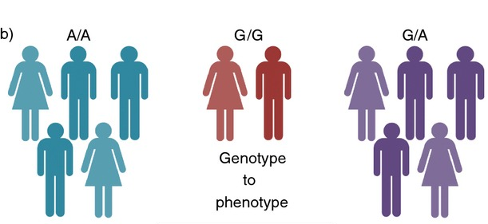
What is a PheWAS?
A/T
T/T
PheWAS: Phenome-Wide Association Study
Tests the association between genetic variants of interest with every phenotype measured.
Association: genotype (G) → all phenotypes (P’s)
Notes:
Reference (Review paper):
The challenges, advantages and future of phenome-wide association studies
https://www.ncbi.nlm.nih.gov/pmc/articles/PMC3904236/
Phenotype
https://en.wikipedia.org/wiki/Phenotype

Slide 8
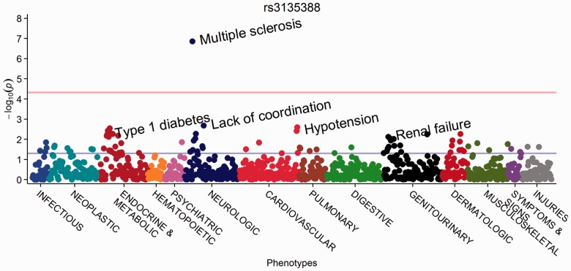
PheWAS Manhattan Plot
Genotype
Bonferroni correction
α = 0.05
Figure 5. PheWAS Manhattan plot for rs3135388, with phenotypes ordered by PheWAS code. (Carrol et al. 2014)
Notes:
Reference:
R PheWAS: data analysis and plotting tools for phenome-wide association studies in the R environment
https://www.ncbi.nlm.nih.gov/pmc/articles/PMC4133579/

Slide 9
Phenome-Wide Association Study (PheWAS)
Statistical Methods for performing PheWAS
Phenotype_i = covariates + SLC26A9 i=1, …, 2000
0 if RS4077468_AA
SLC26A9 = 1 if RS4077468_AT
2 if RS4077468_TT
Covariates: Age, gender and Age-squared.
Perform: Logistic Regression: type of the phenotype
Software:
R ("PheWAS/PheWAS" package from github)
Linux environment for high performance computing.
Notes:
Reference: If snp is aa, at or tt
Ancestral PCA: Principal Components Analysis (PCA) is a fast, nonparametric method of detecting structure in data. When applied to genetic data, it separates major axes of ancestry, which separates samples based on population genetic structure. Differentiates people with different lineages. We only have snp info in the model. And this can be a confounder. Ref:PCAdmix: Principal Components-Based Assignment of Ancestry along Each Chromosome in Individuals with Admixed Ancestry from Two or More Populations: https://www.ncbi.nlm.nih.gov/pmc/articles/PMC3740525/
MINOR ALLELE TT
T minor allele
pValue in a snp
χ2 and t-tests.
Proportional odds models, all kinds of things
R PheWAS: data analysis and plotting tools for phenome-wide association studies in the R environment
https://www.ncbi.nlm.nih.gov/pmc/articles/PMC4133579/
Tree based Methods (Random Forest, etc.)? Perhaps?

Slide 10
UK Biobank
Cohort
500,000 people aged between 40-69 years in 2006-2010 from across the country (UK).
Volunteers recruited from England, Scotland and Wales.
Approximately 2000 phenotypes (30GB).
Genotype data (100GB). Micro arrays: between 500,000 to 1 million SNPs per person.
Anticipate spending a lot of time data wrangling.
Notes:
References: introns and exons.
(UK) https://www.ukbiobank.ac.uk/about-biobank-uk/
(W) https://en.wikipedia.org/wiki/UK_Biobank
Made it publicly available to researchers ( not free)
. Micro arrays 500,000 ~ 1million SNPs per person, indels
*Though only people aged 40-69 years were recruited into the project, there is no upper age limit for participants.
Which measures are self report, which are clinically measured – bias?

Slide 11
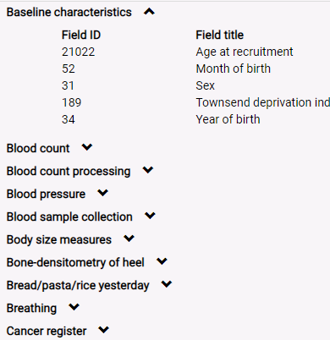
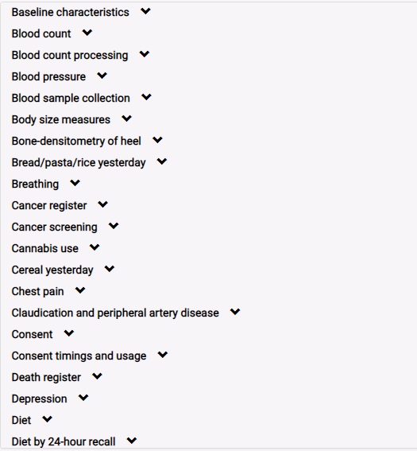
UK Biobank (Variables)
Notes:
References:
(UK) https://www.ukbiobank.ac.uk/about-biobank-uk/
(W) https://en.wikipedia.org/wiki/UK_Biobank
Which measures are self report, which are clinically measured – bias?

Slide 12
Some Challenges and Limitations.
Multiple testing.
2000 phenotypes
Experimental wide α of 0·05
Bonferroni correction: P < 2·5E-5
Missing data (phenotype & genotype).
Choosing covariates.
Relatedness, kinship checking.
Computing the ancestral PCA.
Implementing all of this in a HPF.
External validation and generalizability of results.
Notes:
Reference (Review paper):
The challenges, advantages and future of phenome-wide association studies
https://www.ncbi.nlm.nih.gov/pmc/articles/PMC3904236/
Contrived phenotypes.
Pcomponents
Estimate kinship coefficients.
3rd degree, delete 1st cousins.
But even if case groups are large enough for regression analysis, standard variables such as age and sex may be inappropriate to implement within a regression model.
Small numbers of cases for many phenotypes may restrict analyses to contingency table tests of independence (e.g. Fisher’s exact test) precluding the use of covariates. ( may or may not happen, most likely not an issue for us).
Pleiotropic study: multilinear regression.
Phenome-Wide Association Studies as a Tool to Advance Precision Medicine
https://www.ncbi.nlm.nih.gov/pmc/articles/PMC5480096/

Slide 13
Questions?

