Slide 1
CS254: Database Systems
Project Part 1
Faizan Muhammad BSCS25040
Shahbaz Hussain BSCS25130
Talha Sami BSCS25116
Abdul Moiz BSCS25134

Slide 2
TASK 1A
Organisation Overview
NAME & INDUSTRY
WHY A RELATIONAL DATABASE?
Fusion Bites Restaurant Management System
Food & Restaurant Industry
Data Consistency: Foreign keys maintain valid relationships between users, orders, payments, and menu items.
Transaction Support: Ensures atomic checkout operations using
COMMIT and ROLLBACK transactions.
CORE BUSINESS ACTIVITIES
Customer food ordering
Menu browsing & cart management
Online checkout & payment handling
Order tracking & invoice generation
Admin dashboard & sales monitoring
User and order management
Structured Relationships: Restaurant data is highly structured and naturally modeled using relational tables
SQL Analytics Supports reporting features such as revenue, top-selling items, and payment statistics.

Slide 3
TASK 1A
Database Purpose & Dataset
WHAT THE DATABASE DOES
DATASET
Database Purpose & Dataset
Centralized database for restaurant operations.
Stores and manages:
• Customer accounts
• Menu items
• Orders and order items
• Payments and invoices
• Admin and operational data
Without the database, restaurant data would
be scattered and difficult to manage consistently.
4000+ seeded users
50+ menu items
500+ Multiple orders & payments
Invoice records
Relational schema with PKs/FKs
Structured restaurant dataset
We also populated the database with sample seed data to simulate realistic restaurant operations and testing

Slide 4
TASK 1A
Key Transactions & Role Based Access
DAILY TRANSACTIONS SUPPORTED
ROLE BASED ACCESS
Customer Login User authentication and session creation through backend
API routes.
Customer: Browse menu, place orders,
view invoices and profile.
Menu Browsing
Customers browse categorized menu items
fetched dynamically from the database.
Admin: Manage users, orders,
payments, and dashboard statistics.
Cart & Checkout
Cart items processed into orders,
payments, and order items using SQL transactions.
Kitchen Staff: View and update order
preparation statuses only.
Analyst : Read-only access for
sales and operational reporting.
Order Processing
Orders tracked and updated through
different preparation and delivery stages.
Payment Recording Payment information stored and linked
with customer orders and invoices.
Admin Operations
Admins manage users, orders,
payments, and business statistics.

Slide 5
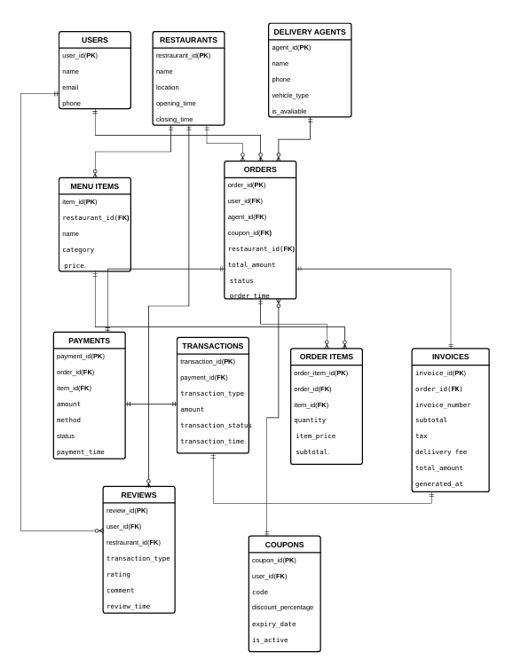
TASK 1B
Entity Relationship Diagram
Challenges
ProblemsEncountered (ERD/Normalisation)
• Early database design stored several dishes inside a single order row, creating repeating groups
and violating First Normal Form (1NF).
• Resolution: The structure was normalised by separating the data into Orders and OrderItems
tables, where each ordered dish is stored as an individual row with its own quantity and price
information

Slide 6
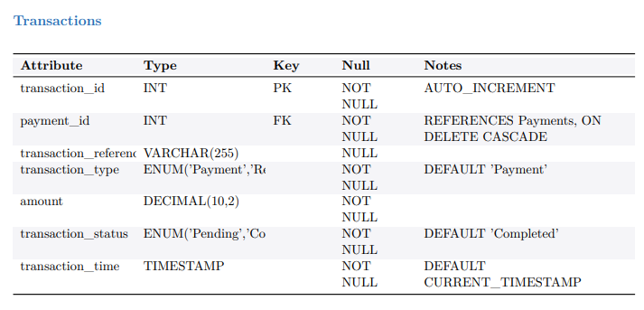
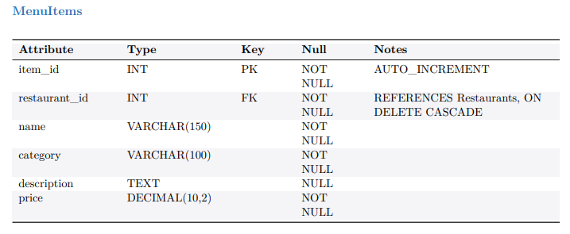
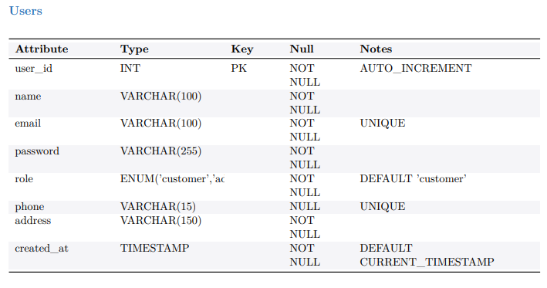
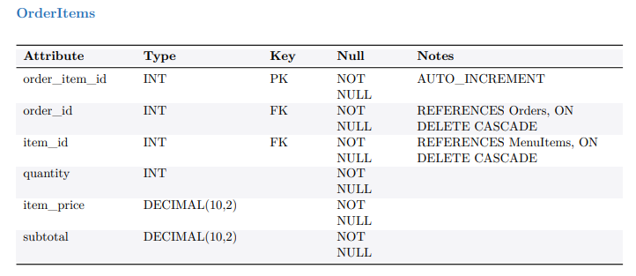
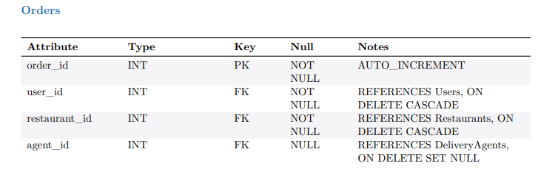
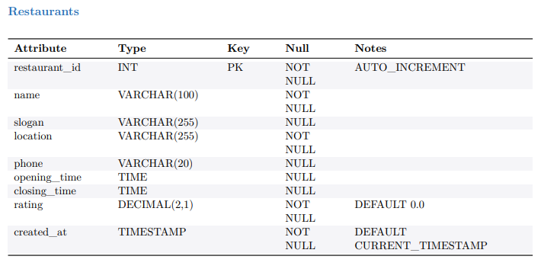
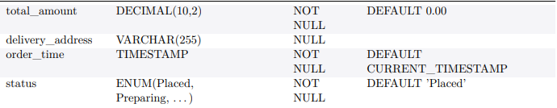
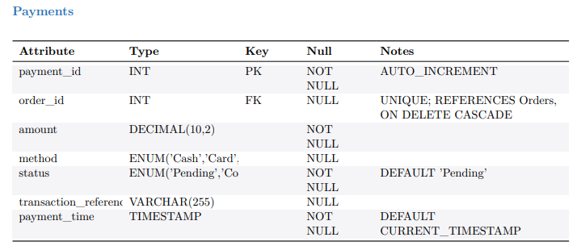
TASK 1B
Data Dictionary

Slide 7
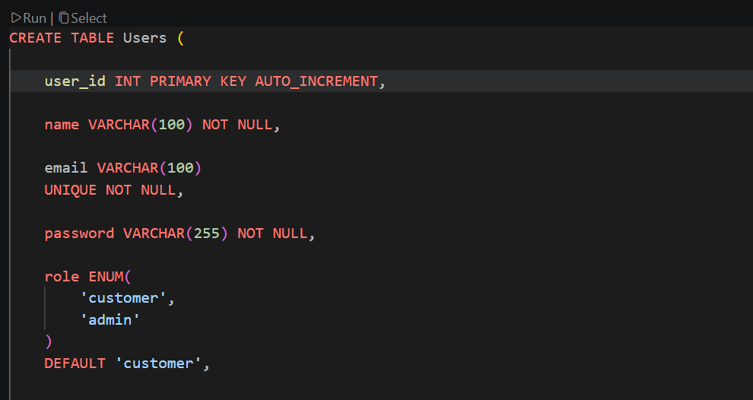
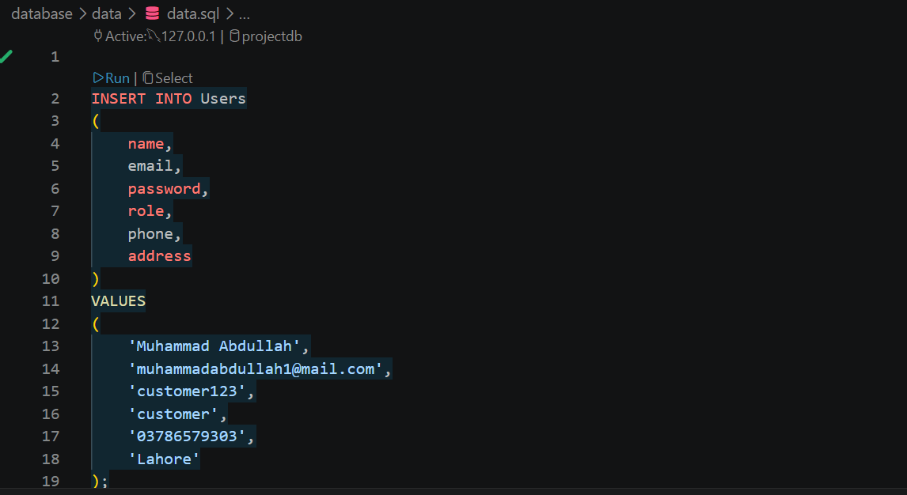
TASK 2A / 2B
Implementation — Schema
CREATE TABLE Scripts (Task 2a)
Sample Data (Task 2b)

Slide 8
TASK 2C
SQL Queries
# | Query Purpose | Key Features
Q1 | High-value customer orders with customer details | CTE, JOIN, WHERE, ORDER BY, LIMIT
Q2 | Menu category analysis with average pricing | GROUP BY, COUNT, AVG, ROUND
Q3 | Order status tracking and updates | SELECT, UPDATE, Conditional Filtering
Q4 | Remove expired inactive coupons | DELETE, Date Filtering
Q5 | Customer order history and lifetime spending | LEFT JOIN, GROUP BY, HAVING, Aggregation

Slide 9
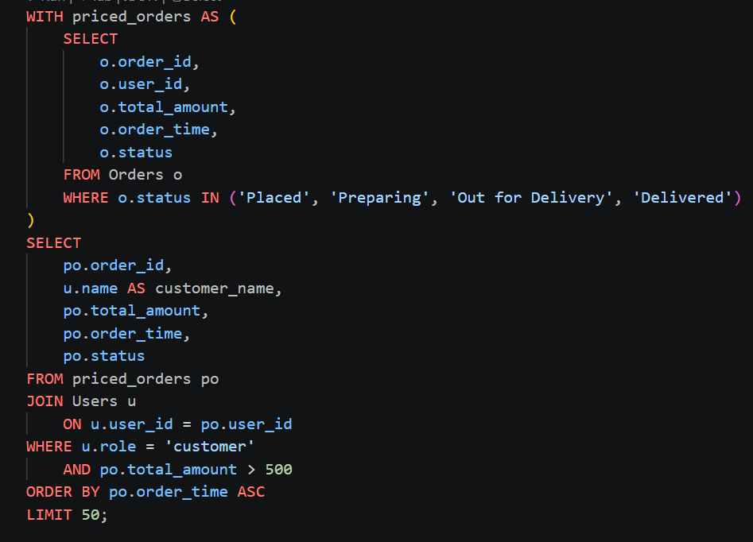
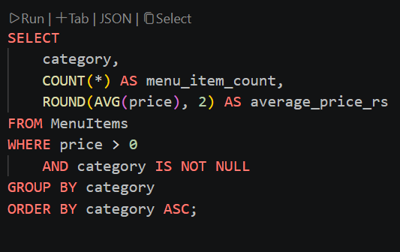
TASK 2D / 2E
FIVE SQL QUERIES
Query 1
Query 2
.

Slide 10
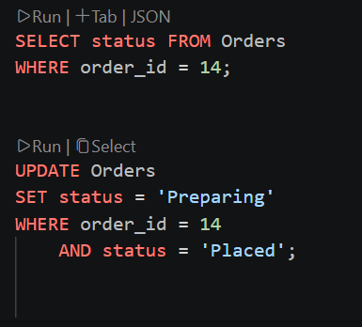
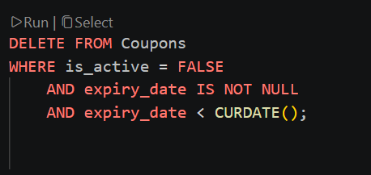
TASK 2D / 2E
FIVE SQL QUERIES
Query 3
Query 4
.

Slide 11
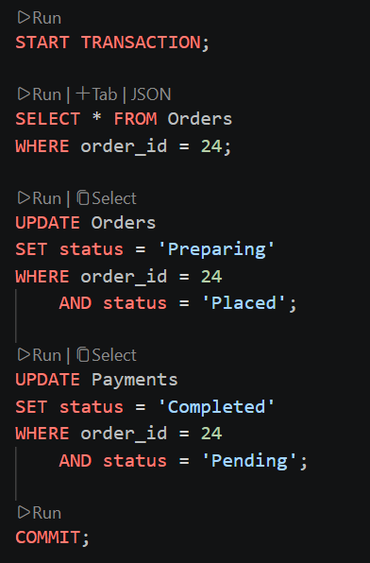
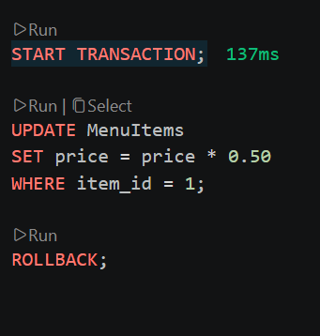
TASK 2D / 2E
Transactions
Query 1
Query 2
.

Slide 12
Role-Based Access Control (RBAC)
What is RBAC?
Role-Based Access Control restricts database access
based on organizational responsibilities.
Different users receive different permissions
according to their operational role.
Role | Permissions
fb_ops_admin | Full CRUD access
fb_kitchen | Order management access
fb_analyst | Read-only analytical access
Why RBAC?
• Improves database security
• Prevents unauthorized access
• Protects sensitive information
• Follows least-privilege principle

Slide 13
TASK 3
Web Application Front End
Frontend Features
• Responsive React-based UI
• Dynamic menu browsing
• Cart and checkout system
• Customer dashboard
• Admin ERP dashboard
• Real-time API integration
Frontend Technologies
• Next.js App Router
• React Client Components
• Tailwind CSS
• TypeScript
• Fetch API
Home / Dashboard

Slide 14
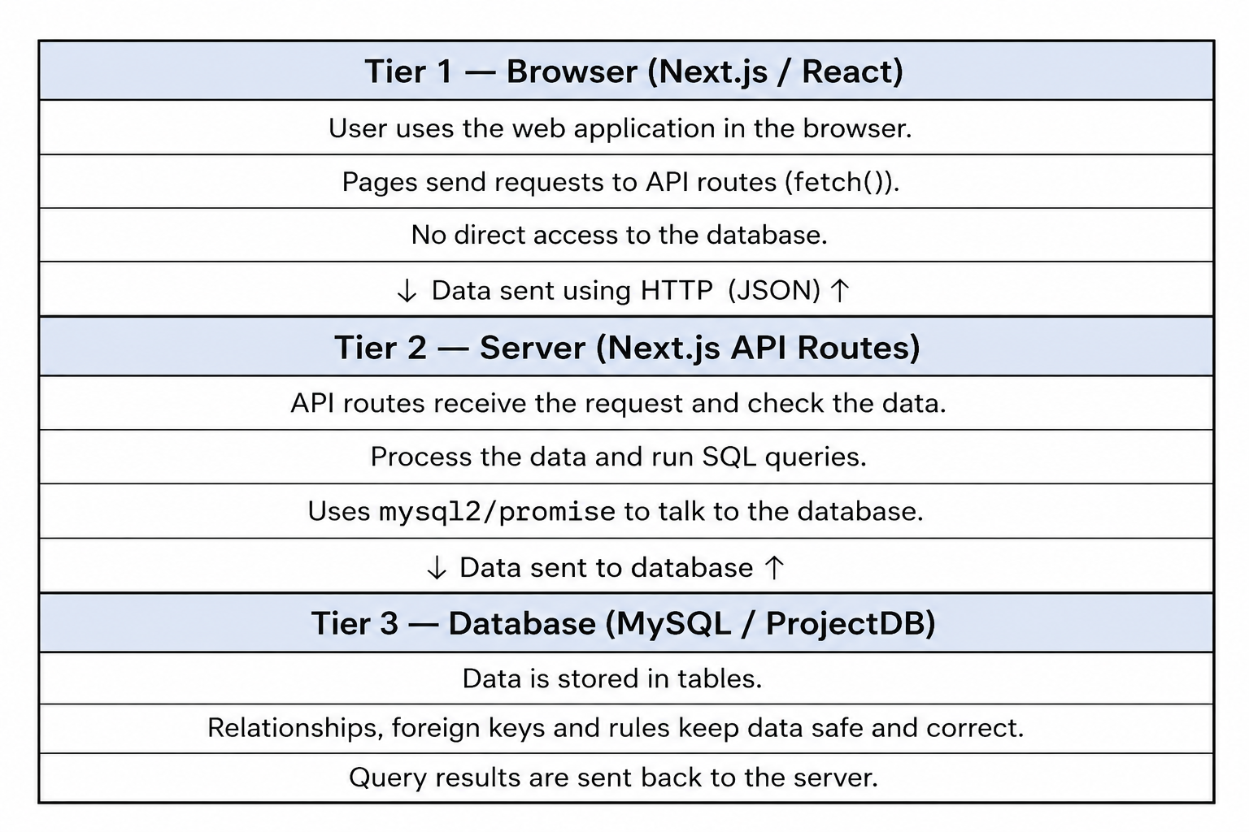
The frontend communicates with backend API routes
instead of directly accessing the database.

Slide 15
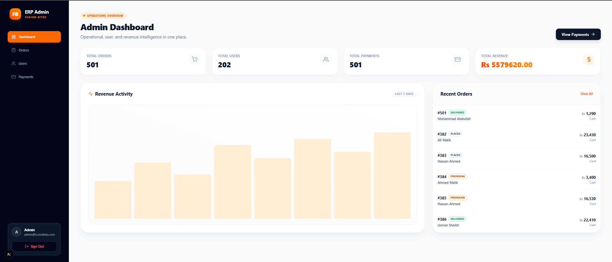

Slide 16
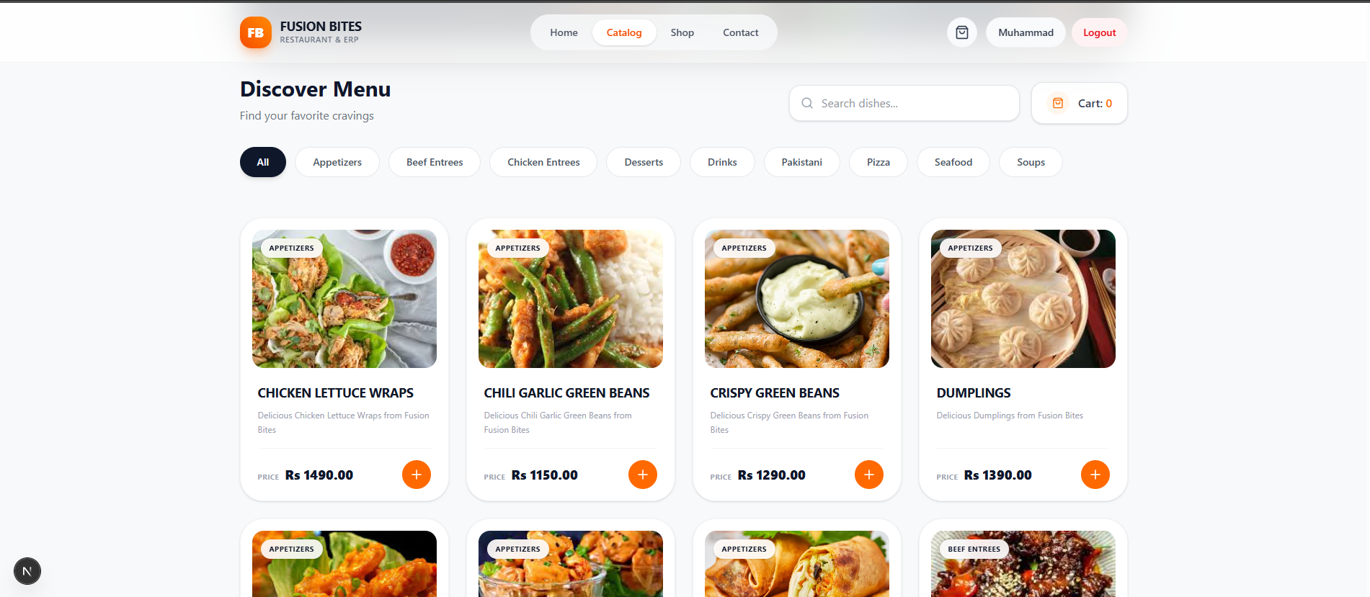

Slide 17
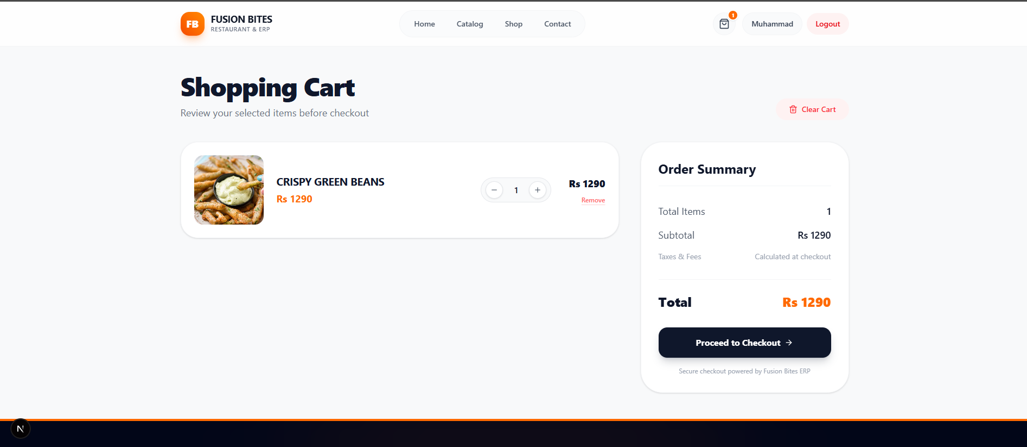

Slide 18
Create Account
And order from Phone

