Slide 1
MULTIUTILITY APP
Submitted by: Project Lead:
Karanpartap Singh Iqbal Muddassir
Harjot Singh

Slide 2
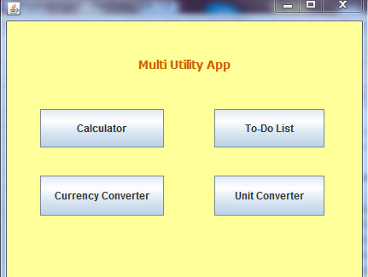
MULTIUTILITY APP
This is the Main Frame

Slide 3
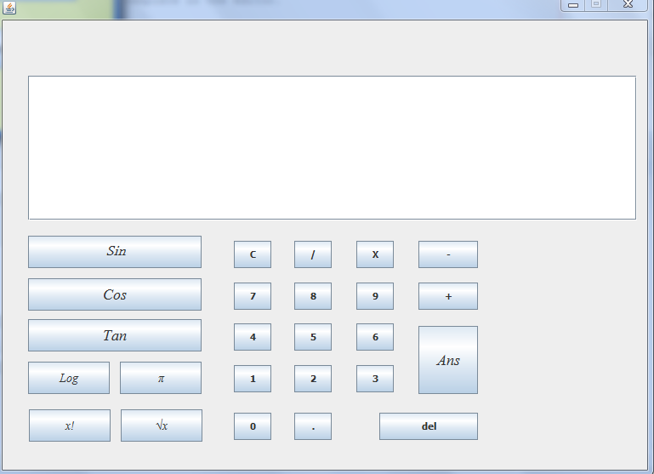
Calculator
This is a java app devloped using netbeans.it contain general sign and scientific signs also.
It performs operations like sine,cos,log,tan etc.it is very efficient to use to perform
mathematical calculations

Slide 4
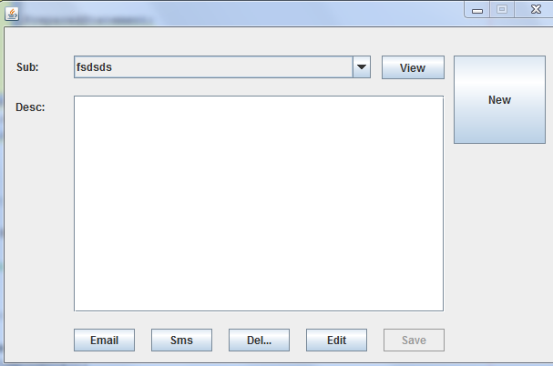
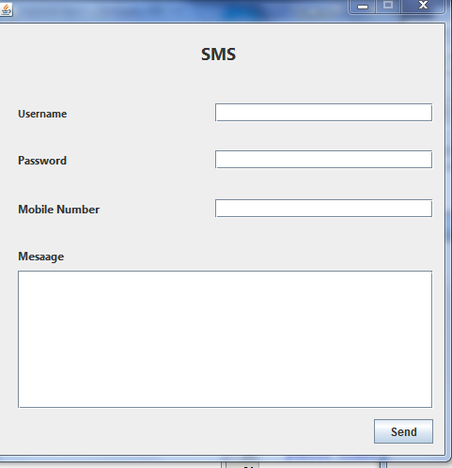
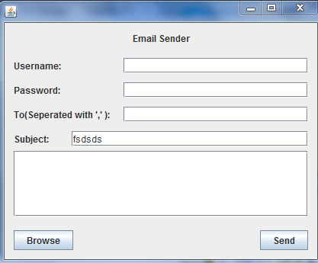
ToDo LIST

Slide 5
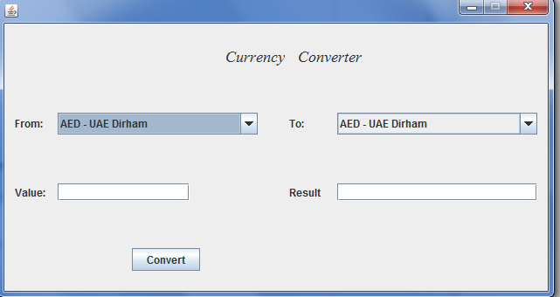
CurrencyConverter

Slide 6
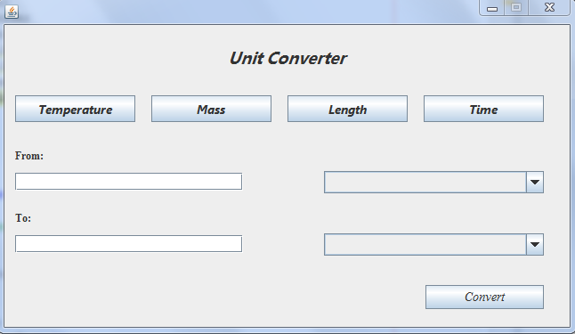
UnitConverter

