Slide 1
RESUME BUILDER SUBMITTED BY- ASHISH

Slide 2
RESUME BUILDER
RESUME BUILDER is basically a type of RESUME GENERATOR APP and the main function of this type of APPLICATION is to TAKE INPUT FROM USER AND PROVIDE AN OUTPUT I.E. RESUME IN PDF FORMAT.

Slide 3
LANGUAGES USED
JAVA
ECLIPSE
MYSQL

Slide 4
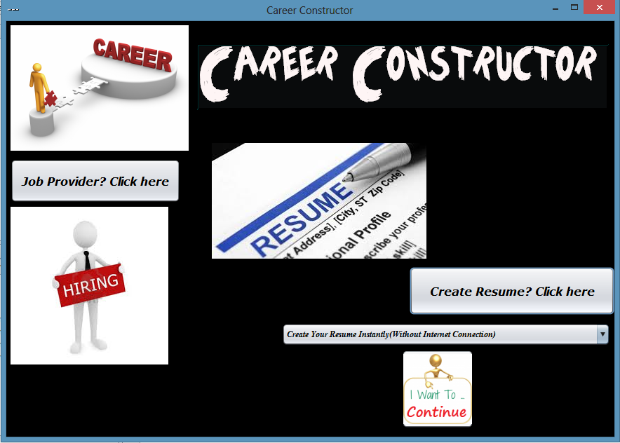
MAIN PAGE SCREENSHOT

Slide 5
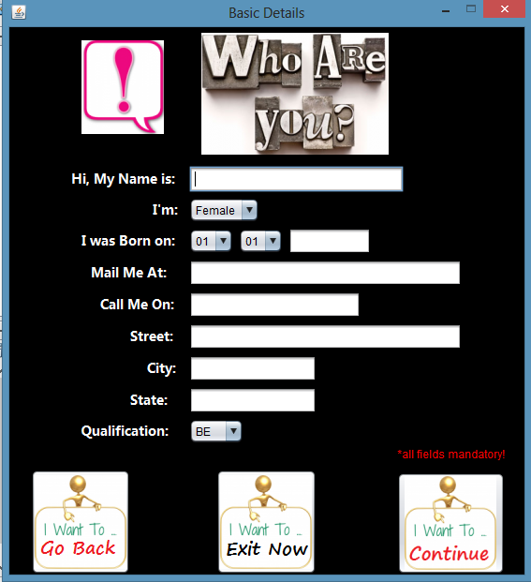

Slide 6
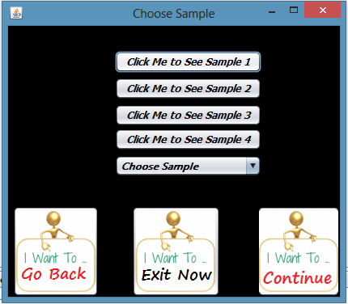

Slide 7
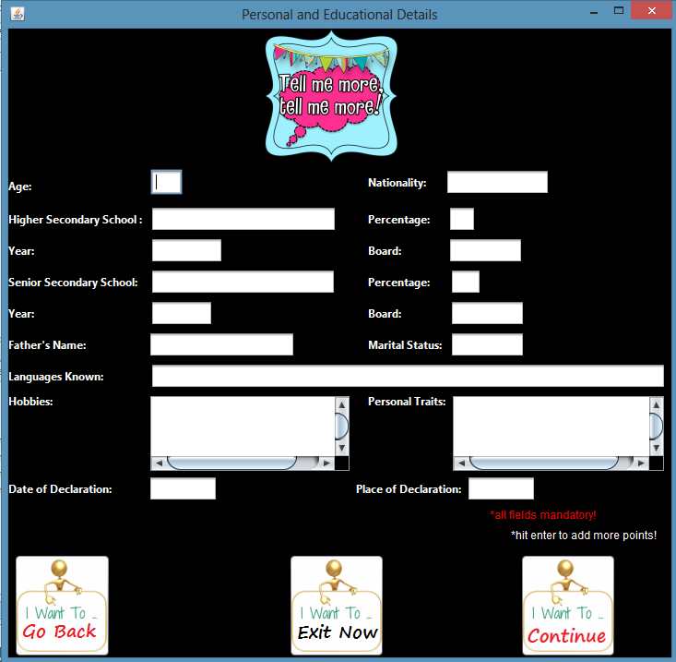

Slide 8
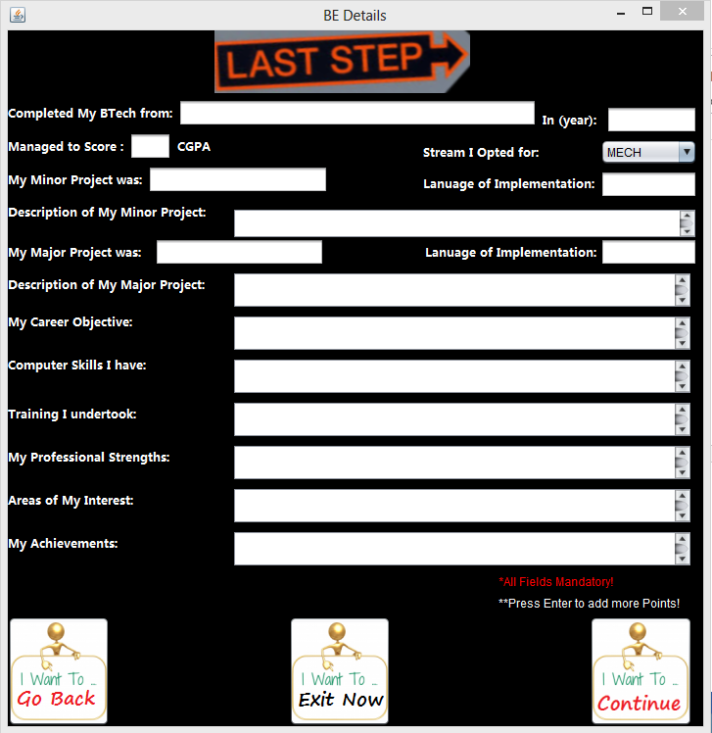

Slide 9
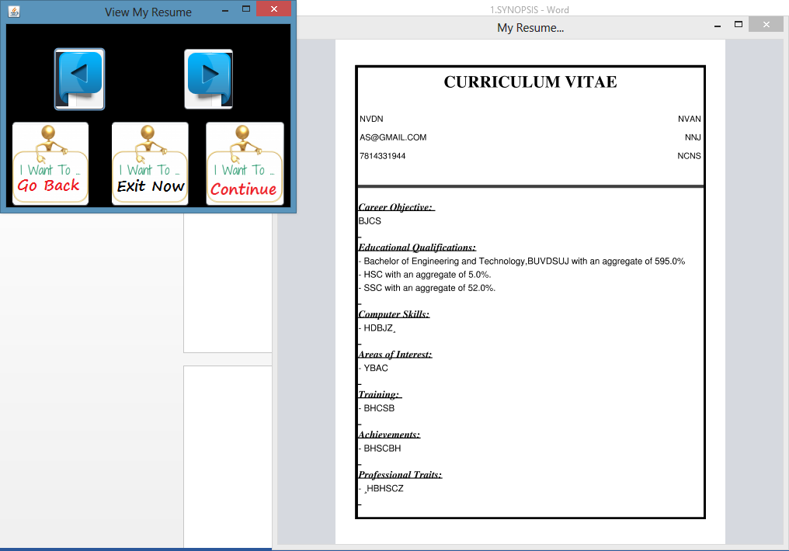

Slide 10
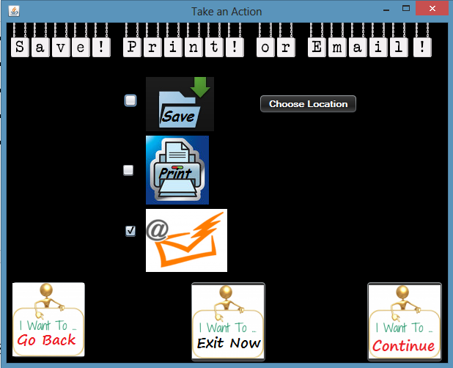

Slide 11
DATABASE
JDBC Connector:
Java database connectivity (JDBC) is the JavaSoft specification of a standard application programming interface (API) that allows Java programs to access database management systems. The JDBC API consists of a set of interfaces and classes written in the Java programming language.
Using these standard interfaces and classes, programmers can write applications that connect to databases, send queries written in structured query language (SQL), and process the results.
The JDBC API is consistent with the style of the core Java interfaces and classes, such as java.lang and java.awt.

Slide 12
JAVA
The whole project code is created using eclipse in Java. Java is a computer programming language that is concurrent, class-based, object-oriented, and specifically designed to have as few implementation dependencies as possible. It is intended to let application developers "write once, run anywhere" (WORA), meaning that code that runs on one platform does not need to be recompiled to run on another. Java applications are typically compiled to bytecode (class file) that can run on any Java virtual machine (JVM) regardless of computer architecture. Java is, as of 2014, one of the most popular programming languages in use, particularly for client-server web applications, with a reported 9 million developers.[10][11] Java was originally developed by James Gosling at Sun Microsystems (which has since merged into Oracle Corporation) and released in 1995 as a core component of Sun Microsystems' Java platform. The language derives much of its syntax from C and C++, but it has fewer low-level facilities than either of them.

Slide 13
ECLIPSE
Eclipse is an integrated development environment (IDE) for developing primarily with Java, but also with other languages, in particular PHP, C/C++, and HTML5. It is also an application platform framework for Java desktop applications and others. The eclipse IDE is written in Java and can run on Windows, OS X, Linux, Solaris and other platforms supporting a compatible JVM.
The eclipse Platform allows applications to be developed from a set of modular software components called modules. Applications based on the eclipse Platform (including the eclipse IDE itself) can be extended by third party developers. The eclipse Team actively support the product and seek future suggestions from the wider community.

Slide 14
BIBLIOGRAPHY
Books:
• Complete Reference for java(j2ee) By Herbert Schildt
• Thinking In Java By Bruce Eckel
• Java in a nutshell By David Flanagan
• Java Programming Language By Ken Arnold, James Gosling, David Holmes
• Head First Java By Kathy Sierra, Bert Bates
• Programming with Java By E Balagurusamy
• Beginning JSP Web Development By Casey Kochmer
• More Servlets and Java-Server Pages By Marty Hall
• Core Web Programming By Marty Hall and Larry Brown

