Slide 1
Proposal for
DARAZ
Thrifted
20I-0879 HAIDER
20I-0854 UMAIS
20I-0565 FAIZAN

Slide 2
Table of contents
01
02
03
Inroduction
Conclusion
Proposed Plan
There are a lot of problems faced by people when buying and selling used products online. The following proposal will address those problems and it will provide the solutions to those problems in order to have a smooth flow of buying and selling process
Online shopping is a unique sort of electronic commerce that connects buyers and sellers from all over the world using a web browser.
This can be a large part of how the web has evolved to where it is today
A web application for both the customers and vendors. We will be able to give services to the customers and sellers digitally through this app. In addition to the web application, there will be a mobile application as well for the customers

Slide 3
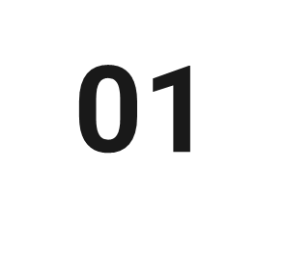
Background
eCommerce
History
  Beliscity (2001)
  Shophive (2005)
  Symbios (2006)
Rocket Internet
  Azmalo
  Foodpanda
OLX

Slide 4
Introduction
Problem:
There are a lot of problems faced by people when buying and selling used products online. The following proposal will address those problems and it will provide the solutions to those problems in order to have a smooth flow of buying and selling process.
Need:
Daraz is not a failure, but they are very slow in their way to success so with this initiative our solution will add value to your marketplace.
Scope:
Our service will aim to provide a platform where you will resell the products after refurbishing them if possible, or your company can deconstruct the goods and reuse them as they want in their other products. Thus, this service aims to make the exchange of used goods online efficient.

Slide 5
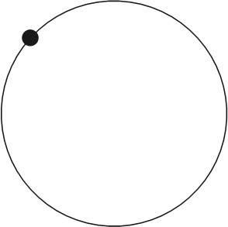

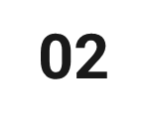
Proposed Plan
Web Application
Mobile Application
We will be creating a web application for both the customers and vendors. We will be able to give services to the customers and sellers digitally through this app. This app will be convenient for the customers as they will be able to order from their homes or offices through web. We will keep the UI of this application straight forward in order to make it user-friendly
In addition to the web application, there will be a mobile application as well for both the customers and vendors. The mobile application will add portability as we know that in this area of technology, majority of the population owns a mobile phone, so they don’t have to wait reach their home or office in order to make a purchase or sell a product.

Slide 6

Cost Analysis
Investment:
  Initial (Rs 25 Million)
    Firstly, Rs 10 million for application developers
    Secondly, Rs 10 million for a team of experts to work remotely
    Lastly, every employee needs a computer. This will be a total of Rs 5 Million
Contracts $ Agreements:
Use the application after signing this contract.
They are bound to give 15% share to us.
Try to resolve the issue in 24 hours.
Take feedback from customers
A complaint against a customer, we will handle the whole situation and will provide the necessary help.

Slide 7
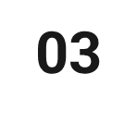
Conclusion:
eCommerce
Remote Jobs for Online Retailers
Traffic Increase
Quality Product
  Defective Goods
  Replicas and Knockoffs
  Overpricing and fake discounts
  Fraudulent reviews
Better Service
Greatest Products in low price
Selling reconditioned goods
A platform that users will be proud of.
Notes:
Reduce Reuse Recycle

Slide 8
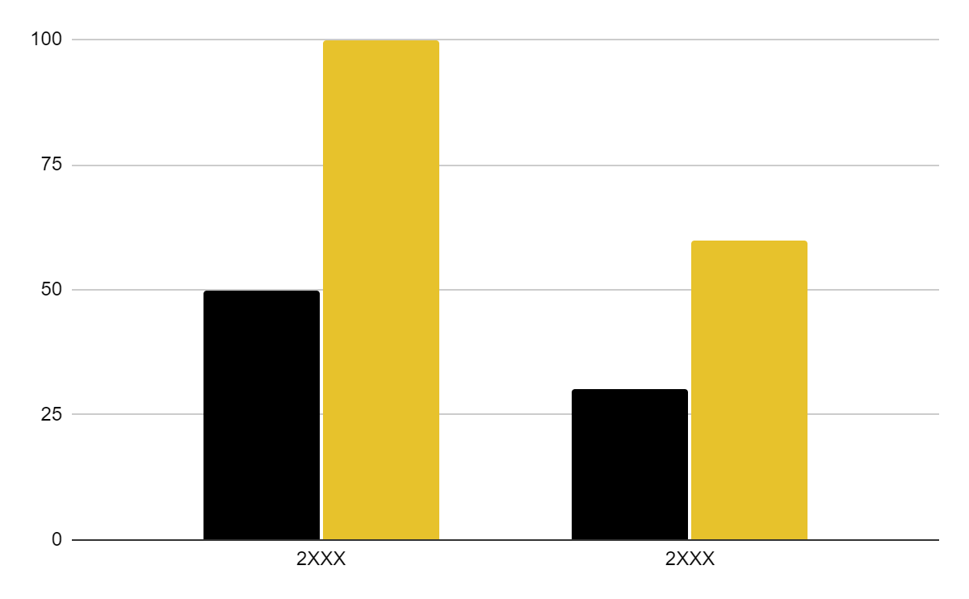
Sale Graph of Daraz
Sales
Traffic
2012-2018
2018-2022

Slide 9
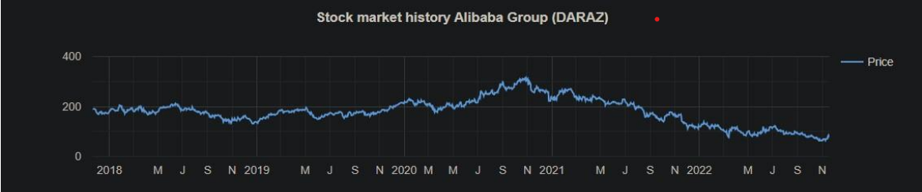
Stocks Graph of Daraz

Slide 10
Thanks!
Do you have any questions?
Keep it to yourself

