Slide 1

Proposals

Slide 2
Why Write a Proposal?
Proposals attempt to persuade an audience to take some form of action:
to authorize a project
accept a service or product
support a specific plan for solving a problem
improving a situation

Slide 3
Types of Proposals
Internal proposals _ written to management within your company
External proposals _ written to sell a new service or product to an audience outside your company
Solicited proposals _ those that have been requested by a manager, client, or customer
Unsolicited proposals _ those that have not been requested
Planning proposals _ offer solutions to a problem or suggestions for improvement
Research (or grant) proposals _ request approval (and often funding) for some type of study
Sales proposals _ offer services or products and may be either solicited or unsolicited

Slide 4
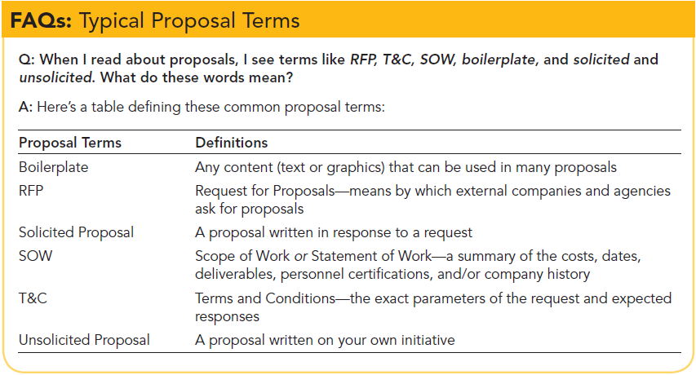

Slide 5
Criteria for Proposals
To guide your readers through a proposal, provide the following:
Title page
Cover letter (or cover e‐mail message for electronic submission of proposals)
Table of contents
List of illustrations
Abstract
Introduction
Discussion (the body of the proposal)
Conclusion/recommendation
Glossary
Works cited (or references) page
Appendix

Slide 6
Abstract
Audience _ multiple
They need information quickly
They need it presented in low‐tech terminology
Write an abstract or executive summary
The abstract, limited to approximately three to ten sentences, presents the problems leading to your proposal, the suggested solutions, and the benefits your audience will derive.

Slide 7
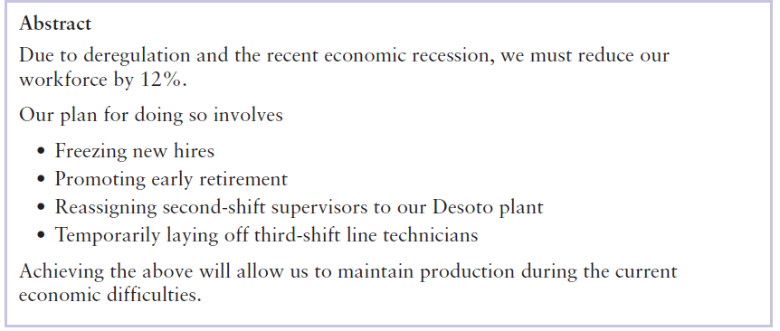
Abstract (Continued…)

Slide 8
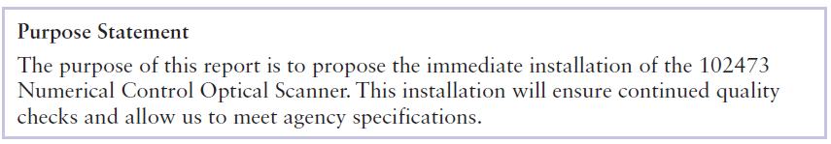
Introduction
Your introduction should include two primary sections:
purpose
Problem
In one to three sentences, tell your readers the purpose of your proposal.
Your purpose statement clarifies the proposal’s context.

Slide 9
Introduction (Continued…)
Problem (Needs Analysis)- To clarify for the audience why this proposal is important, explain the problems leading to your suggestions.

Slide 10

Discussion
Sell your ideas persuasively
Develop your ideas thoroughly through research
Observe ethical technical communication standards
Organize your content so the audience can follow your thoughts easily
Use graphics

Slide 11
Communicating Persuasively
Arouse audience involvement—focus on your audience’s needs that generated this proposal.
Refute opposing points of view in the body of your proposal.
Give proof to develop your content, through research and proper documentation.
Urge action—motivate your audience to act upon your proposal by either buying the product or service or adopting your suggestions or solutions.

Slide 12

Researching Content for Proposals
This can include primary and secondary sources such as
the following:
Interviewing customers, clients, vendors, and staff members
Creating a survey and distributing it electronically or as hard‐copy text
Visiting job sites to determine your audience’s needs
Using the Internet to locate sources of documentation, such as articles
Reading journals, books, newspapers, and other hard‐copy text

Slide 13
Communicating Ethically in Proposals
To write an ethical proposal, provide accurate information about
Credentials
Pricing
Competitors
Needs assessment
Sources of information and research
When using research, for example, cite sources accurately to avoid plagiarism

Slide 14
Organizing Your Content
Comparison/contrast. Rely on this mode when offering options for vendors, software, equipment, facilities, and more.
Cause/effect. Use this method to show what created a problem or caused the need for your proposed solution.
Chronology. Show the timeline for implementation of your proposal, reporting deadlines to meet, steps to follow, and payment schedules.
Analysis. Subdivide the topic into smaller parts to aid understanding.

Slide 15
Using Graphics
Tables. Your analysis of costs lends itself to tables.
Figures. The proposal’s main text sections could profit from the following figures:
Line charts—excellent for showing upward and downward movement over a period of time. A line chart could be used to show how a company’s profits have decreased, for example.
Bar charts—effective for comparisons. Through a bar or grouped bar chart, you could reveal visually how one product, service, or approach is superior to another.
Pie charts—excellent for showing percentages. A pie chart could help you show either the amount of time spent or amount of money allocated for an activity.
Line drawings—effective for technical descriptions and process analyses.
Photographs—effective for technical descriptions and process analyses.
Flowcharts—a successful way to help readers understand procedures.
Organizational charts—excellent for giving an overview of managerial chains of command.

Slide 16

Conclusion/Recommendations
Sum up your proposal, providing your readers closure.
The conclusion can restate the problem, your solutions, and the benefits to be derived.
Your recommendation will suggest the next course of action.
Specify when this action will or should occur and why that date is important.

Slide 17
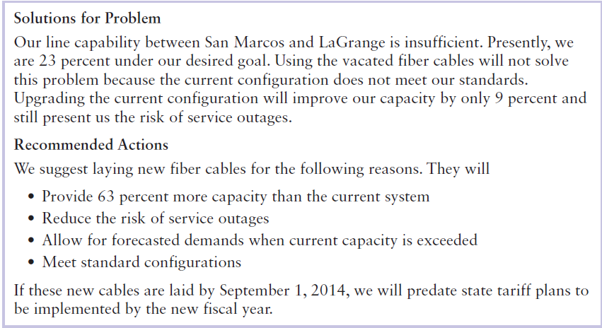
Conclusion/Recommendations

Slide 18
The Writing Process at Work
Prewriting
Writing
Rewriting

Slide 19

Any Questions?

