Slide 1

Multiculturalism

Slide 2
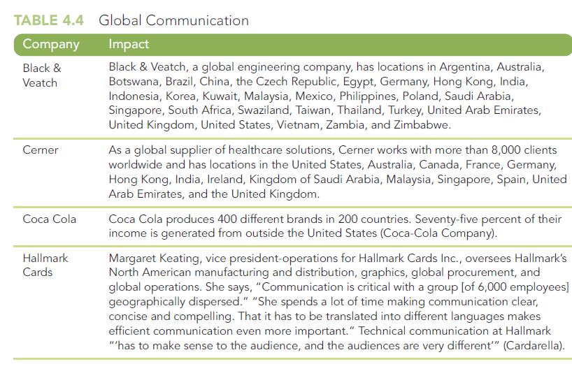
Multicultural Communication
International business requires multicultural communication, the sharing of written or oral information between businesspeople from many different countries.
According to one recent study, 67% of professionals communicate internationally.

Slide 3
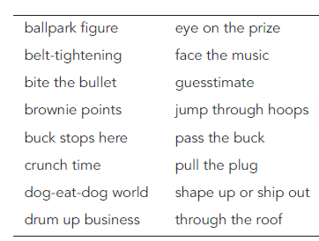
Guidelines for Effective Multicultural Communication
Define Acronyms and abbreviation
For example, corporate employees often abbreviate the job title “system manager” as “sysmgr”
However, in German the title “system manager” is called the “system leiter”
In French, it’s “le responsable”
The abbreviation “sysmgr” would make no sense in either of these countries.
Avoid Jargon and Idioms

Slide 4

Guidelines for Effective Multicultural Communication
Distinguish Between Nouns and Verbs
Computer terms usually act as both nouns and verbs. For example
File, scroll, paste, help, boot, code
Be Careful When Using Slash Marks
Does the slash mark mean “and”, “or” or both “and/ or”
Avoid Humour and Pun
Watch for Cultural Biases/ Expectations

Slide 5
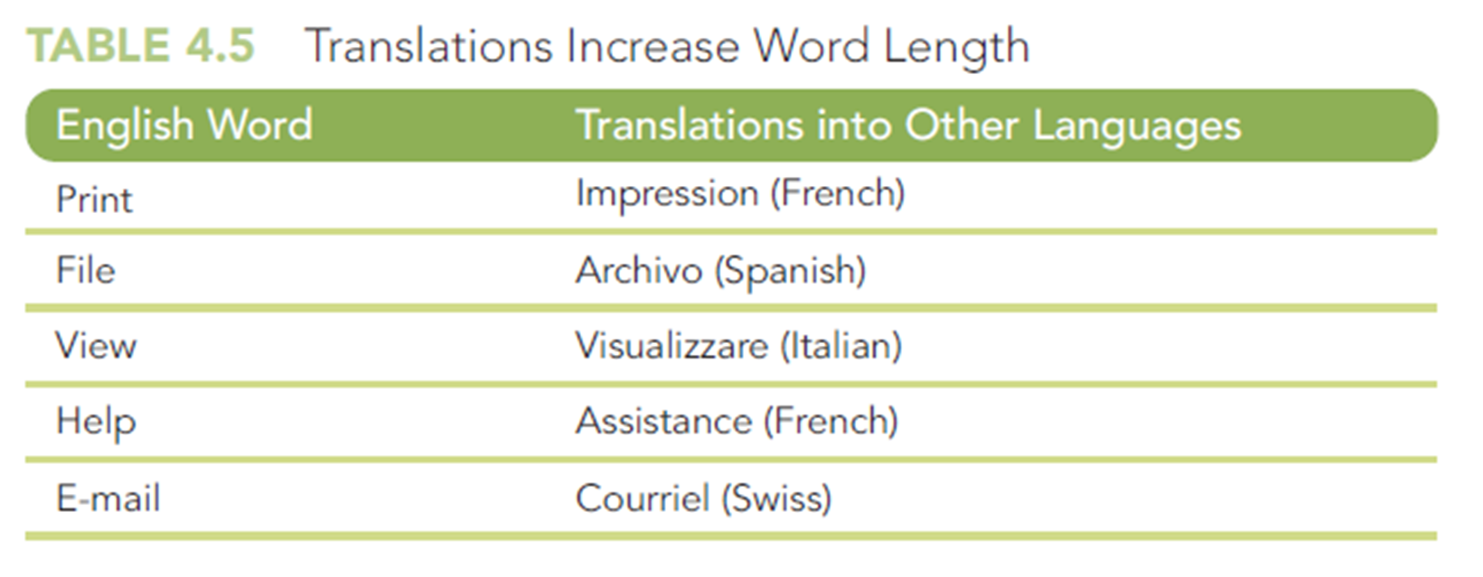
Guidelines for Effective Multicultural Communication
Realize That Translations May Take More or Less Space
Avoid Figurative Language

Slide 6
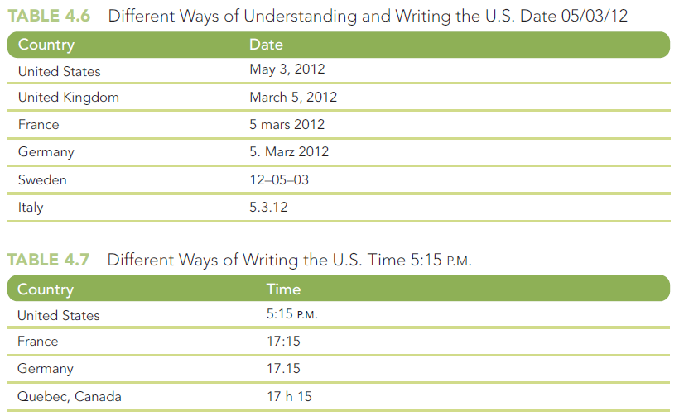
Guidelines for Effective Multicultural Communication
Be Careful with Numbers, Measurements, Date and Time

Slide 7
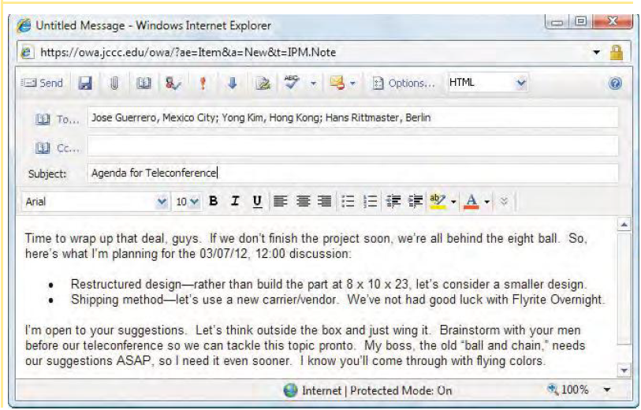
Guidelines for Effective Multicultural Communication
Use Stylized Graphics to Represent People

Slide 8
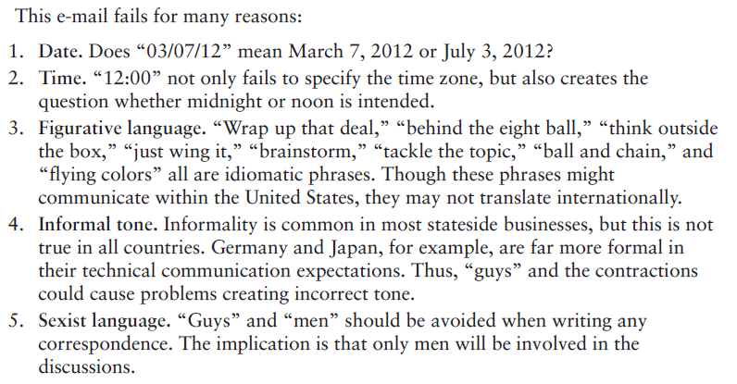

Slide 9
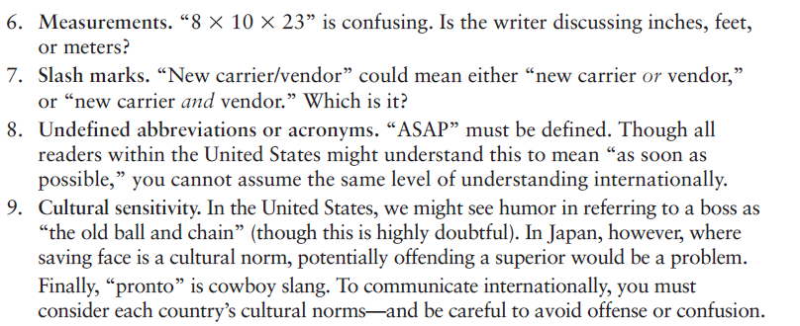

Slide 10
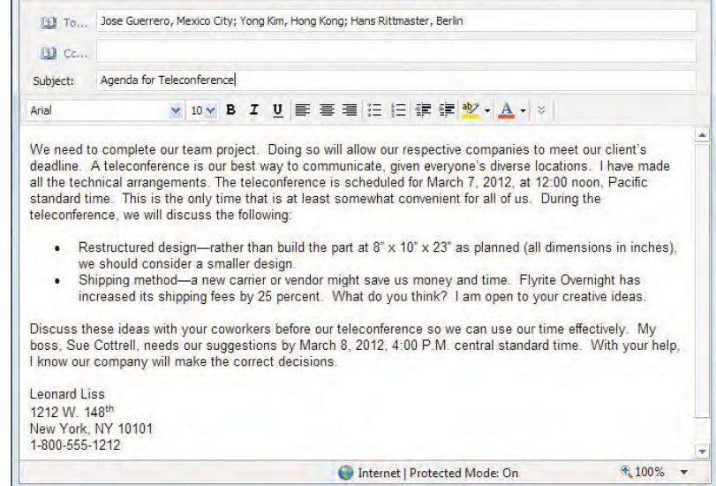

Slide 11
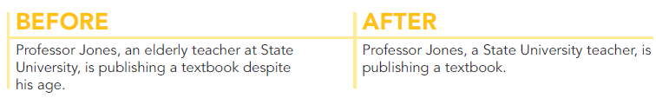
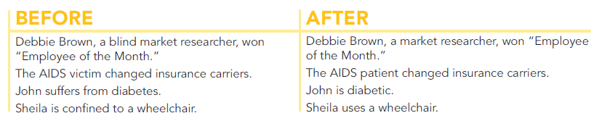
Guidelines for Effective Multicultural Communication
Avoiding Biased Language
Ageist Language
Biased Language About People With Disabilities

Slide 12
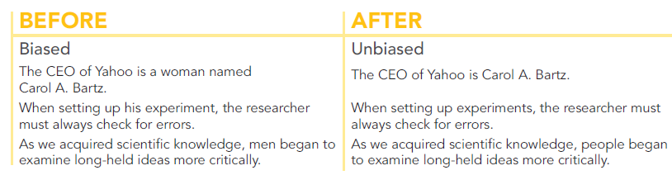
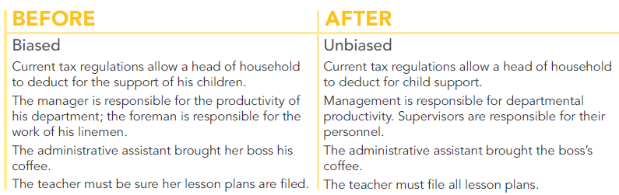
Avoiding Biased Language
Sexist Language
Ignoring Women or Treating Them as Secondary
Stereotyping

Slide 13
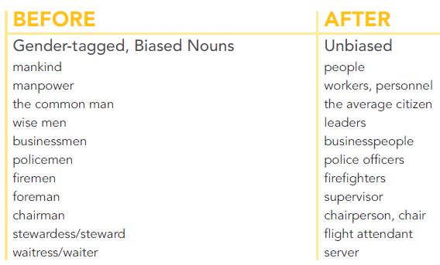
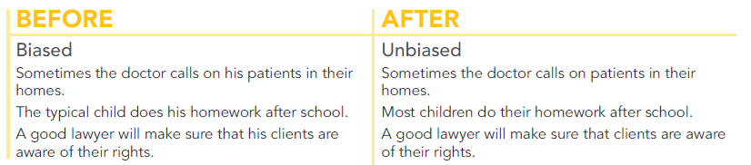
Avoid Biased Language
Sexist Language
Pronouns
Gender Tagged Nouns

Slide 14

Audience Involvement
Personalized Tone
Pronouns
Names

Slide 15
Audience Involvement
Reader Benefit
Explain the benefit
Use Positive Words
We cannot process your request. You failed to follow the printed information.
So that we may process your request rapidly, please fill in line 6 on the printed form.
We have received your letter complaining about our services.
Thank you for writing to us about our services.

Slide 16
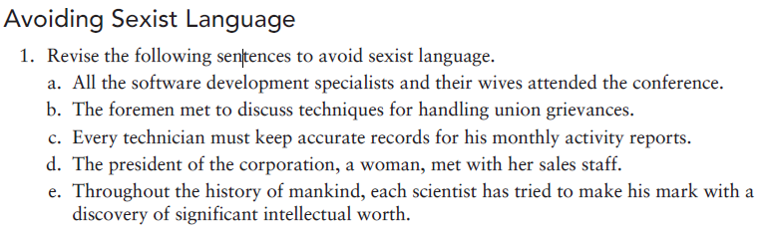
Activity

Slide 17
Activity (answers)
All the software development specialists and their spouses attend the conference.
The supervisors met to discuss techniques for handling union grievances.
Every technician must keep accurate records for monthly activity reports.
The president of the corporation met with the sales staff.
Throughout the history of people, scientists have tried to make their mark with a discovery of significant intellectual worth.

Slide 18

Any Questions?

