Slide 1

AI Agent For Lung Diseases Detection
Presented By:
Muhammad Ehtisham Hanif ECI-IT-21-064
Humair Hayat ECI-IT-21-058
Faizan Rasool ECI-IT-21-057
Project Supervisor:
Miss Aisha Shafique
Department of Computing
Faculty of Engineering Sciences & Technology
Hamdard University Islamabad Campus

Slide 2
Overview of Presentation
Introduction
Aim & Objectives
Problem Statement
Literature Review
Research Gap
Datasets
Preprocessing Techniques
Methodology
Model Architectures
Model Training & Evaluation
System Architecture
Results
Confusion Matrix
Conclusion
References
AI Agent For Lung Diseases Detection

Slide 3
Introduction
Tuberculosis, COVID-19, and Pneumonia are serious lung diseases that show up on chest X-rays.
A chest X-ray is the cheapest and most widely available way to screen for them.
Reading X-rays by hand is slow, expensive, and easy to get wrong when the workload is high.
Deep-learning models can read an X-ray and flag the likely disease automatically.
Our system checks for all three diseases from one simple web app.
Goal: give doctors a fast, reliable second opinion, especially where specialists are few.
AI Agent For Lung Diseases Detection

Slide 4
Aim & Objectives
Aim:
To build an AI system that detects Tuberculosis, COVID-19, and Pneumonia from chest X-rays.
Objectives:
Train three deep-learning models on one unified four-class dataset and compare them fairly.
Use transfer learning and augmentation to handle small medical datasets.
Serve all models in one easy web app and test them on unseen X-rays.
AI Agent For Lung Diseases Detection

Slide 5
Problem Statement
The problem: chest X-rays are the first tool for spotting lung disease, but reading them needs trained radiologists, who are scarce.
The cost: manual reading is slow, costly and prone to error, which delays treatment and puts patients at risk.
The need: a fast, reliable, low-cost way to screen X-rays for Tuberculosis, COVID-19 and Pneumonia.
Our solution: a single web application that classifies all four classes using three independent models, so one upload gives three cross-checked opinions.
AI Agent For Lung Diseases Detection

Slide 6
Why Chest X-rays as Input
Widely available: Almost every clinic has an X-ray machine, while CT scanners are costly and concentrated in cities.
Low cost and fast: an X-ray takes minutes and costs a fraction of a CT scan, so it suits large-scale screening.
Much lower dose: a chest X-ray delivers about 0.1 mSv against roughly 7 mSv for a chest CT.
AI Agent For Lung Diseases Detection

Slide 7
Why These Three Diseases
Clinically significant: Tuberculosis, COVID-19 and Pneumonia are among the most common and serious lung infections worldwide.
Visible on X-ray: all three change the appearance of the lungs on a chest radiograph, so one imaging type covers them all.
Public data exists: each has an established labelled dataset, which makes the study reproducible.
AI Agent For Lung Diseases Detection

Slide 8
Literature Review
Study/Reference | Key Contributions/Methodology | Key Findings | Relevance to our Study
Colombi, D., Panzeri, M. M., Vancheri, S. G., Richeldi, L., & Sverzellati, N. (2025). Computer-aided evaluation of interstitial lung diseases: From HRCT diagnosis to prognostic stratification. Diagnostics, 15(6), 943. | Proposed computer-aided diagnosis (CAD) methods using AI and radiomics on HRCT scans for ILD detection and prognosis stratification. Highlighted use of deep learning and radiomics for automated interpretation. | Demonstrated that AI and radiomics can accurately support diagnosis and predict prognosis, reducing reliance on manual assessments. | Shows that CNN-based and AI-driven tools can be extended beyond cancer to ILD detection, reinforcing the value of AI in medical imaging for early and accurate diagnosis.
Müller, H., Atnafu, S. Y., Engelhardt, S., & Depeursinge, A. (2025). Computer-aided diagnosis (CAD) of lung cancer: The road ahead. Informatics, 12(1), 18. | Surveyed CAD systems for lung cancer, categorizing existing AI approaches, especially deep CNNs, hybrid ML, and radiomics-based methods. Discussed architectural design, data preprocessing, and integration challenges. | Found that deep CNNs and hybrid approaches outperform traditional techniques. Noted challenges of data imbalance, explainability, and clinical adoption. | Supports our study by demonstrating CNN superiority in lung cancer detection tasks and aligning with our aim to build robust CNN-based solutions for multi-disease detection.
Zahid, M., Khan, M. A., Rehman, S. U., Saba, T., Alghamdi, M., & Rehman, A. (2024). An intelligent computer-aided diagnostic system for early detection of lung cancer using hybrid deep features. Multimedia Tools and Applications, 83, 12345–12367. | Developed a CAD system integrating hybrid deep features (CNN + handcrafted features) for lung cancer detection from CT scans. Used feature fusion and classification models to enhance performance. | Achieved high diagnostic accuracy and robustness by combining CNN features with traditional texture-based features, improving early detection of lung cancer. | Highlights the potential of hybrid feature-based CNN approaches, guiding our system to explore ensemble and hybrid methods for improved lung disease detection.
Ignatius, J. L. P., Selvakumar, S., Gabriel, K., Kailash, A. B., Keertivaas, S., & Prajan, S. A. J. A. R. (2023). Histogram Matched Chest X-Rays Based Tuberculosis Detection Using CNN. Computer Systems Science & Engineering, 44(1), 81–97. | Proposed a CNN-based TB detection system using chest X-rays with histogram matching as a preprocessing technique. Evaluated 10 pre-trained CNNs (ResNet, DenseNet, VGG, MobileNet, Inception). | ResNet50 and DenseNet169 achieved the best results, with histogram matching improving accuracy to 99.58%, sensitivity to 99.82%, and specificity to 99.67%. | Demonstrates how preprocessing (histogram matching) enhances CNN performance, supporting reliable detection in clinical imaging tasks.
AI Agent For Lung Diseases Detection

Slide 9
Literature Review
Study/Reference | Key Contributions/Methodology | Key Findings | Relevance to our Study
Varshni, D., Nijhawan, R., Thakral, K., Mittal, A., & Agarwal, L. (2019). Pneumonia Detection Using CNN based Feature Extraction. Proc. Int. Conf. on Electrical, Computer and Communication Technologies (ICECCT), pp. 1–7. | Used pre-trained CNNs (ResNet, DenseNet, VGG, Xception) for feature extraction on the ChestX-ray14 dataset, followed by classifiers (SVM, RF, KNN, NB). Hyperparameter tuning applied for optimization. | DenseNet-169 with SVM achieved the best performance (AUC = 0.8002), outperforming earlier models like logistic regression. | Shows the effectiveness of hybrid deep learning + classifier models, aligning with our aim to design robust AI-based medical diagnostic systems..
AI Agent For Lung Diseases Detection

Slide 10
Research Gap
Single-disease focus: most studies detect only one disease; our system covers TB, COVID-19, and Pneumonia in one tool.
Costly imaging: many works depend on CT scans; we use widely available chest X-rays.
Research-only models: prior methods stay as notebooks or experiments; we deploy a working web application for real users.
No input safety: existing systems assume valid inputs; our input validator rejects non X-ray images before classification.
Fragmented tools: earlier work is one model per disease; we unify three models behind one interface with confidence scores.
AI Agent For Lung Diseases Detection

Slide 11
Datasets
Source 1: TB Chest Radiography Database (Kaggle, Tawsifurrahman) provides Normal and Tuberculosis chest X-rays.
Source 2: Covid19-dataset (Kaggle, Tawsifurrahman) provides COVID-19, Normal and Viral Pneumonia images.
Source 3: Chest X-Ray Images: Pneumonia (Kaggle, Paul Mooney) provides Normal and Pneumonia images.
Merged: 3,227 images after duplicate removal, mapped into one label space of Normal, Tuberculosis, COVID-19 and Pneumonia.
Why merge: every model trains on the same images and labels, so the three architectures can be compared fairly.
AI Agent For Lung Diseases Detection

Slide 12
Dataset Properties
Unified dataset: the three source datasets are merged into one 4-class label space of 3,227 images.
Class | Images | Train / Val / Test | Sources
Normal | 1,200 | 840 / 180 / 180 | 3 datasets
Tuberculosis | 697 | 488 / 105 / 104 | 1 dataset
COVID-19 | 130 | 91 / 20 / 19 | 1 dataset
Pneumonia | 1,200 | 841 / 180 / 179 | 1 dataset
AI Agent For Lung Diseases Detection

Slide 13
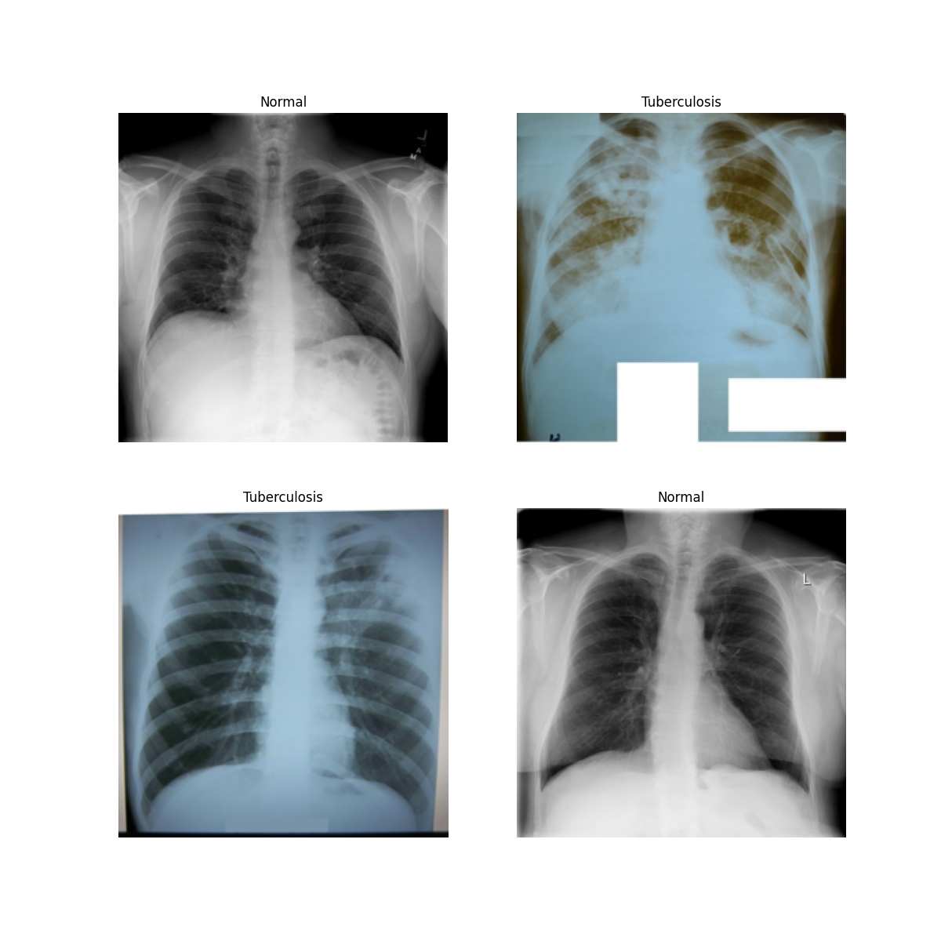
Sample Chest X-rays
Sample Chest X-rays
A few examples from the datasets used to train and test the models.
AI Agent For Lung Diseases Detection

Slide 14
Preprocessing Techniques
Read as color: X-rays are black-and-white, but our models expect color images, so we load each X-ray as 3 channels (RGB).
Resize: every image is resized to the size its model needs 256, 224, or 150 pixels.
Normalize: we scale the pixel values so the model reads them correctly. The two pre-trained models use their original scaling; the custom CNN scales pixels to a 0–1 range.
Augment (training only): during training we randomly flip, rotate, zoom, shift, and change contrast of images to give the model more variety and stop it memorizing.
Same steps when live: when a real user uploads an X-ray, we apply the exact same reading and resizing steps as in training, so the model behaves consistently.
AI Agent For Lung Diseases Detection

Slide 15
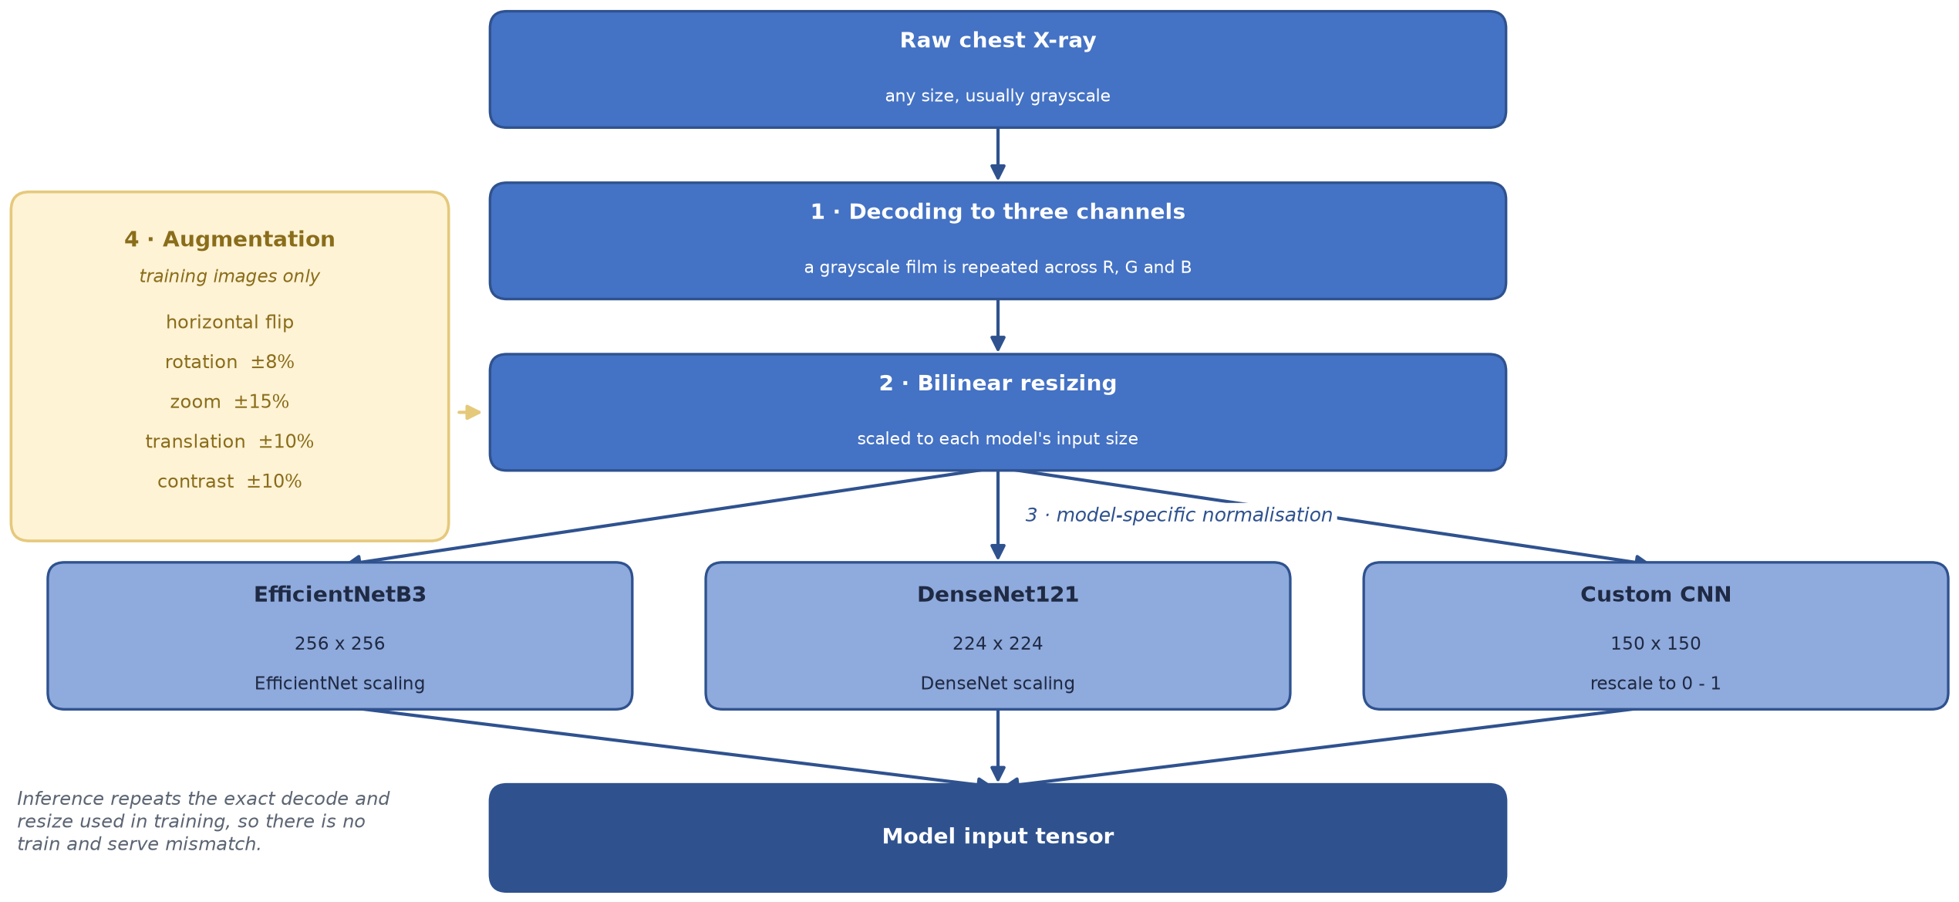
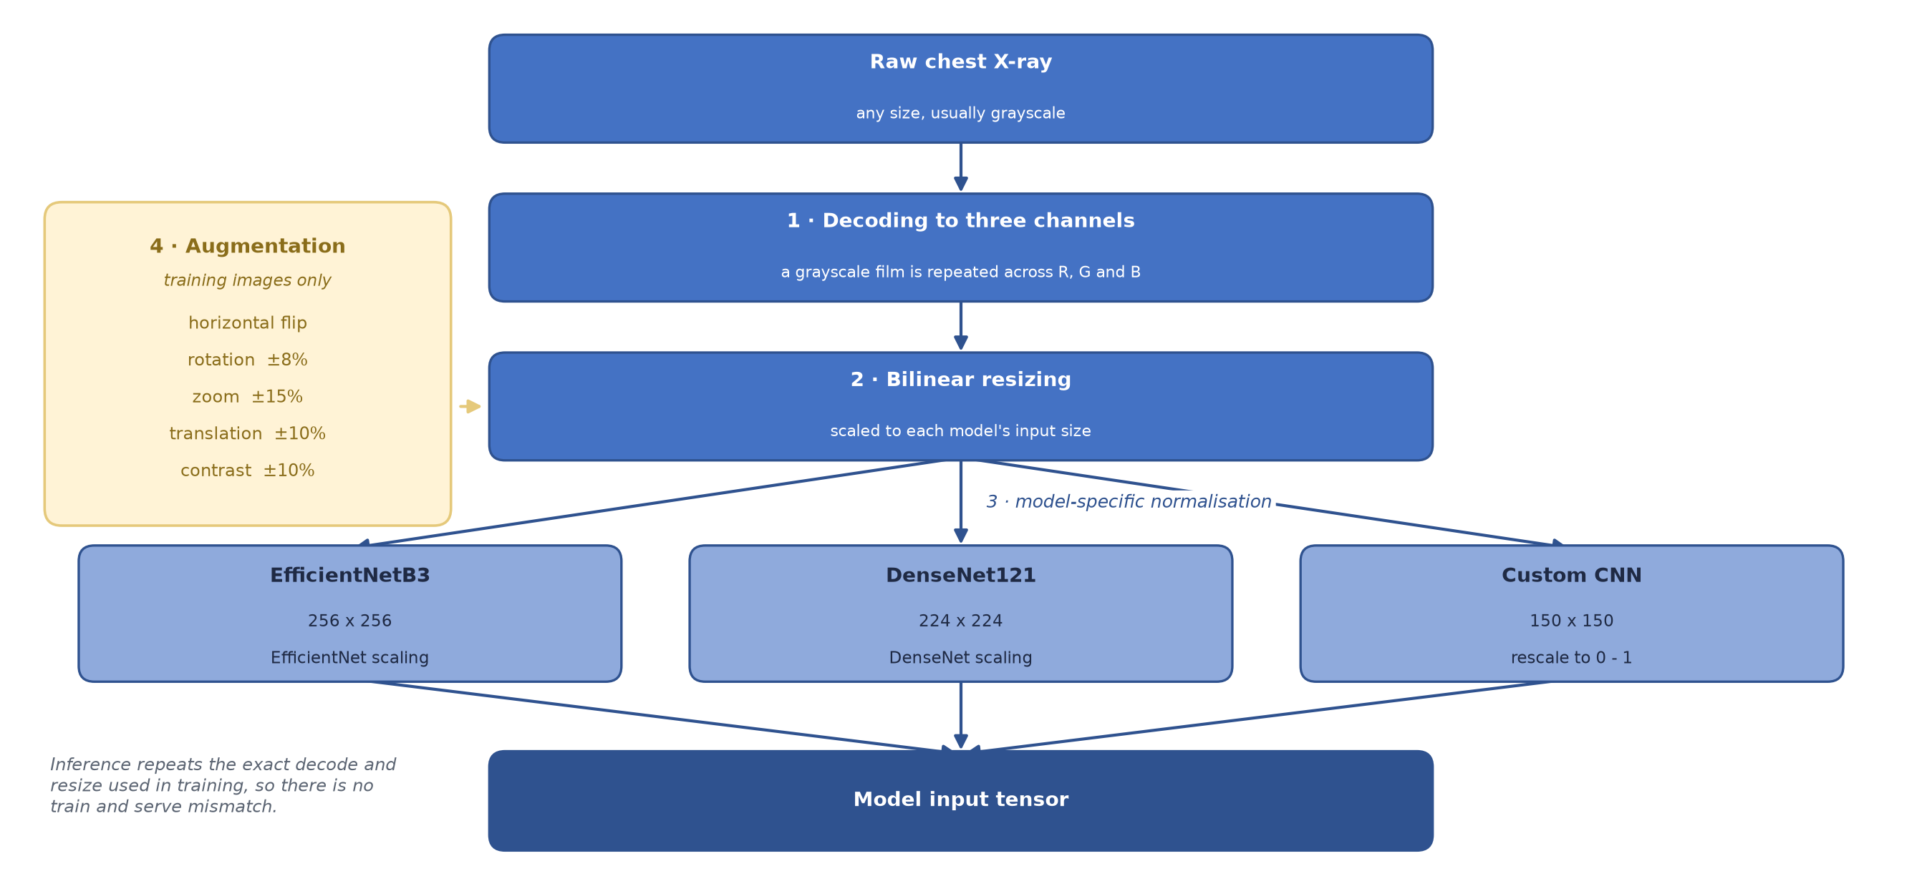
Preprocessing Pipeline
AI Agent For Lung Diseases Detection

Slide 16
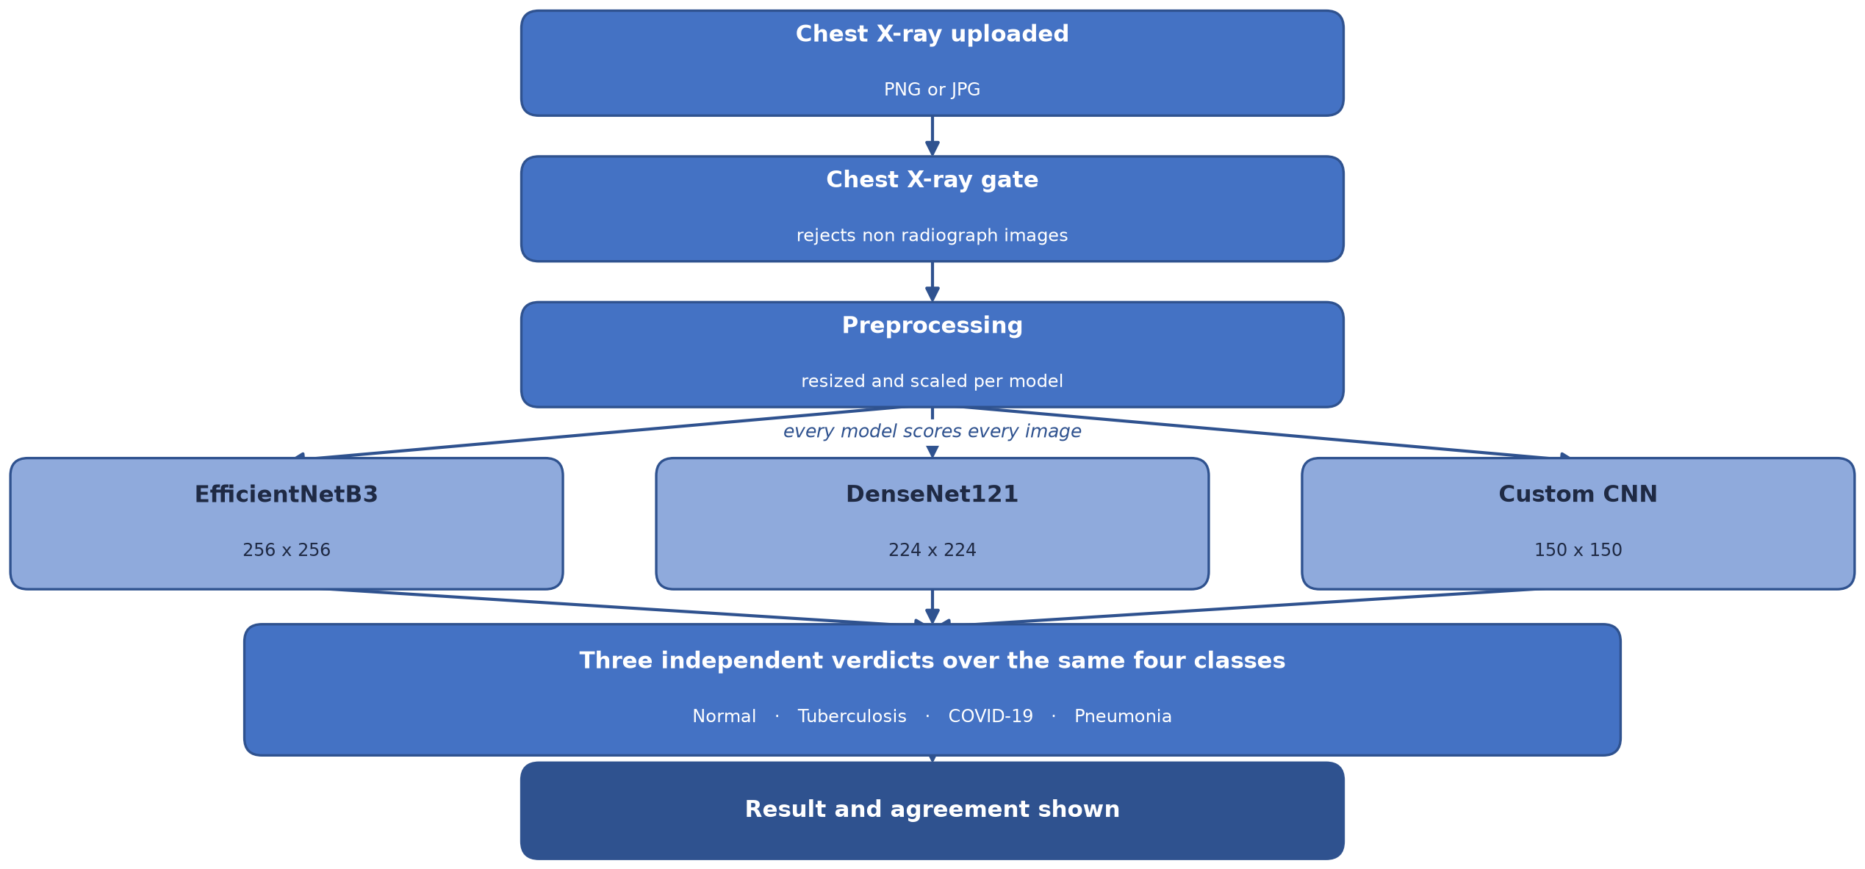
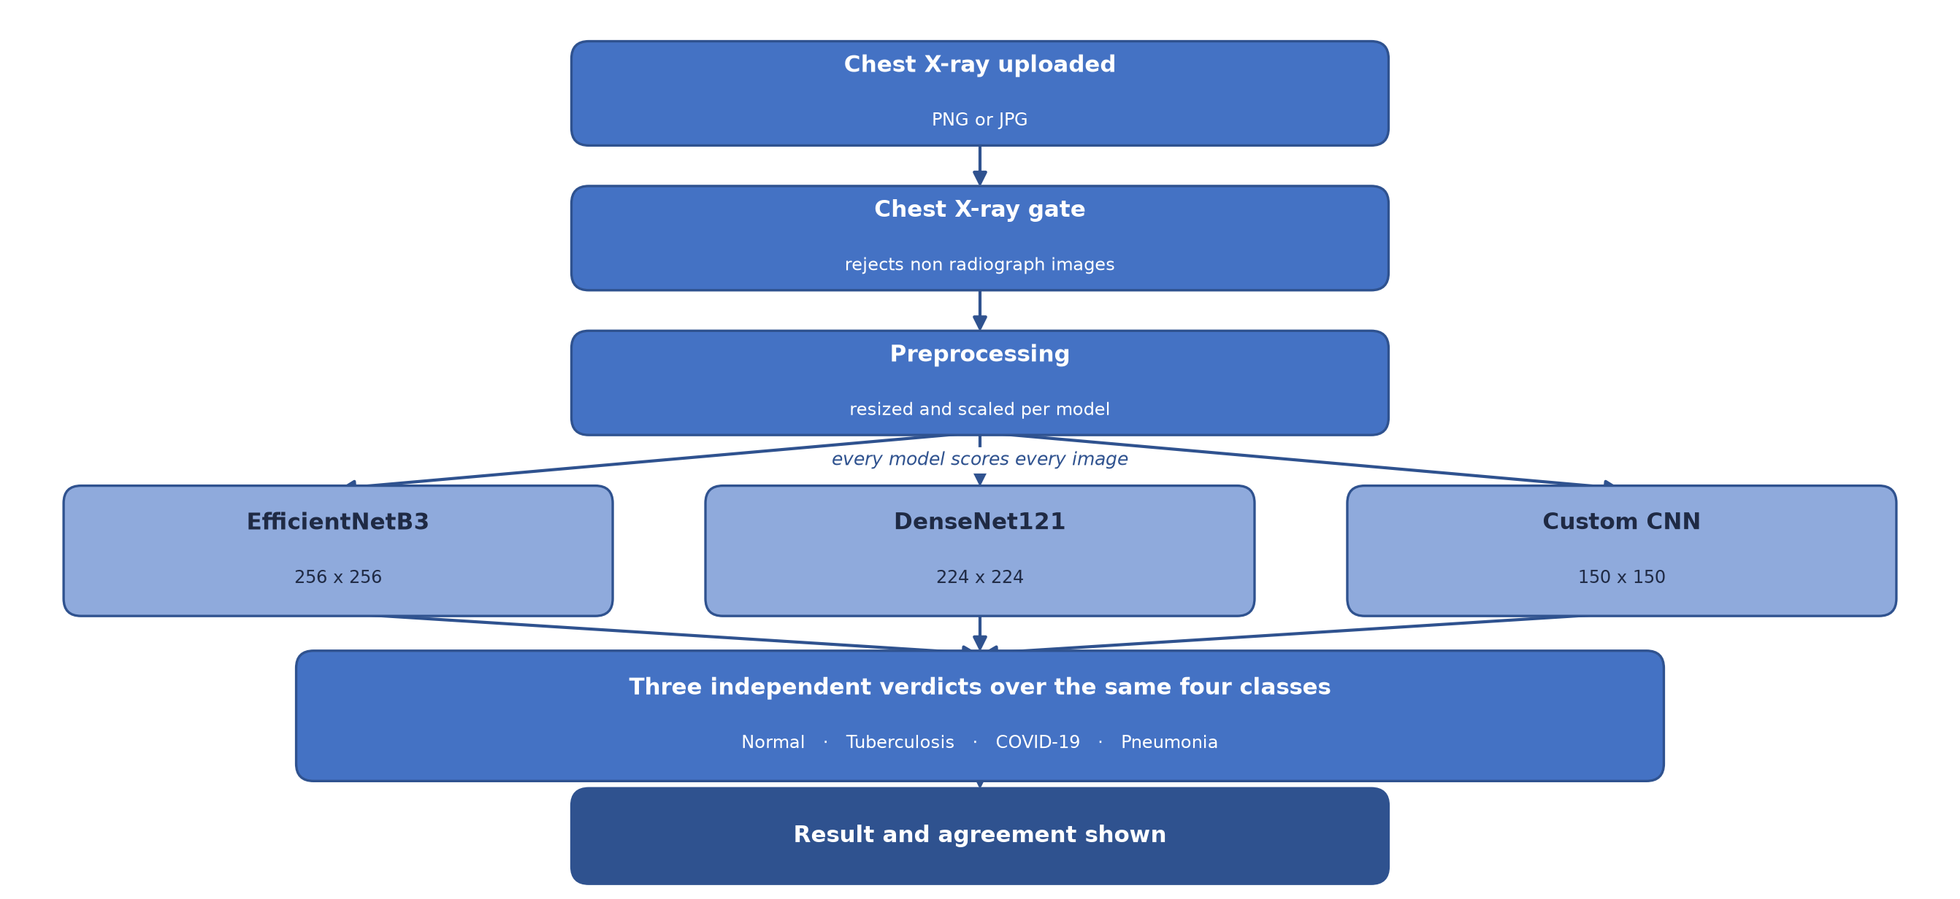
Overall System Architecture
AI Agent For Lung Diseases Detection

Slide 17
Methodology
One shared dataset: all three architectures train on the same 4-class data, splits, augmentation and classification head.
EfficientNetB3 and DenseNet121: transfer learning from ImageNet, then fine-tuned on the chest X-ray data.
Custom CNN: built from scratch, so the benefit of pre-training can be measured directly.
Serving: all three run on every upload and give independent verdicts over the same four classes.
AI Agent For Lung Diseases Detection

Slide 18
Why These Three Models
EfficientNetB3: an efficient transfer-learning baseline that reaches good accuracy from a compact design.
DenseNet121: its dense connections reuse features from every earlier layer, which suits subtle medical patterns.
Custom CNN: trained from scratch, it measures how much ImageNet pre-training actually contributes.
Why only three: each answers a different question, so adding more would raise training cost without adding insight.
Fair comparison: all three share one dataset, one split, the same augmentation and the same epoch budget, so the backbone is the main variable.
AI Agent For Lung Diseases Detection

Slide 19
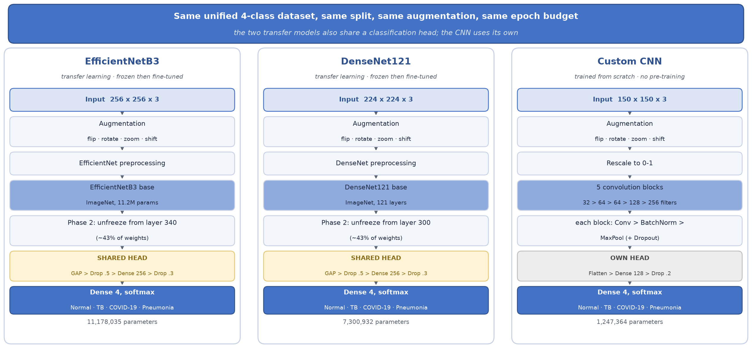
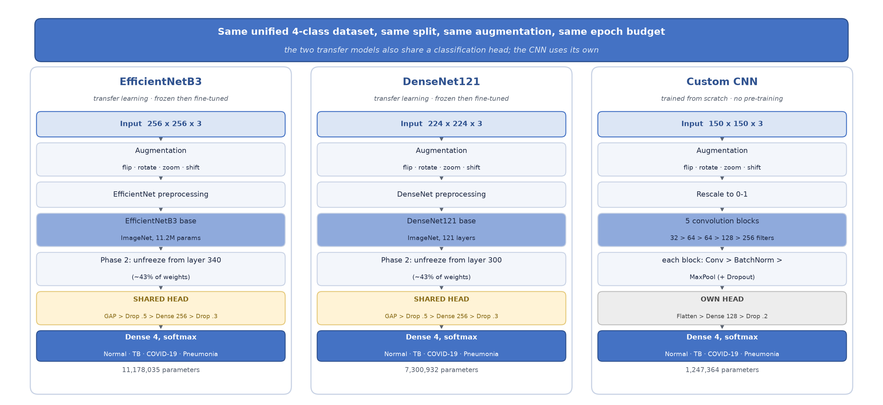
Methodology: Model Architectures
AI Agent For Lung Diseases Detection

Slide 20
Data Splitting
Shared split: 70% training, 15% validation and 15% test, created once and reused by every model.
Grouped by patient: all images of one patient stay in a single split, so nothing leaks between train and test.
Sizes: 2,260 training, 485 validation and 482 test images.
Why it matters: the test set is never seen during training, so the reported accuracy is honest.
AI Agent For Lung Diseases Detection

Slide 21
Model Development
We compared several architectures before choosing our models.
Transfer learning reuses ImageNet features and trains only a small head, which is ideal for small medical datasets.
Architecture | Test Accuracy | Role in Project | Ref
EfficientNetB3 | 82.99% | Transfer learning | [1]
DenseNet121 | 90.87% | Best performer | [2]
Custom CNN | 90.25% | Trained from scratch | N/A
AI Agent For Lung Diseases Detection

Slide 22
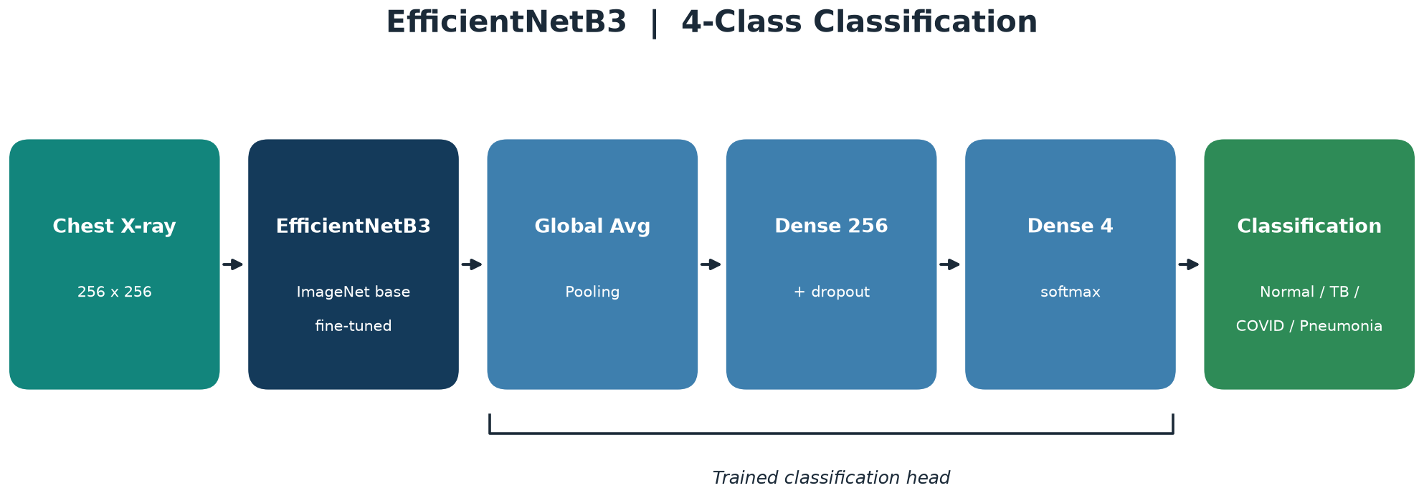
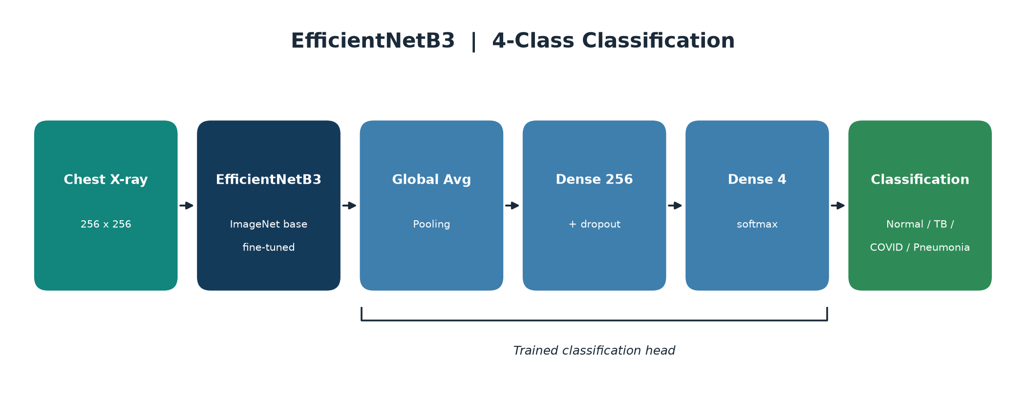
Methodology: EfficientNetB3
AI Agent For Lung Diseases Detection

Slide 23
Model Architecture: EfficientNetB3
Input (256x256x3): the chest X-ray is resized to 256x256 and scaled for EfficientNet, so every image enters the network in the same format.
EfficientNetB3 base (frozen): pre-trained on ImageNet and used as a fixed feature extractor, so it already knows generic visual patterns and is not retrained.
Learns step by step: it reads simple edges first, then textures, and finally the larger shapes and opacities that signal TB in the lungs.
Why frozen: freezing the base keeps training fast and prevents overfitting, which matters on a small medical dataset.
AI Agent For Lung Diseases Detection

Slide 24
Model Architecture: EfficientNetB3
Global Average Pooling: turns each feature map into a single number, giving one compact summary that describes the whole image.
What it focuses on: it captures whether a useful feature is present anywhere, rather than the exact place where it appears.
Dropout: randomly ignores some neurons during training, so the model does not rely on any single feature and generalises better.
Feature extraction: only the small classification head is trained on top, while the heavy EfficientNet base stays frozen underneath.
AI Agent For Lung Diseases Detection

Slide 25
Model Architecture: EfficientNetB3
Output layer: a final dense layer produces four scores, one for each class, using softmax.
Decision: the class with the highest score is the classification, and that score is the confidence.
Training setup: trained with the Adam optimiser and categorical cross-entropy until validation accuracy stops improving.
Result: this gives 82.99% test accuracy on X-rays the model has never seen before.
AI Agent For Lung Diseases Detection

Slide 26
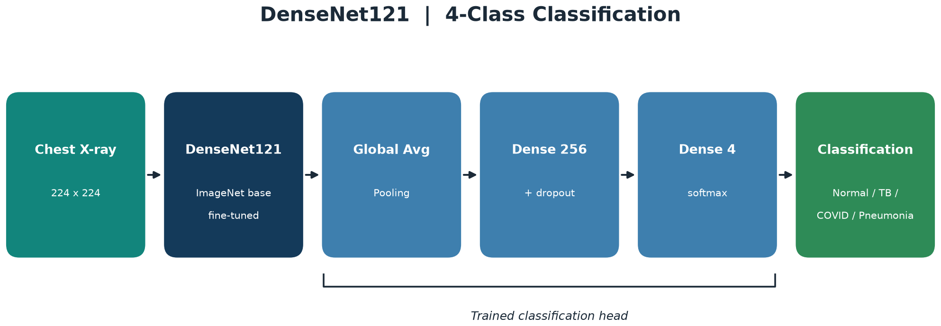
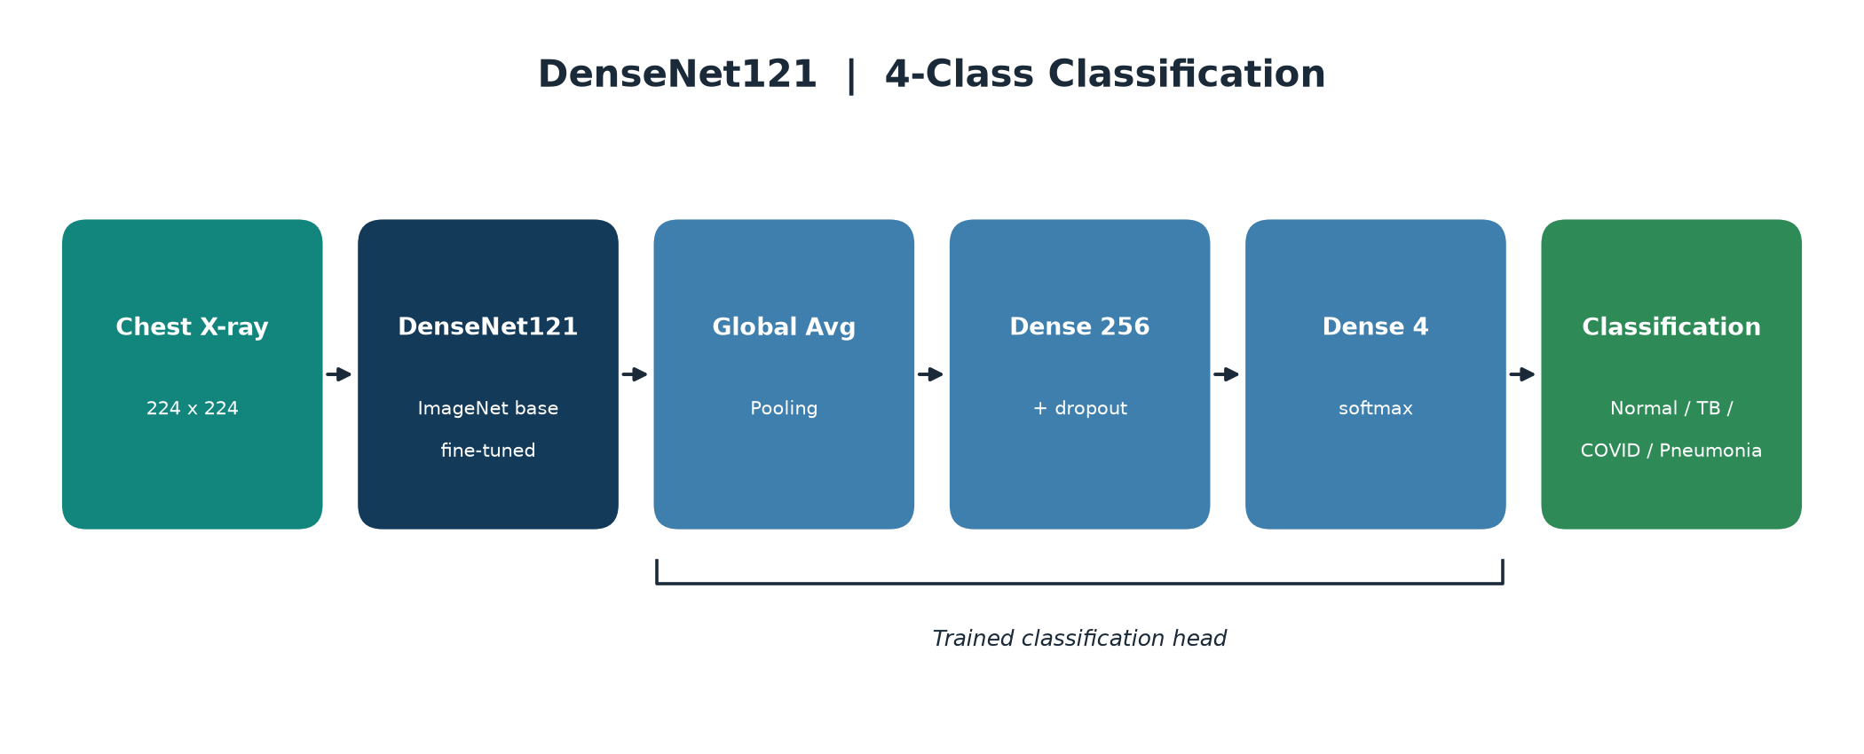
Methodology: DenseNet121
AI Agent For Lung Diseases Detection

Slide 27
Model Architecture: DenseNet121
DenseNet121 is our COVID model. Its dense connections let each layer reuse features from all earlier layers, which is great for subtle medical patterns.
Input: a 224x224 colour X-ray is prepared with DenseNet's own preprocessing before it enters the network.
Classification head: the features pass through pooling, a dense layer with dropout, and then the output layer that makes the decision.
Task: the model classifies an X-ray as Normal, Tuberculosis, COVID-19 or Pneumonia.
Strategy: transfer learning with data augmentation on the unified dataset, to get the most from limited data.
AI Agent For Lung Diseases Detection

Slide 28

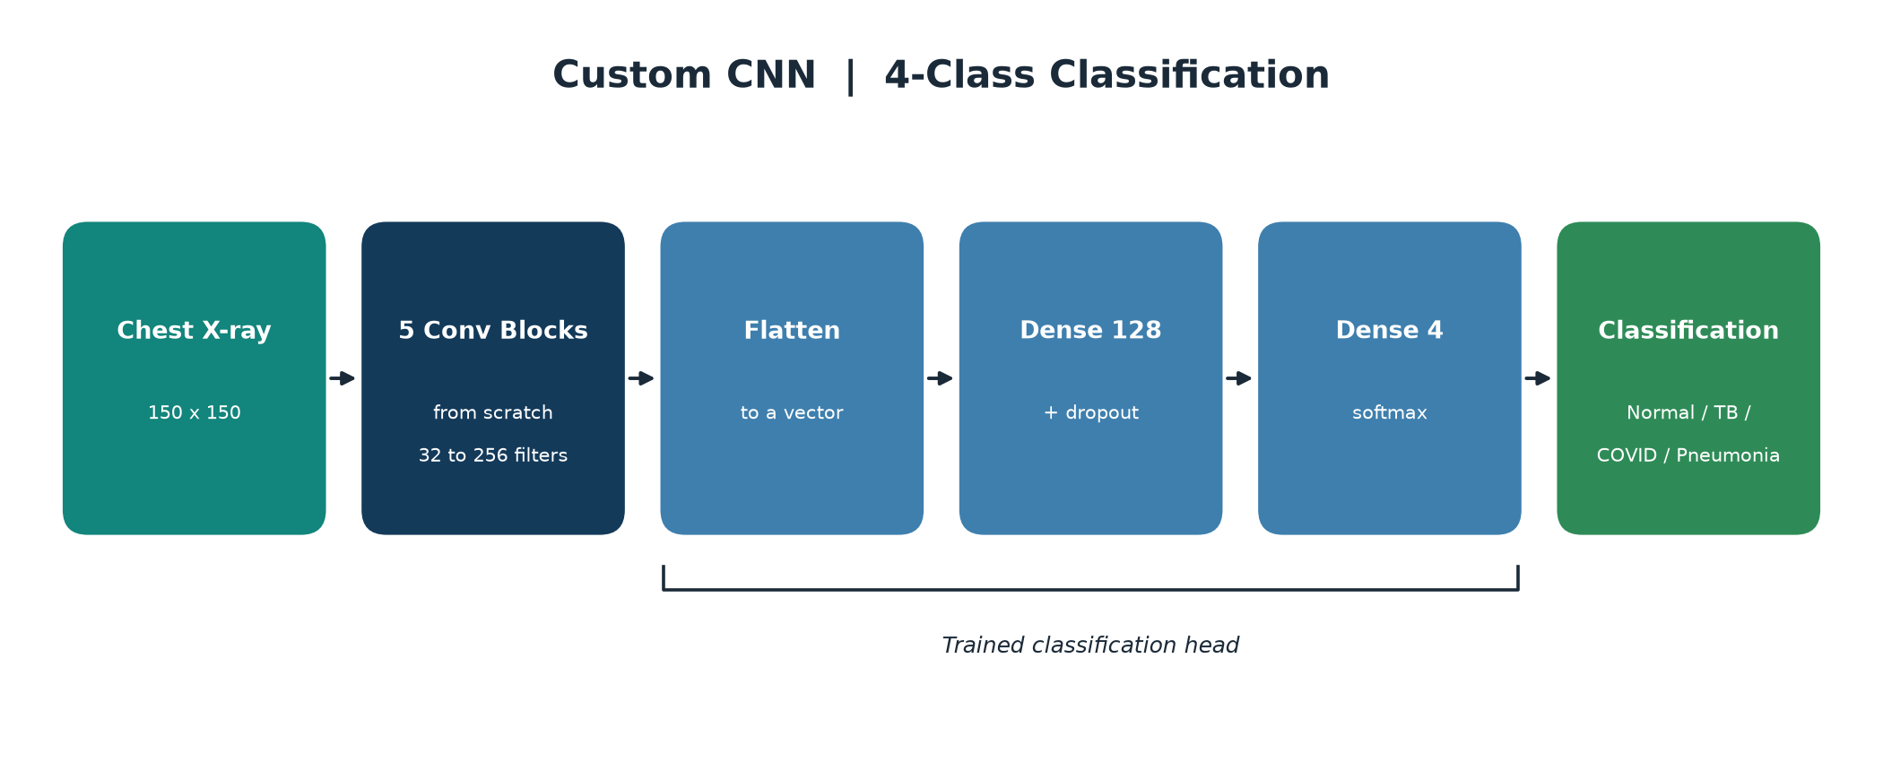
Methodology: Custom CNN
AI Agent For Lung Diseases Detection

Slide 29
Model Architecture: Custom CNN
Built from scratch: this model uses no pre-trained weights, so it learns every pattern directly from the pneumonia X-rays.
Input: each 150x150 colour image is rescaled so its pixel values sit in a small, consistent range.
Five convolution blocks: the number of filters grows block by block, letting the network capture more detail as it goes deeper.
Each block: a convolution finds patterns, normalisation stabilises training, and pooling shrinks the image to stay efficient.
Head: the final feature maps are flattened into a vector and passed to a dense layer that makes the decision.
Output: a probability for each of the four classes, and the highest one is the classification.
Result: the model reaches 90.25% accuracy on the unified test set.
AI Agent For Lung Diseases Detection

Slide 30
Best Model: DenseNet121
Test set: 482 unseen chest X-rays spanning all four classes.
Accuracy: 90.87%, the strongest of the three architectures.
Balanced accuracy: 89.14%, which weights every class equally regardless of size.
Strength: Pneumonia and Tuberculosis are detected most reliably.
Metric | Value
Test Accuracy | 90.87% (482 images)
Balanced Accuracy | 89.14%
Macro F1 | 0.864
AI Agent For Lung Diseases Detection

Slide 31
Application Workflow
1. Upload: the user uploads a chest X-ray.
2. Validate: the app checks the image really is a chest radiograph.
3. Preprocess: resize and scale to match each model.
4. Classify: all three models output a class and its confidence.
5. Show result: each model's scores and whether they agree appear on the results page.
AI Agent For Lung Diseases Detection

Slide 32
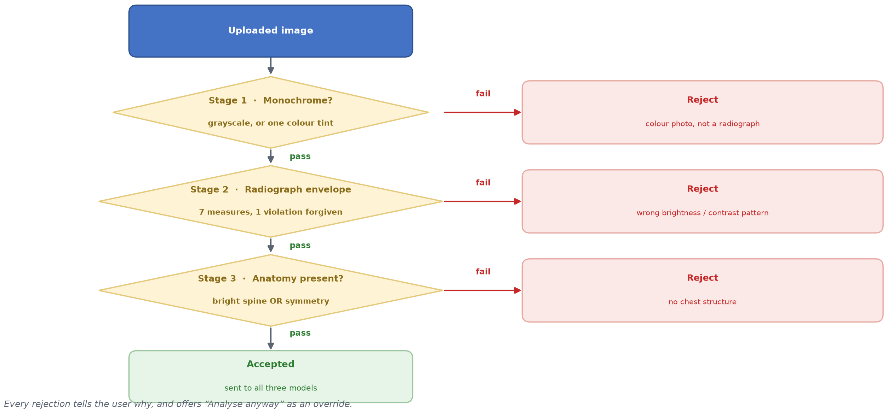
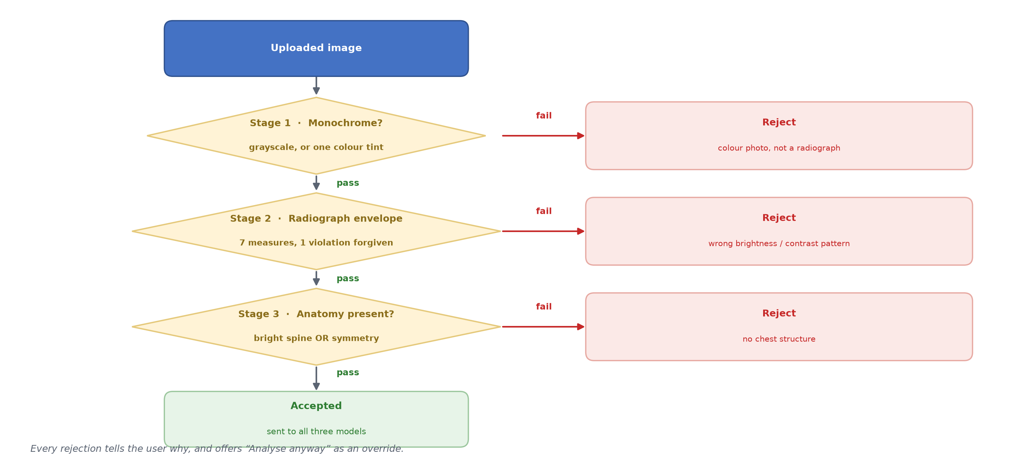
Input Validation Pipeline
AI Agent For Lung Diseases Detection

Slide 33
Tools and Technologies Used
Language: Python 3.8+.
Deep Learning: TensorFlow and Keras to build, train, and evaluate the models.
Models: EfficientNetB3, DenseNet121 (Keras Applications), and a custom CNN.
Web App: Flask and Werkzeug serve all three models from one page.
Images & Data: OpenCV, NumPy, Pillow, Pandas, and Scikit-learn.
Plots: Matplotlib and Seaborn for the accuracy graph and confusion matrix.
AI Agent For Lung Diseases Detection

Slide 34
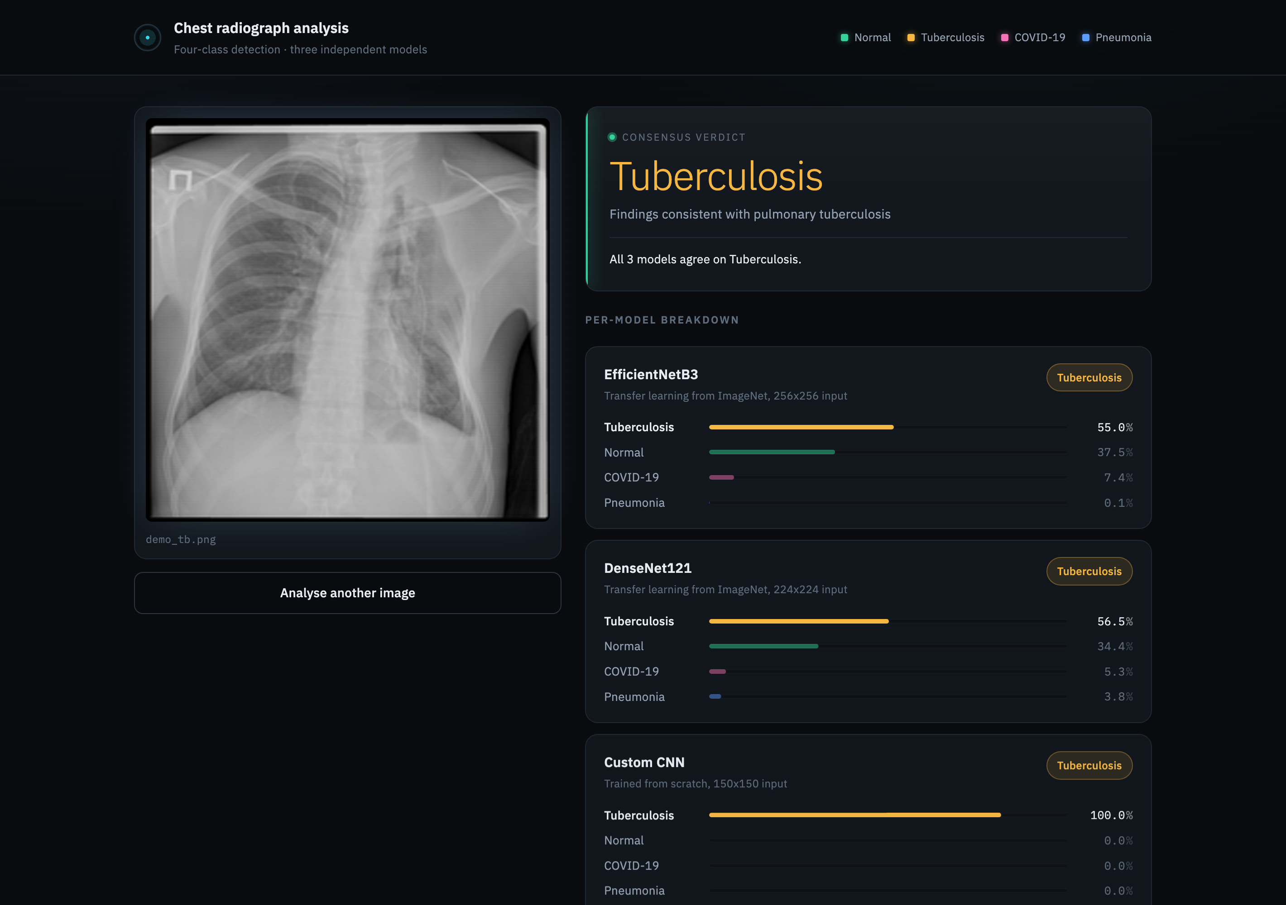
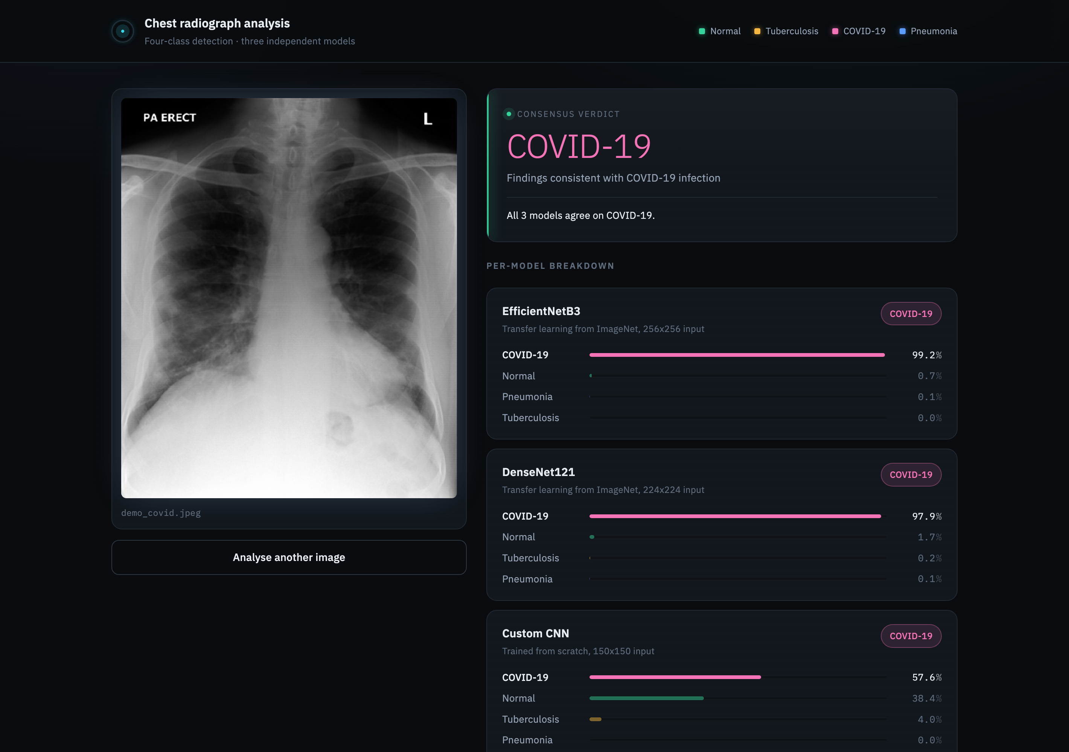
Live App Demonstration
Tuberculosis detection
COVID-19 detection
AI Agent For Lung Diseases Detection

Slide 35
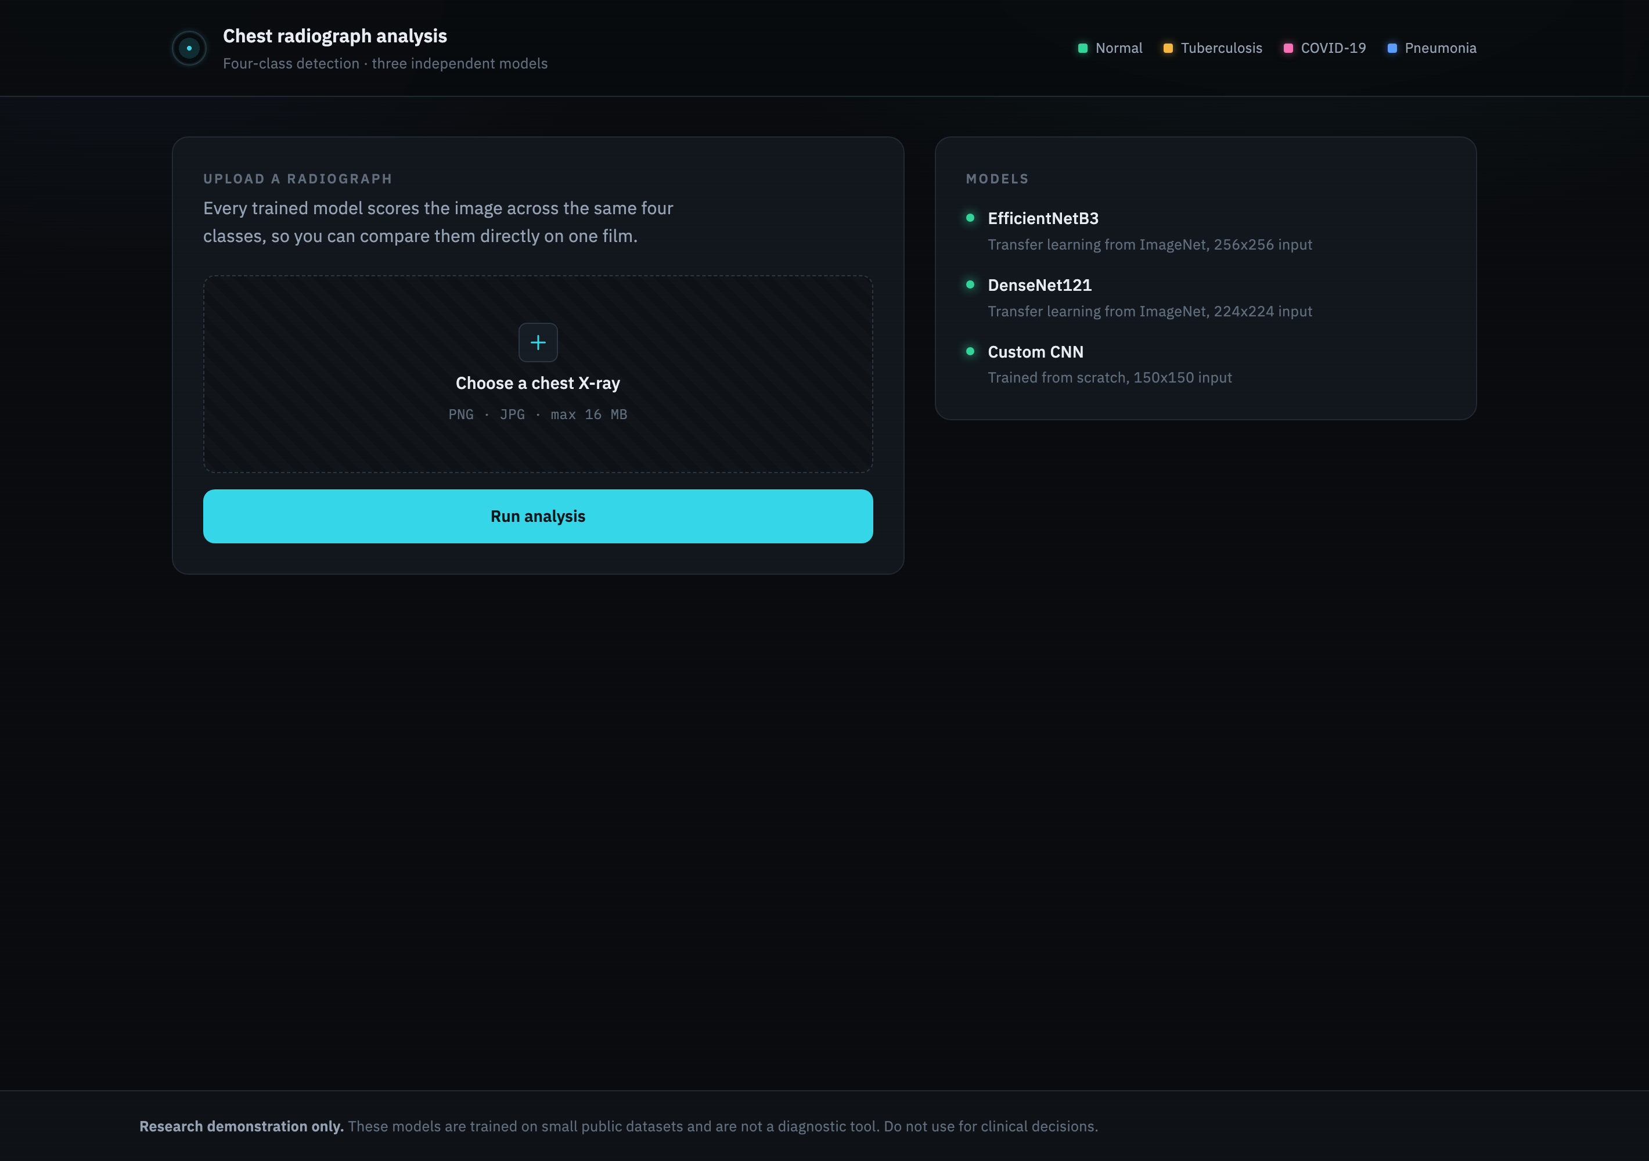
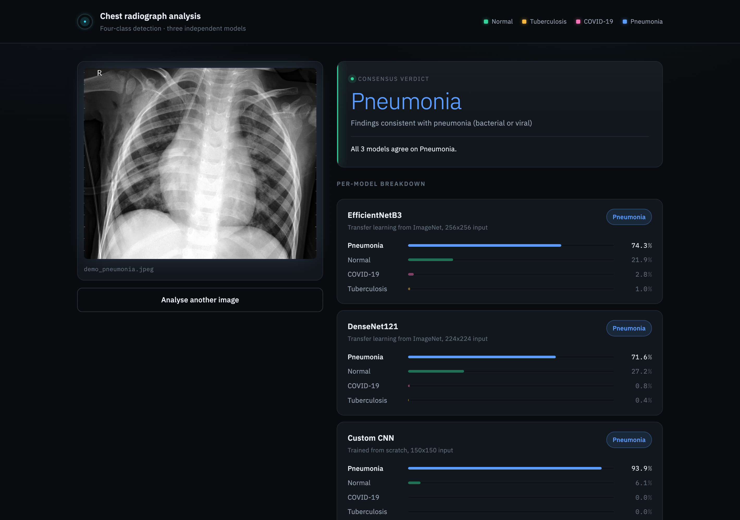
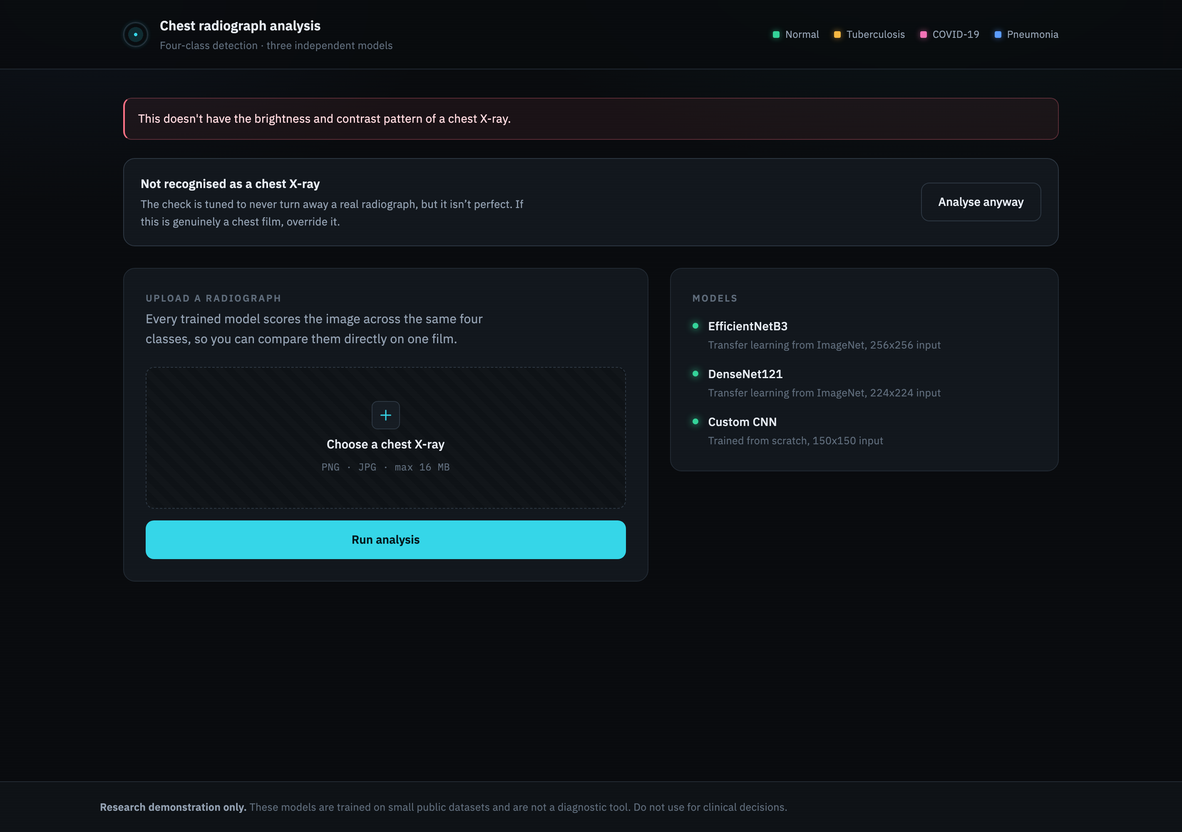
Web App: Classification Results
Home page
Pneumonia detection
Non X-ray rejected
AI Agent For Lung Diseases Detection

Slide 36
Evaluation Metrics
Metric | Formula | What it measures | Ideal
Accuracy | (TP + TN) / all | overall share classified correctly | 100%
Precision | TP / (TP + FP) | how much a positive flag can be trusted | 1.00
Recall | TP / (TP + FN) | share of real cases the model catches | 1.00
F1 Score | 2PR / (P + R) | balance between precision and recall | 1.00
Balanced Accuracy | mean of per-class recall | fairness across unequal class sizes | 100%
AI Agent For Lung Diseases Detection

Slide 37
Evaluation Metrics by Model
All Models: Test Accuracy (482 test images)
Model | Classes | Test Accuracy
DenseNet121 | All four | 90.87%
Custom CNN | All four | 90.25%
EfficientNetB3 | All four | 82.99%
DenseNet121: Per-Class Metrics
Class | Precision | Recall | F1-Score
Normal | 0.92 | 0.86 | 0.89
Tuberculosis | 0.98 | 0.89 | 0.93
COVID-19 | 0.59 | 0.84 | 0.70
Pneumonia | 0.91 | 0.98 | 0.94
AI Agent For Lung Diseases Detection

Slide 38
Model Comparison
Like-for-like: identical data, splits, augmentation, classification head and epoch budget; only the backbone differs.
Model | Parameters | Test Accuracy | Macro F1
DenseNet121 | 7,300,932 | 90.87% | 0.864
Custom CNN | 1,247,364 | 90.25% | 0.835
EfficientNetB3 | 11,178,035 | 82.99% | 0.745
AI Agent For Lung Diseases Detection

Slide 39
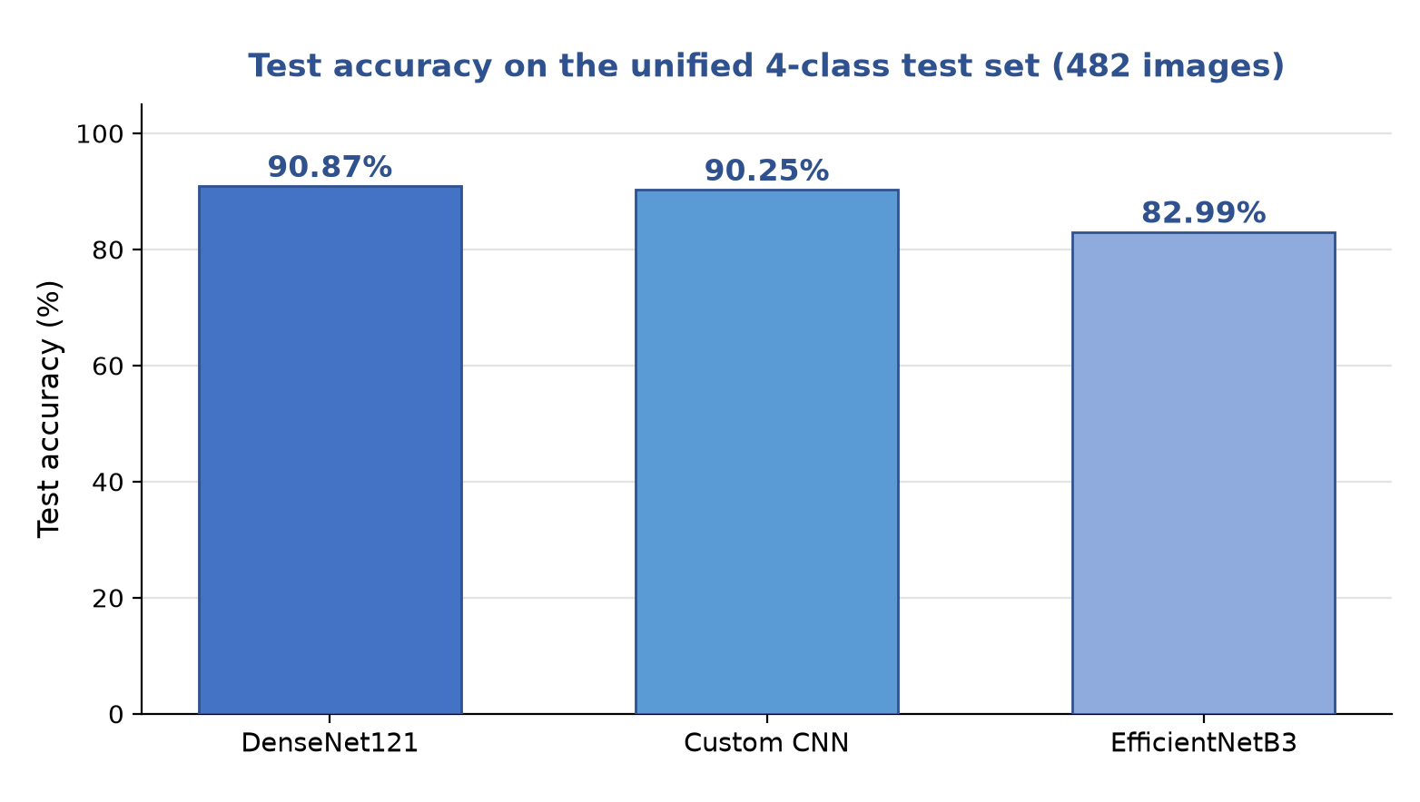
Results: Model Accuracy
DenseNet121: 90.87% test accuracy on 482 unseen X-rays.
Custom CNN: 90.25% test accuracy, with six times fewer parameters.
EfficientNetB3: 82.99% test accuracy.
Takeaway: the two strongest models are close, and both generalise well to unseen X-rays.
AI Agent For Lung Diseases Detection

Slide 40
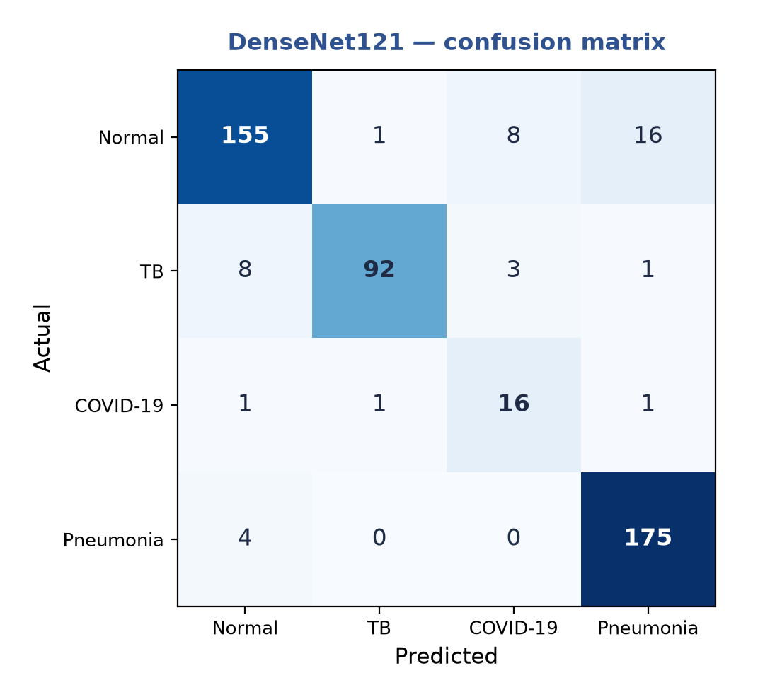
Confusion Matrix: DenseNet121
What it shows: the DenseNet121 model on all 482 test X-rays across the four classes.
Strong diagonal: most classifications fall on the diagonal, meaning they are correct.
Best detected: Pneumonia (175 of 179) and Tuberculosis (92 of 104).
Main confusion: some Normal X-rays are read as Pneumonia, the hardest pair to separate.
AI Agent For Lung Diseases Detection

Slide 41
Results Evaluation
DenseNet121: 90.87% test accuracy, the best of the three.
Custom CNN: 90.25% test accuracy, using six times fewer parameters.
EfficientNetB3: 82.99% test accuracy, the weakest despite being the largest.
Key finding: with enough data the from-scratch CNN nearly matches the pre-trained DenseNet121.
Reading the chart: taller bars mean higher accuracy on unseen X-rays.
AI Agent For Lung Diseases Detection

Slide 42
Model Performance & Challenges
1. Small, imbalanced datasets. Medical X-ray data is limited. Our approach: data augmentation (rotation, zoom, flips) to add variety.
2. Risk of overfitting. small datasets can make a model memorise. Our approach: dropout, early stopping, and lowering the learning rate.
3. Model choice. simple models can underfit. Our approach: transfer learning (EfficientNetB3, DenseNet121) for strong features.
AI Agent For Lung Diseases Detection

Slide 43
Limitations
Small COVID-19 class: only 130 COVID images exist, so that class stays the weakest by a wide margin.
Class imbalance: COVID-19 has far fewer images than the other classes, which lowers its precision.
No external validation: models are tested on held-out data, not on other hospitals' scans.
Image quality: unusual angles, artifacts or low-quality scans can lower accuracy.
Not a diagnosis: the system is a screening aid and cannot replace a radiologist.
AI Agent For Lung Diseases Detection

Slide 44
Conclusion
One system: three models detect four classes from a single chest X-ray.
Results: DenseNet121 90.87%, Custom CNN 90.25% and EfficientNetB3 82.99% test accuracy.
Fair comparison: training all three on one shared dataset made the architecture comparison meaningful.
Main lesson: more training data improved every model far more than longer training did.
Deployment: all three run in one Flask web app with a built-in chest X-ray check.
AI Agent For Lung Diseases Detection

Slide 45
References
[1] M. Tan and Q. V. Le, "EfficientNet: Rethinking Model Scaling for CNNs," in Proc. ICML, 2019.
[2] G. Huang, Z. Liu, et al., "Densely Connected Convolutional Networks," in Proc. CVPR, 2017.
[3] T. Rahman et al., "Reliable Tuberculosis Detection Using Chest X-ray," IEEE Access, vol. 8, 2020.
[4] P. Mooney, "Chest X-Ray Images (Pneumonia)," Kaggle Dataset, 2018.
[5] K. He, X. Zhang, et al., "Deep Residual Learning for Image Recognition," in Proc. CVPR, 2016.
[6] C. Szegedy et al., "Rethinking the Inception Architecture for Computer Vision," in Proc. CVPR, 2016.
[7] K. Simonyan and A. Zisserman, "Very Deep Convolutional Networks (VGG)," in Proc. ICLR, 2015.
[8] D. P. Kingma and J. Ba, "Adam: A Method for Stochastic Optimization," in Proc. ICLR, 2015.
[9] N. Srivastava et al., "Dropout: A Simple Way to Prevent Overfitting," JMLR, vol. 15, 2014.
[10] S. Ioffe and C. Szegedy, "Batch Normalization," in Proc. ICML, 2015.
[11] R. R. Selvaraju et al., "Grad-CAM: Visual Explanations from Deep Networks," in Proc. ICCV, 2017.
[12] J. Deng et al., "ImageNet: A Large-Scale Hierarchical Image Database," in Proc. CVPR, 2009.
[13] TensorFlow and Keras Documentation, tensorflow.org; Flask Documentation, 2024.
AI Agent For Lung Diseases Detection

