Slide 1


Airplane Management System in C
Presented by [Syed Raahim Ali (CT-25191 & Faizan Khan (CT-25195)]

Slide 2

Introduction to Project
Overview of Flight Management System
The Airplane Management System project aims to develop a simple flight management solution in C, utilizing arrays and a menu-driven interface to effectively manage flight data for introductory programming.
2

Slide 3
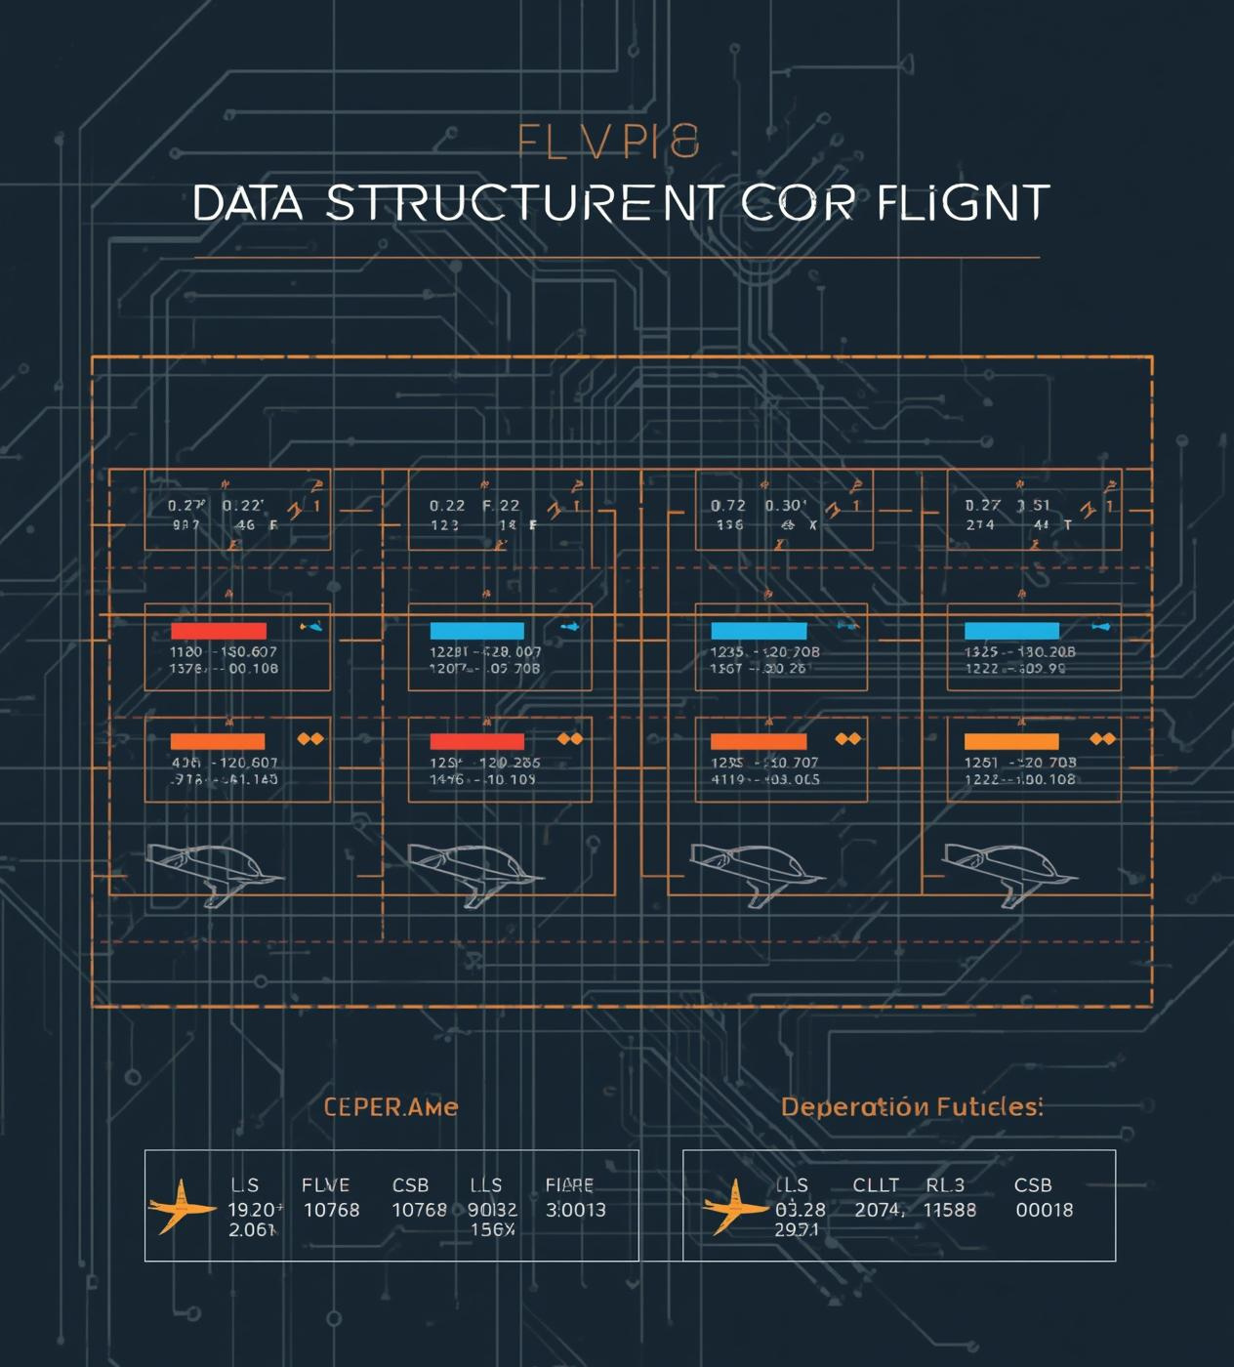
Data Storage Using Arrays
  Flight numbers stored in an integer array format
  Destination codes mapped to specific cities for clarity
  Departure times represented in a simple integer format
  MAX flights constant defines the system's capacity limit
  Count variable tracks current number of flights stored

Slide 4
Destination Codes and Time Representation
Understanding Flight Destinations and Scheduling
4

Slide 5
Main Menu Loop and User Interaction
The main menu loop is a crucial part of the Airplane Management System, enabling user interaction through a menu-driven interface. The loop utilizes a while structure to continuously present options until the user chooses to exit. Input validation is essential; it ensures that user entries are both valid and safe. By using scanf for input and printf for output, the program engages users effectively. Moreover, implementing error handling provides feedback for invalid inputs, enhancing user experience and stability of the system, fostering a smooth interaction throughout the application.

Slide 6
Adding Flights
Key Functionalities of the System
Capacity Check
Input Details
Confirmation Messages
Before adding a flight, the system checks the maximum capacity to ensure no more than the allowed number of flights are entered, maintaining data integrity.
Users are prompted to enter specific flight details, such as flight number, destination, and departure time, ensuring comprehensive information collection for each record.
Upon successful addition, the system provides confirmation messages to the user, enhancing the user experience by indicating that the flight has been recorded successfully.
6

Slide 7
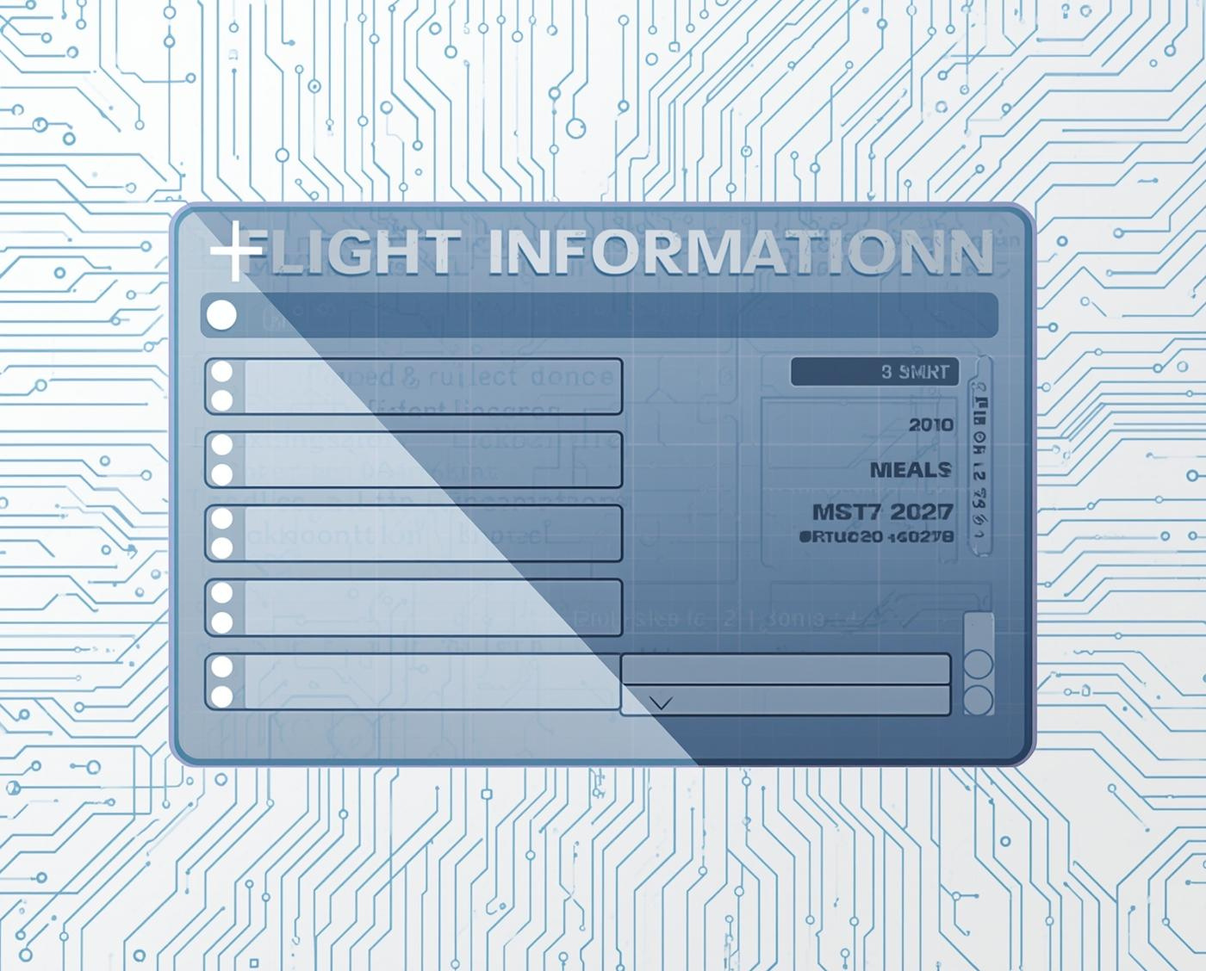
Viewing All Flights: Handle Empty List
Importance of Handling Empty Flight Lists
Ensure users receive clear feedback messages

Slide 8
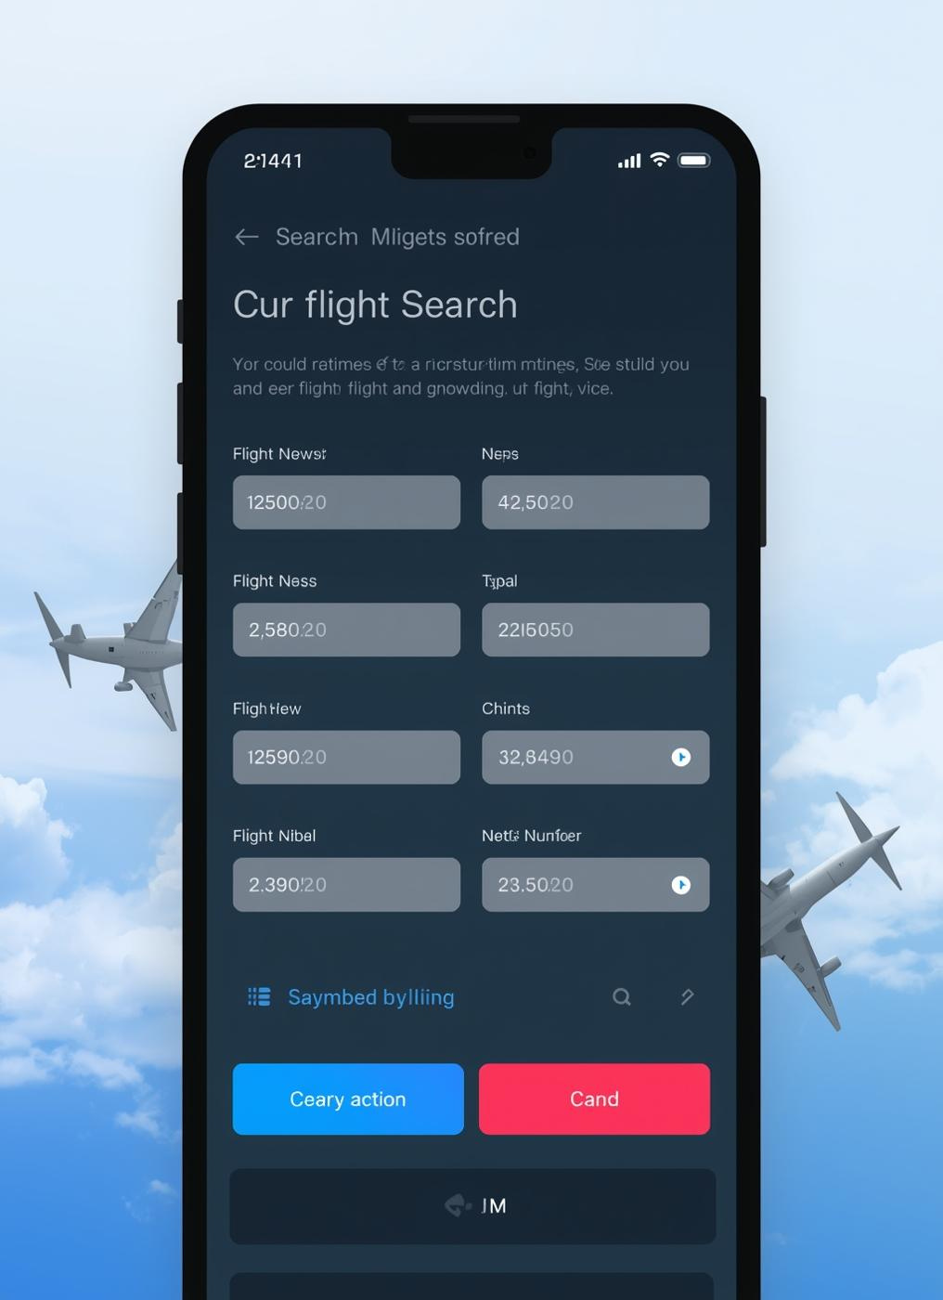
Flight Number Search
The flight search feature allows users to input a flight number, enabling efficient retrieval of specific flight details. It implements a linear search algorithm, providing immediate feedback on search outcomes.

Slide 9
Exit Options and Error Handling
Managing User Choices in the System
The program includes a clear exit option, allowing users to terminate the session effectively. Additionally, it handles invalid choices through prompts and guidance, ensuring user-friendly navigation.
9

Slide 10
Program Flow and Enhancements
Understanding the Menu Loop Dynamics
10

Slide 11
Limitations and Enhancements
Addressing Constraints and Future Options
The current system's fixed array size limits scalability; introducing file I/O for persistent storage and additional features like sorting and a GUI could significantly enhance functionality and user experience.
11

Slide 12
Suggested Enhancements for User Experience
The Airplane Management System can be significantly improved with several added features:
  Sorting Flights: Implement functionality to sort flights by departure time or destination for easier viewing.
  Editing Records: Allow users to modify existing flight details, enhancing data accuracy and user interactivity.
  Deleting Flights: Introduce an option to delete flights, providing flexibility in managing flight data.
Additionally, developing a Graphical User Interface (GUI) would make the system more user-friendly and visually appealing, facilitating better user interaction and engagement while reinforcing core programming concepts.

Slide 13

Project Recap and Next Steps
This project highlights core programming concepts through a flight management system, emphasizing areas for future growth, such as persistence, user interface, and added functionalities to enhance learning and usability.

Slide 14

Thank You

