Slide 1

Project Title - Seasonal Agriculture Performance Analysis
[Student Name – Faizan Khan
College Name- Oriental Institute Of Science & Technology, Bhopal ]
AICTE STU ID : STU682de61dae71d1747838493

Slide 2

PROBLEM STATEMENT
Agricultural activities are influenced by seasonal variations in environmental conditions, farming practices, resource availability and market conditions. As a result, agricultural performance may differ from one season to another. However, raw agricultural data does not clearly explain how agricultural performance changes across seasons or what patterns can be observed in different seasonal conditions. The problem is to analyze the given agricultural dataset and investigate seasonal differences in agricultural performance by identifying meaningful patterns, trends, relationships and variations within the available data.

Slide 3
Project Description
Seasonal Agriculture Performance Analysis is a data analytics project that analyzes agricultural activities across different seasons, geographical areas, and farming conditions.
Explores crop production, farming practices, resource usage, environmental conditions, and economic performance.
Compares agricultural performance across different seasons and categories.
Identifies seasonal patterns, trends, relationships, variations, and unusual observations in the dataset.
Uses data cleaning, statistical analysis, and visualization techniques to transform raw agricultural data into meaningful insights.
Provides evidence-based findings and recommendations to support better seasonal agricultural planning.

Slide 4

WHO ARE THE END USERS?
Farmers & Agricultural Practitioners -Understand seasonal performance, crop patterns, and resource usage.
Agricultural Planners & Decision-Makers -Use data-driven insights for better seasonal agricultural planning.
Researchers & Agricultural Analysts -Study seasonal trends, environmental conditions, and relationships in agricultural data.
Government & Agricultural Organizations -Support evidence-based planning and identify areas requiring further investigation.
Students & Data Analysts -Explore real-world agricultural data and develop analytical insights.

Slide 5

Technology Used
Programming Language
Python
Development Environment
Visual Studio Code (VS Code)
Data Handling & Analysis
Pandas
NumPy
Data Visualization
Matplotlib
Seaborn
Dataset
CSV (Seasonal Agriculture Performance Dataset)

Slide 6
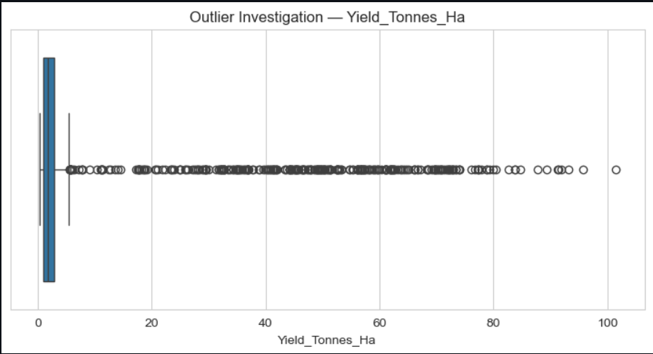
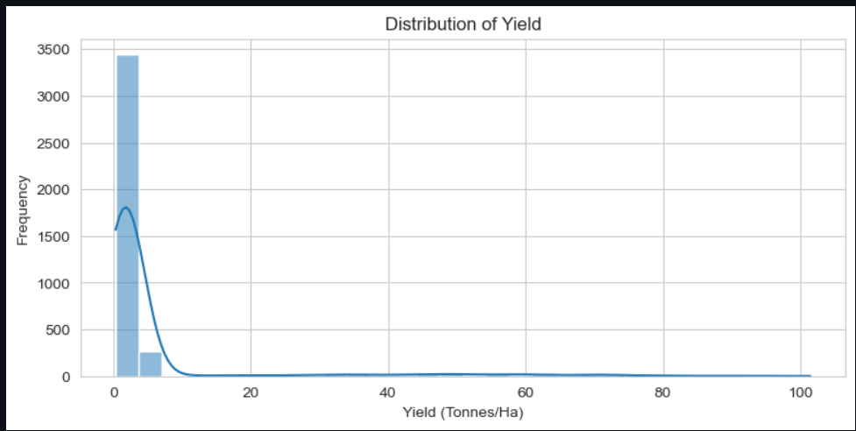
RESULTS

Slide 7
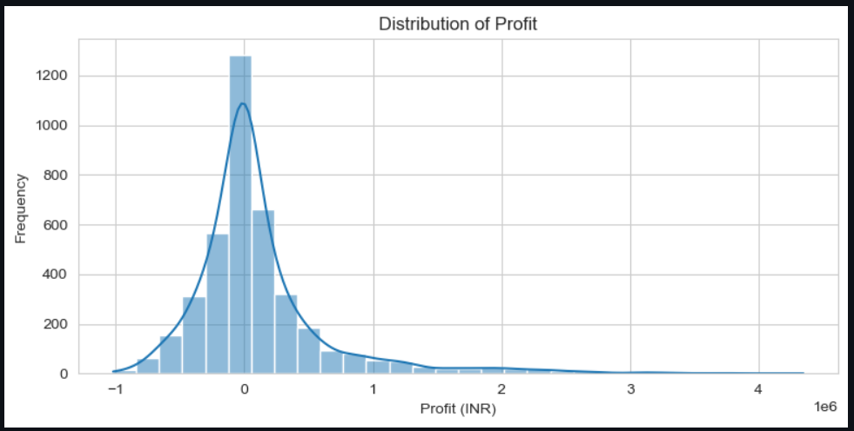
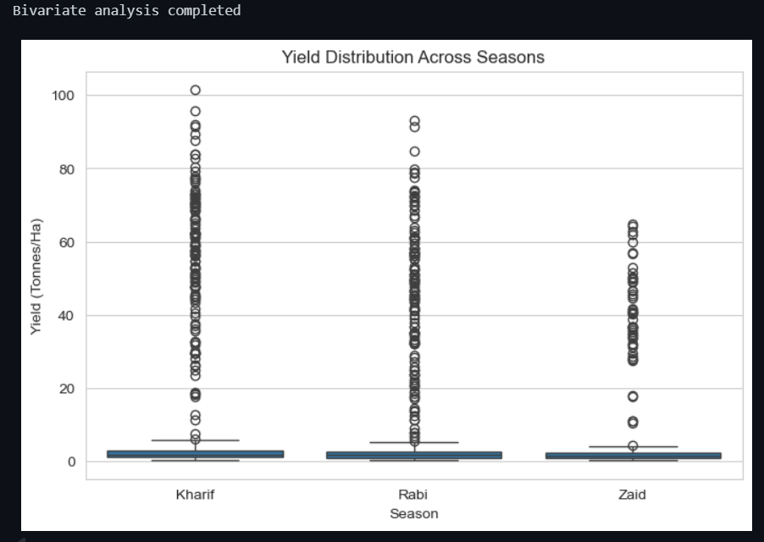
RESULTS

Slide 8
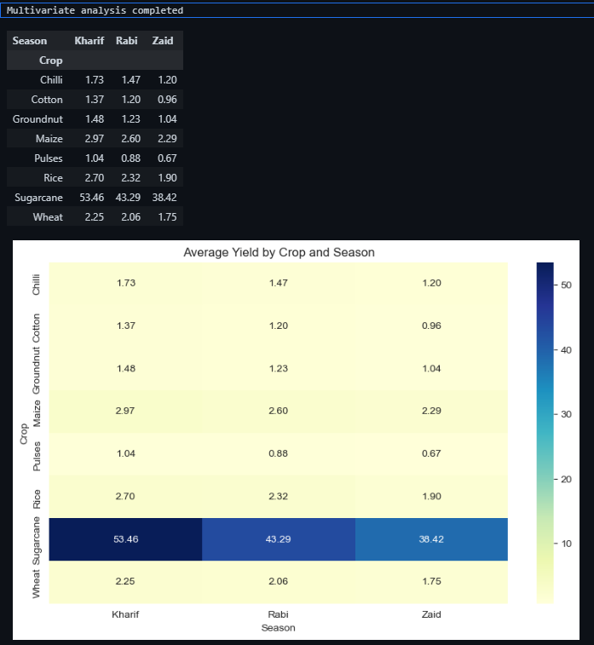
RESULTS

Slide 9
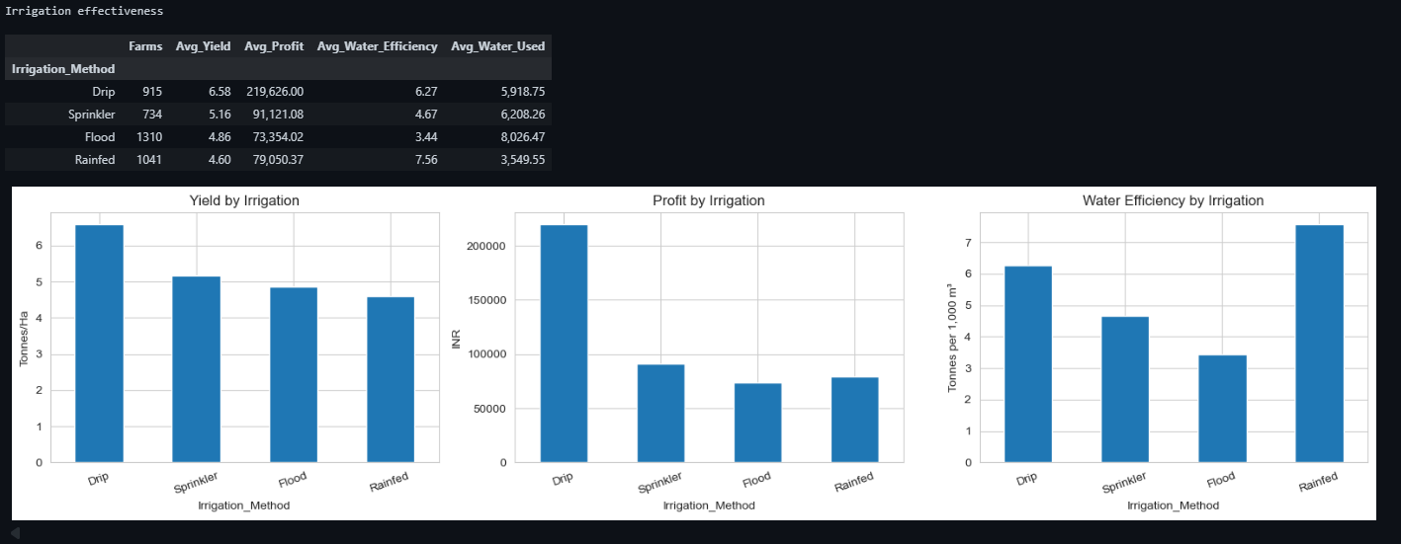
RESULTS

Slide 10
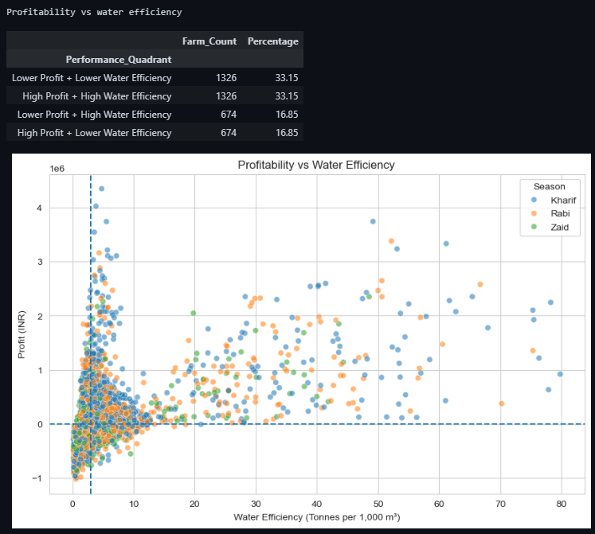
RESULTS

Slide 11
Future scope
Predictive Analysis – Develop models to predict future agricultural performance across seasons.
Real-Time Data Integration – Incorporate live weather, soil, and market data for continuous analysis.
Regional Analysis – Extend the analysis to more geographical regions and agricultural categories.
Advanced Analytics – Apply machine learning to identify deeper relationships and seasonal patterns.
Decision Support System – Develop a data-driven system to support farmers and agricultural planners in seasonal planning.
Interactive Dashboard – Create an interactive dashboard for easier exploration of agricultural trends and insights.

Slide 12
GitHub Link
Github Profile link- https://github.com/Faizankhan2612/Seasonal-Agriculture-Performance-Analysis-

Slide 13

VOIS Course completion certificate - Course name- Data Visualization

Slide 14
Thank you
.
.

