Slide 1

Natura.IO

Slide 2
1. Introduction

Slide 3
1.1 Problem Definition
It is seen many times that video game players face difficulties while trying to portray their input to the gaming system.
Sometimes, it is because they are so engrossed in the game that by-mistake they give wrong input.
Voice (or Written Text) is a natural interaction medium for Humans.
Games capable of processing their I/O based on “Natural Human Talks” present many benefits, especially to the players in the field of Serious Games.
The players that will be playing any Serious Game may or may not be an expert gamer.
Thus he/she may be more comfortable while interacting using the natural human language.

Slide 4
1.2 Scope of Project
To develop tool for Natural Language I/O Interaction in Video Games.

Slide 5
1.3 Users and their requirements
Game Developers (Gameplay Programmers): API that can be Integrated.
Video Game Hobbyist & Professional Players: Ready-made game.
Scientists working on interactive simulation research: Player’s behavioural via IO data.

Slide 6
1.4 Technologies to be used
Tkinter - It is a Python binding to the Tk GUI toolkit. It is the standard Python interface to the Tk GUI toolkit, and is Python's de facto standard GUI.
Language Understanding (LUIS) - It is a cloud-based API service that applies custom machine-learning intelligence to a user's conversational, natural language text to predict overall meaning, and pull out relevant, detailed information.

Slide 7
2. Literature Survey

Slide 8
Fast and easy language understanding for dialog systems with Microsoft Language Understanding Intelligent Service (LUIS)
Towards Open Intent Discovery for Conversational Text
Bot Colony – a Video Game Featuring Intelligent Language-Based Interaction with the Characters
Natural Language Processing and Game-based Practice in iSTART
Design and implementation of voice controlled Tetris game based on Microsoft SDK
UTTERANCE-LEVEL EXTRACTIVE SUMMARIZATION OF OPEN-DOMAIN SPONTANEOUS CONVERSATIONS WITH RICH FEATURES

Slide 9
3. Conceptual System Diagram

Slide 10
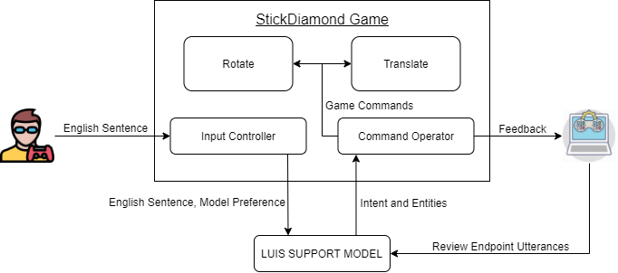
3.1 Conceptual System Diagram

Slide 11
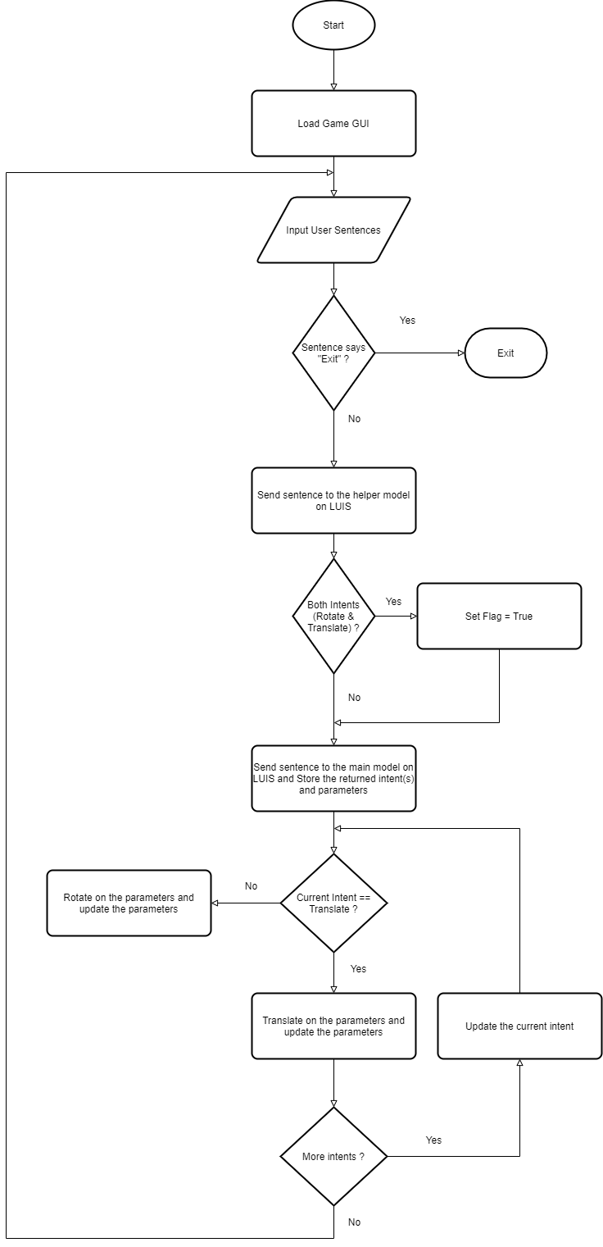
3.2 Flowchart

Slide 12
4. Gameplay

Slide 13
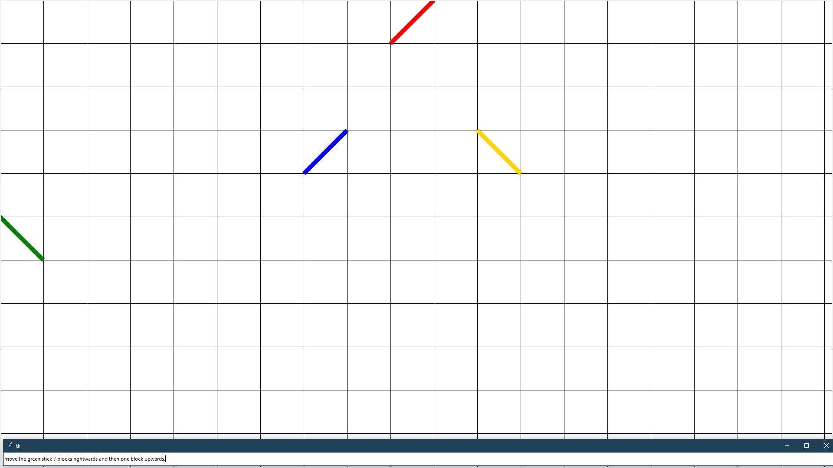
4.1 Player’s Input

Slide 14
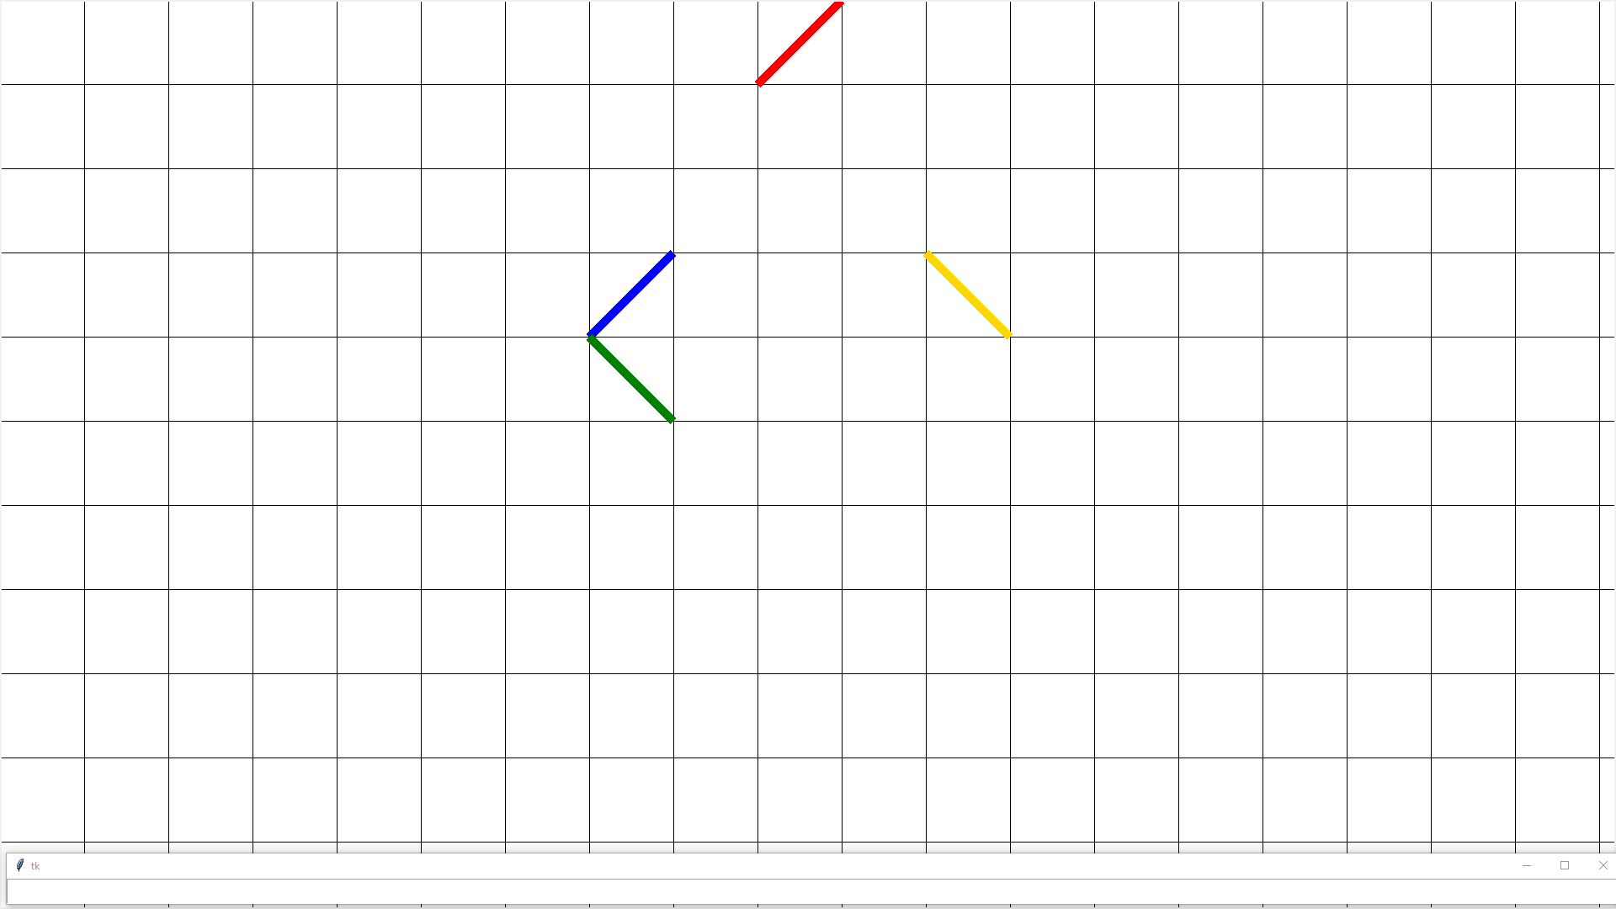
4.2 Game’s Response

Slide 15
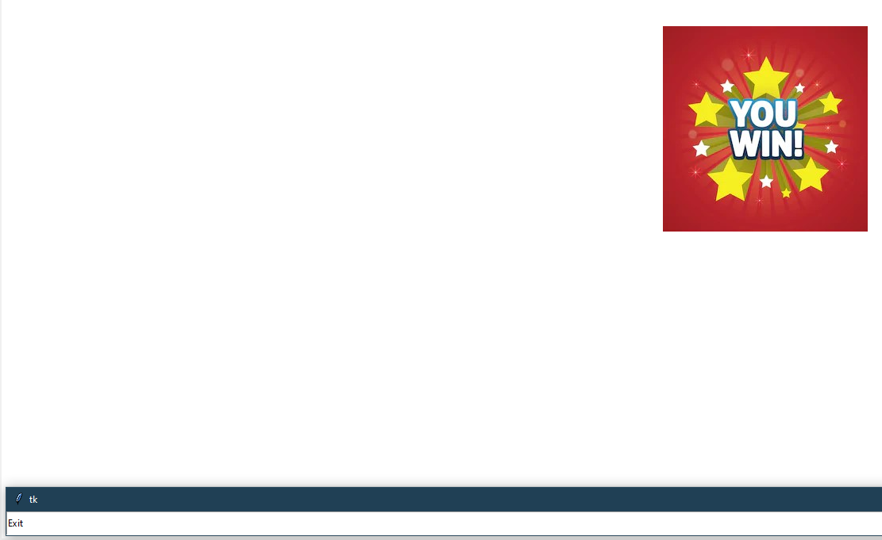
4.3 Winner’s Screen

Slide 16
5. Conclusion and Future scope

Slide 17
5.1. Conclusion
Natura.IO attempts to increase the involvement of the player in the gameplay by controlling the game via natural language.

Slide 18
5.2. Future scope
Voice controlled natural language game IO system, this will allow the player to shift his whole focus towards the game rather than on the input devices like keyboard, mouse, joystick, etc.

Slide 19
6. References

Slide 20
Zhu, Xiaodan & Penn, Gerald. (2006). Utterance-Level Extractive Summarization of Open-Domain Spontaneous Conversations with Rich Features. 793-796. 10.1109/ICME.2006.262600.
Joseph, E.: Bot Colony – a Video Game Featuring Intelligent Language-Based Interaction with the Characters (2014). https://www.botcolony.com/doc/BotColony_paper.pdf
Jackson, T., Boonthum-Denecke, C., & McNamara, D. (2015). Natural language processing and game-based practice in iSTART. Journal of Interactive Learning Research, 26(2), 189-208.
Williams, Jason & Kamal, Eslam & Ashour, Mokhtar & Amr, Hani & Miller, Jessica & Zweig, Geoff. (2015). Fast and easy language understanding for dialog systems with Microsoft Language Understanding Intelligent Service (LUIS). 159-161. 10.18653/v1/W15-4622.
Yuan, XiaoJie & Fan, Jing. (2011). Design and implementation of voice controlled Tetris game based on Microsoft SDK. 10.1109/ICMT.2011.6001825.
Vedula, Nikhita & Lipka, Nedim & Maneriker, Pranav & Parthasarathy, Srinivasan. (2019). Towards Open Intent Discovery for Conversational Text.

Slide 21
THANK YOU

