Slide 1
Sales Forecasting for a Retail Chain
By Faiz Hussain

Slide 2
Objective
To forecast future sales for a retail chain using time series models.
Compare model performance and derive actionable business insights.

Slide 3
Dataset Overview
Retail chain sales data with 18 columns and 9800 rows.
Key variables: Order Date, Sales, Order Date, Region.
Datetime parsing applied to Order and Ship Dates.

Slide 4
Exploratory Data Analysis (EDA)
Monthly sales trend shows strong seasonality.
Region-wise and Category-wise sales patterns analyzed.
Profitability varies by segment and sub-category.

Slide 5
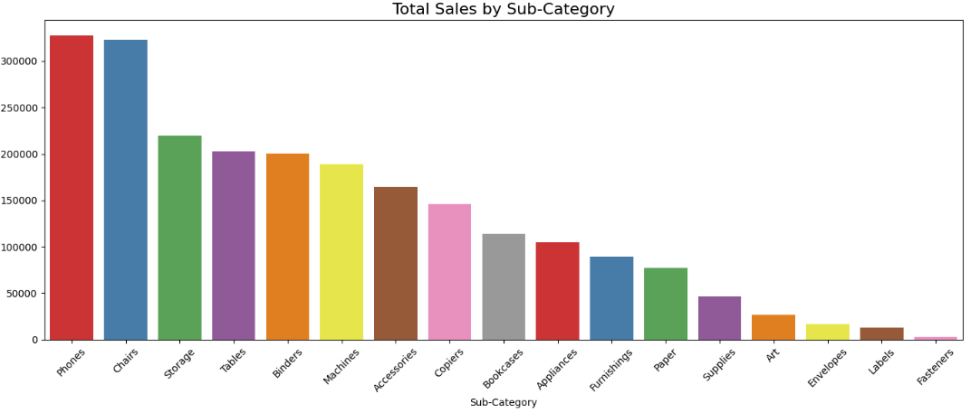
Total Sales by Sub-Category
Phones Were the Highest Selling Sub-Category
Labels were the least Selling Sub-Category

Slide 6
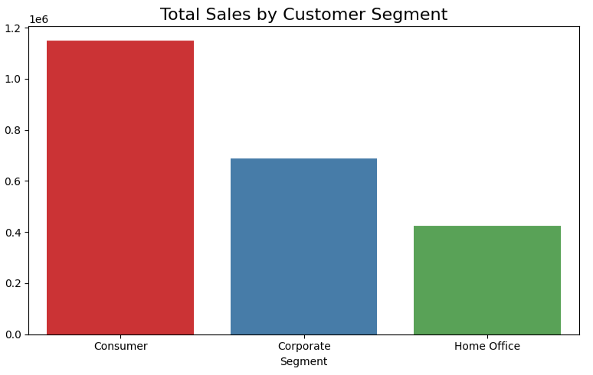
Total Sales By Customer Segment
Consumer had the highest Sales Segment
Followed by Corporate Segment and Home Office

Slide 7
Time Series Modeling
Two models were used:
a) SARIMAX: Seasonal ARIMA with Exogenous Variables
b) Prophet: Facebook's open-source forecasting model

Slide 8
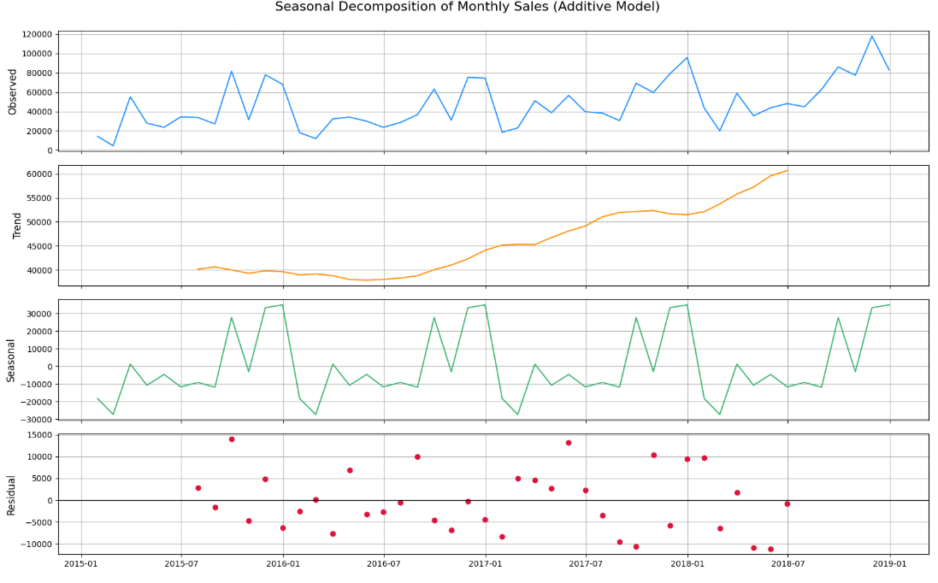
Decomposition analysis shows trend, seasonality, and residuals

Slide 9
Model Comparison
Prophet model captured seasonality effectively.
SARIMAX performed well on short-term forecasts.
Both models tuned for optimal parameters

Slide 10
Performance Metrics
Evaluation using MAE and RMSE.
Prophet RMSE: 14133.07 | SARIMAX RMSE: 16394.82
Prophet slightly outperformed SARIMAX in accuracy.

Slide 11
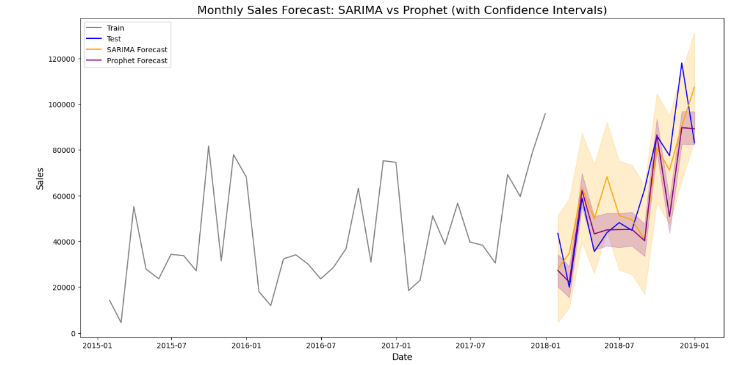
Monthly Sales Forecast
Sarima Forecast had higher sales

Slide 12
Insights & Recommendations
Strong seasonality – plan inventory for high-sales months.
Region & category segmentation helps target promotions.
Use Prophet for monthly sales planning.
Continuously retrain model on new data for better accuracy.

Slide 13
Conclusion
Time series forecasting provides valuable insights for retail sales.
Prophet is recommended due to its interpretability and accuracy.
EDA revealed key trends and profit-driving segments.
Adopt data-driven strategies for operational planning.

