Slide 1

Next Event Prediction in eCommerce Sessions using PySpark
Unlocking User Behavior Insights from the 2019-Oct eCommerce Multi-Category Store Dataset.
This presentation explores our approach to predicting the next user event within a shopping session, leveraging big data tools and machine learning to enhance e-commerce recommendations and user experience.

Slide 2
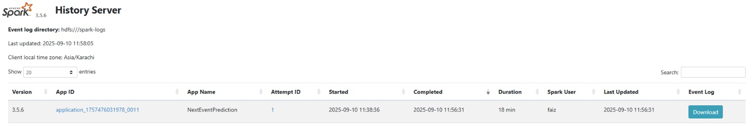
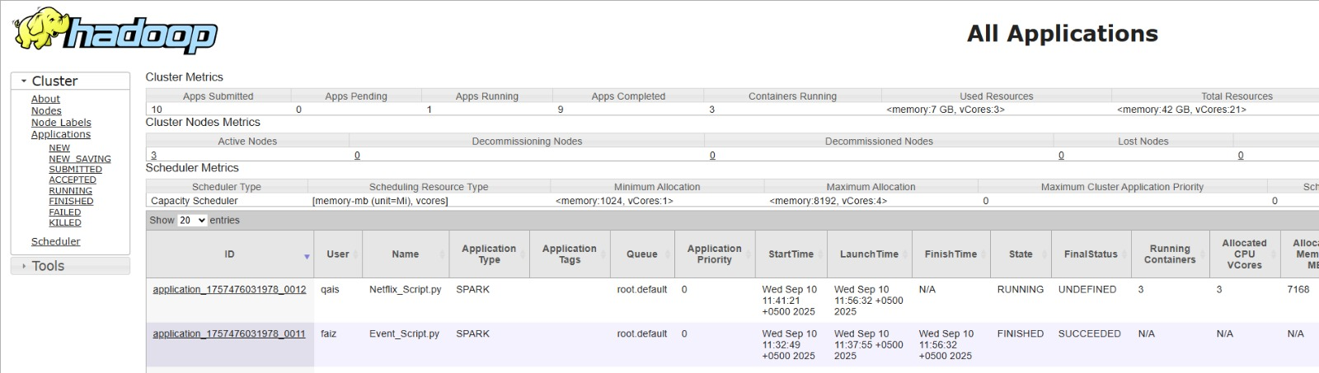
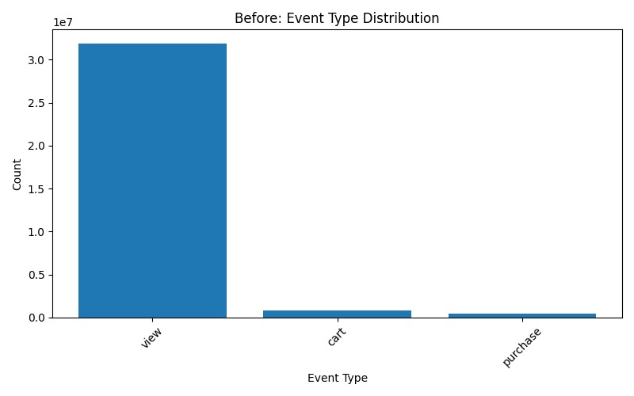
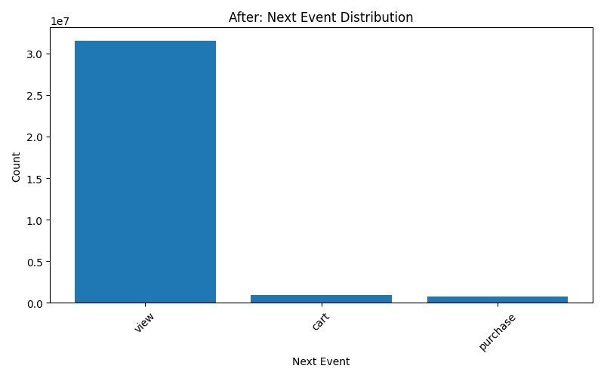
Approach & Key Findings
Dashboard
Dataset & Preprocessing
Spark
Features Used: event_time, event_type, price, user_session.
Data Preparation:
Timestamp conversion and session sorting.
Creation of next_event target variable for prediction.
Extraction of temporal features (hour, dayofweek).
One-hot encoding for categorical variables.
Yarn
Model & Evaluation
Model: Random Forest Classifier, integrated into a PySpark ML pipeline.
Pipeline Steps: StringIndexer for labels, VectorAssembler for feature consolidation, followed by the Random Forest model.
Accuracy: Achieved approximately 0.72.
Significance
Graphs
This predictive capability significantly enhances our understanding of user behavior within shopping sessions. It provides actionable insights to improve real-time recommendations, optimize user flow, and ultimately drive conversion rates in e-commerce platforms.

