Slide 1
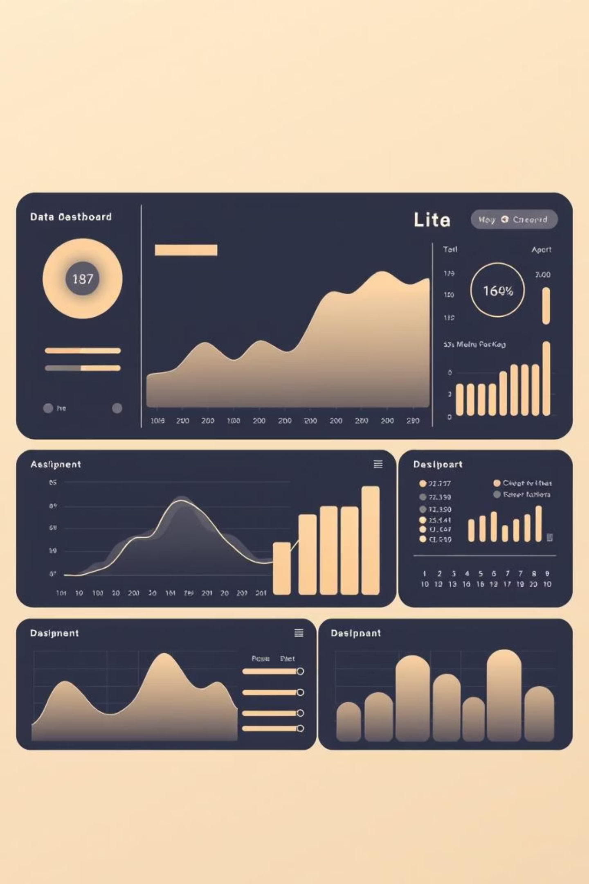
Sentiment Analysis of Tweets with PySpark
Using TF-IDF + Logistic Regression on Sentiment140 Dataset

Slide 2



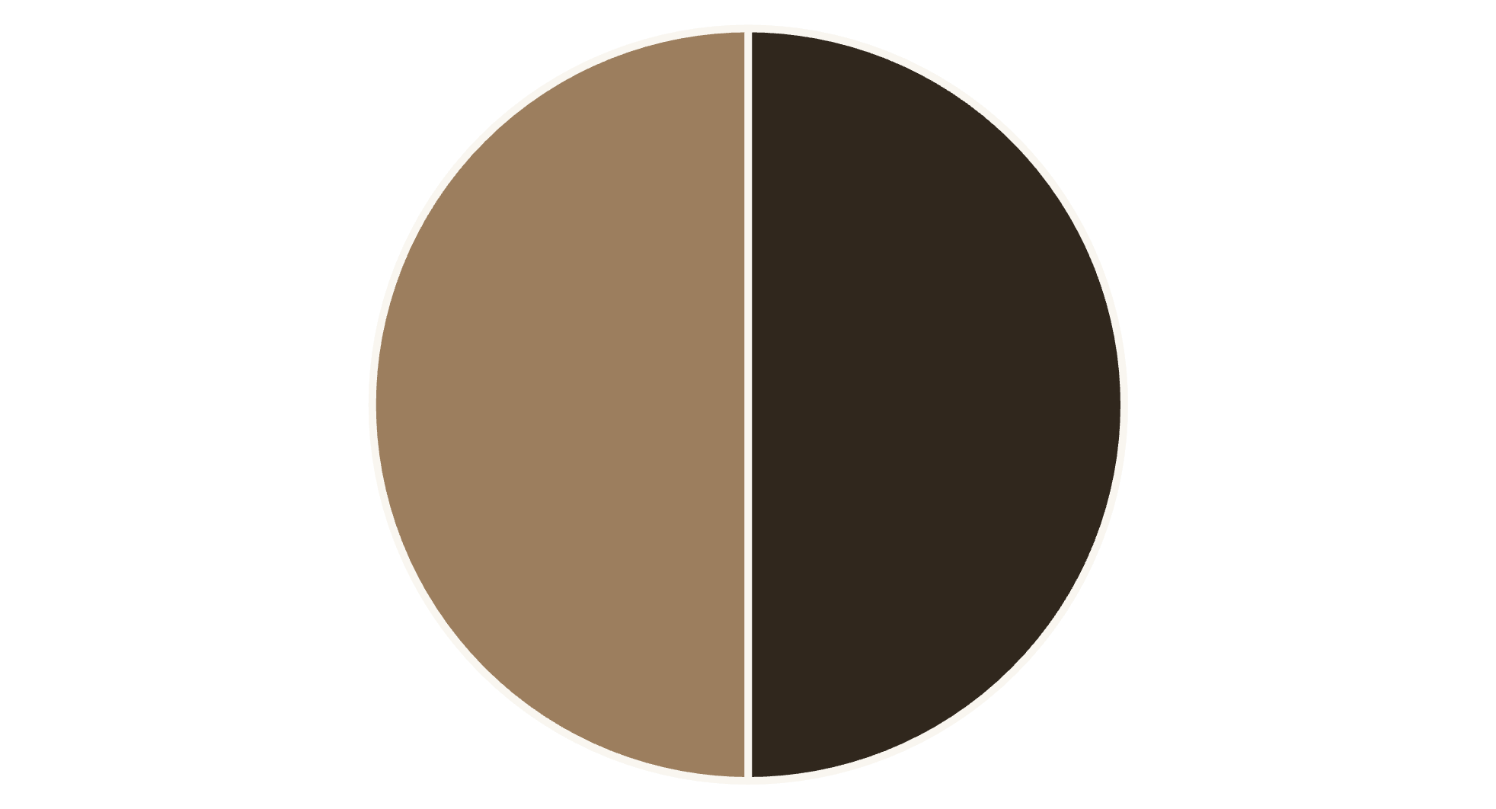
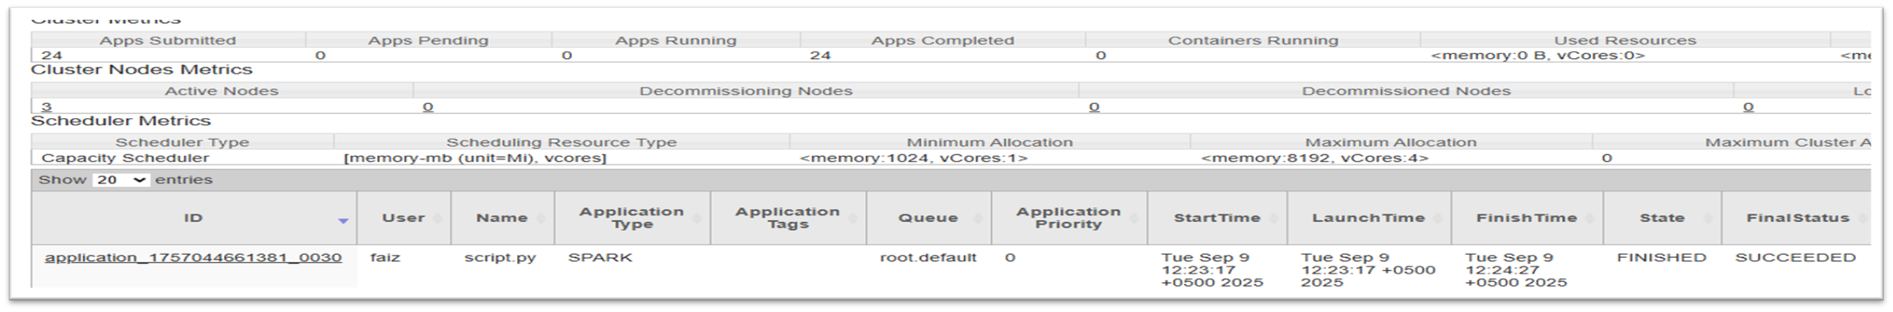
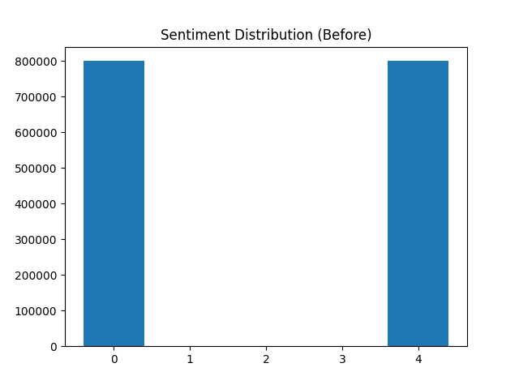
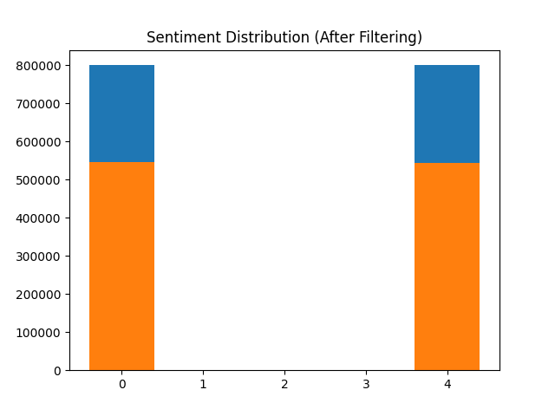
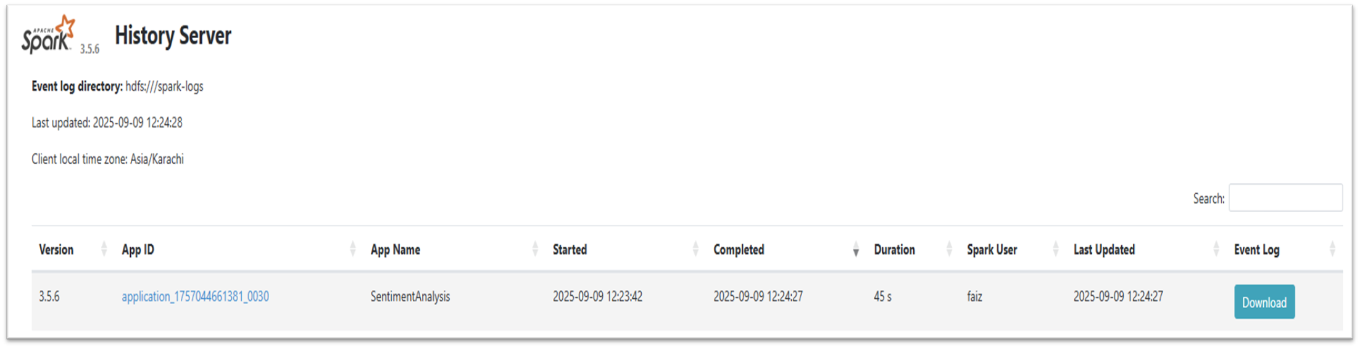
PySpark for Tweet Sentiment
Sentiment Task
ML Pipeline
Classify emotional tone of tweets (positive/negative) from the 1.6M-tweet Sentiment140 dataset.
Preprocessing (clean, tokenize), TF-IDF feature extraction, then Logistic Regression model training.
Results & Scalability
82%
Tweet Distribution
Model Accuracy
PySpark enables scalable processing of millions of tweets for real-time analysis.
Dashboards
Positive
Negative
Yarn
Graphs
Spark

