Slide 1
Home Needs Portal

Slide 2
CONTENT
Introduction
Objective
Modules

Slide 3
Introduction
This project will helps to purchase home need things and also can book worker in easy way.
If we have problem in Ac or friger in home something like that.., we can easily contact our customer service and booked them easily to fix the problem

Slide 4
Objective
The main objective of this website is to make it interactive and it is easy to use.It would make searching, viewing and selection of a product easier.
It contains a sophisticated search engine it is an easy and convenient way to search products for users and also search for workers to there needs.
And the search engine would refine the products available based on the user’s input. The user can then view the complete specification of each product.
They can also view the product reviews and also write their own reviews.
This website also provides a drag and drop feature so that a user can add a product to the shopping cart by dragging the item into the shopping cart.

Slide 5
Modules
User Registration
Admin/User login
Edit Profile
User signup can purchase the product and book workers.
User can also give feedback and rating for products and workers.
Admin can add products,workers and their details using CRUD operation.
Admin can view and check the orders,booking and payment details
Admin can check number of users login this website and also check users last seen.
Admin can also provide a status after user purchased their products.

Slide 6
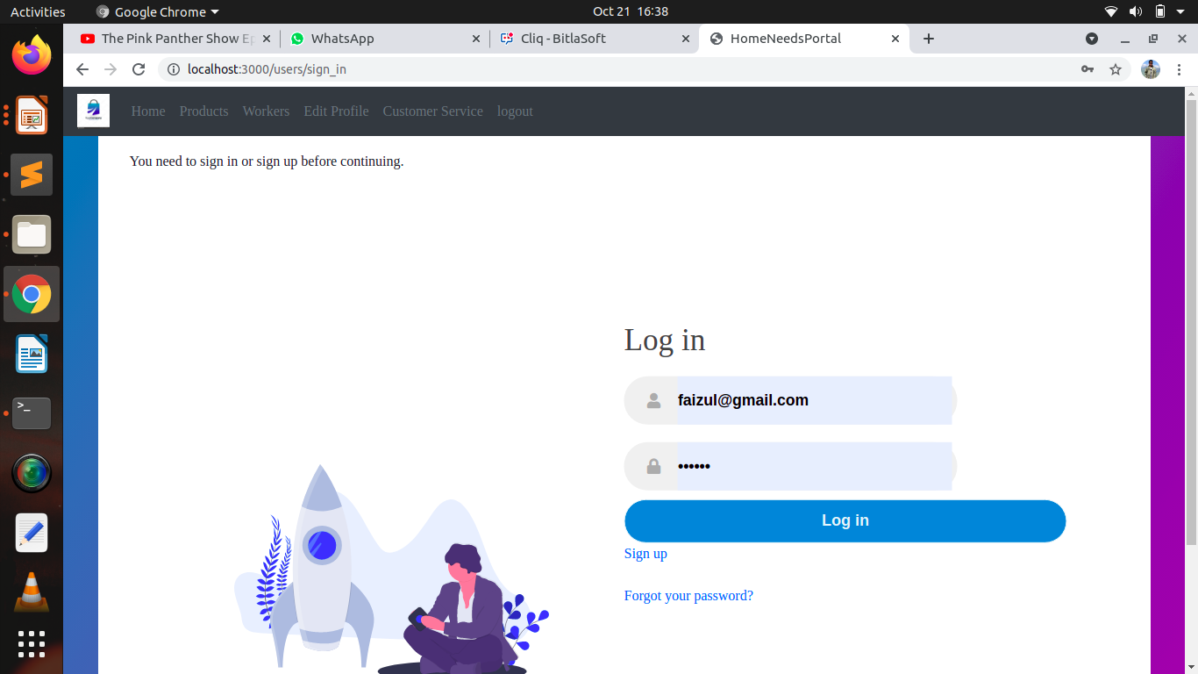
Login Page:

Slide 7
In this slide admin can add,delete,edit products and workers.

Slide 8
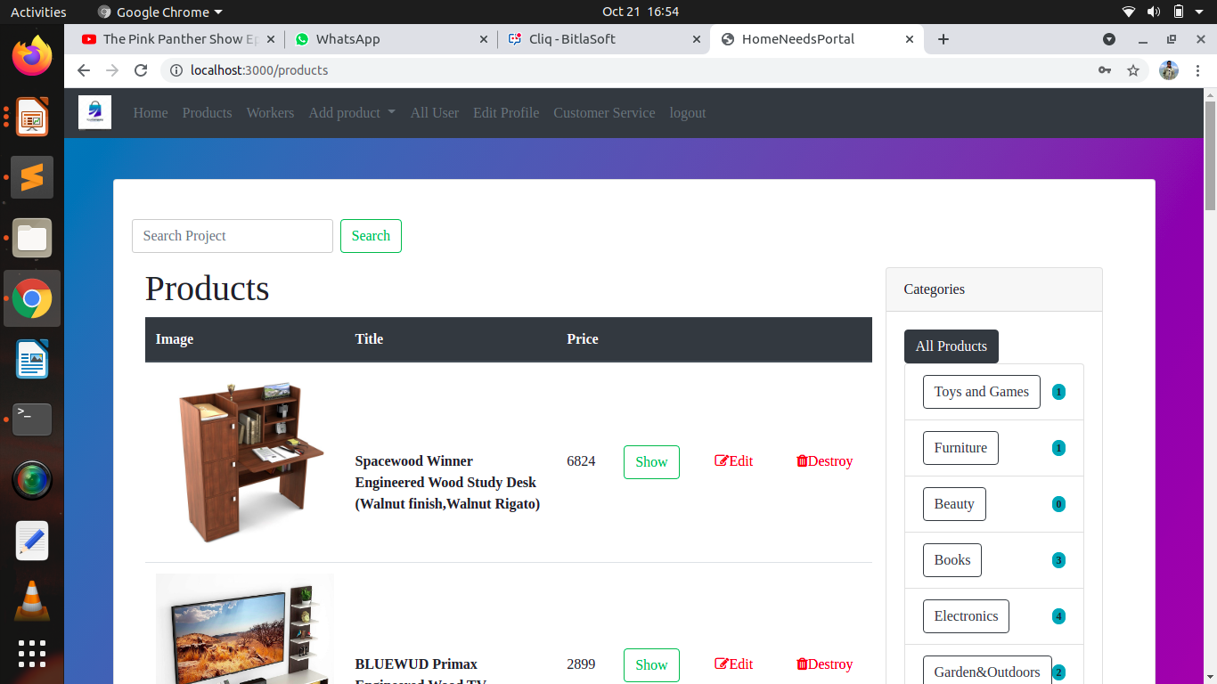

Slide 9
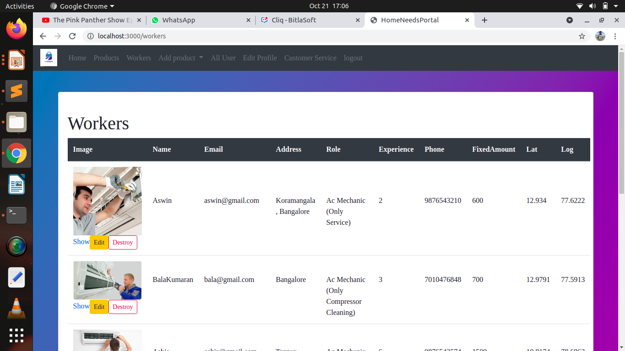

Slide 10
Here admin can check all the users, and also their lastseen

Slide 11
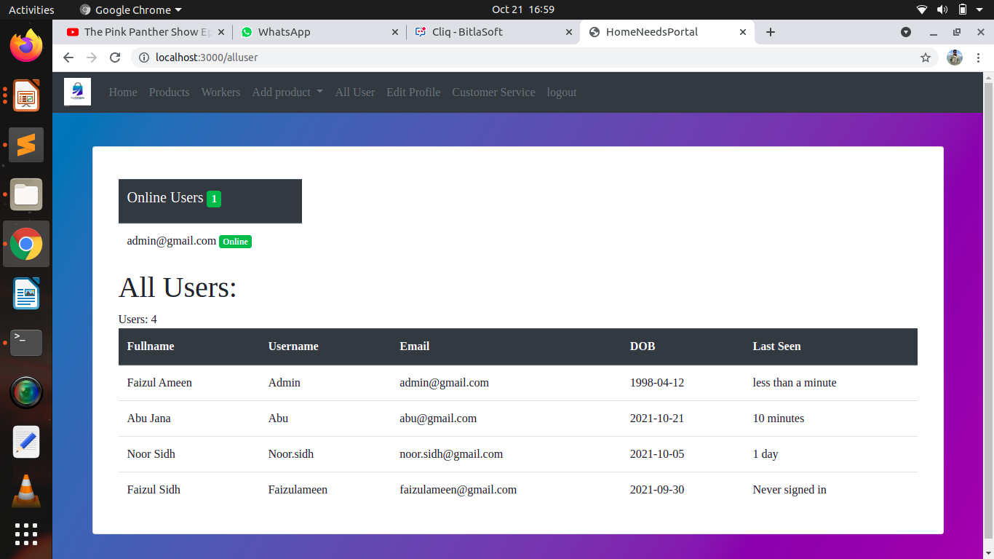

Slide 12
Here user can purchase product through buy now options and also user can add product to shopping cart

Slide 13
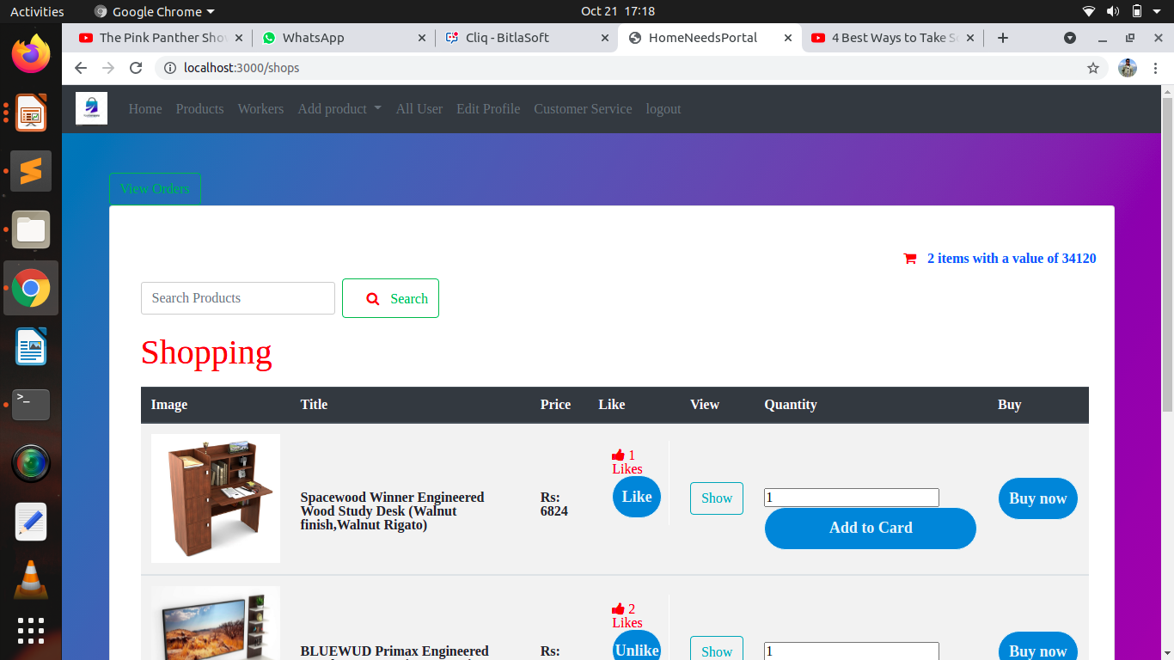
User Home Page:
\

Slide 14
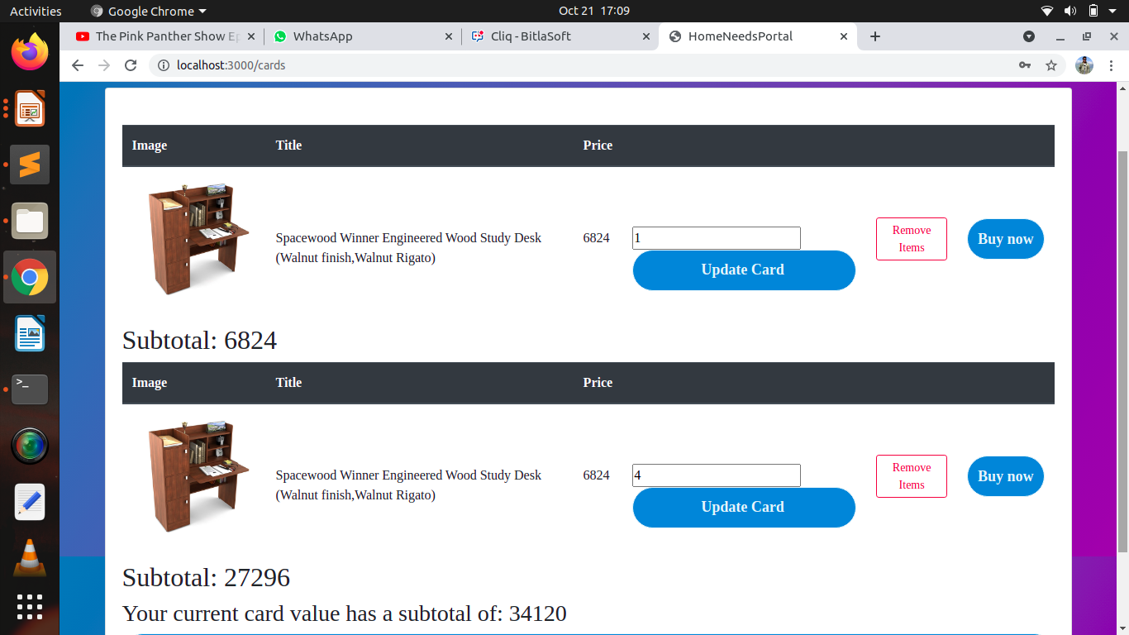
Shopping cart:

Slide 15
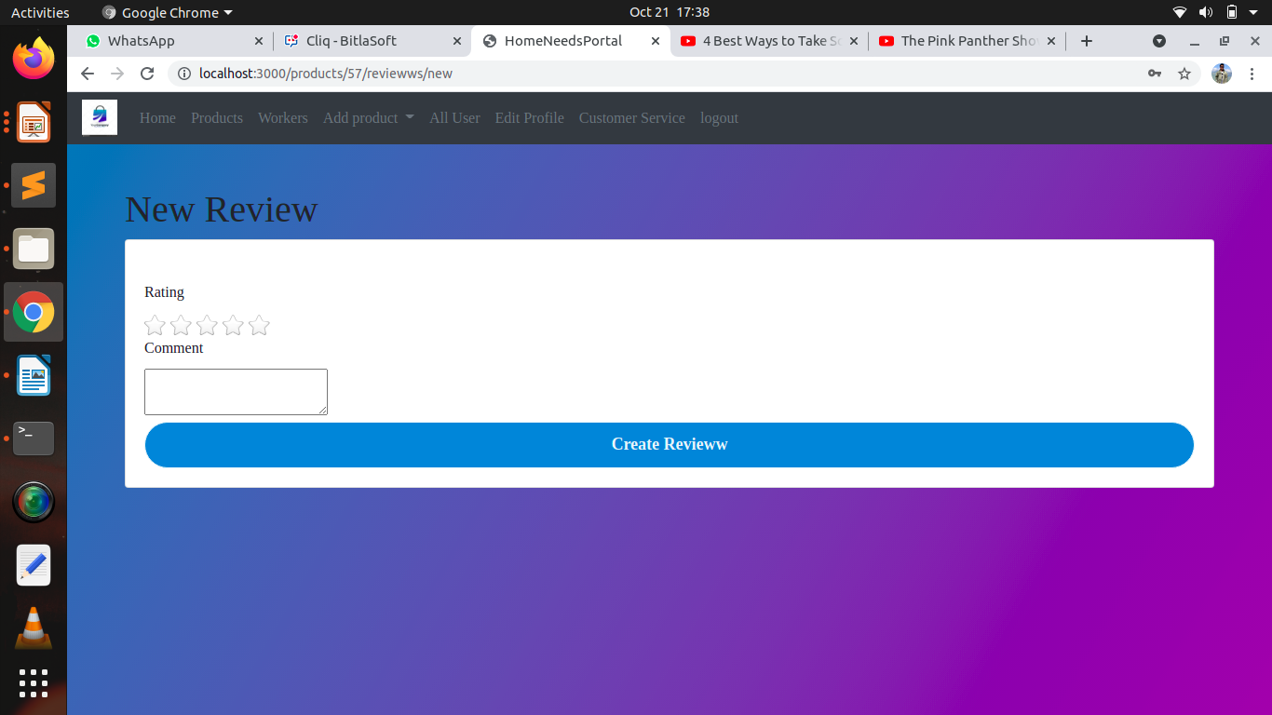
Review:

Slide 16
Here user can select the worker and view the worker place in map

Slide 17
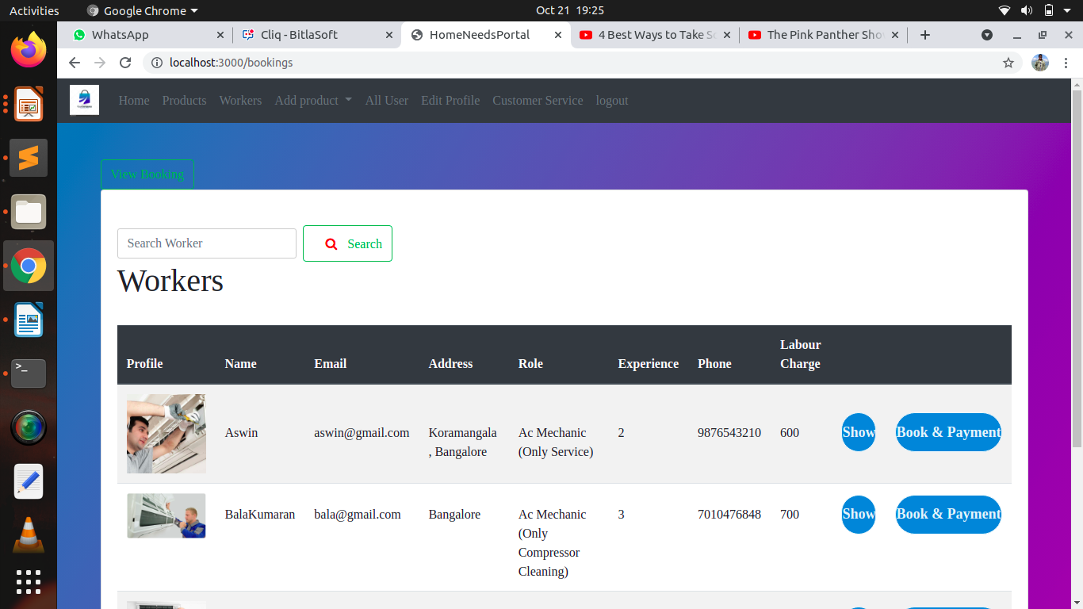

Slide 18
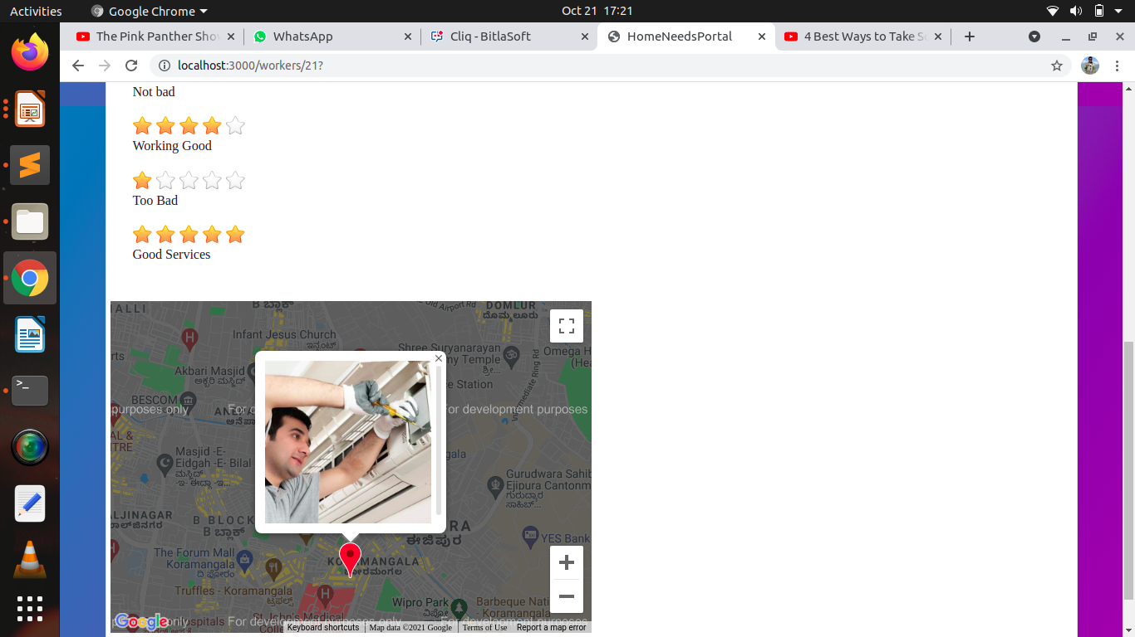

Slide 19
Here the user will pay the amount by filling his bank details ,if anything charged extra it will collected by worker at the end of work.

Slide 20
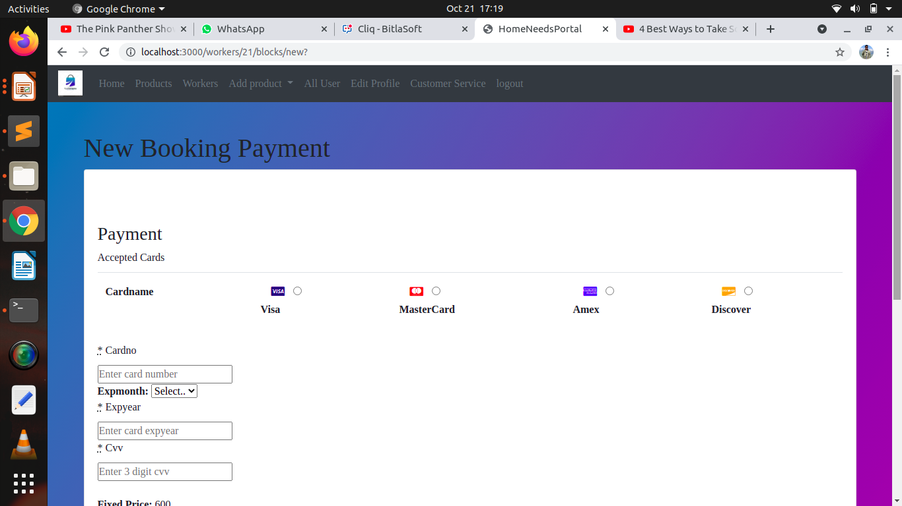

Slide 21
Admin can check the order details and provide the status

Slide 22
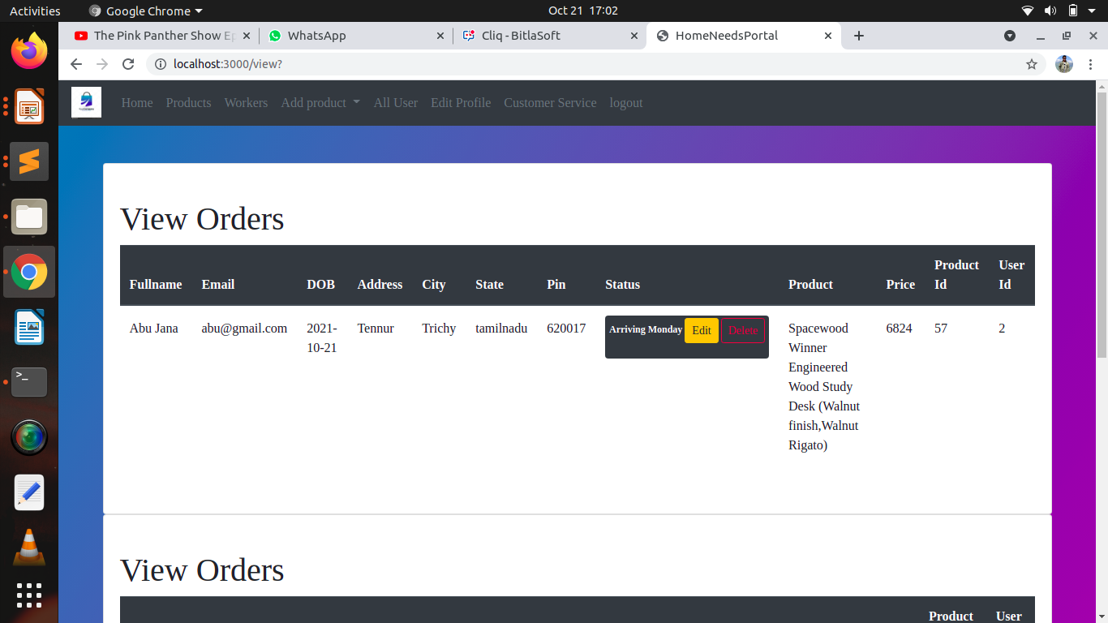

Slide 23


