Slide 1
Using the JPEG Pleno Light Field Box Framework for GMIS
These slides explore certain options for employing the JPEG Pleno File Format for GMIS
The aim is for these slides to form a starting point for a more detailed study of the changes required to the existing JPEG Pleno framework
By generalising the 2D array of views to a graph representation, various types of image sets can be incorporated to the JPEG Pleno Light Field box framework.
A graph allows for a certain ordering of images and defines a hierarchy for coding
New boxes that will need to be defined, along with modifications and extensions to current boxes, are highlighted in these slides

Slide 2


















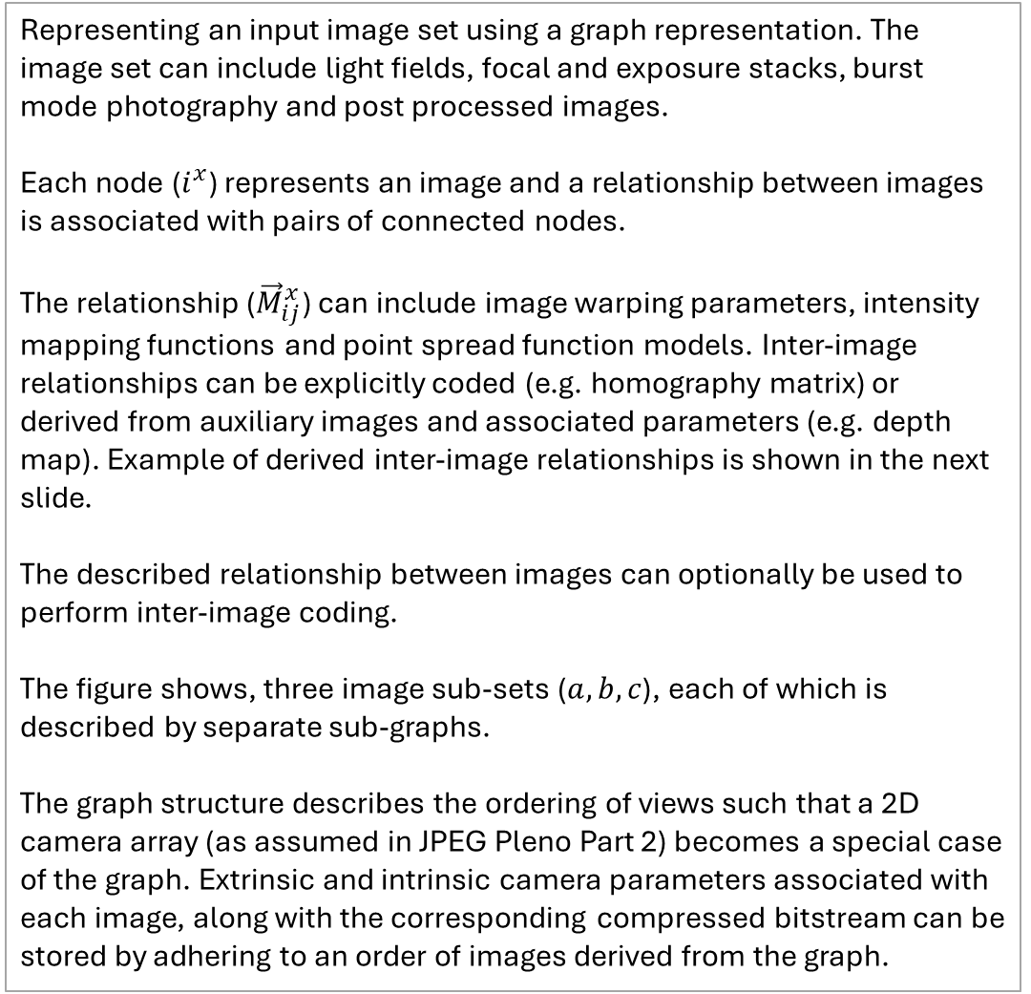



Image Set Representation Using Graphs
Representing an input image set using a graph representation. The image set can include light fields, focal and exposure stacks, burst mode photography and post processed images.
Each node ($i^{x}$) represents an image and a relationship between images is associated with pairs of connected nodes.
The relationship (${\vec{M}}_{ij}^{x}$) can include image warping parameters, intensity mapping functions and point spread function models. Inter-image relationships can be explicitly coded (e.g. homography matrix) or derived from auxiliary images and associated parameters (e.g. depth map). Example of derived inter-image relationships is shown in the next slide.
The described relationship between images can optionally be used to perform inter-image coding.
The figure shows, three image sub-sets ($a,b,c$), each of which is described by separate sub-graphs.
The graph structure describes the ordering of views such that a 2D camera array (as assumed in JPEG Pleno Part 2) becomes a special case of the graph. Extrinsic and intrinsic camera parameters associated with each image, along with the corresponding compressed bitstream can be stored by adhering to an order of images derived from the graph.
$$m$$
$${\vec{M}}_{mi}^{b}$$
$$i^{a}$$
$$i^{b}$$
$$i^{c}$$
$${\vec{M}}_{ij}^{a}$$
$${\vec{M}}_{ik}^{a}$$
$${\vec{M}}_{ij}^{c}$$
$${\vec{M}}_{ij}^{b}$$
$$j^{a}$$
$$k^{a}$$
$$j^{b}$$
$$j^{c}$$
$${\vec{M}}_{jl}^{a}$$
$${\vec{M}}_{jl}^{c}$$
$${\vec{M}}_{jk}^{c}$$
$$l^{a}$$
$$l^{c}$$
$$k^{c}$$
$$m$$
Mother Image
Intra coded Image
Inter coded Image
$${\vec{M}}_{ij}^{x}$$
Relationship between images $i$ and $j$ for sub-graph $x$

Slide 3








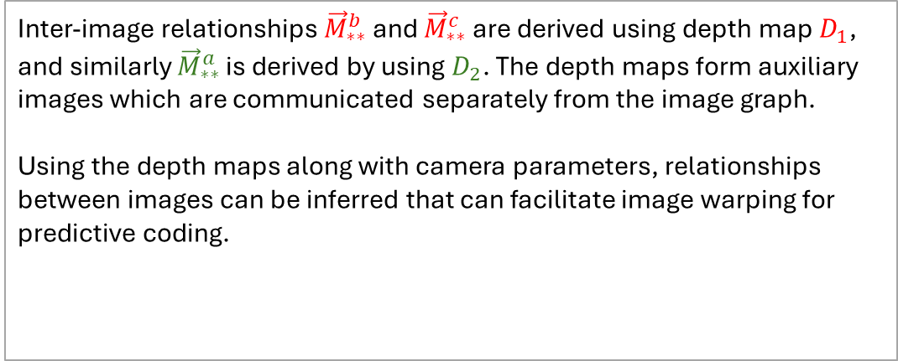


Implicit Relationships Derived from Auxiliary Images
Inter-image relationships ${\vec{M}}_{∗∗}^{b}$ and ${\vec{M}}_{∗∗}^{c}$ are derived using depth map $D_{1}$, and similarly ${\vec{M}}_{∗∗}^{a}$ is derived by using $D_{2}$. The depth maps form auxiliary images which are communicated separately from the image graph.
Using the depth maps along with camera parameters, relationships between images can be inferred that can facilitate image warping for predictive coding.
$$m$$
$${\vec{M}}_{mi}^{b}$$
Depth
Maps
$$i^{a}$$
$$i^{b}$$
$$i^{c}$$
$${\vec{M}}_{ij}^{a}$$
$${\vec{M}}_{ik}^{a}$$
$${\vec{M}}_{ij}^{c}$$
$${\vec{M}}_{ij}^{b}$$
$$j^{a}$$
$$k^{a}$$
$$j^{b}$$
$$j^{c}$$
$$D_{1}$$
$${\vec{M}}_{jl}^{a}$$
$${\vec{M}}_{jl}^{c}$$
$${\vec{M}}_{jk}^{c}$$
$$l^{a}$$
$$l^{c}$$
$$k^{c}$$
$$D_{2}$$
$$m$$
Mother Image
Intra coded Image
Inter coded Image
$${\vec{M}}_{ij}^{x}$$
Relationship between images $i$ and $j$ for sub-graph $x$

Slide 4

















Using JPEG Pleno Light Field Box Framework
A modified JPEG Pleno FF can be used to store the camera parameters, inter-image relationships, auxiliary images and coded bitstreams.
The Camera Parameter box can store extrinsic and intrinsic camera parameters, following an order of the images derived from the graph structure.
A 2D camera array with a common baseline and shared camera parameters can be a specific case for which JPEG Pleno FF provisions for efficient signalling are maintained. Furthermore, modifications to efficiently signal a small number of camera intrinsic parameters will be advantageous. This corresponds to, for example, when a set of images is captured by 2 or 3 different cameras.
An Inter-image Relationship Model box will be required to signal relationships that need to be explicitly communicated. This will be a new box to add to the JPEG Pleno FF.
…
XCC($i^{a}$)
YCC($i^{a}$)
ZCC($i^{a}$)
Θ_{XCAM}($i^{a}$)
Θ_{YCAM}($i^{a}$)
Θ_{ZCAM}($i^{a}$)
f($i^{a}$)
sW($i^{a}$)
sH($i^{a}$)
sk($i^{a}$)
u₀($i^{a}$)
v₀($i^{a}$)
…
Camera Parameter box (modified)
…
$${\vec{M}}_{ij }^{a}$$
$${\vec{M}}_{ikj}^{a}$$
$${\vec{M}}_{jlj}^{a}$$
$${\vec{M}}_{mij}^{b}$$
$${\vec{M}}_{ij }^{b}$$
…
Inter-image Relationship Model box (new)

Slide 5
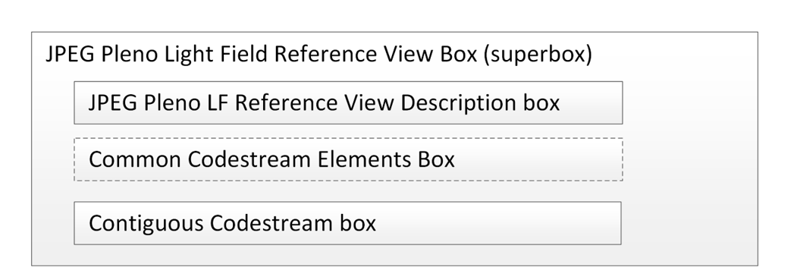
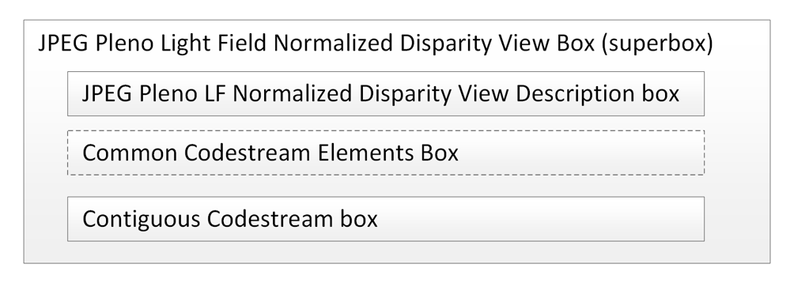
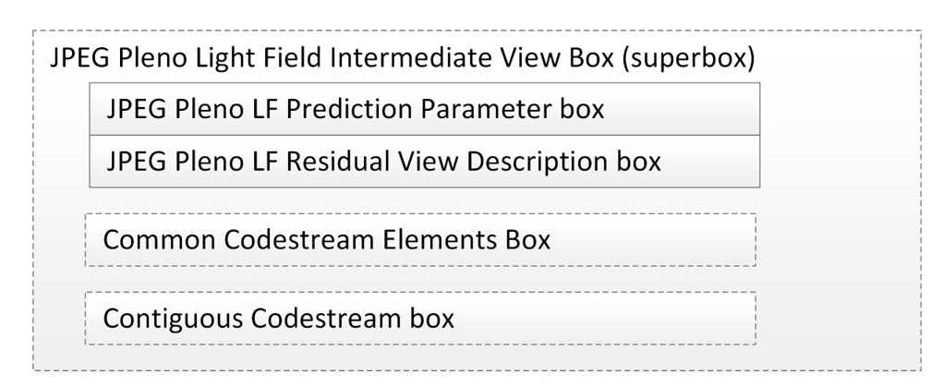
Using JPEG Pleno Light Field Box Framework
Storing of coded reference views, auxiliary images and intermediate views can be based on existing JPEG Pleno FF superboxes with suitable modifications.
Reference views are intra coded views and can be communicated in an order derived from the graph representation using the JPEG Pleno Light Field Reference View superbox.
Similarly, communication of auxiliary images, such as depth maps, can be based on the JPEG Pleno Light Field Normalised Disparity View superbox. Modifications will be required to signal auxiliary images either collocated with views in the graph or at new locations that may differ from the coordinates of reference or intermediate views.
Intermediate views are inter coded views and following an order derived from the graph representation, the coded bitstreams and associated prediction parameters can be stored using the JPEG Pleno Light Field Intermediate View superbox. The prediction algorithm will make use of either the explicitly communicated or implicitly derived relationships between images. Accordingly, the prediction parameter box will need to be modified to include details of forming a prediction for each of the different modes of relationships that can be described. The hierarchal level of each intermediate view can also be derived from the graph representation.

