Slide 1
UE24CS352A · MACHINE LEARNING MINI-PROJECT
Machine Learning Techniques for Distracted Driver Detection
Replicating, optimizing, and advancing Stanford CS229 benchmarks
Mohammed Faizan (PES1UG24AM472) & Vikas R (PES1UG24AM477)

Slide 2
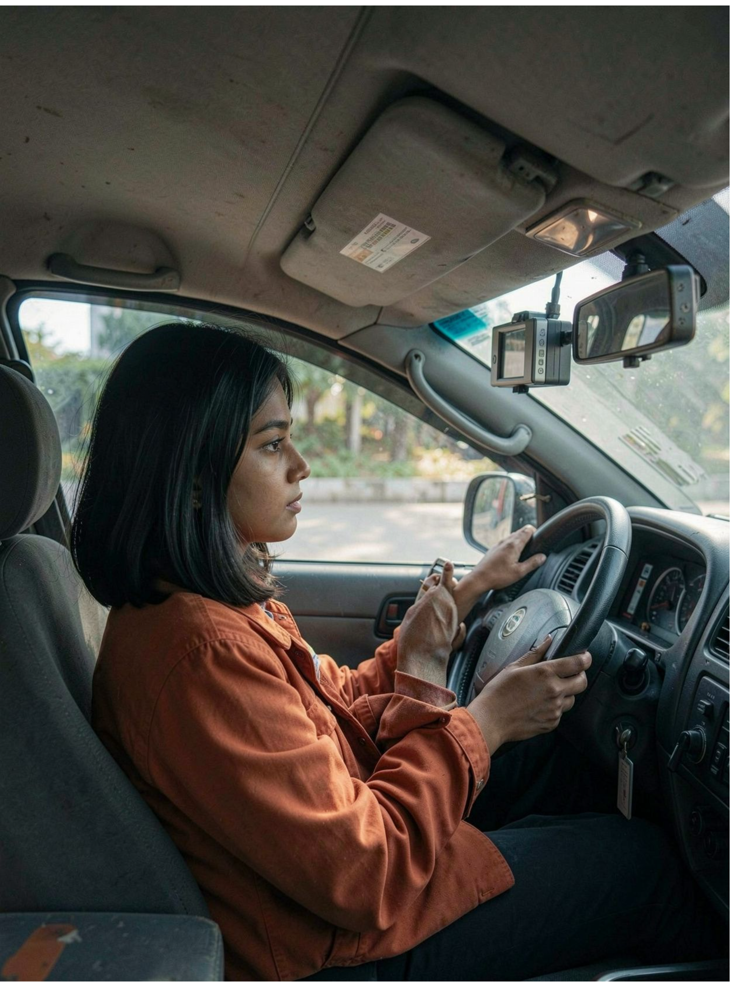
THE PROBLEM
Distracted driving needs an in-cabin vision system
Distracted driving contributes to 10–15% of global fatal vehicular crashes.
Target behaviors include texting, calling, reaching behind, drinking, and applying makeup.
Project goal: real-time 10-class classification for ADAS, with one safe-driving class plus nine distraction classes.

Slide 3
DATASET · STATE FARM
The State Farm dataset defines a balanced 10-class task
22,424 high-resolution RGB images at 640×480×3; 80/20 split: 17,939 training images and 4,485 validation images. Stratified sampling preserves class balance across both splits.
c0
c1
c2
c3
c4
Safe Driving
Texting-Right
Talking on Phone-Right
Texting-Left
Talking on Phone-Left
c5
c6
c7
c8
c9
Operating Radio
Drinking
Reaching Behind
Hair and Makeup
Talking to Passenger

Slide 4
REPRESENTATION
Flattening created the benchmark’s key failure modes
64×64 → 12,288 features
Spatial information lost
Stanford resized images to 64×64 and flattened them into 12,288-feature vectors.
Flattening discards 2D spatial locality and hand-to-face geometry.
Hard-to-separate pairs
Initialization failure
Phone-Left vs Texting-Left and Makeup vs Drinking were especially difficult to separate.
Standard initialization caused the MLP to collapse to about 55% accuracy.

Slide 5

METHODOLOGY
Two tiers test optimization before spatial transfer learning
Tier 1 — Flattened Path
Preprocessing & Augment
Tier 2 — Spatial Path
Training & Scheduler
The study separates optimization from representation: first stabilize learning on flattened inputs, then test whether preserved spatial structure improves transfer.

Slide 6
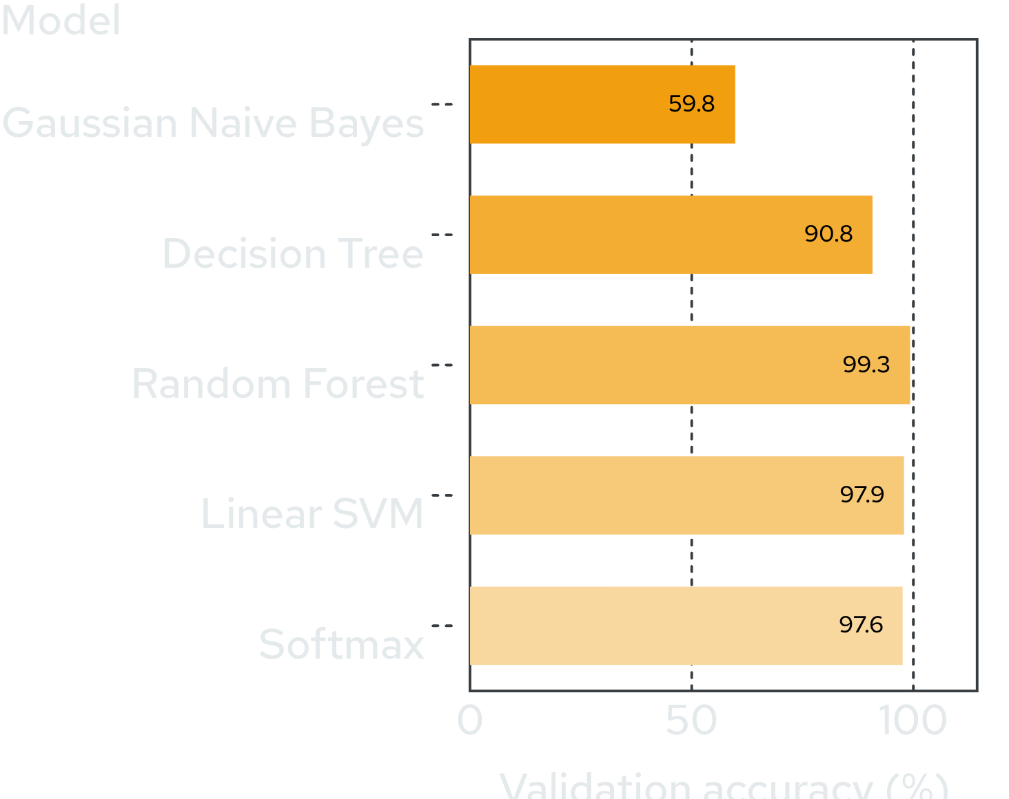
TRADITIONAL ML
Ensembles and tuned optimization close the traditional ML gap
Random Forest leads the traditional benchmark while Gaussian Naive Bayes lags sharply. StandardScaler and SGD support the Linear SVM and Softmax baselines.
Decision Tree: max_depth=25. Random Forest: 100-tree variance-reducing ensemble.

Slide 7
NEURAL BASELINE
12,288
512
Kaiming initialization restores the two-layer neural baseline
Input features
ReLU hidden units
0.3
10
Dropout
Output classes
With a stable initialization and tuned Adam optimization, the flattened-input network reaches 99.06% validation accuracy with smooth loss reduction.
Adam · learning rate 1e−3 · weight decay 1e−4 · 25 epochs · Kaiming/He normal initialization
99.06% VALIDATION ACCURACY

Slide 8
TRANSFER LEARNING
ResNet-50 retains spatial features through fine-tuning
Input
ResNet-50 Backbone
Classification Head
Output
Spatial tensors preserve the visual structure that flattened vectors discard. The backbone begins frozen, then layer4 is fine-tuned with a lower learning rate than the classification head.

Slide 9
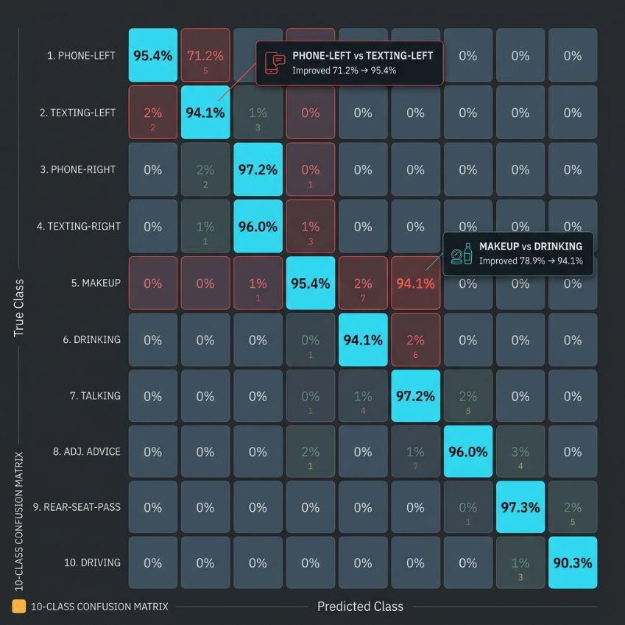
ERROR ANALYSIS
Spatial features resolve the benchmark’s hardest confusions
Class pair | Before | After
Phone-Left vs Texting-Left | about 71.2% | 95.4%
Makeup vs Drinking | about 78.9% | 94.1%
Seven models compared against the Stanford CS229 Project Report (Feng & Yue, 2019).

Slide 10

DEPLOYMENT DIRECTION
From benchmark to real-time driver safety feedback
Live dashboard: driver image with Green/Red safety alert banner beside 10-class probabilities.
Approx. 22 ms per frame, or about 45 FPS on GPU.
Conclusion: convolutional spatial representations are critical for driver-distraction safety systems.
45 FPS ON GPU

