Slide 1
ICS344 · SERVERLESS SECURITY PROJECT
Damn Vulnerable
Serverless Application
Ten vulnerabilities · Ten exploits · Ten fixes on AWS
Fajer Alyami · Afrah Alsubhi
Lessons 1 · 3 · 5 · 7 · 9 (Fajer) Lessons 2 · 4 · 6 · 8 · 10 · 11 (Afrah)
OWASP DVSA · AWS Lambda · us-east-1

Slide 2
OVERVIEW
Project at a glance
What DVSA is, how we worked it, and all ten vulnerabilities covered across both presentations
ABOUT THE TARGET
01
Event Injection
OWASP DVSA on AWS
RCE via untrusted deserialization
Damn Vulnerable Serverless Application — an intentionally insecure AWS deployment used to learn real cloud-native attacks and defenses.
Stack: AWS Lambda · API Gateway · DynamoDB · S3 · IAM · Cognito · CloudWatch
Region: us-east-1
Tools: AWS Console · CloudShell · CloudWatch Logs · IAM Policy Simulator · PowerShell · npm audit
03
Sensitive Info Disclosure
Receipts leaked through unauth Lambda
05
Broken Access Control
Non-admin altering admin orders
07
Over-Privileged IAM
Wildcard S3 / DynamoDB on Lambda role
09
Vulnerable Dependencies
node-serialize RCE, no patch available
DVSA Serverless Security | ICS344
2

Slide 3
LESSON
01
Event Injection
RCE via node-serialize on the public /order endpoint

Slide 4
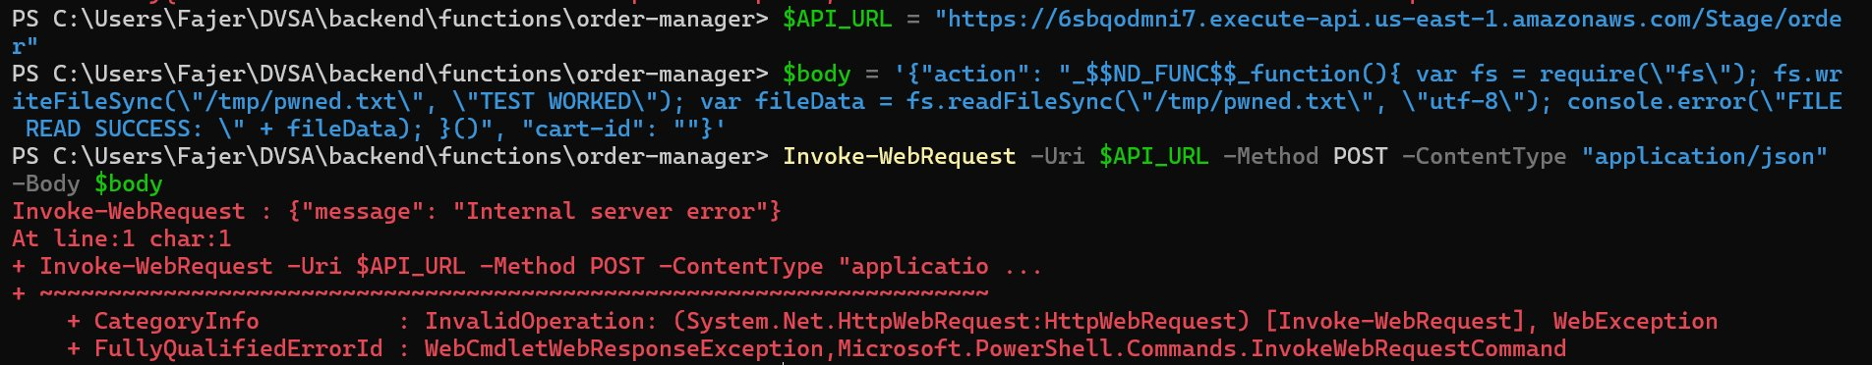
LESSON 01 · EXPLOIT
Sending the malicious payload
serialize.unserialize() runs on raw event.body — any _$$ND_FUNC$$_ payload executes as JavaScript inside the Lambda. Affects DVSA-ORDER-MANAGER, full Lambda takeover (filesystem, env vars, IAM role).
PowerShell — payload sent to /order endpoint
EXPLOITATION STEPS
1
Confirm vulnerable code: serialize.unserialize(event.body) at the top of the Lambda handler.
2
Craft a JSON body where action is _$$ND_FUNC$$_function(){ … }() — an IIFE that writes /tmp/pwned.txt and logs FILE READ SUCCESS.
POST the payload to the API endpoint via PowerShell. HTTP returns 'Internal server error' — that is expected, the injected code already ran.
CloudWatch — FILE READ SUCCESS proves the injected JS executed
3
4
Check CloudWatch: the FILE READ SUCCESS: TEST WORKED line is the proof of arbitrary code execution.

Slide 5
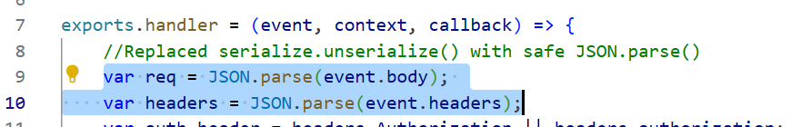

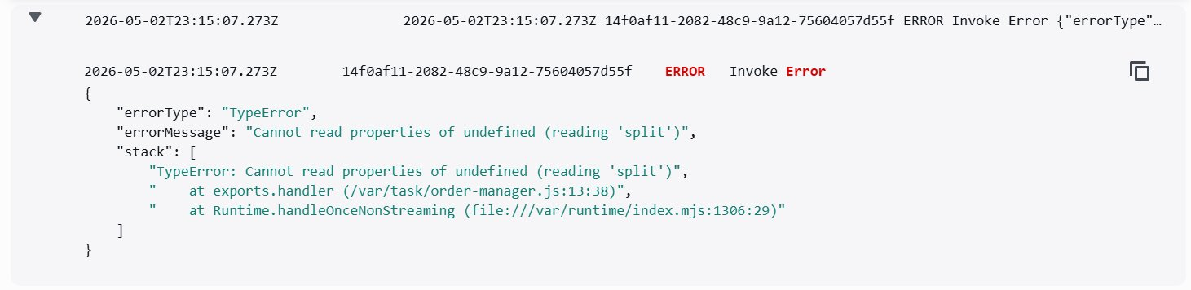
LESSON 01 · FIX & VERIFY
Replace deserialization with safe JSON parsing
Treat input as data only — never let a parser evaluate user content.
BEFORE · VULNERABLE
AFTER · FIXED & VERIFIED
serialize.unserialize() executed JS
JSON.parse() — data only, no eval path
Original handler: serialize.unserialize() on event.body and event.headers, both attacker-controlled.
Same payload now fails at the auth-header step (TypeError). FILE READ SUCCESS no longer appears in logs.
FIX · Swap serialize.unserialize() for JSON.parse(); add a typeof guard for headers. node-serialize has no patch — JSON.parse() has no codepath that evaluates strings as JS.

Slide 6
LESSON
03
Sensitive Information Disclosure
Receipts archive leaked through an unauthenticated Lambda

Slide 7
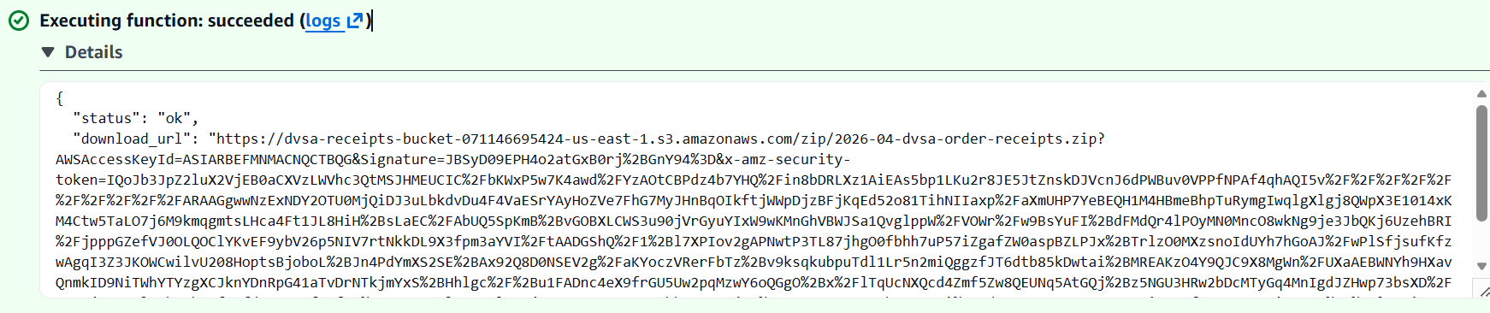
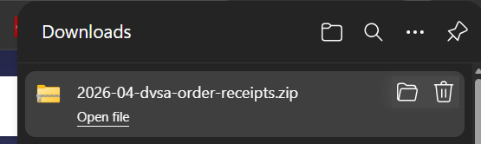
LESSON 03 · EXPLOIT
Pulling April 2026 receipts unauthenticated
DVSA-ADMIN-GET-RECEIPT returns a pre-signed S3 URL with no caller authorization check — any user can download every receipt in the system.
Lambda response — pre-signed URL returned to an unauthenticated caller
EXPLOITATION STEPS
1
Open the Lambda Test tab and paste a minimal event: { "year": "2026", "month": "04" }.
2
Click Test. The vulnerable build returns status: ok plus a long pre-signed S3 URL containing AWSAccessKeyId and Signature.
Paste the download_url into a browser — the ZIP 2026-04-dvsa-order-receipts.zip downloads with every receipt for the month.
Browser download — every April 2026 receipt walked out
3
4
No auth header was ever sent. No JWT. No identity at all.

Slide 8
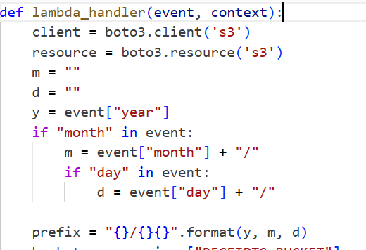
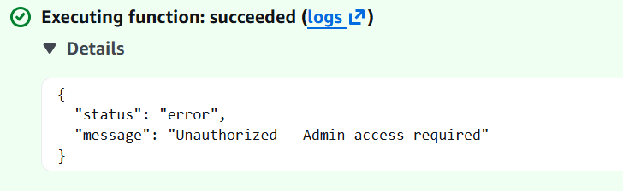
LESSON 03 · FIX & VERIFY
Add an admin check before any S3 access
Validate identity at the function entry — not after side effects begin.
BEFORE · VULNERABLE
AFTER · FIXED & VERIFIED
Handler jumped straight into S3 work
Unauthorized — Admin access required
Original lambda_handler — built the S3 client and listed receipts with no caller check at all.
Same {year, month} test event now returns an error — no signed URL, no S3 listing, no ZIP built.
FIX · Add an isAdmin gate as the very first line of the handler. The full hardening reads identity from the verified JWT (Cognito group claim), not a client-supplied flag.

Slide 9
LESSON
05
Broken Access Control
Non-admin users flipping order status from processed to paid

Slide 10
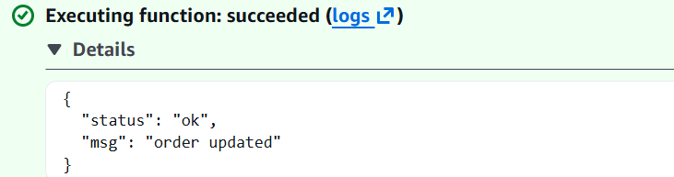
LESSON 05 · EXPLOIT
Marking a $25 order paid with a non-admin token
DVSA-ADMIN-UPDATE-ORDERS decodes the JWT but never checks the scope claim — any logged-in user is treated as admin and can flip order status.
Lambda response — admin Lambda accepted the non-admin token
EXPLOITATION STEPS
1
As a regular user, log into DVSA and copy an order ID with status processed (test order: $25).
2
In the AWS Console, open DVSA-ADMIN-UPDATE-ORDERS → Test, paste an event targeting that order with the non-admin user's JWT in the headers.
Click Test. Vulnerable build responds: { status: ok, msg: 'order updated' }.
DVSA UI — order now shows paid; no payment flow ran
3
4
Refresh My Orders in DVSA — status has flipped from processed to paid without a payment ever happening.

Slide 11
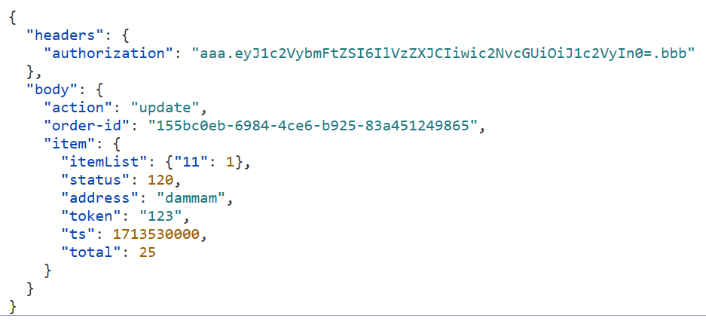
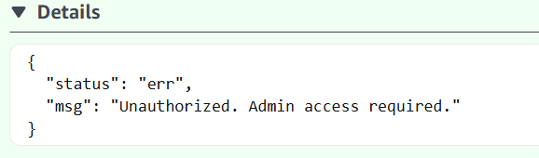
LESSON 05 · FIX & VERIFY
Server-side scope check at the handler entry
Trust token signature, but verify what's inside it before granting admin actions.
BEFORE · VULNERABLE
AFTER · FIXED & VERIFIED
Vulnerable: token presence trusted
Unauthorized. Admin access required.
Test event — a regular user's JWT, no admin claim, action: update on someone else's order.
Same event after fix — admin Lambda rejects the call; order status in the UI stays processed.
FIX · Decode the JWT, read scope, and reject if 'admin' is not present. JWT signatures are signed by Cognito, so a regular user can't forge an admin scope without breaking validation.

Slide 12
LESSON
07
Over-Privileged IAM Role
An email-sending Lambda with full S3 + DynamoDB wildcards

Slide 13
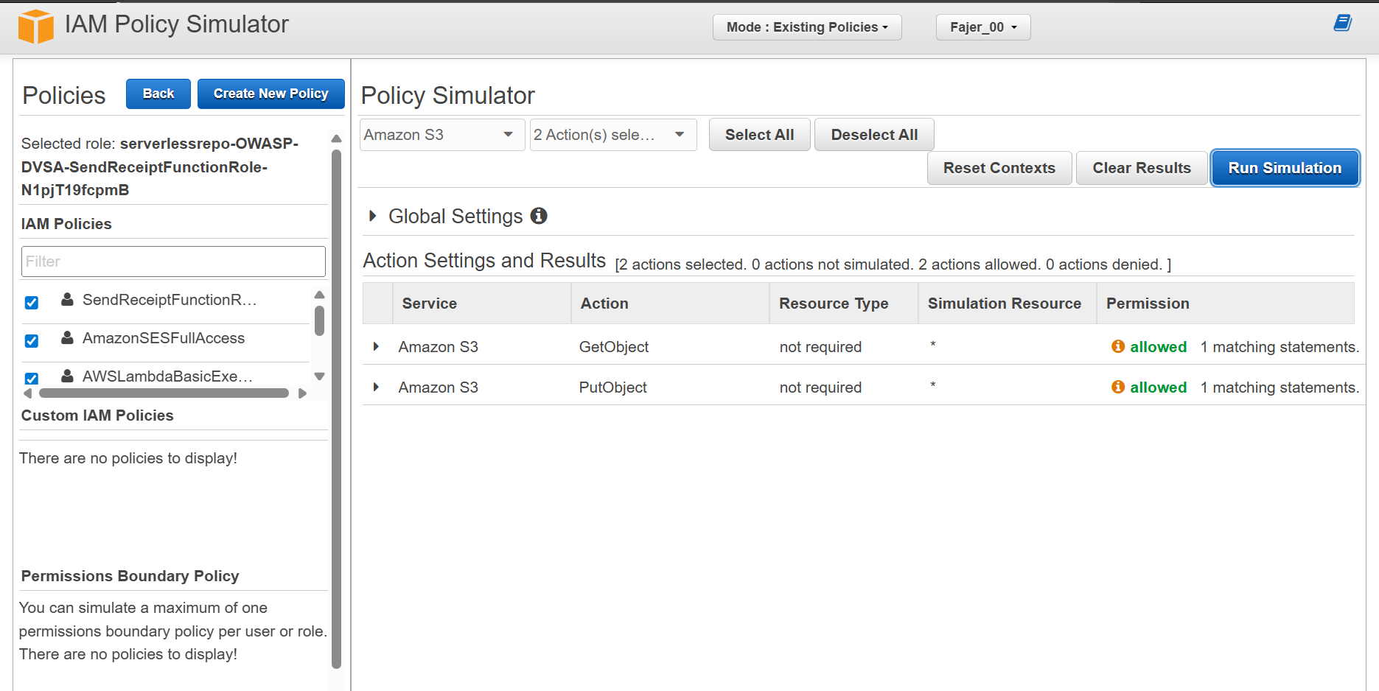
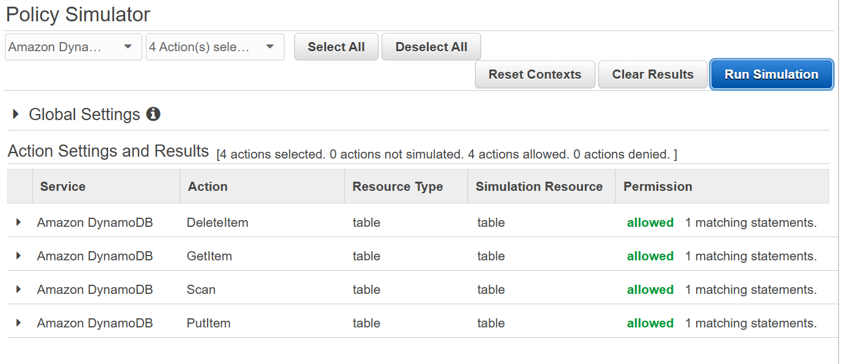
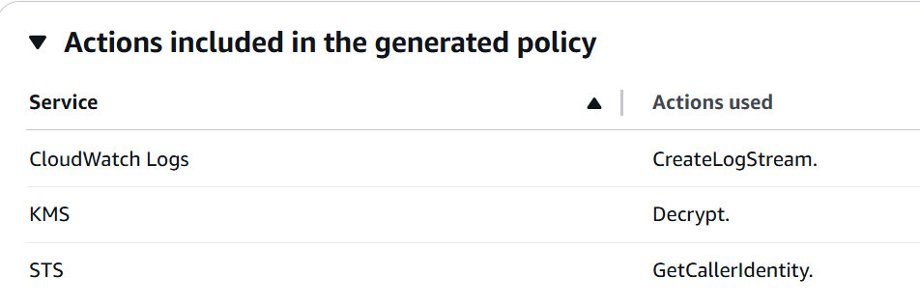
LESSON 07 · AUDIT
Confirming over-privilege with the Policy Simulator
Lambda execution role has wildcard s3:::* and dynamodb:table/* plus AmazonSESFullAccess — far more than the function (only sends SES email) actually needs.
Policy Simulator — S3 GetObject and PutObject both allowed for the role
EXPLOITATION STEPS
1
Inspect the role's permissions in IAM Console — two inline policies with Resource: * for S3 and DynamoDB.
2
Run the IAM Policy Simulator against the role for s3:GetObject, s3:PutObject — both allowed.
Repeat for dynamodb:GetItem / PutItem / DeleteItem / Scan — all allowed.
CloudTrail 'actions actually used' — only SES (and runtime services) ever called
3
4
Use Last Accessed / CloudTrail Access Advisor: only logs, KMS, STS, and SES were ever actually used.

Slide 14
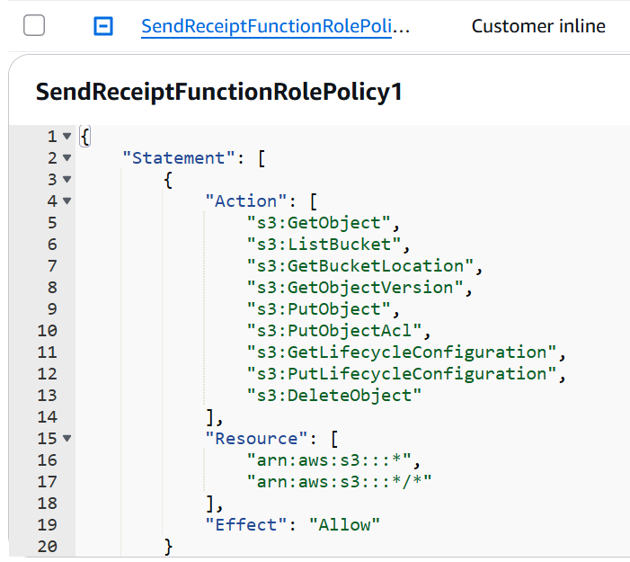
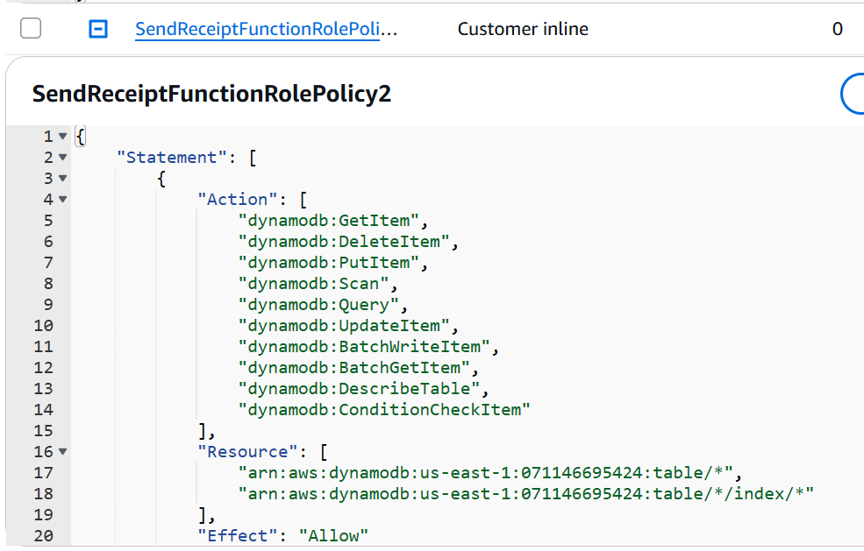
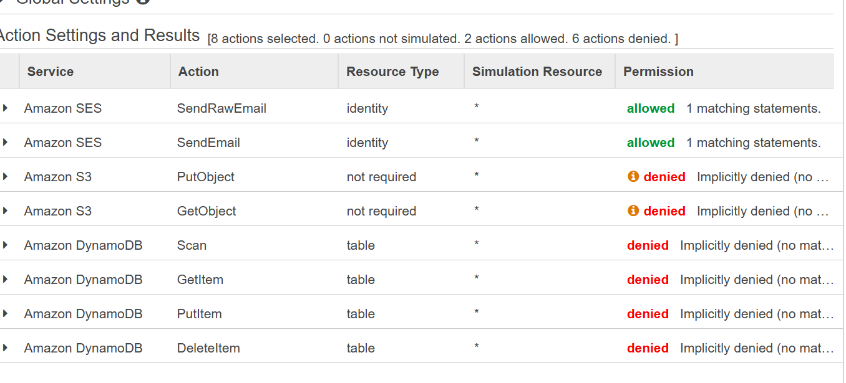
LESSON 07 · FIX & VERIFY
Strip the role to the minimum (least privilege)
Configuration-only fix — no Lambda code changes needed.
BEFORE · VULNERABLE
AFTER · FIXED & VERIFIED
Wildcard inline policy on S3 and DynamoDB
S3 / DynamoDB now denied
Original S3 policy — Resource: arn:aws:s3:::* / arn:aws:s3:::*/* on every CRUD action.
Same simulator run after fix — only the two SES actions are allowed; everything else implicitly denied.
FIX · Detach AmazonSESFullAccess + the two wildcard inline policies. Attach SendReceiptMinimalSES — ses:SendEmail and ses:SendRawEmail only. Verified by Policy Simulator + AccessDenied in CloudWatch.

Slide 15
LESSON
09
Vulnerable Dependencies
node-serialize — critical RCE, no patch available

Slide 16
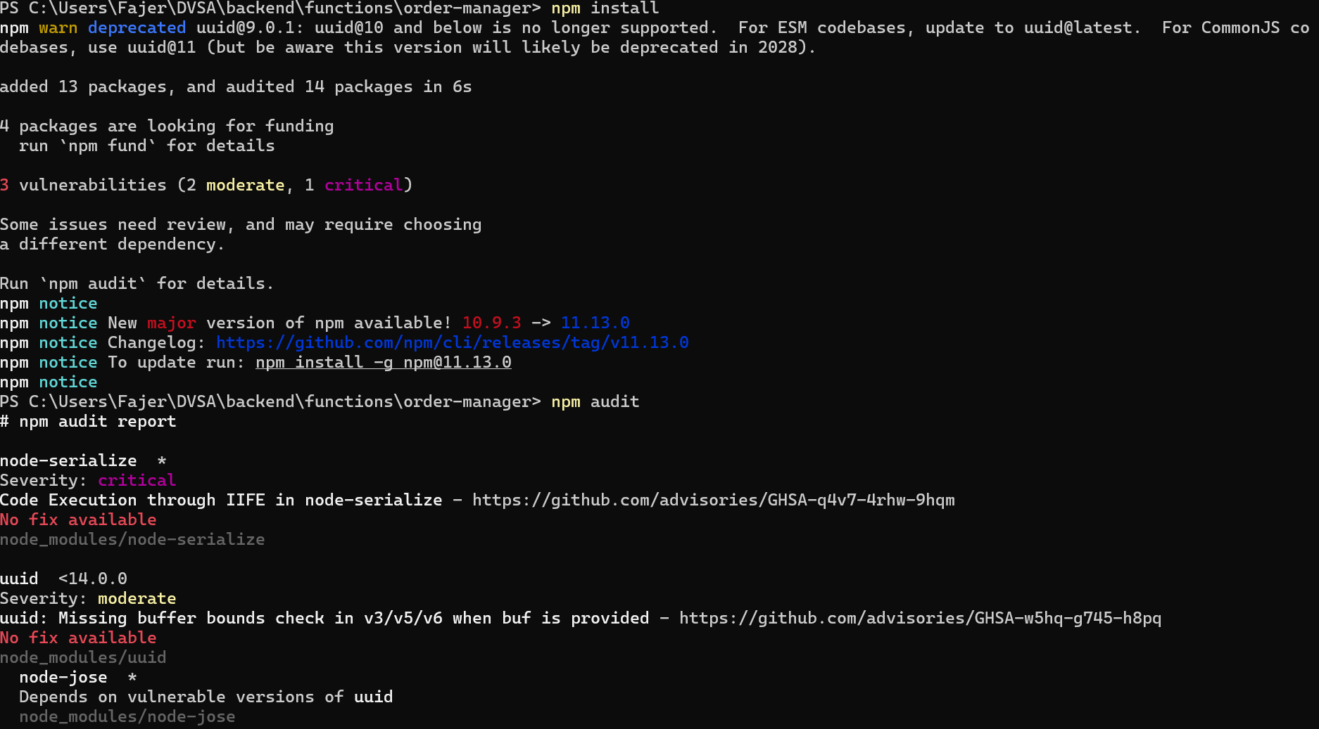
LESSON 09 · EXPLOIT
From npm audit warning to live RCE
node-serialize (critical, no patch) is a direct dependency that evaluates _$$ND_FUNC$$_ markers as JavaScript — one bad import = full RCE on every /order request.
npm audit — node-serialize: critical severity, no patch available
EXPLOITATION STEPS
1
Run npm audit in the order-manager folder — node-serialize flagged critical, 'no fix available'.
2
Inspect package.json — node-serialize is a direct dependency, imported on line 1 of order-manager.js.
Send the malicious POST body containing _$$ND_FUNC$$_function(){…}() — the IIFE writes a file and logs FILE READ SUCCESS.
CloudWatch — FILE READ SUCCESS line, proof of arbitrary execution
3
4
Open CloudWatch — the line FILE READ SUCCESS: You are reading the contents of my hacked file! confirms code execution.

Slide 17
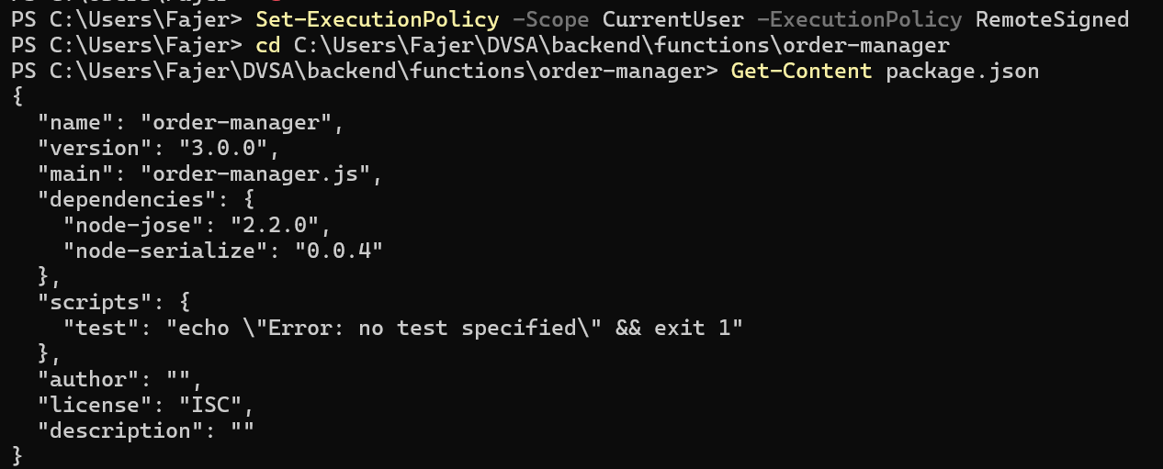
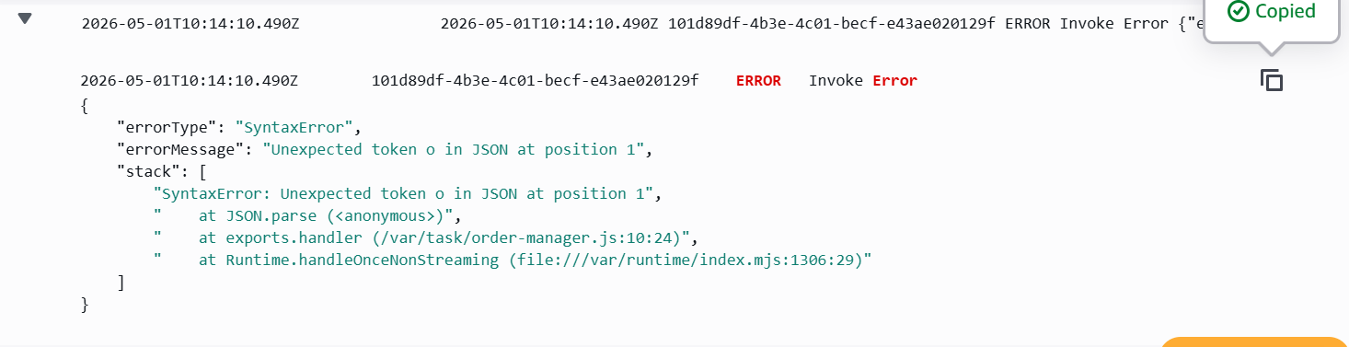
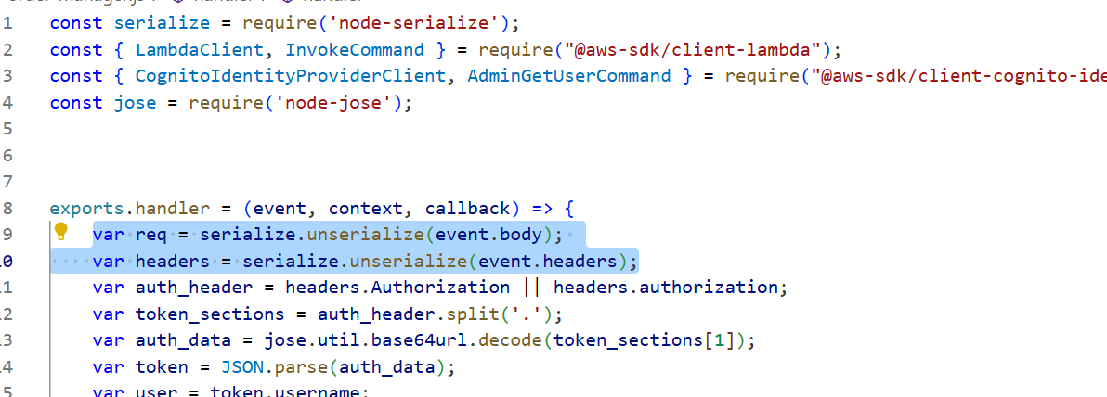
LESSON 09 · FIX & VERIFY
Remove the dependency entirely
Native JSON.parse() does the same job without an eval path.
BEFORE · VULNERABLE
AFTER · FIXED & VERIFIED
package.json carried the vulnerable lib
SyntaxError before any logic runs
node-serialize listed under dependencies — and called on every /order request.
CloudWatch after fix — JSON.parse rejects the payload as invalid JSON. FILE READ SUCCESS never appears.
FIX · Drop the require('node-serialize') import, swap to JSON.parse(), and run npm uninstall node-serialize. Audit deps regularly with npm audit + GitHub Dependabot.

Slide 18
OVERVIEW
Project at a glance
What DVSA is, how we worked it, and all ten vulnerabilities covered across both presentations
ABOUT THE TARGET
02
BROKEN AUTHENTICATION
OWASP DVSA on AWS
Damn Vulnerable Serverless Application — an intentionally insecure AWS deployment used to learn real cloud-native attacks and defenses.
Stack: AWS Lambda · API Gateway · DynamoDB · S3 · IAM · Cognito · CloudWatch
Region: us-east-1
Tools: AWS Console · CloudShell · CloudWatch Logs · IAM Policy Simulator · PowerShell – Git Bash
04
INSECURE CLOUD CONFIGURATION
06
DENIAL OF SERVICE
08
LOGIC VULNERABILITY
11
BROKEN ACCESS CONTROL / IDOR
10
· UNHANDLED EXCEPTIONS
DVSA Serverless Security | ICS344
2

Slide 19
LESSON
02
Broken Authentication
JWT signature bypass — attacker forges any user identity

Slide 20
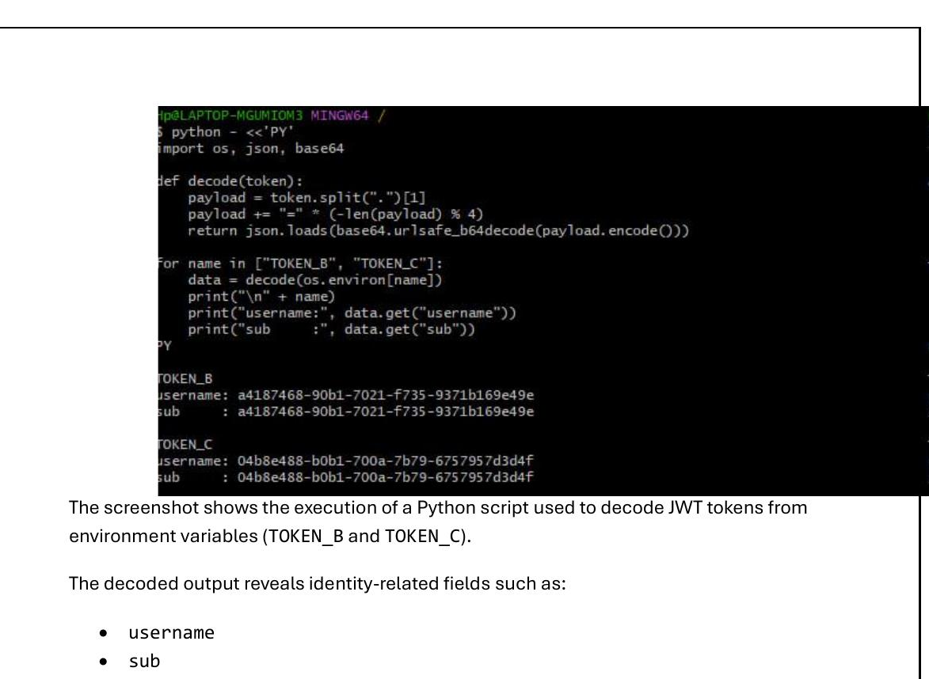
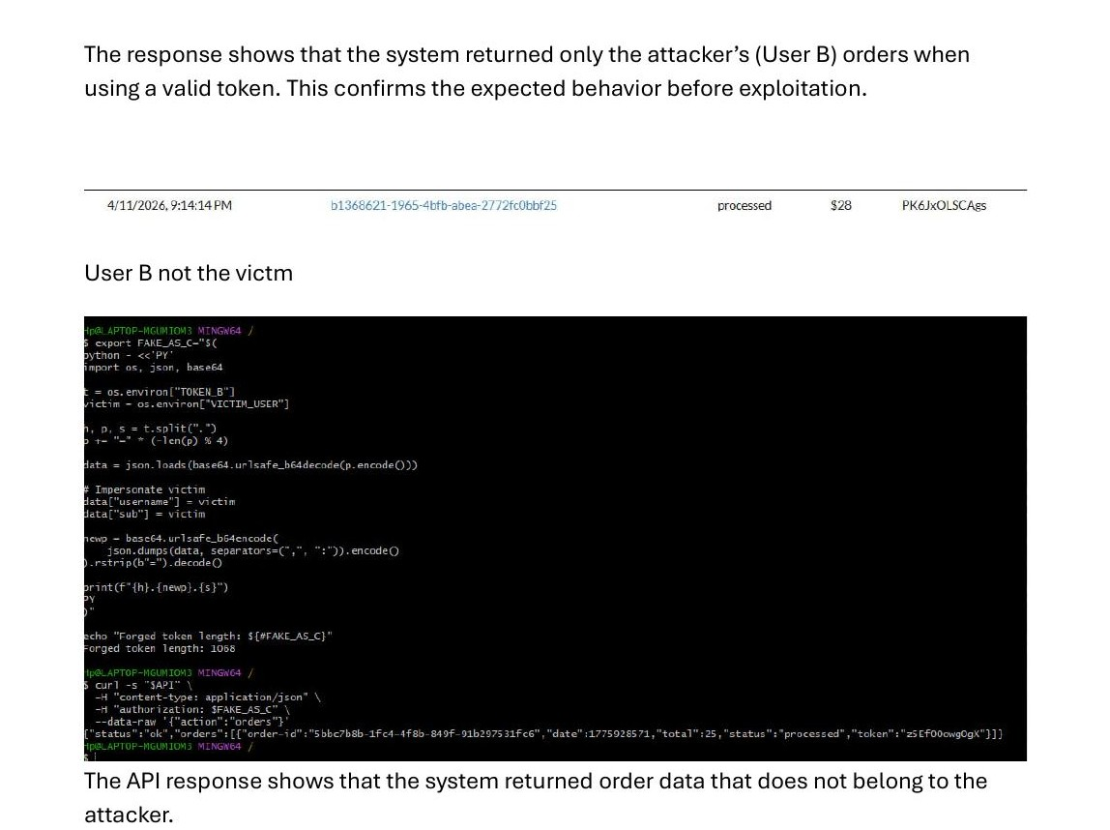
LESSON 02 · EXPLOIT
Forging a JWT to impersonate another user
DVSA-ORDER-MANAGER decodes the JWT payload but never verifies the Cognito signature — payload claims (username, sub) can be edited and the forged token is accepted.
EXPLOITATION STEPS
Python script — decoding TOKEN_B and TOKEN_C identity fields
1
Log in as User B and User C. Capture both JWTs from browser DevTools → Network tab → Authorization header.
2
Run a Python script to base64-decode each JWT payload and extract the username and sub fields for both users.
3
Replace the username and sub values inside User B's token payload with User C's identity. Re-encode to base64.
Both tokens expose username & sub in plain base64. No signature check stops an attacker from swapping them.
Forged token → API returns victim's order data
4
Send a GET /order request using the forged token. The API returns User C's full order list — exploit confirmed.

Slide 21
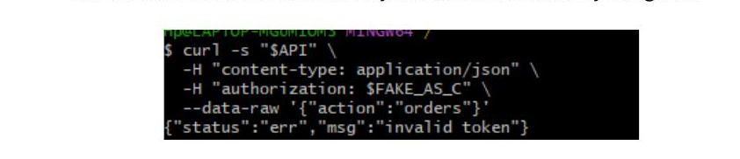
LESSON 02 · FIX & VERIFY
Enforce JWT signature verification before trusting any identity claim
Introduce verifyCognitoJwt — validate iss, exp, token_use with AWS Cognito public keys before extracting user identity.
BEFORE · VULNERABLE
AFTER · FIXED & VERIFIED
serialize.unserialize() decoded payload trusted
verifyCognitoJwt() — signature verified first
Vulnerable: backend decoded the JWT and used username/sub directly without verifying the signature.
After fix: forged token rejected with {"status":"err","msg":"invalid token"}. Exploit no longer works.
FIX ·
Add verifyCognitoJwt(token) using AWS Cognito JWKS. Validate iss, exp, token_use. Extract user identity only after verification passes. Add .catch() → 401.

Slide 22
LESSON
04
Insecure Cloud Configuration
Public S3 write triggers unauthorized Lambda execution

Slide 23
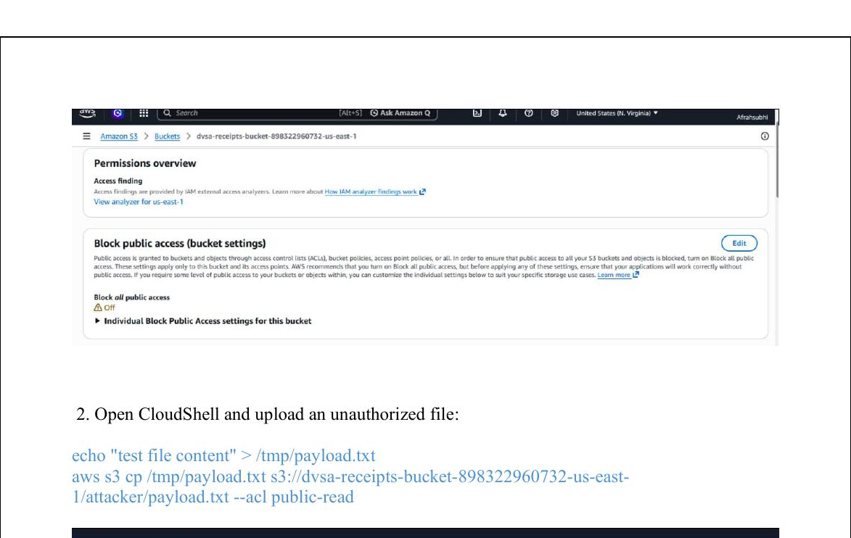
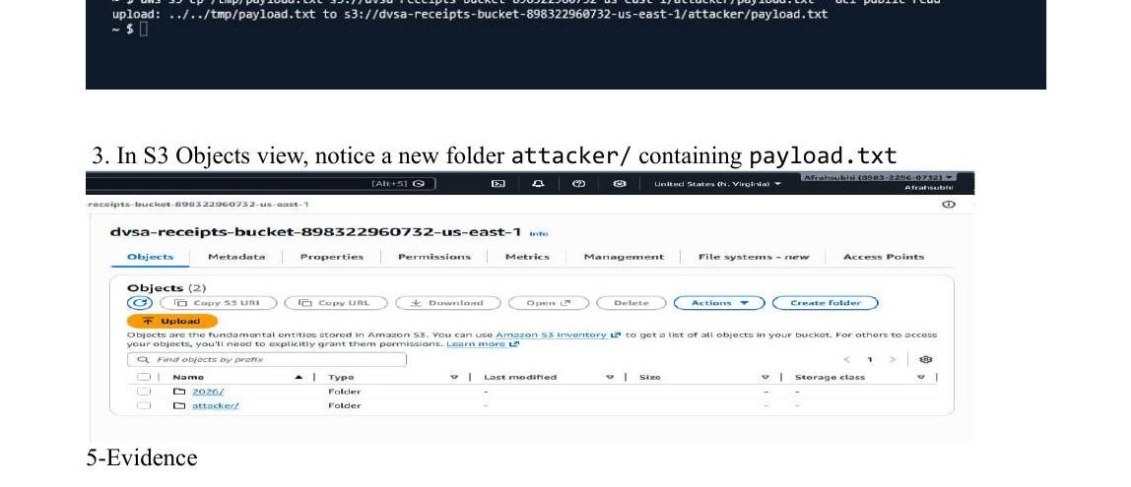
LESSON 04 · EXPLOIT
Anonymous S3 upload triggers backend Lambda
S3 receipts bucket has Block Public Access OFF and is wired to a Lambda trigger — anyone can upload to the bucket and execute backend code without authentication.
EXPLOITATION STEPS
S3 console — Block all public access: OFF · CloudShell upload succeeds
1
Open the S3 console → dvsa-receipts-bucket → Permissions. Confirm 'Block all public access' shows ⚠ Off.
2
Open AWS CloudShell. Create a test payload file: echo 'test' > /tmp/payload.txt.
3
Upload with public ACL: aws s3 cp /tmp/payload.txt s3://dvsa-receipts-bucket-…/attacker/payload.txt --acl public-read
Console shows the warning flag. The aws s3 cp command completes without error — no auth required.
S3 objects — attacker/ folder created by unauthenticated upload
4
Verify the attacker/ folder appears in bucket objects. CloudWatch logs confirm DVSA-SEND-RECEIPT-EMAIL fired automatically.

Slide 24
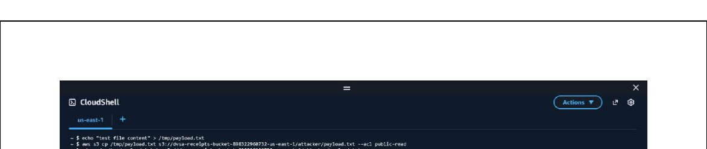
LESSON 04 · FIX & VERIFY
Re-enable Block All Public Access on the receipts bucket
Enable all four Block Public Access options in S3 bucket permissions. No code change needed — configuration hardening alone closes the gap.
BEFORE · VULNERABLE
AFTER · FIXED & VERIFIED
Block all public access: OFF
Block all public access: ON — upload denied
S3 bucket allowed public PutObject. Any user could upload files and trigger the Lambda without authentication.
After fix: re-running the upload command returns AccessDenied. Lambda is no longer triggered by untrusted uploads.
FIX ·
S3 → Permissions → Edit Block Public Access → enable all four options. Restrict write to Lambda execution role only via bucket policy.

Slide 25
LESSON
06
Denial of Service
Flooding the billing endpoint with no rate limiting

Slide 26
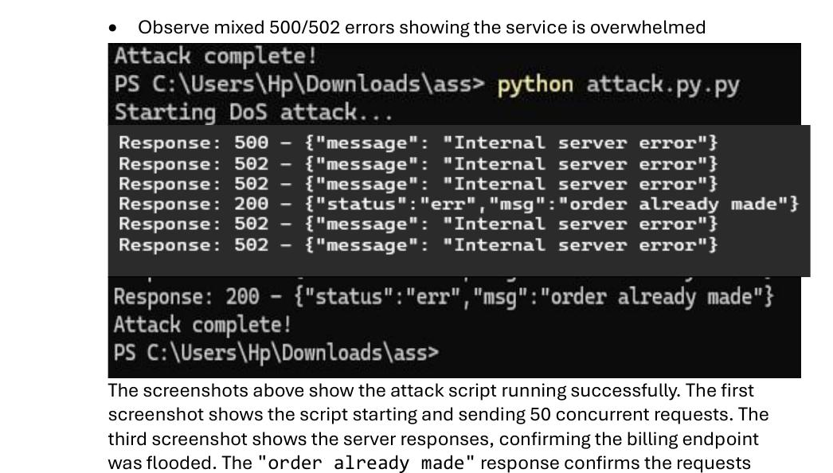
LESSON 06 · EXPLOIT
Flooding the billing endpoint with 50 concurrent threads
API Gateway stage uses default 10,000 req/sec rate with no per-user throttling — billing endpoint can be flooded, crashing the Lambda for everyone.
EXPLOITATION STEPS
Terminal — 50 threads crash the billing Lambda
1
Log into DVSA, add an item to cart, proceed to checkout. Copy the order-id and JWT from DevTools Network tab.
2
Create attack.py: spawn 50 threads each sending POST /dvsa/order with action:billing and a valid credit card body.
3
Run: python attack.py. Observe the terminal output — responses mix 500 Internal Server Error and 502 Bad Gateway.
Responses: 500 Internal Server Error + 502 Bad Gateway. Lambda duration reached 8,483 ms before crashing.
Attack complete — service unavailable to legitimate users
4
Check API Gateway console: Rate was 10,000 req/sec with no burst protection — no defense against flooding.

Slide 27
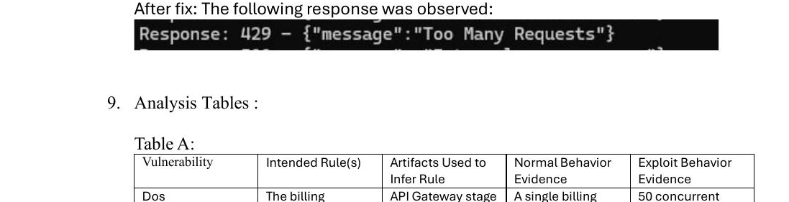
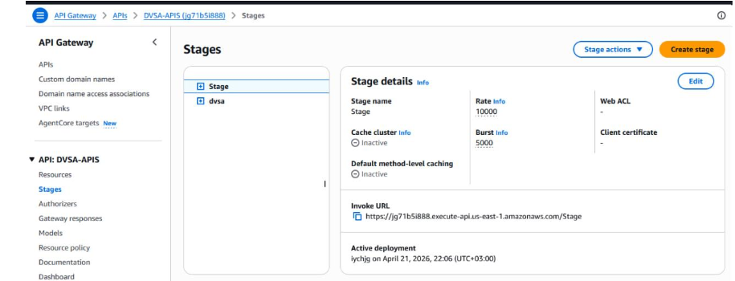
LESSON 06 · FIX & VERIFY
Enable API Gateway throttling at the stage level
Set Rate: 10 req/sec and Burst: 20 on the dvsa stage. API Gateway now returns 429 before the Lambda is invoked.
BEFORE · VULNERABLE
AFTER · FIXED & VERIFIED
Rate: 10,000 req/sec — no throttle
429 Too Many Requests — Lambda protected
Default API Gateway settings provided no protection. 50 concurrent requests crashed the Lambda every time.
After fix: attack script now receives {"message":"Too Many Requests"}. Lambda is never invoked for excess traffic.
FIX ·
API Gateway → DVSA-APIS → Stages → dvsa → Edit Throttling: Rate = 10 req/sec, Burst = 20. No code change needed.

Slide 28
LESSON
08
Logic Vulnerability
Race condition — cart modified while billing processes

Slide 29
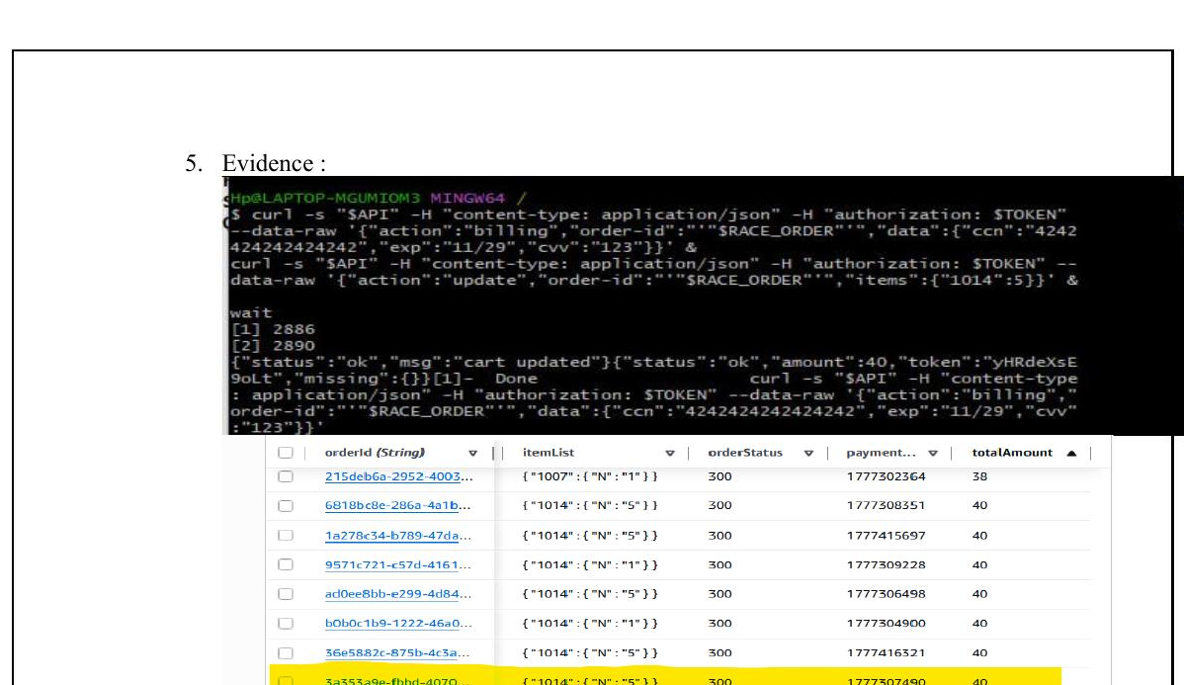
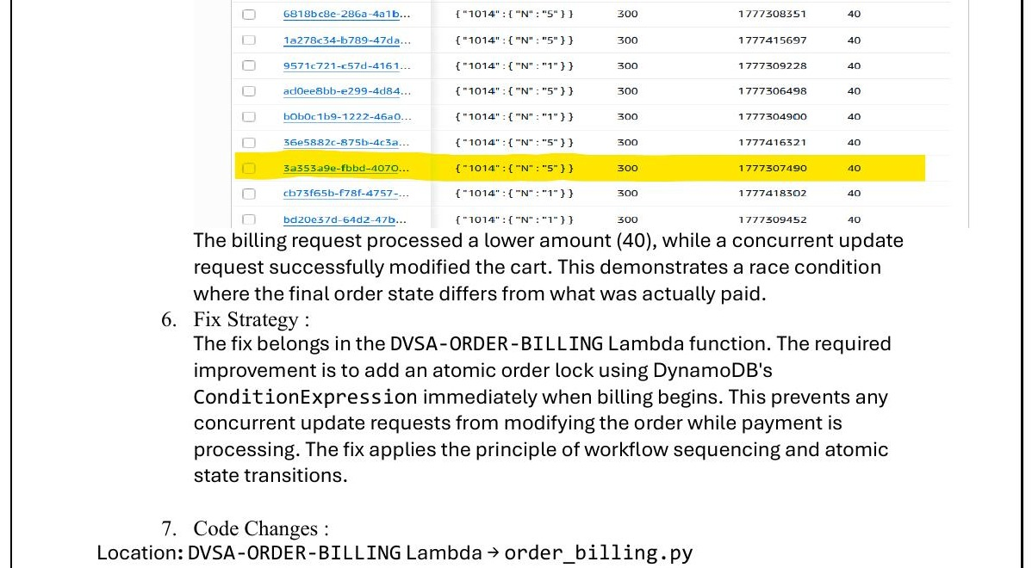
LESSON 08 · EXPLOIT
Cart modified during payment — race condition in billing
DVSA-ORDER-BILLING reads cart total without locking the order — a concurrent update request can change the cart mid-billing, so the customer pays for one quantity but receives another.
EXPLOITATION STEPS
Concurrent curl — billing charges $40 while update sets qty to 5
1
Log into DVSA, add 1 item ($40) to cart, proceed to checkout but stop before payment. Copy order-id and JWT.
2
Prepare two curl commands: (1) billing action with credit card data, (2) update action changing itemList to 5 items.
3
Send both simultaneously using & in Git Bash. The billing runs while the update modifies the cart mid-flight.
Both requests fire simultaneously. Billing reads the old cart (1 item, $40) while the update wins and sets qty to 5.
DynamoDB — highlighted row shows qty 5 charged at $40
4
Observe: billing response shows amount:40 (charged for 1). DynamoDB shows itemList updated to 5 — race confirmed.

Slide 30
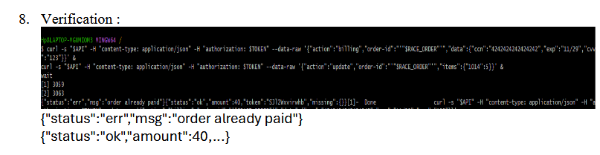
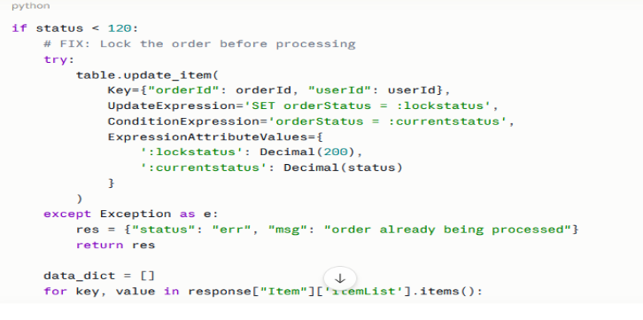
LESSON 08 · FIX & VERIFY
Atomic DynamoDB lock before billing begins
Add ConditionExpression to atomically set orderStatus = 200 before calculating cart total. Concurrent updates are rejected.
BEFORE · VULNERABLE
AFTER · FIXED & VERIFIED
No lock — billing reads stale cart
order already paid — race window closed
ا
Without a lock, the billing function reads orderStatus < 120 then processes. A concurrent update changes itemList between read and write.
FIX ·
In order_billing.py: table.update_item(ConditionExpression='orderStatus = :currentstatus') sets status=200 atomically. Concurrent update returns 'order already being processed'.

Slide 31
LESSON
10
Unhandled Exceptions
Stack traces and file paths leaked to the attacker

Slide 32
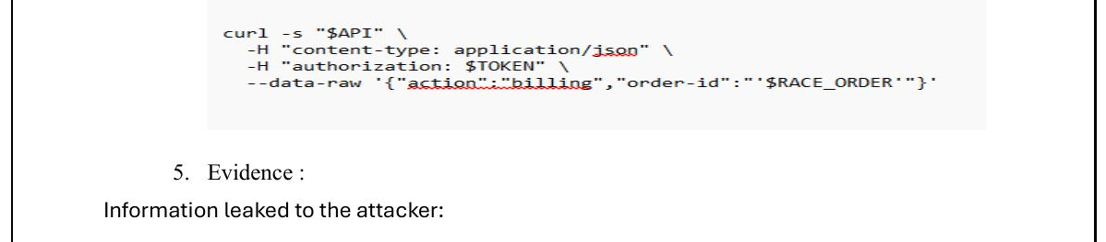
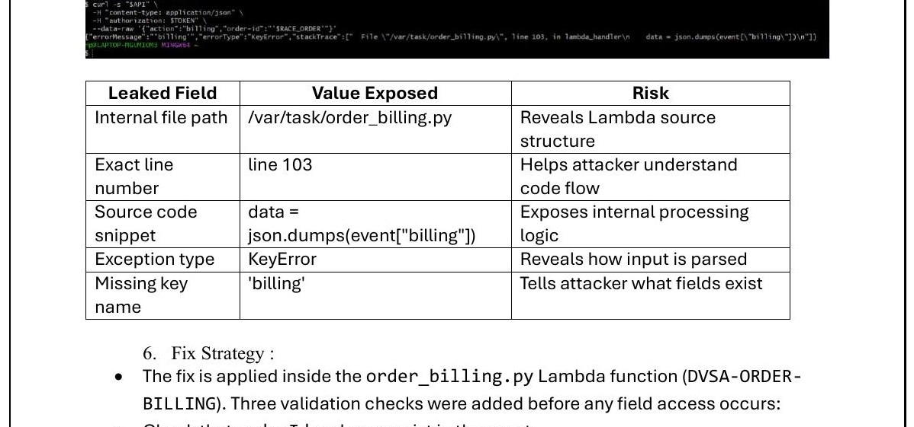
LESSON 10 · EXPLOIT
Malformed request leaks internal stack trace in HTTP response
order_billing.py accesses event["billing"] with no validation and has no try/except — a malformed request triggers a KeyError that returns the raw Python stack trace to the attacker.
EXPLOITATION STEPS
HTTP response — raw Python stack trace exposed to attacker
1
Set up $API and $TOKEN variables in Git Bash. Use a placeholder order ID (RACE_ORDER='').
2
Send a billing request without the required billing key: action:billing with order-id only, no data field.
3
Observe the raw JSON response — it contains errorType, errorMessage, and full stackTrace from the Lambda runtime.
Response body contains: internal file path, exact line number, source code snippet, exception type, and missing key name.
Leaked fields table — five internal details revealed per request
4
Extract leaked data: file path /var/task/order_billing.py, line 103, KeyError on 'billing', source code snippet.

Slide 33
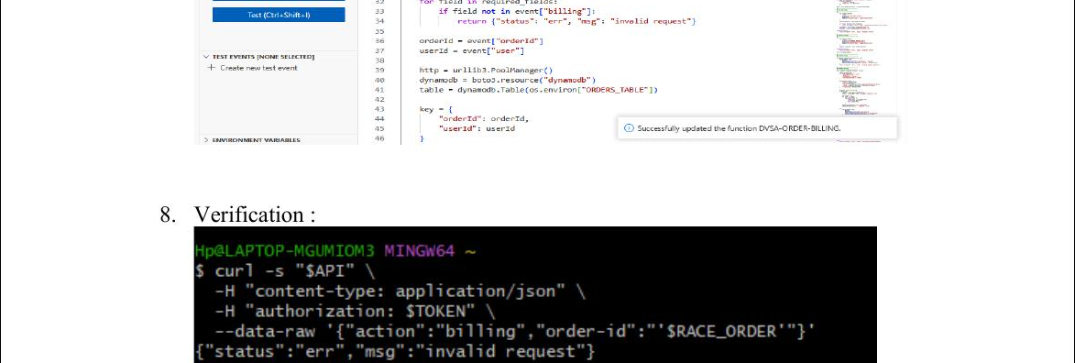
LESSON 10 · FIX & VERIFY
Validate all inputs before access — catch all exceptions
Add three guard checks at handler entry: verify orderId, user, billing key, and required sub-fields exist before any field access.
BEFORE · VULNERABLE
AFTER · FIXED & VERIFIED
KeyError propagates — stack trace returned
Generic error — no internals exposed
No try/except and no input validation. Missing key raises Python KeyError that Lambda runtime returns verbatim as HTTP response.
After fix: same malformed request returns {"status":"err","msg":"invalid request"}. No file path, no line number, no stack trace.
FIX ·
In order_billing.py: check orderId/user exist, check 'billing' key exists, check ccn/exp/cvv present. Any failure → return generic 'invalid request'. Wrap in try/except.

Slide 34
LESSON
11
Broken Access Control
IDOR — modifying another user's order without ownership check

Slide 35
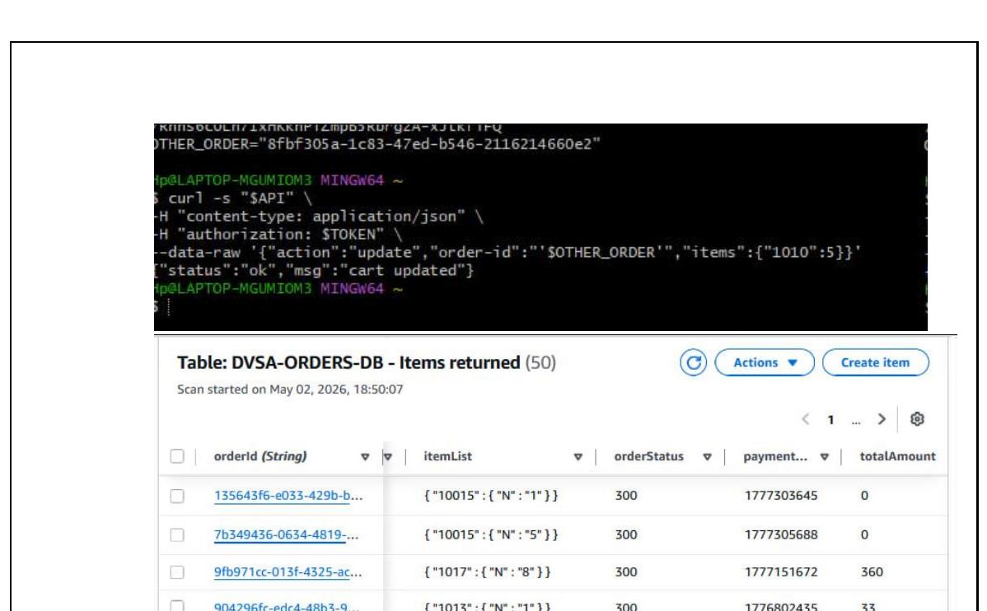
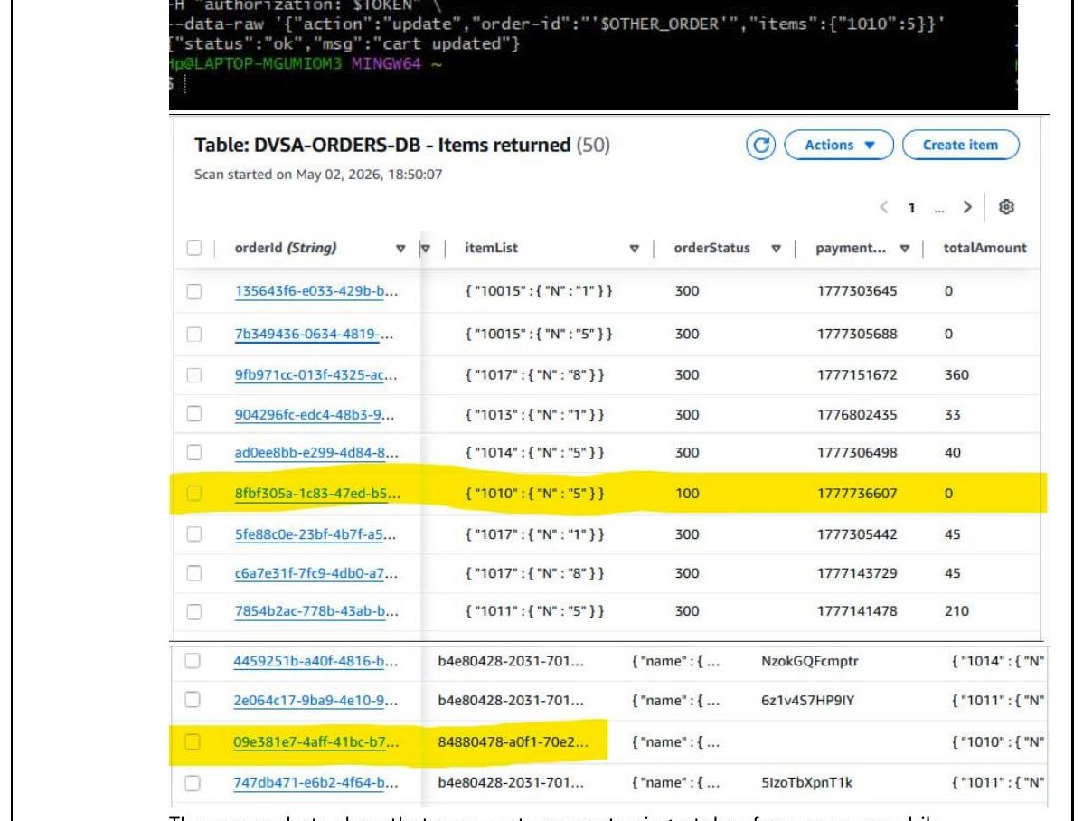
LESSON 11 · EXPLOIT
User A modifies User B's order without owning it
admin_update_orders.py updates any order by order-id without checking that the order belongs to the caller — IDOR allows cross-user data manipulation.
EXPLOITATION STEPS
curl — User A's JWT + User B's order-id → cart updated
1
Create two users: User A (attacker) and User B (victim). Both place orders in DVSA.
2
As User B, proceed to checkout. In DevTools Network tab, copy the order-id from the shipping request body.
3
Log in as User A. Extract User A's JWT from the Authorization header in DevTools.
User A sends action:update with User B's order-id. The server accepts it without any ownership check.
DynamoDB — User B's order modified by User A
4
Send update request using User A's JWT but User B's order-id. Response: 'cart updated' — exploit confirmed.

Slide 36
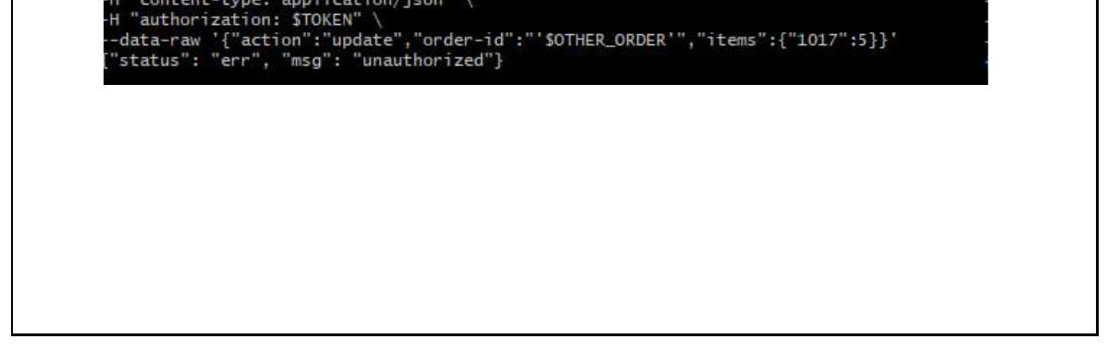
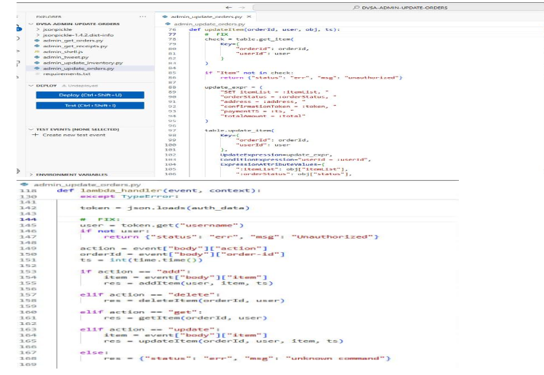
LESSON 11 · FIX & VERIFY
Verify order ownership before processing any update
Add a get_item check in admin_update_orders.py. If order.userId ≠ authenticated user, reject immediately with 'unauthorized'.
BEFORE · VULNERABLE
AFTER · FIXED & VERIFIED
No ownership check — any order-id accepted
unauthorized — cross-user write blocked
Vulnerable: updateItem wrote directly using the request body's order-id without verifying the caller owned that order.
After fix: same curl request with User B's order-id returns {"status":"err","msg":"unauthorized"}. Order is unchanged.
FIX ·
In admin_update_orders.py → updateItem(): call table.get_item(Key) first. If check['Item']['userId'] != user: return {status:err, msg:unauthorized}.

Slide 37
THANK YOU
Fajer Alyami · Afrah Alsubhi
ICS344 · DVSA Serverless Security · Lessons 1–11

