Slide 1

PYTHON FOR DATA ANALYSIS
Spambase dataset

Slide 2

TABLE OF CONTENTS
1. EXPLORING THE DATASET
2. CLEANING THE DATASET
3. BUILDING THE MODELS
4. API FLASK

Slide 3

EXPLORING THE DATASET
First, we started to read the dataset just to see and get familiar with the elements inside.
For this, we decided to use many functions like :
spam.infos() → to see the types of variables
spam.isnull().sum() → to check if there is any missing values
spam.shape () → to obtain the number of rows and columns
spam,columns → to obtain the name of columns in order to visualize all the variables that we may need in the future
After visualizing the dataset, we wanted to know the number of spam/not spam.
→ spam['class'].value_counts() which has shown us :
0 means the email is not a spam
1 means the email is a spam
To represent the distribution spam/not spam, we called the matplot library to build an histogram.

Slide 4
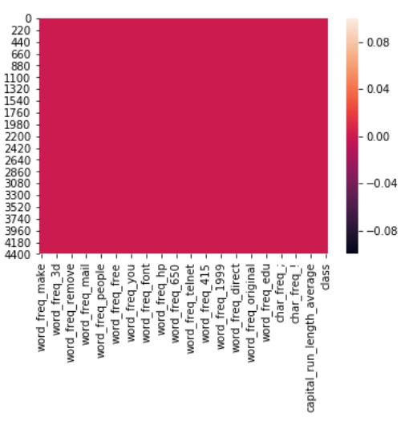
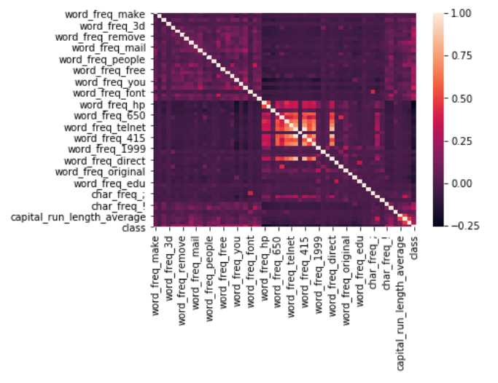
We created a matrix to show the missing values and a correlation using the library seaborn

Slide 5
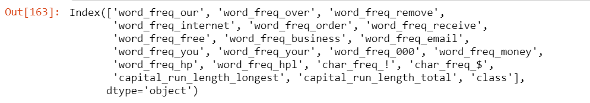
CLEANING THE DATASET
After discussion , we have decided to drop the features which have correlation less than <0.2. We now only have 20 variables left :
We will test our future models on both data set and based on the accuracy score we will decide which dataset is better for prediction :
The one with all the features
The other one with only 20 features

Slide 6
BUILDING THE MODEL
We have built different models using different libraries such as sckiti from Python :
Logistic Regression → using sklearn.linear_model
Random Forest → using sklearn.ensemble
Boost → using xgboost
Naives Bayes → using sklearn.naive_bayes
We also built a KNN algorithm which consists to have a cluster.
After spliting the data into train_set and test_test.
We trained our models on the train_set and then we did a prediction on the test_set.
We got different accuracies score for different models and dataset :
The model with the highest accuracy score is the Boosting one.
Also, we tried this model on both dataset : the one with all the variables and the one with only 20 variables
Conclusion : The highest accuracy score is obtained using all the variables and by the boosting model.

Slide 7
API FLASK
We decided to go with the Flask method to do our API. For that we have followed the same method as our teacher explained during the class.
We have chosen the software Visual Studio Code in which we have app.py where we imported different libraries from flask such as :
Bootstrap
FlaskForm
StringField,FloatField etc….
We have 3 different files :
App.py where we have created the form in which the person will enter his/her email and submit
Prediction_form.html and base.html → we created these two files during our last session in class with our teacher.

Slide 8
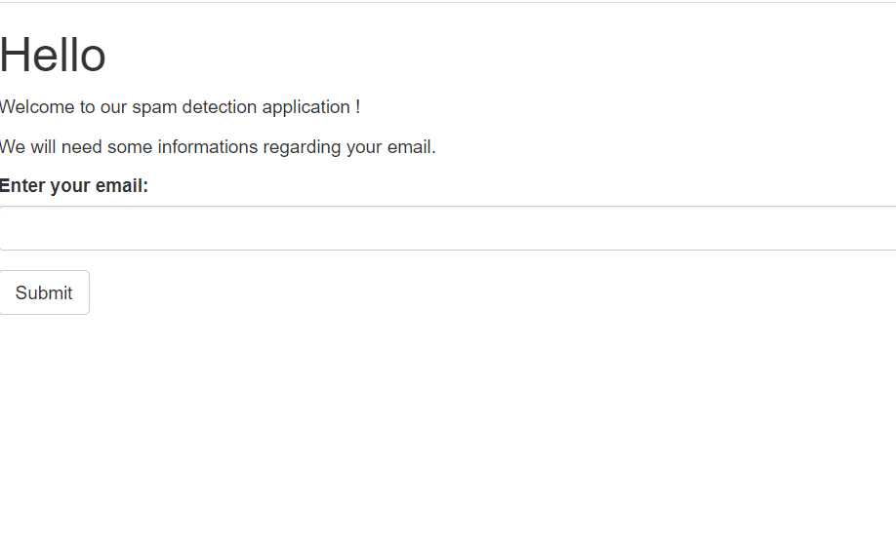
Mon Application Flask
This is how our form looks like

Slide 9
API FLASK
Now that we have our application, the task here was to predict if the mail entered is a spam or not.
In order to do this, we have created different functions :
Def comptage (mail) → this function counts the percentage of each feature present in the mail (which we just entered).
Def fonctionfinal (mail) → remodel the function comptage and return a dataframe in which the frequency of each feature is clearly seen.
After obtaining the frequency of each feature, we define the function def prediction() where will predict if the email is a spam or not based on our built model previously.
In our case the boosting model has the highest accuracy score, so we decided to use this one and predict the given mail on this model.

Slide 10
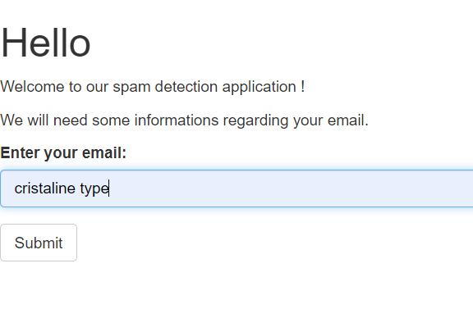
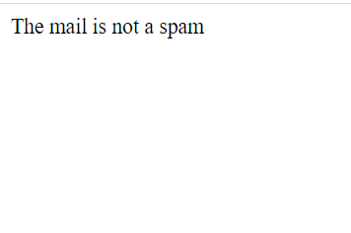
The display message looks like this stating if the email is a spam or not

