Slide 1
Anti-Fraud
By: Fajriocta

Slide 2
What is Anti-Fraud ?
Penipuan atau Kebohongan yang dilakukan oleh suatu individu untuk mendapatkan keuntungan pribadi dan merugikan pihak lain
Mencegah atau mengurangi penipuan
Strategi Anti-Fraud
Whistleblowing
Risk management system

Slide 3
Theory of Fraud
Triangle of Fraud, there is three elements for individuals are motivated to commit fraud Pressure, Opportunity, and Rationalization
Scale Theory, is an advanced theory or further development of the triangle theory.
Gone Theory, according to this theory there is 4 factors Greed, Need, Opportunity, and Exposure
Fraud Diamond Theory
Crowe’s Fraud Pentagon

Slide 4
Deskripsi Fraud
Terdapat beberapa point penting mengenal Fraud, dimana terdapat pada dataset
Minor/Uncommon
Concealed
Changing over time

Slide 5



Contoh Anti-Fraud
Finance and Banking
Credit card fraud detection
E-Commerce
Payment fraud detection
reviews and ratings identification
Retail
Return Fraud detection
Loyalty program abuse prevention

Slide 6
Method of Fraud Detection
Rule Based System | Machine Learning
Threshold Rules Pattern Matching Geolocation Rules Identity Verification Rules Transaction Consistency Rules | Supervised Learning Unsupervised Learning Pattern Recognition

Slide 7
Benefit of Anti-Fraud
Protecting the company from problematic users
Protecting user from problematic users
Reducing the potential for Fraud
Creating a secure and convenient transaction ecosystem

Slide 8
Method of choice
Rule Based Fraud detection
Machine Learning

Slide 9
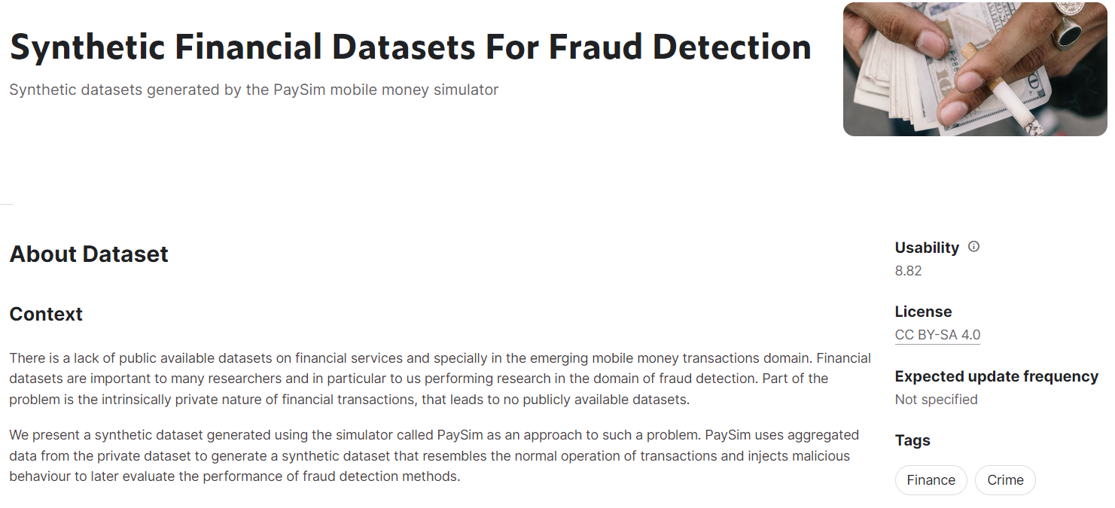
Dataset Fraud Detection
Link

Slide 10
Objective
Objective :
Membuat model untuk mengidentifikasi transaksi dengan label Fraud dan not Fraud
Goals :
Melakukan Exploratory analysis pada data untuk menemukan pola aktivis fraud
Membuat model Machine Learning untuk classify fraud dan non-fraud

Slide 11
Available Variables
Step | maps a unit of time in the real world. In this case 1 step is 1 hour of time. Total steps 744 (30 days simulation)
Type | CASH-IN, CASH-OUT, DEBIT, PAYMENT and TRANSFER
Amount | amount of the transaction in local currency
NameOrig | customer who started the transaction
oldbalance Org | initial balance before the transaction
newbalanceOrig | new balance after the transaction
nameDest | customer who is the recipient of the transaction
oldbalanceDest | initial balance recipient before the transaction. Note that there is not information for customers that start with M (Merchants)
newbalanceDest | new balance recipient after the transaction. Note that there is not information for customers that start with M (Merchants).
isFraud | This is the transactions made by the fraudulent agents inside the simulation. In this specific dataset the fraudulent behavior of the agents aims to profit by taking control or customers accounts and try to empty the funds by transferring to another account and then cashing out of the system.
isFlaggedFraud | The business model aims to control massive transfers from one account to another and flags illegal attempts. An illegal attempt in this dataset is an attempt to transfer more than 200.000 in a single transaction.

Slide 12
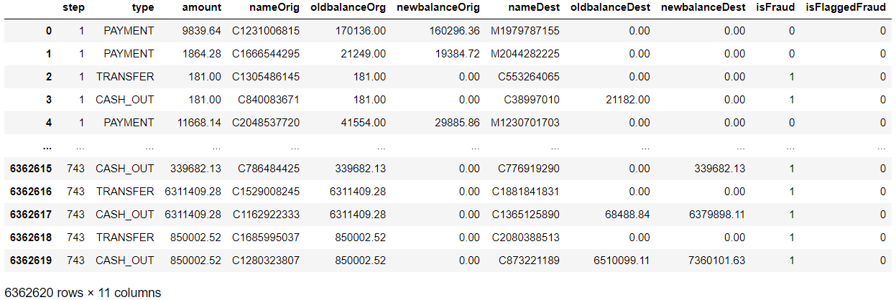
Dataset

Slide 13
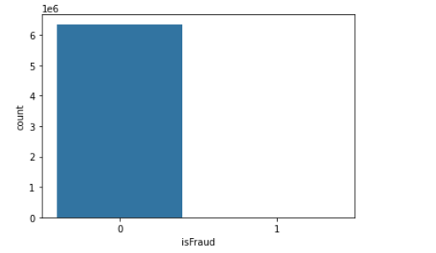

Dataset
6.362.620 baris dan 11 kolom
3 object & 8 int/float variable
Data tidak memiliki tipe data date/periode
Data tidak memiliki data regional
Pada amount, nilai minimal adalah 0
Dataset dalam kondisi Imbalanced

Slide 14
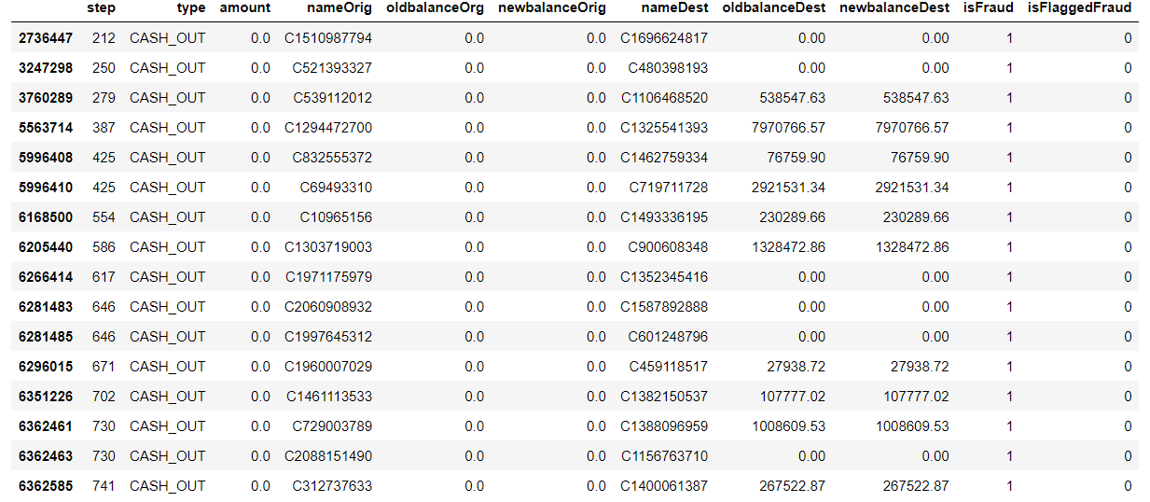
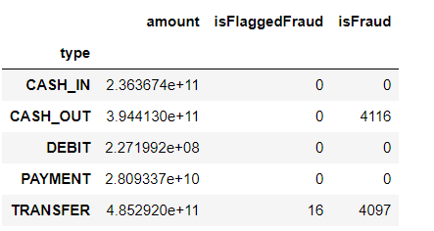
Dataset
Data dilihat pada amount == 0
Data dilihat pada Type

Slide 15
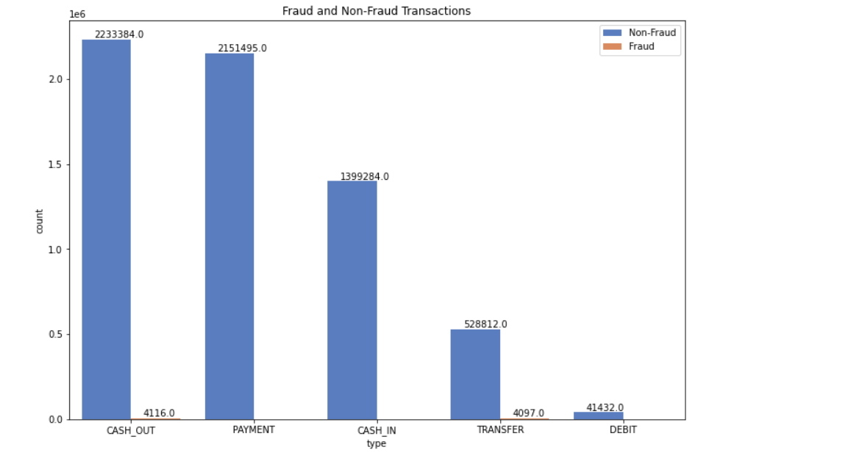
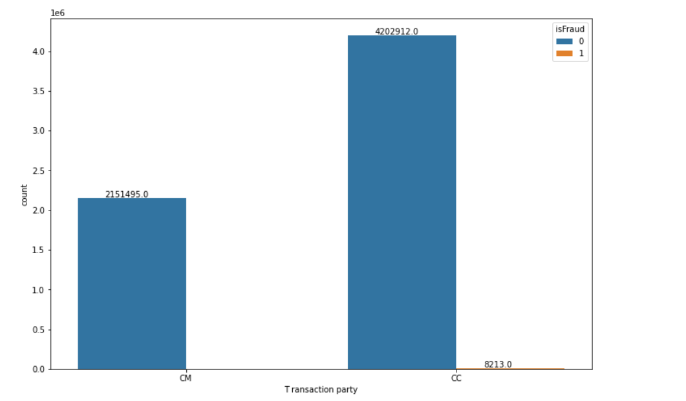
Most common type, Cash Out
Least common type, Debit
Cash out have most fraud activity
Following with Transfer
Customer to Customer have fraud activity
Most transactions done were customer to customer
Transaction of merchant dont have any fraud activity
At this point there is no CM/MM/MC

Slide 16
Feature Engineering
Orig different Dest different | melihat perbandingan antara nilai new dan old balance
Surge indicator | Flag untuk customer dengan nilai amount diatas upperfence
Frequency User | Freq untuk flag customer yang menjadi penerima lebih dari 20 transaksi
Merchant indicator | Flag untuk menentukan customer dengan Merchant (Re: cek CC/CM/MC/MM)

Slide 17
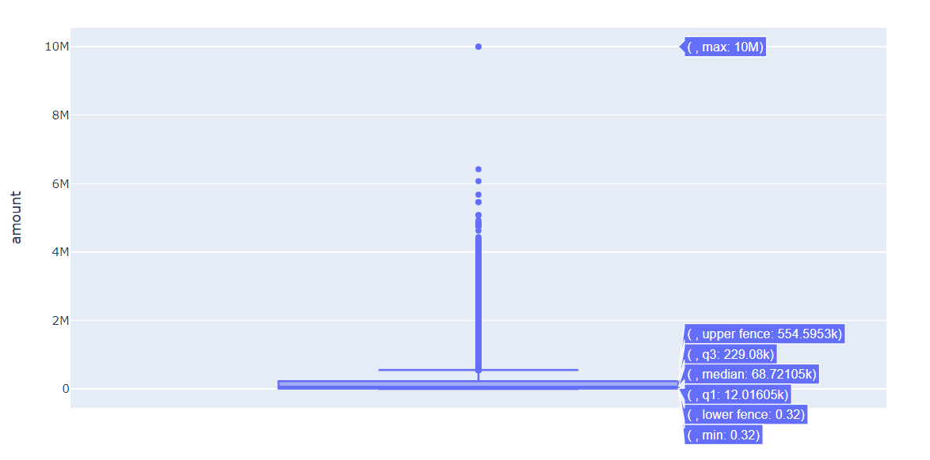
*Contoh penggunaan boxplot

Slide 18
Drop Columns | nameOrig, nameDest, isFlaggedFraud, type(after encoding)
Handling Categorical | Type feature using one hot encoding
Split dataset | Train : 80% Test : 20%
Handling Imbalanced dataset | As it is Under sampling SMOTE
Machine Learning (Supervised) | Naive Bayes classifier Random Forest classifier Decision Tree classifier
Tuning | Tuning Best model with GridSearchCV

Slide 19
Evaluation of ML
Method / ML | Naive Bayes | Random Forest | Decision Tree
As it is | Accuracy: 0.98 F1 Score: 0.002 ROC-AUC Score: 0.51 recall: 0.51 precision 0.0014 | Accuracy: 0.99 F1 Score: 0.94 ROC-AUC Score: 0.94 recall: 0.94 precision 1.0 | Accuracy: 0.99 F1 Score: 0.91 ROC-AUC Score: 0.94 recall: 0.94 precision 0.94
Under sampling | Accuracy: 0.24 F1 Score: 0.0012 ROC-AUC Score: 0.62 recall: 0.62 precision 0.00062 | Accuracy: 0.97 F1 Score: 0.036 ROC-AUC Score: 0.93 recall: 0.93 precision 0.018 | Accuracy: 0.97 F1 Score: 0.034 ROC-AUC Score: 0.93 recall: 0.93 precision 0.017
SMOTE | Accuracy: 0.26 F1 Score: 0.0012 ROC-AUC Score: 0.63 recall: 0.63 precision 0.00064 | Accuracy: 0.99 F1 Score: 0.81 ROC-AUC Score: 0.94 recall: 0.89 precision 0.73 | Accuracy: 0.99 F1 Score: 0.73 ROC-AUC Score: 0.94 recall: 0.94 precision 0.62

Slide 20
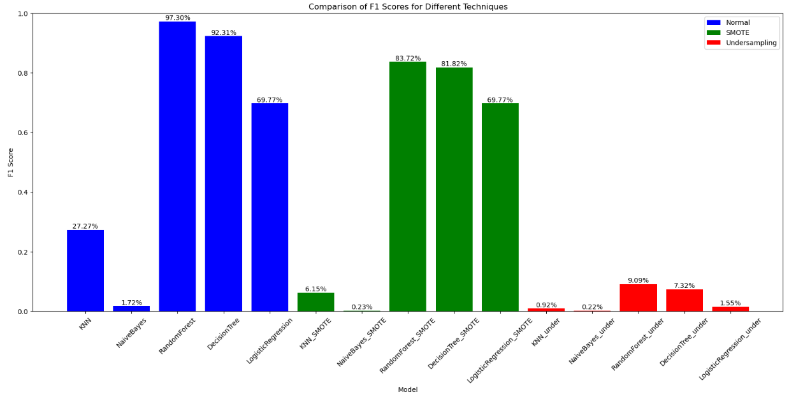

Slide 21
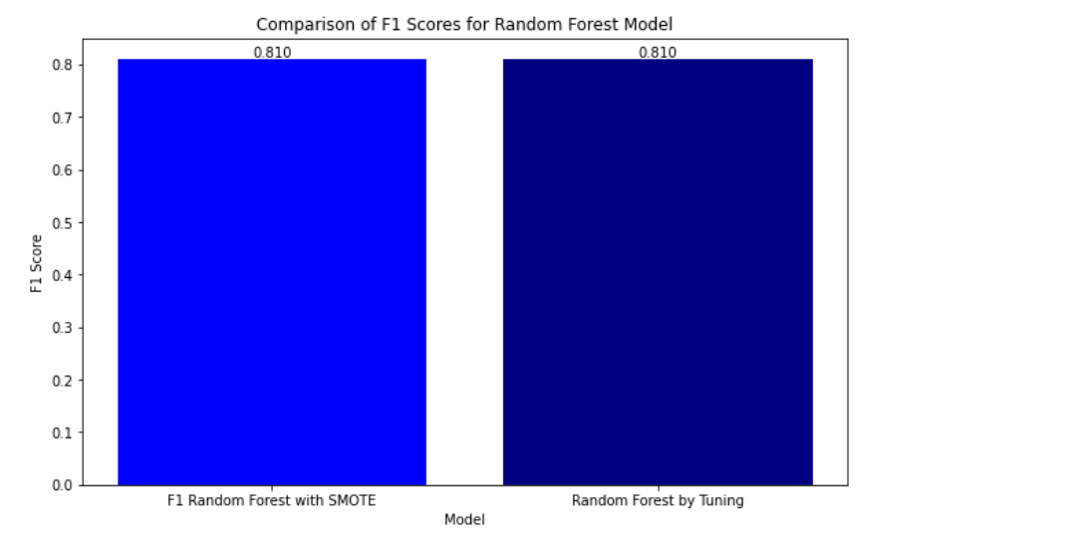
*hasil tuning

Slide 22
Conclusion on dataset
Conclusion on Model
Most common type, Cash Out
Least common type, Debit
Most transactions done were customer to customer
Transaction of merchant dont have any fraud activity
Amount with 0 value, have high chance for fraud
Random Forest give best accuracy and F1 score
In this case, SMOTE increase F1 score and accuracy

Slide 23
Reference
Audit Team Brainstorming, Fraud Risk Identification, and Fraud Risk Assessment: Implications of SAS No. 99
A Method for Online Transaction Fraud Detection Based on Individual Behavior
ANALISIS REVIEW PENDETEKSIAN KECURANGAN (FRAUD)
Fraud prevention in the Indonesian banking sector using anti-fraud strategy
Benfords_Law_As_a_Useful_Tool_to_Determine_Fraud_
Credit Card Fraud Detection Based on Machine Learning
FRAUD THEORY EVOLUTION AND ITS RELEVANCE TO FRAUD
Increasing trust and fairness in machine learning applications within the mortgage industry

