Slide 1


Identifying Fake News
Hyesoo Youn | Jinmei Zhang
mentored by Kevin O’Sullivan

Slide 2

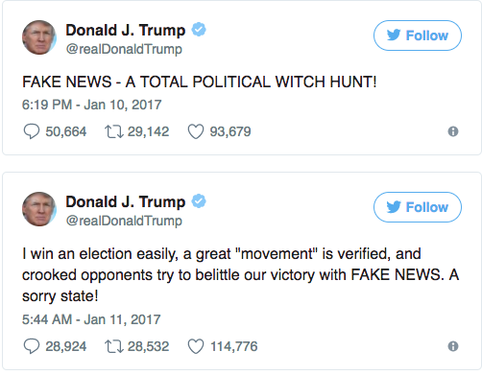

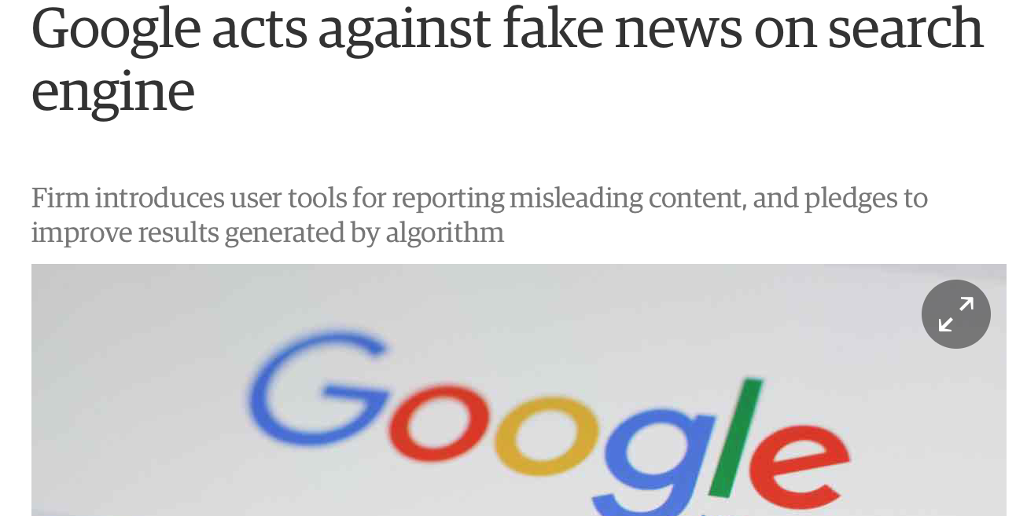
FAKE news is a REAL problem
Fake news are becoming a bigger problem
as social medias develop.
Many are using them for their own benefits!
But it is very hard to solve the problem

Slide 3

Challenges and our goal
Challenges:
Definition of Fake News
Factually wrong, or highly biased news
We determined them by a source-based search
Dataset of Fake News
Raw data was collected with python library Newspaper
Data was manually cleaned up and balanced
 | url | source | title | text | authenticity
2942 | https://newswithviews.com/vaccines-good-or-bad... | newswithviews | Vaccines: Good or Bad?, Part 8 | Vaccines: Good or Bad?, Part 8\n\nThe more we ... | 1
2943 | https://reagancoalition.com/articles/2017/fath... | reagancoalition | Father PUNISHES 10-Year-Old Daughter by Strand... | Christopher Charles Watson, from Kingman, Ariz... | 1
2944 | http://www.foxbusiness.com/features/2017/07/27... | foxnews | Delta purchases 10% stake in Air France-KLM | Delta Air Lines (DAL) and China Eastern Airlin... | 0
2945 | http://www.cnn.com/2016/09/08/health/rubella-h... | cnn | Can forgotten rubella children of the '60s hol... | Brooklyn, New York (CNN) One side of the bedro... | 0
Goal:
Using the source-labeled news articles to train our model
Identify factually wrong or highly-biased articles without knowing its source
1473 real articles from 12 websites
1473 fake articles from 42 websites
OpenSources.co: https://github.com/BigMcLargeHuge/opensources

Slide 4
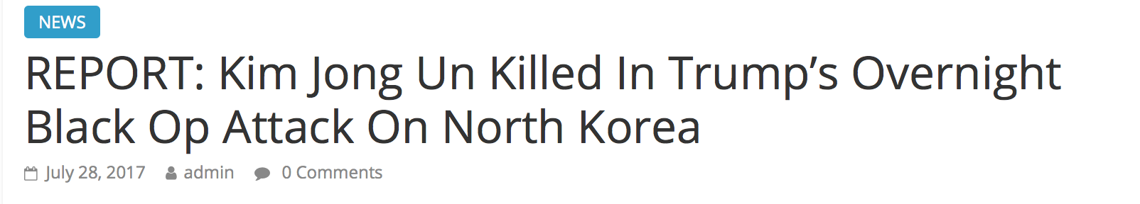
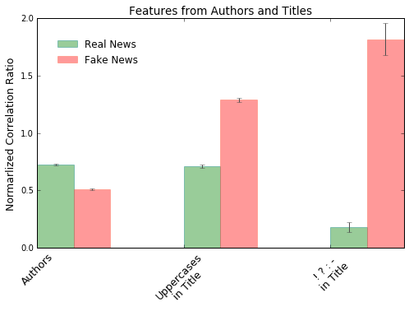

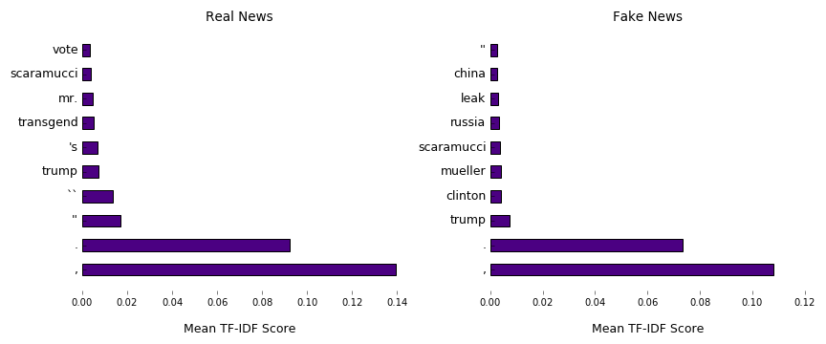
Feature generation
TF: Term Frequency
IDF: Inverse Document Frequency

Slide 5
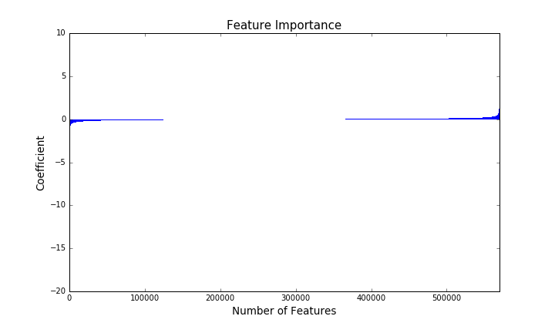
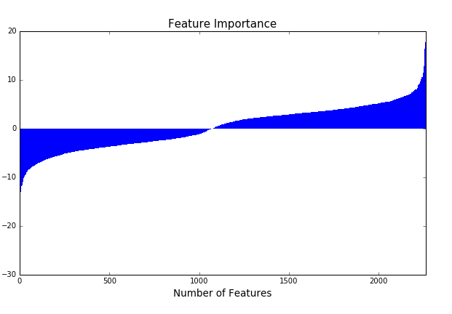
Feature selection and data split
1. Feature scaling:
sklearn.preprocessing.StandardScaler
2. Feature selection:
sklearn.feature_selection.SelectFromModel
LinearSVC(C=9000, penalty="l1", dual=False)
~0.38%
Num of features: 570029
Num of features: 2161
3. Data split:
Training: 70%
Cross validation: 12%
Test: 18%
For finding optimal parameters in each machine learning models

Slide 6
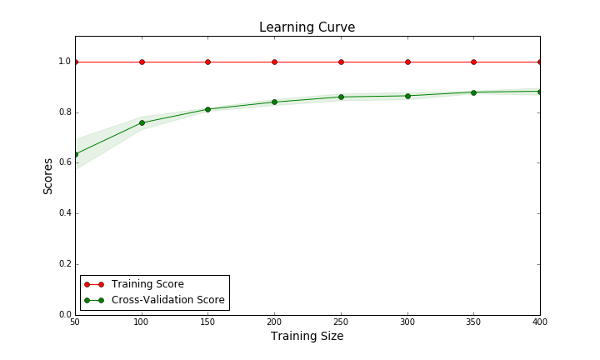
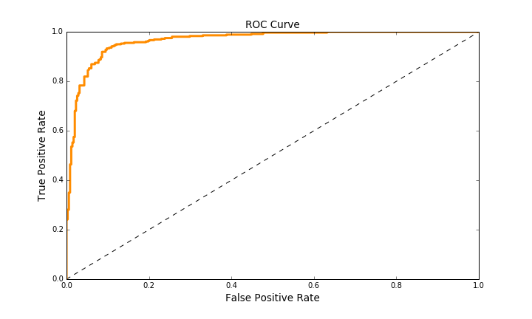
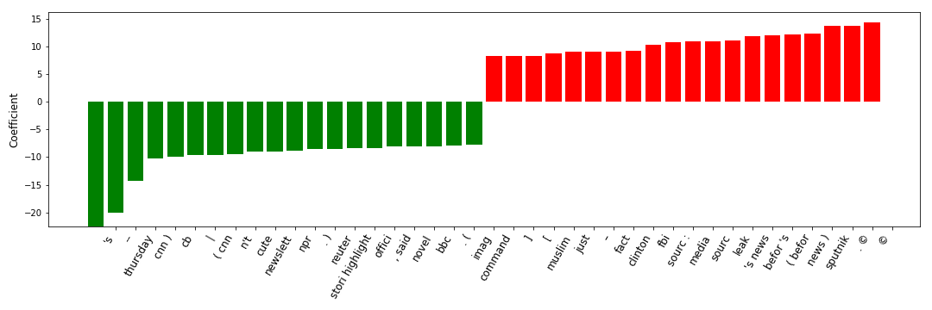
Predicting fake news with logistic regression
AUC: 0.97
Accuracy: 0.92
F1 score: 0.92
News sources like cnn, bbc, reuter, cbs,
official, said, newsletter, image, story highlight
_ ( )
News sources like beforenews, sputnik,
source, leak, command, muslim, clinton, fbi
- [ ] ©
￼

Slide 7

Conclusion, future improvement, and acknowledgement
Conclusion:
Fake news could be identified with > 92% accuracy, using logistic regression
Future improvement:
More / diverse / precise data
More features ( pictures, social medias)
Acknowledgement:
Mentor: Kevin O’Sullivan
CDIPS organizers

