Slide 1

Sprocket Central Pty Ltd
Data analytics approach
[Division Name] – Nikhil Rathore [Junior Consultant]

Slide 2
Agenda
Introduction
Data Exploration
Model Development
Interpretation

Slide 3
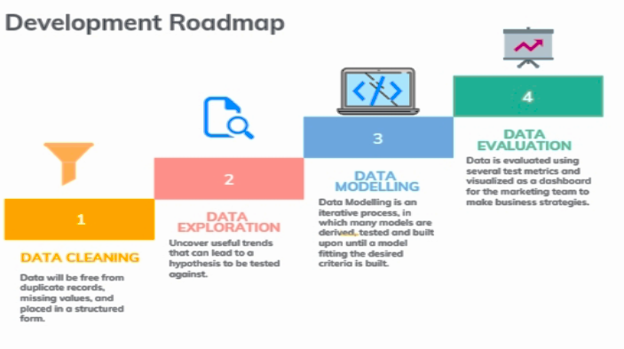
Note: The data and information in this document is reflective of a hypothetical situation and client. This document is to be used for KPMG Virtual Internship purposes only.
Introduction

Slide 4
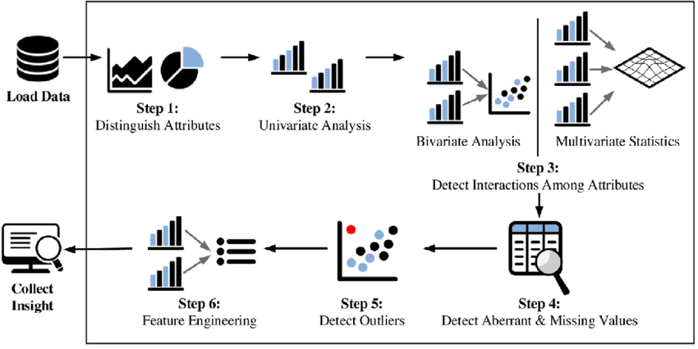
Data Exploration
Data exploration is the first step in data analysis, which involves using data visualization tools and statistical techniques to uncover data set characteristics and initial patterns
Significance of performing an EDA:
Identifying patterns and relationships.
Detecting errors and anomalies
Informing model selection.
Generating hypotheses
fig. Steps for Data Exploration.

Slide 5
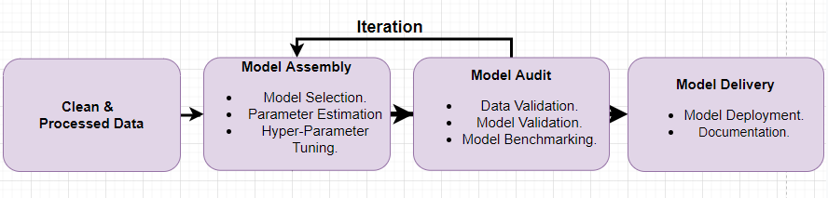
Model Development
The model development process involves designing, building, and validating a predictive model to solve a specific problem.
Fig. Model Development Steps.
Defining the problem
Collecting and preparing data
Selecting a model
Training the model
Validating the model
Deploying and monitoring the model

Slide 6
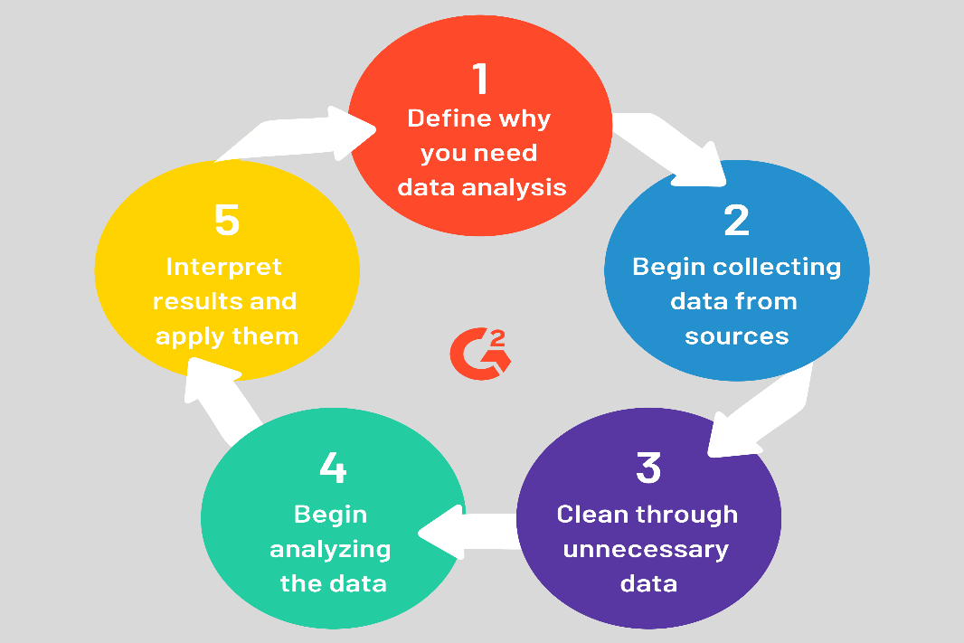
Interpretation
Data interpretation is the process of reviewing data and drawing meaningful conclusions using a variety of analytical approaches.
Understanding the data, its context, and its implications
Categorize, manipulate, and summarize the information to answer critical questions
The interpretation of data helps in identifying relationships between variables, identifying trends, and making predictions.

