Slide 1
Dawn Blossoms Plucked at Dusk
Block4-Dimensionality reduction and manifold learning
Junru Jin
2023.5.31

Slide 2
Outline
1. T-SNE
2. GraphDR
3. Sphinx

Slide 3
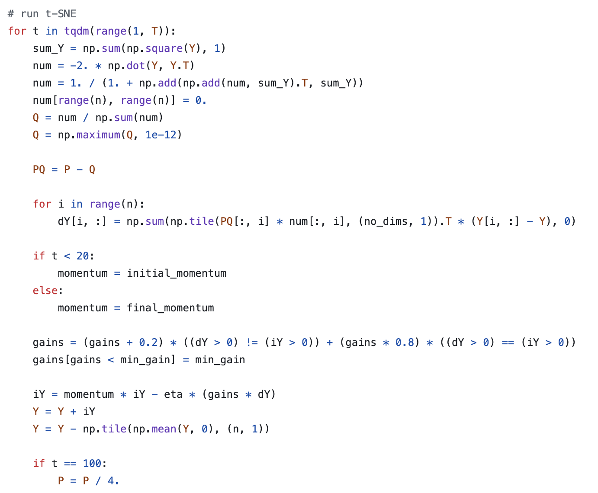
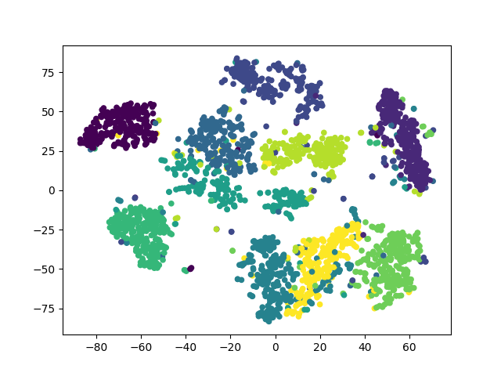
T-sne
Laurens van der Maaten et al. Visualizing Data using t-SNE. JMLR. 2008

Slide 4
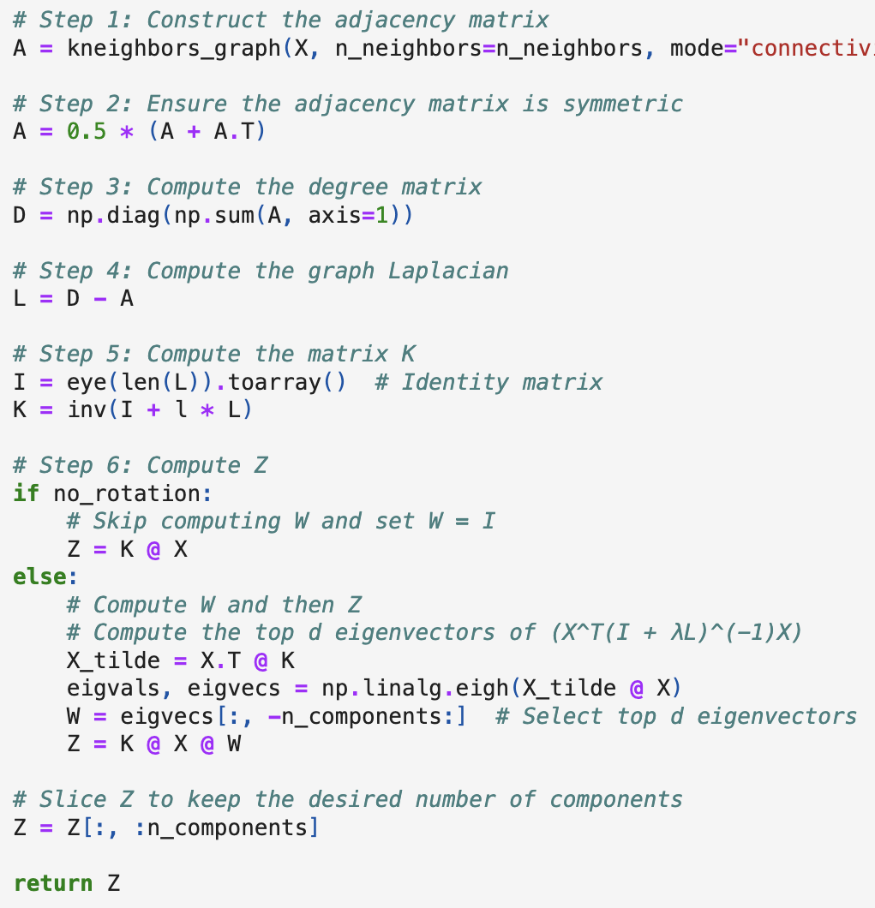
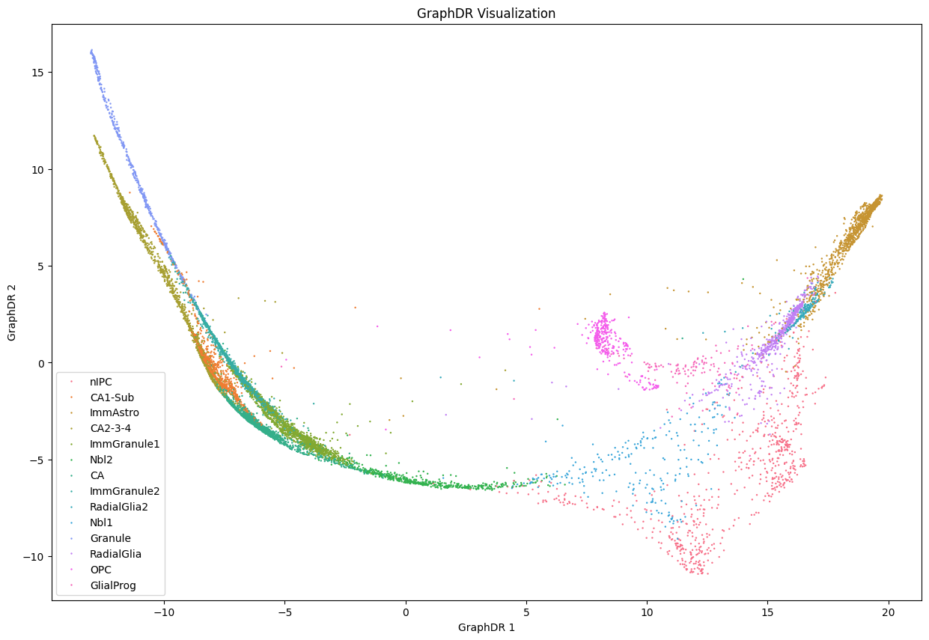
GraphDR
Jian et al. An analytical framework for interpretable and generalizable single-cell data analysis. Nature Methods. 2021

Slide 5
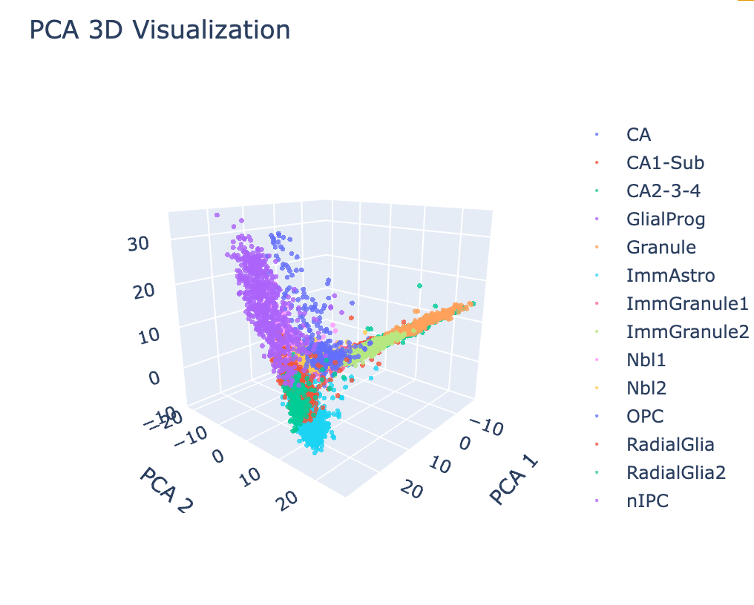
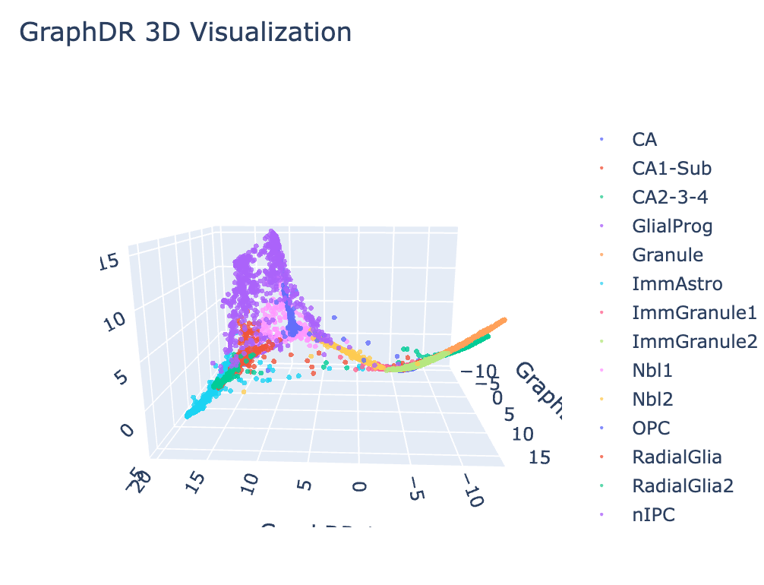
GraphDR
Jian et al. An analytical framework for interpretable and generalizable single-cell data analysis. Nature Methods. 2021

Slide 6
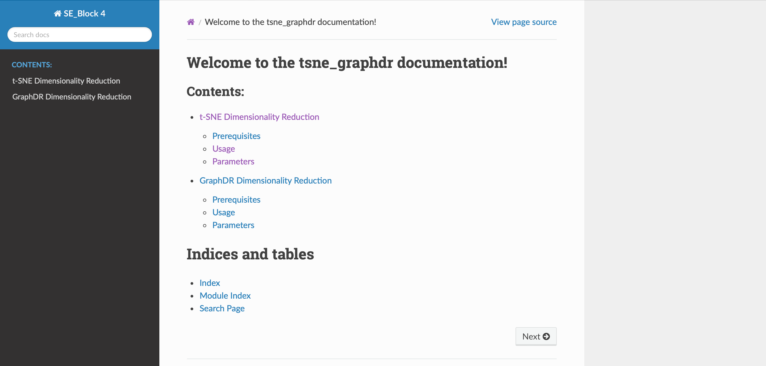
Sphinx

